Slide 1
WAY OF DISCIPLESHIP:
JOINING IN WITH THE SPIRIT
OPENING WORSHIP
Father, we give you thanks for the people who helped us to meet you.
We give thanks for: name of the person or people.
Thank you for sending these people to us.
We ask for your blessing on all that they have done in your name.
Help us to bless others in the same way. Amen.

Slide 2
WAY OF DISCIPLESHIP:
JOINING IN WITH THE SPIRIT
AIMS OF THIS SESSION (3)
To grow in my desire to share my faith.
To understand the practice of hospitality.
To understand what evangelism is and the difference between evangelism and witness.
To know my story of the good news and share my faith story naturally and sensitively.

Slide 3
WAY OF DISCIPLESHIP:
JOINING IN WITH THE SPIRIT
AIMS OF THIS SESSION (3)
To have confidence in knowing how to help someone become a Christian and disciple others.
To understand the significance of baptism.
To grow in understanding of how to relate to people of other faiths in my lived experience.
To understand the work of the Holy Spirit in faith sharing and prevenient grace.

Slide 4
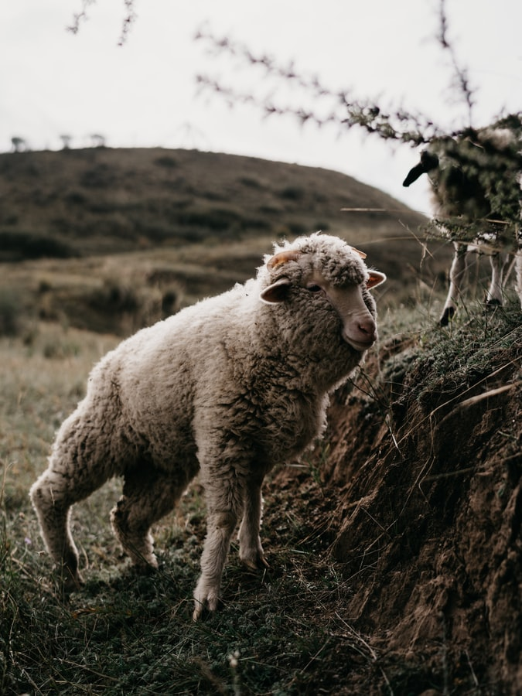
WAY OF DISCIPLESHIP:
JOINING IN WITH THE SPIRIT
DISCOVERY BIBLE STUDY PASSAGE
Luke 15
Now the tax collectors and sinners were all gathering around to hear Jesus. 2 But the Pharisees and the teachers of the law muttered, “This man welcomes sinners and eats with them.”

Slide 5
WAY OF DISCIPLESHIP:
JOINING IN WITH THE SPIRIT
DISCOVERY BIBLE STUDY PASSAGE
Luke 15
3 Then Jesus told them this parable: 4 “Suppose one of you has a hundred sheep and loses one of them. Doesn’t he leave the ninety-nine in the open country and go after the lost sheep until he finds it? 5 And when he finds it, he joyfully puts it on his shoulders 6 and goes home.

Slide 6
WAY OF DISCIPLESHIP:
JOINING IN WITH THE SPIRIT
DISCOVERY BIBLE STUDY PASSAGE
Luke 15
Then he calls his friends and neighbours together and says, ‘Rejoice with me; I have found my lost sheep.’ 7 I tell you that in the same way there will be more rejoicing in heaven over one sinner who repents than over ninety-nine righteous persons who do not need to repent.

Slide 7
WAY OF DISCIPLESHIP:
JOINING IN WITH THE SPIRIT
DISCOVERY BIBLE STUDY PASSAGE
Luke 15
8 “Or suppose a woman has ten silver coins and loses one. Doesn’t she light a lamp, sweep the house and search carefully until she finds it? 9 And when she finds it, she calls her friends and neighbours together and says, ‘Rejoice with me; I have found my lost coin.’ 10 In the same way, I tell you, there is rejoicing in the presence of the angels of God over one sinner who repents.”

Slide 8
WAY OF DISCIPLESHIP:
JOINING IN WITH THE SPIRIT
DISCOVERY BIBLE STUDY QUESTIONS
What do we learn about God?
What do we learn about humanity?
What does this passage say about obedience?
In the light of what we now know about this passage, what is God calling you to do? (I will……..)
Who might you share this story with this week?

Slide 9
WAY OF DISCIPLESHIP:
JOINING IN WITH THE SPIRIT
CLOSING PRAYER
Those who are baptized are called to worship and serve God.
Will you continue in the apostles’ teaching and fellowship,
in the breaking of bread, and in the prayers?
With the help of God, I will.
Will you proclaim by word and example
the good news of God in Christ?
With the help of God, I will.
Will you seek and serve Christ in all people,
loving your neighbour as yourself?
With the help of God, I will.

Slide 10
WAY OF DISCIPLESHIP:
JOINING IN WITH THE SPIRIT
CLOSING PRAYER
May Christ dwell in our hearts through faith,
that we may be rooted and grounded in love
and bring forth the fruit of the Spirit.
Amen.
God of grace and life,
in your love you have given us
a place among your people;
keep us faithful to our baptism,
and prepare us for that glorious day
when the whole creation will be made perfect
in your Son our Saviour Jesus Christ.
Amen.

