Slide 1
WAY OF DISCIPLESHIP:
BIBLE CONFIDENCE AND KNOWING THE STORY
OPENING WORSHIP
Lord of all life,
help us to work together for that day
when your kingdom comes
and justice and mercy will be seen in all the earth.
Look with favour on your people,
gather us in your loving arms
and bring us with all the saints
to feast at your table in heaven.

Slide 2
WAY OF DISCIPLESHIP:
BIBLE CONFIDENCE AND KNOWING THE STORY
OPENING WORSHIP
Through Christ, and with Christ, and in Christ,
in the unity of the Holy Spirit,
all honour and glory are yours, O loving Father,
for ever and ever.
Amen.

Slide 3
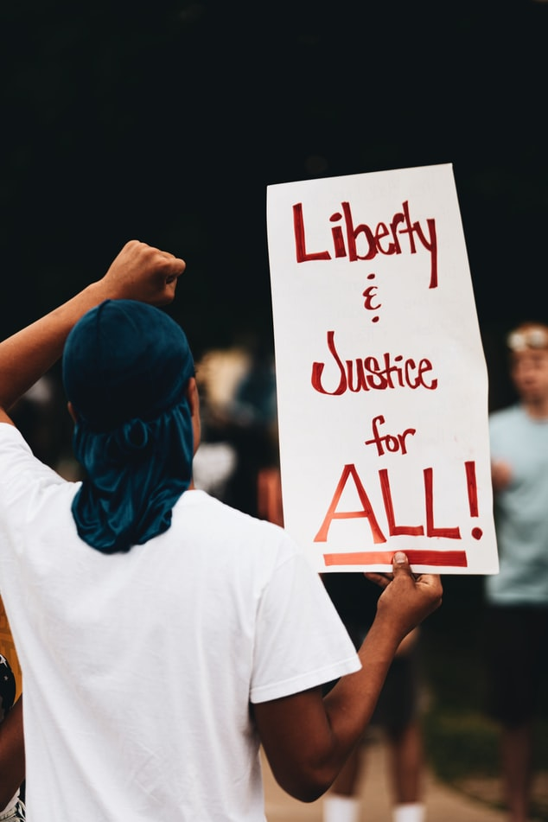
WAY OF DISCIPLESHIP:
BIBLE CONFIDENCE AND KNOWING THE STORY
AIMS OF THIS SESSION (4)
To understand the difference that the key themes of freedom and justice, exile and Messiah make in my lived experience.
To understand the significance of Passover.
To explore how to read the violent portrayals of God in the Bible through the lens of the cross.

Slide 4
WAY OF DISCIPLESHIP:
BIBLE CONFIDENCE AND KNOWING THE STORY
DISCOVERY BIBLE STUDY PASSAGE
Amos was speaking in about 750 BC to the ten tribes in the northern Kingdom of Israel before they were invaded by Assyria and dispersed.
Amos 5
You levy a straw tax on the poor
and impose a tax on their grain.
Therefore, though you have built stone mansions,
you will not live in them;
though you have planted lush vineyards,
you will not drink their wine.
12 For I know how many are your offenses
and how great your sins.

Slide 5
WAY OF DISCIPLESHIP:
BIBLE CONFIDENCE AND KNOWING THE STORY
DISCOVERY BIBLE STUDY PASSAGE
There are those who oppress the innocent and take bribes
and deprive the poor of justice in the courts.
13 Therefore the prudent keep quiet in such times,
for the times are evil.
14 Seek good, not evil,
that you may live.
Then the LORD God Almighty will be with you,
just as you say he is.
15 Hate evil, love good;
maintain justice in the courts.

Slide 6
WAY OF DISCIPLESHIP:
BIBLE CONFIDENCE AND KNOWING THE STORY
DISCOVERY BIBLE STUDY PASSAGE
Perhaps the LORD God Almighty will have mercy
on the remnant of Joseph.
21 “I hate, I despise your religious festivals;
your assemblies are a stench to me.
22 Even though you bring me burnt offerings and grain offerings,
I will not accept them.
Though you bring choice fellowship offerings,
I will have no regard for them.
23 Away with the noise of your songs!
I will not listen to the music of your harps.
24 But let justice roll on like a river,
righteousness like a never-failing stream!

Slide 7
WAY OF DISCIPLESHIP:
BIBLE CONFIDENCE AND KNOWING THE STORY
DISCOVERY BIBLE STUDY QUESTIONS
What do we learn about God?
What do we learn about humanity?
What does this passage say about obedience?
In the light of what we now know about this passage, what is God calling you to do? (I will……..)
Who might you share this story with this week?

Slide 8
WAY OF DISCIPLESHIP:
BIBLE CONFIDENCE AND KNOWING THE STORY
CLOSING PRAYER
Philippians 3
“20 But our citizenship is in heaven. And we eagerly await a Saviour from there, the Lord Jesus Christ, 21 who, by the power that enables him to bring everything under his control, will transform our lowly bodies so that they will be like his glorious body.”

