Slide 1
WAY OF DISCIPLESHIP:
BECOMING LIKE CHRIST
OPENING WORSHIP
We have come to be changed in our characters, to draw close to God so that we might be disciples who are becoming like Christ. Let's spend a moment to ask God to change us tonight from the inside out - to give us hearts of love like His, and to clear away anything that blocks His love.
A minute's quiet.

Slide 2
WAY OF DISCIPLESHIP:
BECOMING LIKE CHRIST
OPENING WORSHIP
Jesus said: ‘Let anyone who is thirsty come to me and drink. Whoever believes in me, as Scripture has said, rivers of living water will flow from within them.’

Slide 3
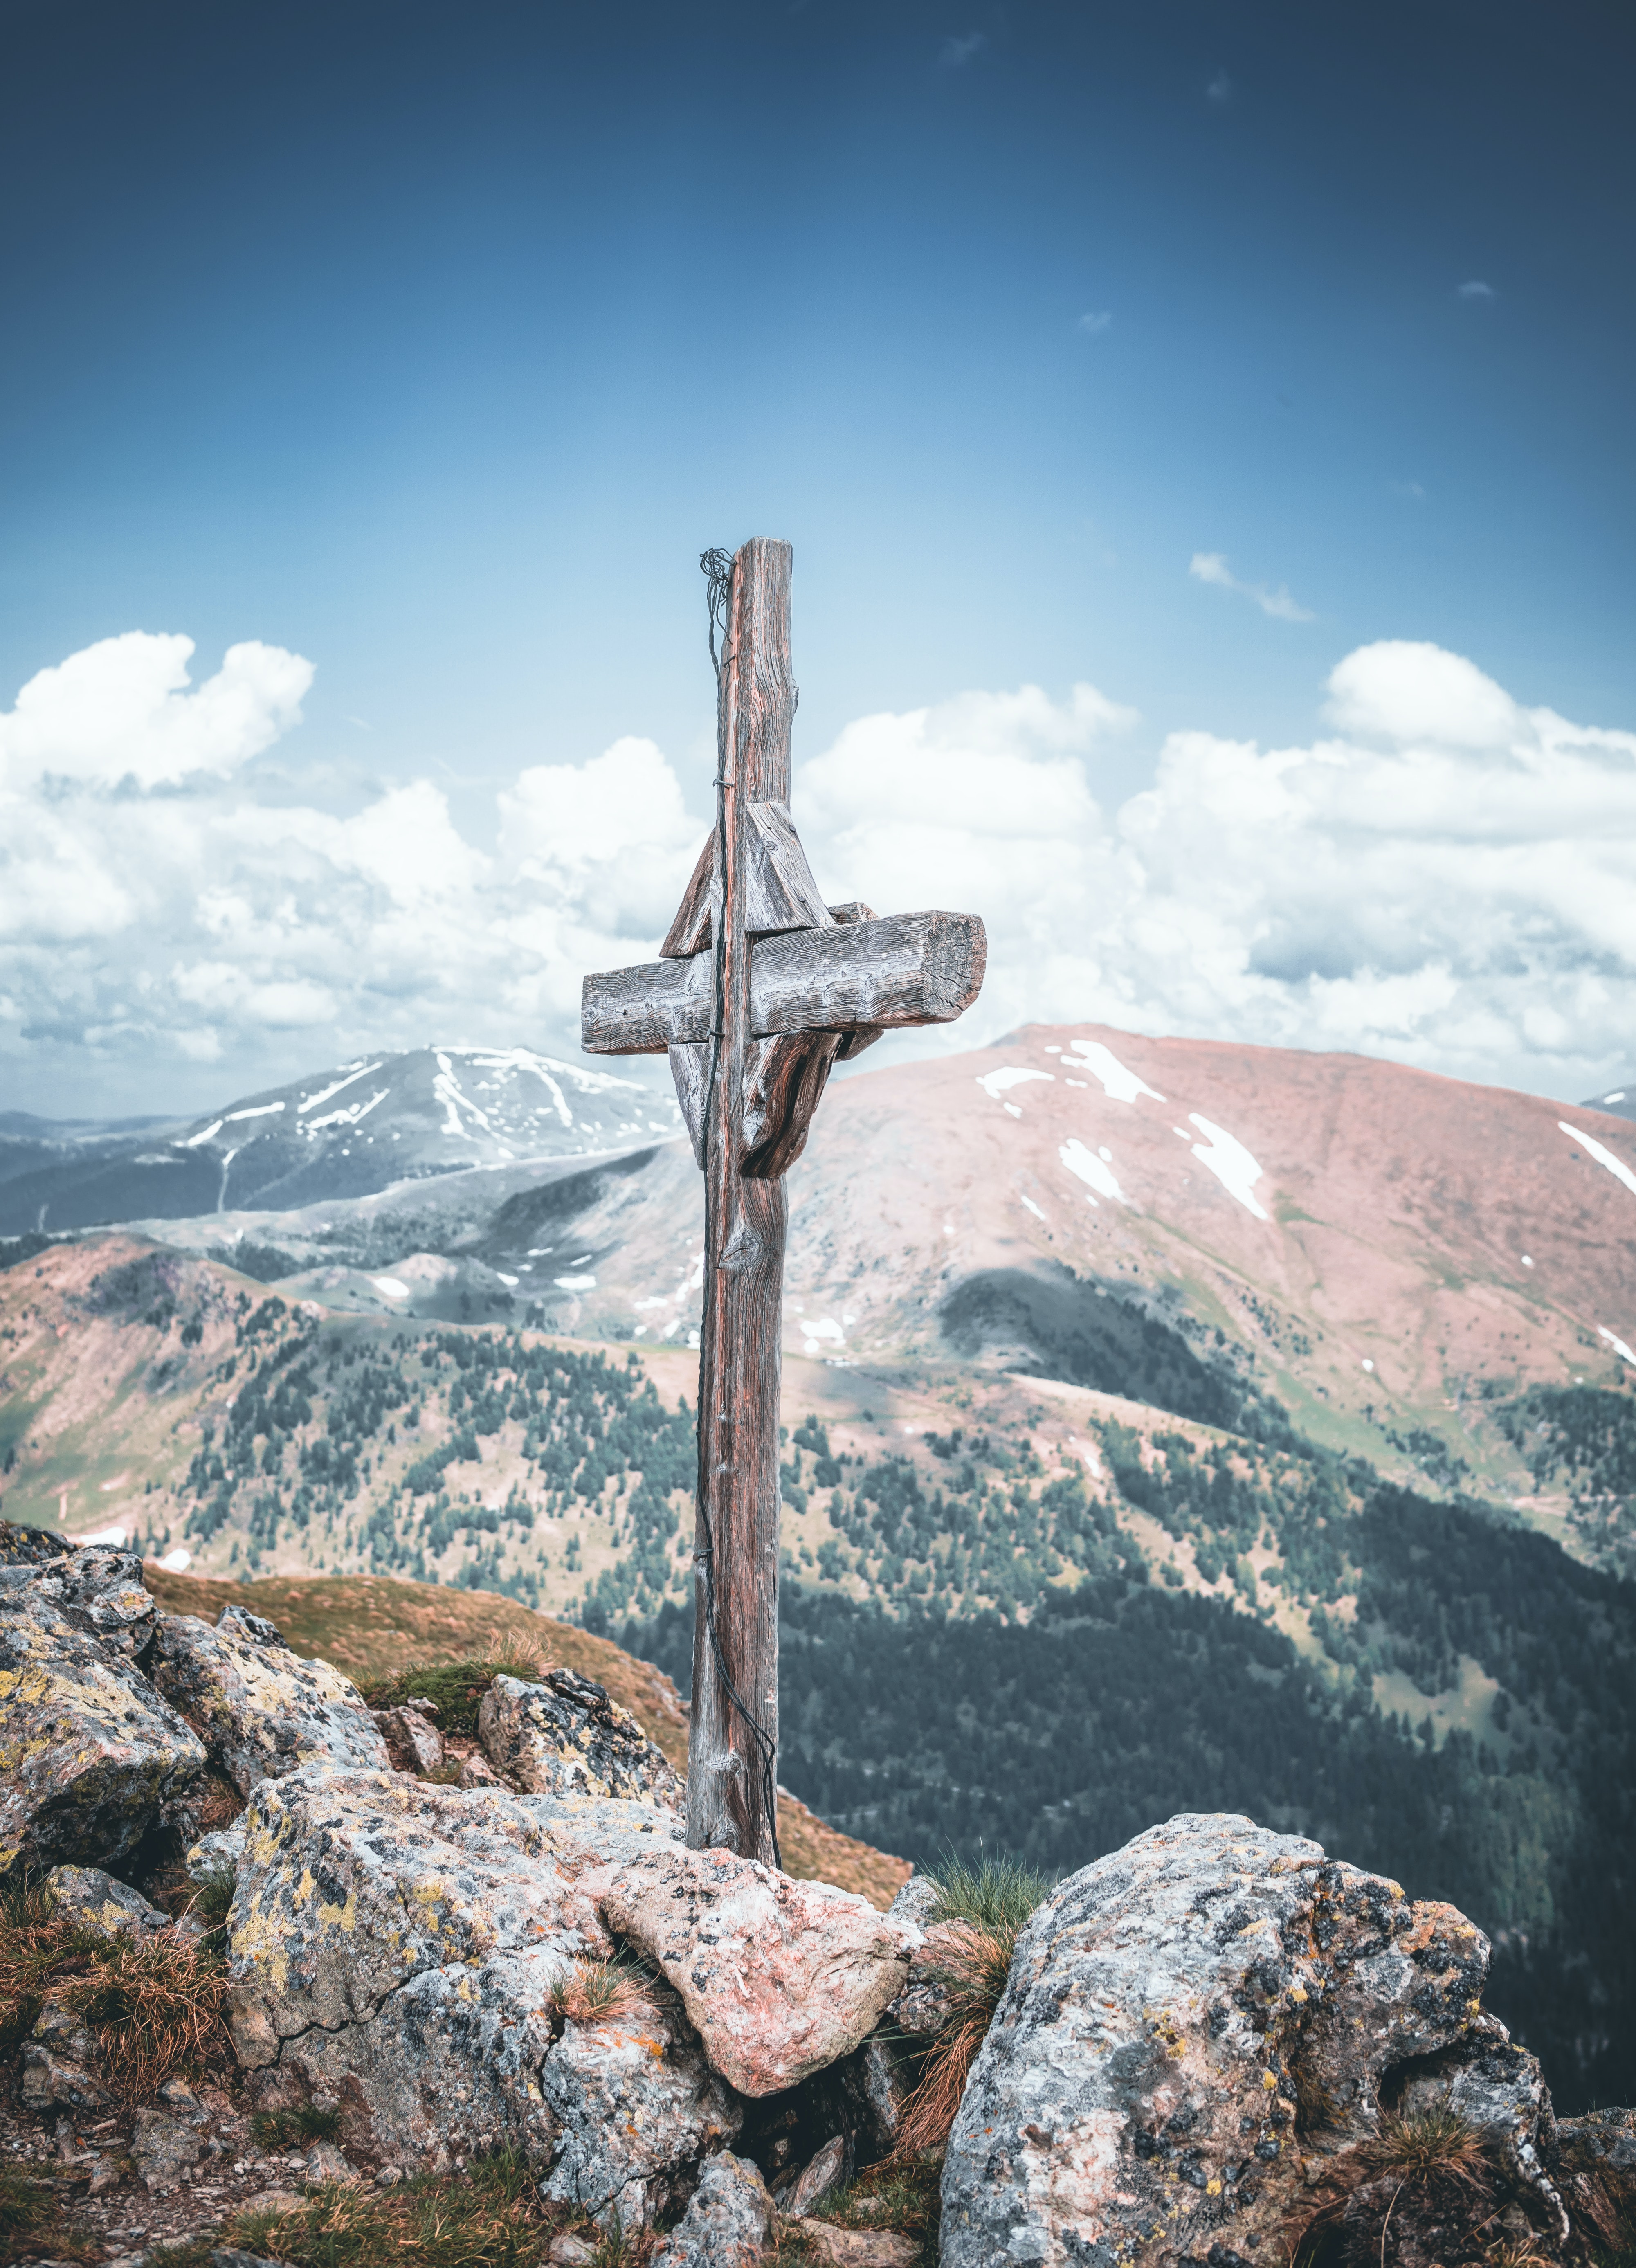
WAY OF DISCIPLESHIP:
BECOMING LIKE CHRIST
AIMS OF THIS SESSION (4)
To understand what Christian character is.
To understand how Jesus reveals the distinctive nature of God's love and how God works in the world through love.
To understand what the fruits of self-giving love might be in my lived experience.
To reflect on the nature and challenges of my relationships with others.
To understand the three ways God changes my character, growing Christlike love in me, in my lived experience.

Slide 4
WAY OF DISCIPLESHIP:
BECOMING LIKE CHRIST
DISCOVERY BIBLE STUDY PASSAGE
Matthew 5
38 “You have heard that it was said, ‘Eye for eye, and tooth for tooth.’ 39 But I tell you, do not resist an evil person. If anyone slaps you on the right cheek, turn to them the other cheek also. 40 And if anyone wants to sue you and take your shirt, hand over your coat as well. 41 If anyone forces you to go one mile, go with them two miles. 42 Give to the one who asks you, and do not turn away from the one who wants to borrow from you.

Slide 5
WAY OF DISCIPLESHIP:
BECOMING LIKE CHRIST
DISCOVERY BIBLE STUDY PASSAGE
Matthew 5
43 “You have heard that it was said, ‘Love your neighbour and hate your enemy.’ 44 But I tell you, love your enemies and pray for those who persecute you, 45 that you may be children of your Father in heaven. He causes his sun to rise on the evil and the good, and sends rain on the righteous and the unrighteous. 46 If you love those who love you, what reward will you get? Are not even the tax collectors doing that? 47 And if you greet only your own people, what are you doing more than others? Do not even pagans do that? 48 Be perfect, therefore, as your heavenly Father is perfect.

Slide 6
WAY OF DISCIPLESHIP:
BECOMING LIKE CHRIST
DISCOVERY BIBLE STUDY QUESTIONS
What do we learn about God?
What do we learn about humanity?
What does this passage say about obedience?
In the light of what we now know about this passage, what is God calling you to do? (I will……..)
Who might you share this story with this week?

Slide 7
WAY OF DISCIPLESHIP:
BECOMING LIKE CHRIST
CLOSING PRAYER
Romans 9: 9-13
Love must be sincere. Hate what is evil; cling to what is good. 10 Be devoted to one another in love. Honour one another above yourselves. 11 Never be lacking in zeal, but keep your spiritual fervour, serving the Lord. 12 Be joyful in hope, patient in affliction, faithful in prayer. 13 Share with the Lord’s people who are in need. Practise hospitality.

Slide 8
WAY OF DISCIPLESHIP:
BECOMING LIKE CHRIST
CLOSING PRAYER
My song is love unknown, My Saviour's love to me; Love to the loveless shown, That they might lovely be.
O who am I, That for my sake My Lord should take Frail flesh, and die?
.

