Slide 1
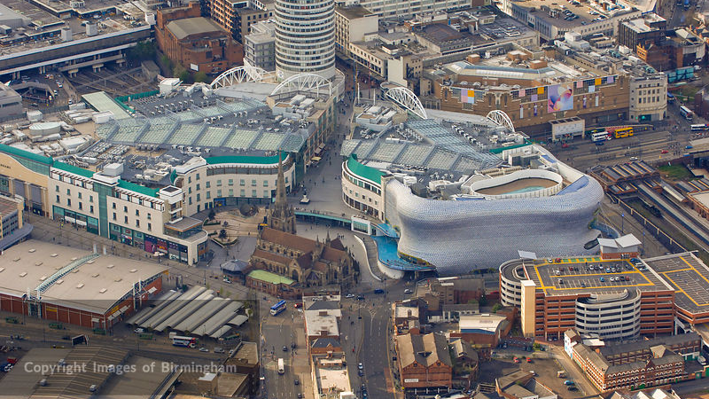
WAY OF DISCIPLESHIP:
BEING WITH GOD
WAY OF DISCIPLESHIP: BEING WITH GOD:
BEING WITH GOD IN WORSHIP

Slide 2
WAY OF DISCIPLESHIP:
BEING WITH GOD
I want to grow in being with God and becoming like Christ...how does this happen?

Slide 3
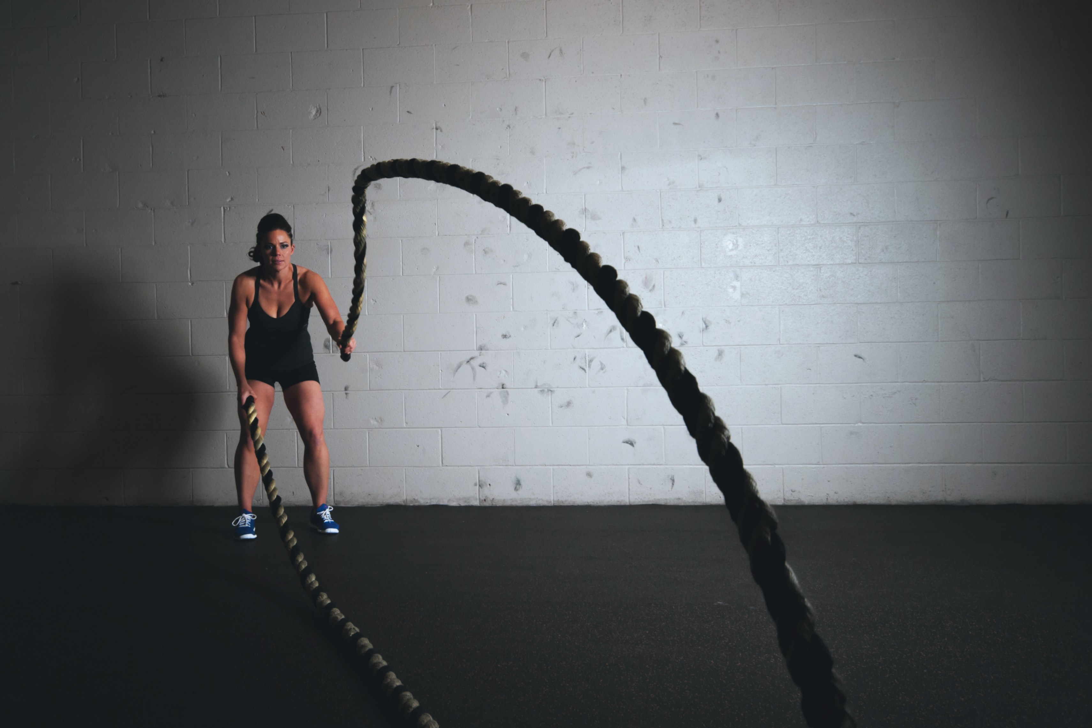
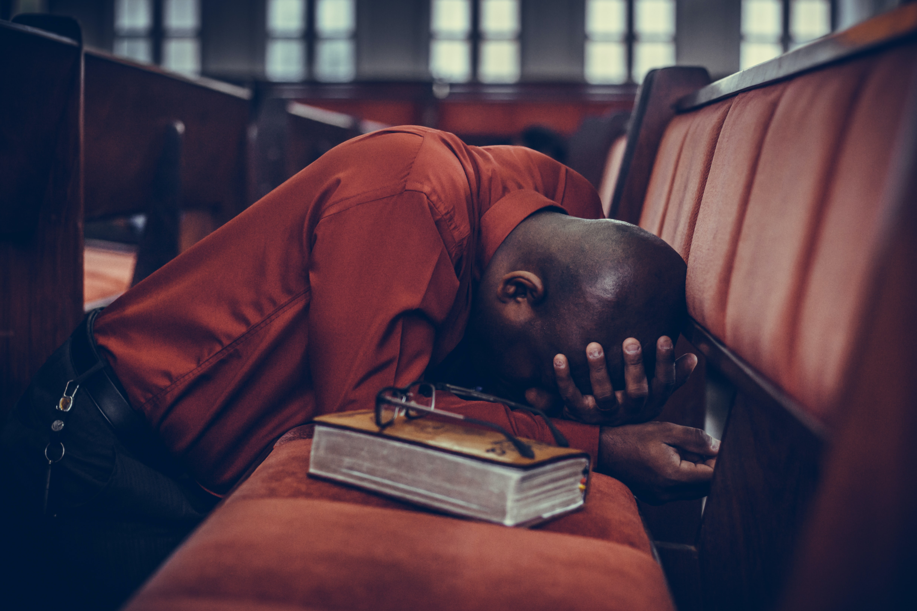
WAY OF DISCIPLESHIP:
BEING WITH GOD
We get to experience this “being with God” by developing the kinds of habits, practices or rhythms that focus on Him.
We do not have to make these habits up from scratch.
The language of habits or practices to avoid splitting life up into a “spiritual” and a “non-spiritual” part.
Notes:
Put simply, on a day by day basis, we get to experience this being with God by developing the kinds of habits, practices or rhythms that develop this focus. So as we look for the rest of this module at the everyday practices of worship, prayer, Bible reading and a balanced life, we will be learning and experiencing ways of living that help us to “Be with God”. We do not have to make this up from scratch – these habits are ways in which disciples have grown for millennia and are ways of living found in Jesus’ life. Sometimes they have been called “spiritual disciplines”. These days, more people are adopting the language of habits or practices to avoid splitting life up into a “spiritual” and a “non-spiritual” part (God calls us to Be with Him in all of our lives), and to avoid making “Being with God” sound like a duty.

Slide 4
WAY OF DISCIPLESHIP:
BEING WITH GOD
What are practices?

Slide 5
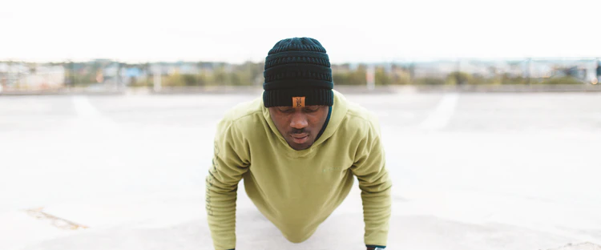
WAY OF DISCIPLESHIP:
BEING WITH GOD
Things that over time become a natural part of our lives and focus the way we live.
These habits are the ones which draw us into a life of love and joy with the God who loves us!
The other things practices do is change us.
Notes:
We are familiar with the idea of good and bad practices. Things that over time become a natural part of our lives and focus the way we live. These habits are the ones which draw us into a life of love and joy with the God who loves us! The other things practices do is change us.

Slide 6
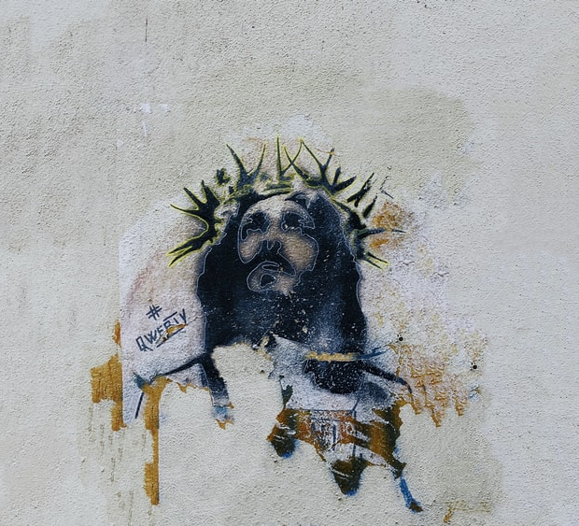
WAY OF DISCIPLESHIP:
BEING WITH GOD
Over time we do the things Christ does because they become things we want to do, and the natural choices we make will be to do what He would do if He were in our situation, in the strength that He gives.
Daily discipleship is gradually becoming the kind of person who will naturally live a life like the Master.
Notes:
As disciples we learn in order to become like our teacher. God doesn’t want us to be people who can just do the right thing in our behaviour. The picture the Bible gives us is that He wants to do something far deeper – to change our inmost being (the heart). Over time we do the things Christ does because they become things we want to do, and the natural choices we make will be to do what He would do if He were in our situation, in the strength that He gives. Daily discipleship is gradually becoming the kind of person who will naturally live a life like the Master. If joining the Way of Discipleship has no impact on shaping us to become more like Christ, then it will not be discipleship.

Slide 7
WAY OF DISCIPLESHIP:
BEING WITH GOD
How does this change happen?

Slide 8
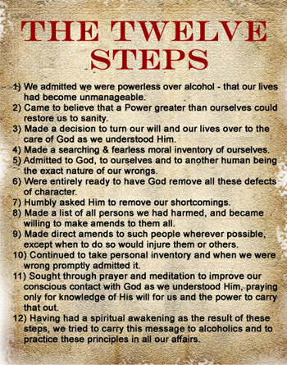
WAY OF DISCIPLESHIP:
BEING WITH GOD
For the deeper patterns of our personalities to change we need a power beyond ourselves.
Genuine change is a lifelong journey of letting God transform us.
Notes:
We can’t change by just saying, “I want to change.” Most people know that while we might be able to tweak our behaviours a little, for the deeper patterns of our personalities to change we need a power beyond ourselves. (See the AA twelve step programme). Genuine change is a lifelong journey of letting God transform us.

Slide 9
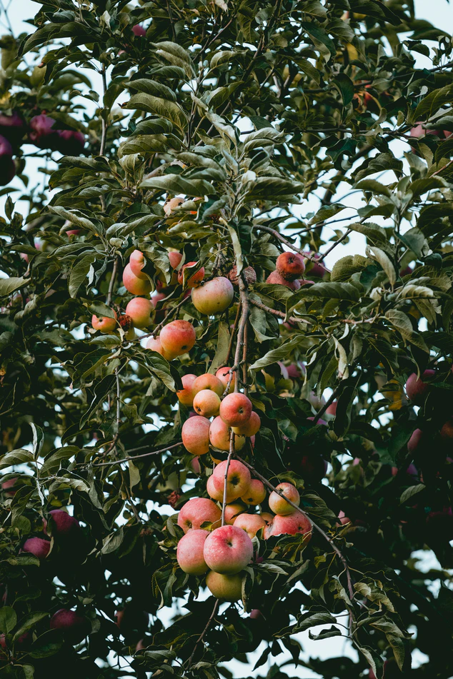
WAY OF DISCIPLESHIP:
BEING WITH GOD
Our minds are renewed so we see the world and people more and more as God sees them.
Our innermost selves (hearts) are changed by allowing God’s Holy Spirit to change us from the inside out.
Habits and practices are about giving space in our lives for God’s Holy Spirit to shape our minds and our innermost desires, so that over time our natural expression comes to be the deeds of Christ done in the power of Christ.
Notes:
Very briefly, disciples are changed as two things happen. Our minds are renewed so we see the world and people more and more as God sees them. To have the “mind of Christ”. The Way of Discipleship offers this. Our innermost selves (hearts) are changed by allowing God’s Holy Spirit to change us from the inside out. In Luke 6, Jesus points out that "there is no good tree which produces bad fruit.... Men do not gather figs from thornbushes...." (vv. 43-44) It is the inner nature of the tree that determines its outward product. Habits and practices are about giving space in our lives for God’s Holy Spirit to shape our minds and our innermost desires, so that over time our natural expression comes to be the deeds of Christ done in the power of Christ. They give us ways of “abiding in Him”, or “walking in the Spirit.” As we do so, as well as knowing what to do, we gradually want to do it.

Slide 10
WAY OF DISCIPLESHIP:
BEING WITH GOD
Practices change us indirectly. We do what we can in order to enable us to do what we can’t do directly.
“Without Him we can’t, but without us He won’t.”
Notes:
Practices change us indirectly. We do what we can in order to enable us to do what we can’t do directly. We can see this reality in any physical training. The more you train, the easier it becomes to, for example, run a marathon. And the more natural marathon-running will be. As we are being with God through worship, prayer, study and rest, we become the kind of people who want what God wants. Sometimes we get transformed in moments of “breakthrough”, like Saul on the road to Damascus. But most of the time it is through the process of living. Because we are covenant partners, we have a part to play in this. We make ourselves available and open. But it is God who does the work, through His Spirit. “Without Him we can’t, but without us He won’t.” We are making an effort, but we aren’t earning. We are training, but we aren’t trying. Richard Foster calls this ‘the path of disciplined grace.’ It is ‘grace’ because it is free; it is ‘disciplined’ because there is something for us to do.” All the practices create the environment for the Holy Spirit to change us.

Slide 11
WAY OF DISCIPLESHIP:
BEING WITH GOD
What is worship and why do we do it?

Slide 12
WAY OF DISCIPLESHIP:
BEING WITH GOD
Worship is the first practice of any disciple.
You worship what you most love, give attention to, or desire.
Worship is how we respond to what we value the most. Who or what we worship is the deepest expression of our humanity.
Notes:
Worship is the first practice of any disciple. Maureen Collins is a modern example of a worshipping creature. Her home is a shrine to Barry Manilow, and she is so obsessed that she doesn’t have time for full-time employment. The walls are covered with posters from different parts of Barry’s career. She doesn’t listen to music by any other artist, she has seen him all over the world and written him hundreds of letters. She has a scrapbook filled with newspaper and magazine cuttings, and calls radio stations all over the UK requesting his songs. Her family and friends have long since given up trying to dissuade her from her obsession. While Maureen may be a somewhat extreme example, she illustrates a point: People from all tribes, cultures and nations worship and have been worshipping someone or something since the beginning of humanity. You worship what you most love, give attention to, or desire. Worship is how we respond to what we value the most. Who or what we worship is the deepest expression of our humanity.

Slide 13
WAY OF DISCIPLESHIP:
BEING WITH GOD
Worship expresses what we value, but also shapes it.
Notes:
Who we worship also shapes us. This is why the Bible warns against idolatry so often. Worship expresses what we value, but also shapes it.

Slide 14
WAY OF DISCIPLESHIP:
BEING WITH GOD
Why do we worship God?

Slide 15
WAY OF DISCIPLESHIP:
BEING WITH GOD
God (alone) is worthy of our worship.
Throughout the story of the Bible when people encounter God, they worship.
‘When we face up to the glory of God, we find ourselves face down in worship.’
Notes:
God (alone) is worthy of our worship. Throughout the story of the Bible when people encounter God, they worship. Worship is the only appropriate relationship we can have when we see God for who He is. As Matt Redman writes, ‘When we face up to the glory of God, we find ourselves face down in worship.’

Slide 16
WAY OF DISCIPLESHIP:
BEING WITH GOD
Worship is the deepest expression of who we are.
Worship is the opposite of sin.
‘The most dangerous idol is our own selves when we want to occupy the place of God.’
Worship is joining in with the activity of earth and heaven, now and forever.
“All the earth worships you and sings praises to you; they sing praises to your name.” Psalm 66:4
Notes:
Worship is the deepest expression of who we are. As we have seen – everyone worships (gives ultimate worth) in some way. Worship is the practice that makes us most human and reveals our deepest longings. Christian faith says, “I worship, therefore I am.” We are made for God. The human heart is restless until it finds its rest in God. Worship is the opposite of sin. Pope Francis has said, ‘The most dangerous idol is our own selves when we want to occupy the place of God.’ Worship is joining in with the activity of earth and heaven, now and forever. To worship God is to join in with a creation which gives glory to God, making us more at home with the rhythms of earth. “All the earth worships you and sings praises to you; they sing praises to your name.” Psalm 66:4

Slide 17
WAY OF DISCIPLESHIP:
BEING WITH GOD
Worship connects us with God and changes us
He kissed his daughter to show he loves her (expressing), but as he kisses her his love grows (strengthening).
“Worship isn’t just something we do; it is where God does something to us. Worship is the heart of discipleship because it is the gymnasium in which God retrains our hearts.” James K.A. Smith.
Notes:
Worship connects us with God and changes us When we worship, we seek to give our full attention to God, and to place Him at the centre. As this happens, not only is our love expressed, it is also strengthened, and we open up our lives to the work of God’s Spirit. Worship changes us, as it helps us grow in love for God. A writer called Baron von Hugel said worship is like kissing his daughter. He kissed his daughter to show he loves her (expressing), but as he kisses her his love grows (strengthening). Worship connects us to God, aligning what we want with what He wants, submitting who we are to Him. As we draw close in this union, God can change us from the inside out. One writer says, “Worship isn’t just something we do; it is where God does something to us. Worship is the heart of discipleship because it is the gymnasium in which God retrains our hearts.” James K.A. Smith. It is not that God is an egotist who needs our praises, but for all the reasons above God knows we are shaped, completed, and drawn into His love through worship, and He delights in that relationship.

Slide 18
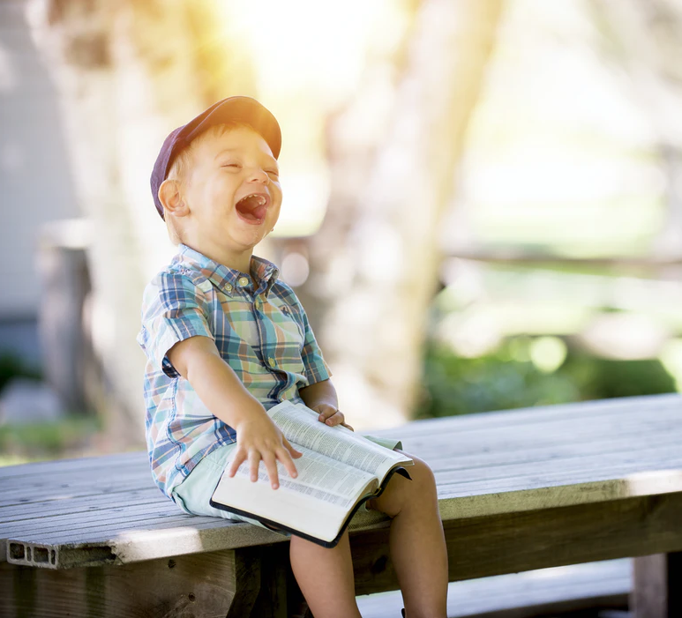
WAY OF DISCIPLESHIP:
BEING WITH GOD
The practice of worshipping God is strongly linked to the practice of celebration and to joy.
The early church “ate together with glad and sincere hearts, praising God” (Acts 2:46/7).
“If anyone would tell you the shortest, surest way to all happiness and perfection, he must tell you to make a rule to thank and praise God for everything that happens to you.”
Notes:
The practice of worshipping God is strongly linked to the practice of celebration and to joy. In a time and culture in which many struggle with anxiety, stress and depression it is important to experience the practice of worship as key to better mental health and well-being. The early church “ate together with glad and sincere hearts, praising God” (Acts 2:46/7). Nehemiah tells the people, “Do not grieve, for the joy of the Lord is your strength.” (Nehemiah 8:10)

Slide 19
WAY OF DISCIPLESHIP:
BEING WITH GOD
How do I worship God on my own?

Slide 20
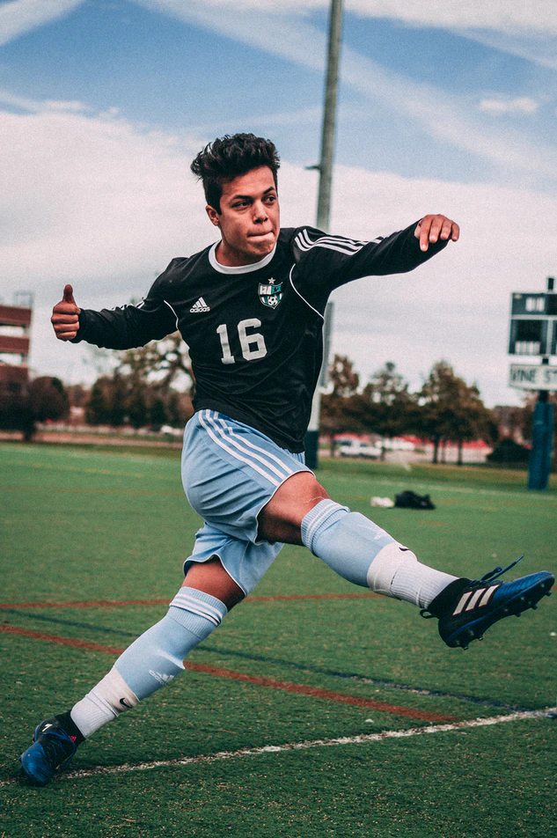
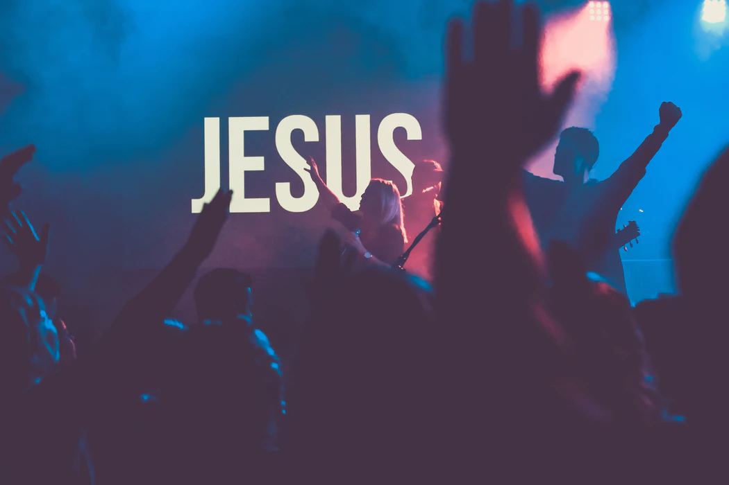
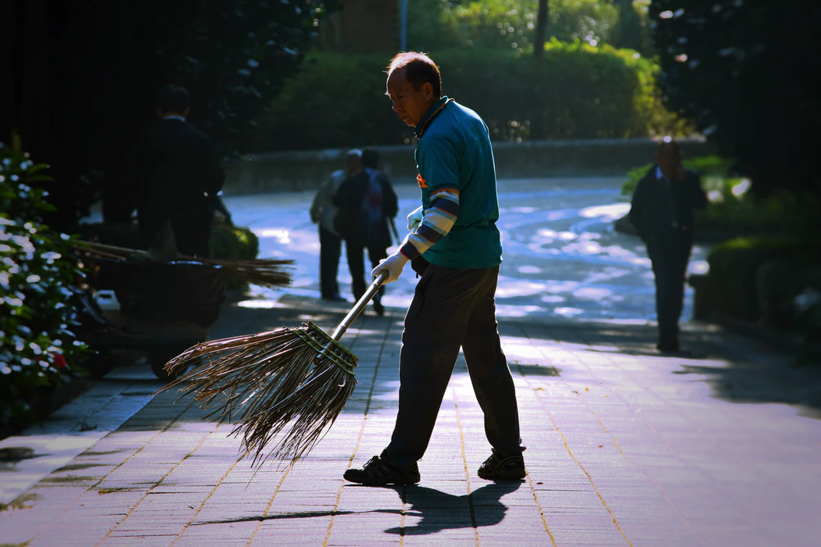
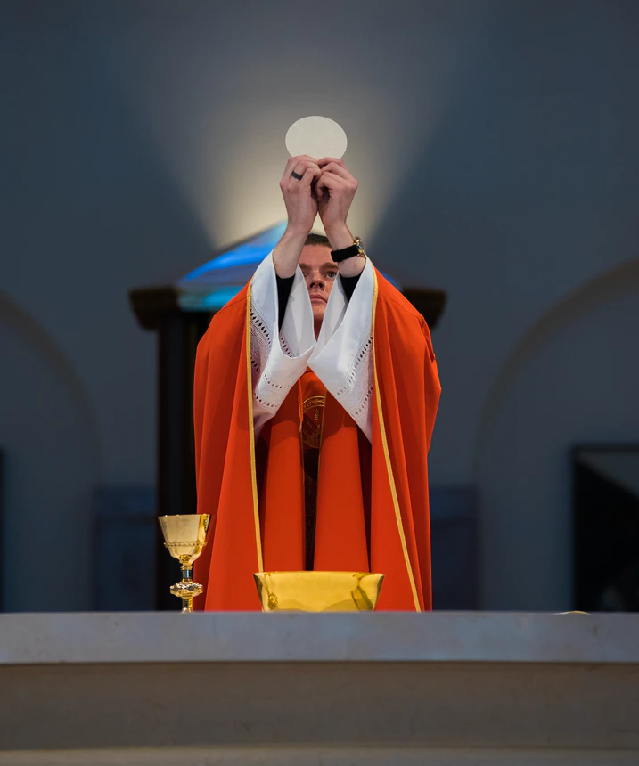
WAY OF DISCIPLESHIP:
BEING WITH GOD
Notes:
Which of these is worship? The answer is that they all can be, or not.

Slide 21
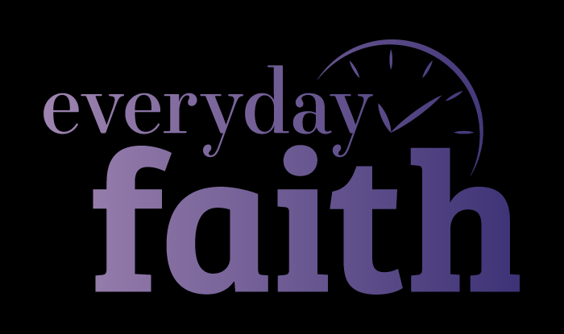
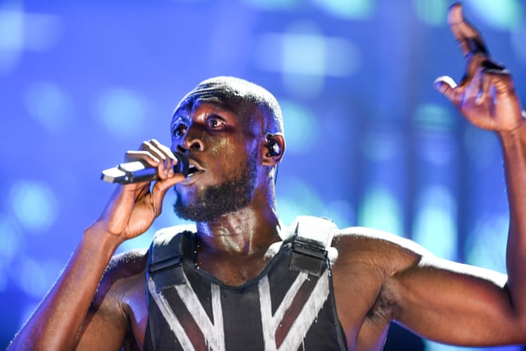
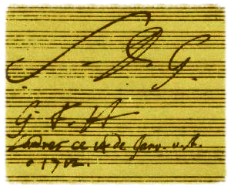
WAY OF DISCIPLESHIP:
BEING WITH GOD
To worship God in church, but not to offer that worship in the rest of life is a contradiction.
“And whatever you do, whether in word or deed, do it all in the name of the Lord Jesus, giving thanks to God the Father through him…”
Notes:
We often think of worship as something we do with others in church. But God is present in all of our lives, and can be worshipped through all of our lives. Worship doesn’t split life up. In fact, to worship God in church, but not to offer that worship in the rest of life is a contradiction. In Colossians we read, “And whatever you do, whether in word or deed, do it all in the name of the Lord Jesus, giving thanks to God the Father through him….Whatever you do, work at it with all your heart, as working for the Lord, not for human masters.” (Colossians 3: 17;23). To worship God in our everyday tasks is to do it in His name. In other words, for His glory and not ours. At the Glastonbury Festival in 2019, with millions of people watching him, the artist Stormzy said, “Let all the glory go to God.” There is a humility in worshipping God, in which we don’t need recognition, but want others to see Him in what we do. The composer Bach was not widely recognised in His lifetime. Whenever he wrote a piece of music he would always sign it “S.D.G.” “To God alone be the glory.” (Soli Deo Gloria). To worship God in our daily tasks is to “work for the Lord”. We express God’s worth in our tasks by making obeying Him the priority. The poet George Herbert wrote a poem called “The Elixir” – a potion which changes ordinary things into something wonderful. The “elixir” is worship. He writes that doing things “for Thy sake” can make “drudgery divine”.

Slide 22
WAY OF DISCIPLESHIP:
BEING WITH GOD
Focussing our attention on what is good.
“...brothers and sisters, whatever is true, whatever is noble, whatever is right, whatever is pure, whatever is lovely, whatever is admirable—if anything is excellent or praiseworthy—think about such things.”
Slowing down.
Being childlike.
Seeing worship as a gift rather than a task.
Notes:
Worship will only be our priority if we choose to make it so. These habits may help: Focussing our attention on what is good. Paul writes, “...brothers and sisters, whatever is true, whatever is noble, whatever is right, whatever is pure, whatever is lovely, whatever is admirable—if anything is excellent or praiseworthy—think about such things.” Slowing down. It can take time to notice the goodness of God. To consciously give Him glory as we go about our tasks. Being childlike. Matthew writes, “He called a little child to him, and placed the child among them. And he said: “Truly I tell you, unless you change and become like little children, you will never enter the kingdom of heaven.” Children have humility, but in terms of worship they demonstrate a great capacity for wonder. This wonder is at the heart of gratitude and worship. Seeing worship as a gift rather than a task. It is easy to experience worship as something we do. Going to church, reading the Bible, praying, helping people, giving. This can burn us out – we are never finished - but also runs the risk of putting ourselves at the centre of worship. A different way of looking at worship is as a gift and a privilege. As C. S. Lewis says, ‘In commanding us to glorify him, God is inviting us to enjoy him.’

Slide 23
WAY OF DISCIPLESHIP:
BEING WITH GOD
Why do I worship God with others?

Slide 24
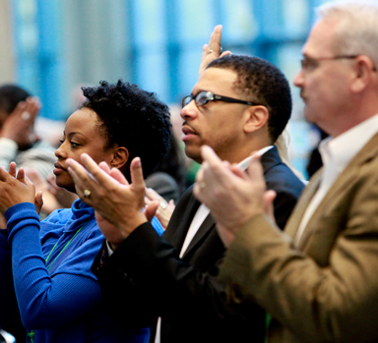
WAY OF DISCIPLESHIP:
BEING WITH GOD
As those who are united with Christ, we are a sign and image of Him by being together. “Now you are the body of Christ and individually members of it” (1 Corinthians 12:27).
When we worship together it encourages an expectancy of God’s power and presence in our lives. Coming together can heighten our awareness of God, and help us to focus on Him.
As we worship together, we can encourage each other to continue to worship God in our individual lives. “And let us consider how we may spur one another on toward love and good deeds, not giving up meeting together, as some are in the habit of doing…” (Hebrews 10:24-25)
Notes:
In contrast to a culture which can be about the individual, from the beginning, God calls a people to be the best sign of His presence in the world. Among the many good reasons for worshipping God with others, key reasons would be: As those who are united with Christ, we are a sign and image of Him by being together. “Now you are the body of Christ and individually members of it” (1 Corinthians 12:27). Jesus’ final prayer was that we may be one. Worshipping together is an expression of this unity, and the fulness of His image in us as His body. When we worship together it encourages an expectancy of God’s power and presence in our lives. When Moses entered the tabernacle he knew he was entering the presence of God. In the early church when people prayed and worshipped together, sometimes the buildings shook. Coming together can heighten our awareness of God, and help us to focus on Him. As we worship together, we can encourage each other to continue to worship God in our individual lives. The letter to the Hebrews encourages Christians to worship together with these words: “And let us consider how we may spur one another on toward love and good deeds, not giving up meeting together, as some are in the habit of doing…” (Hebrews 10:24-25)

Slide 25
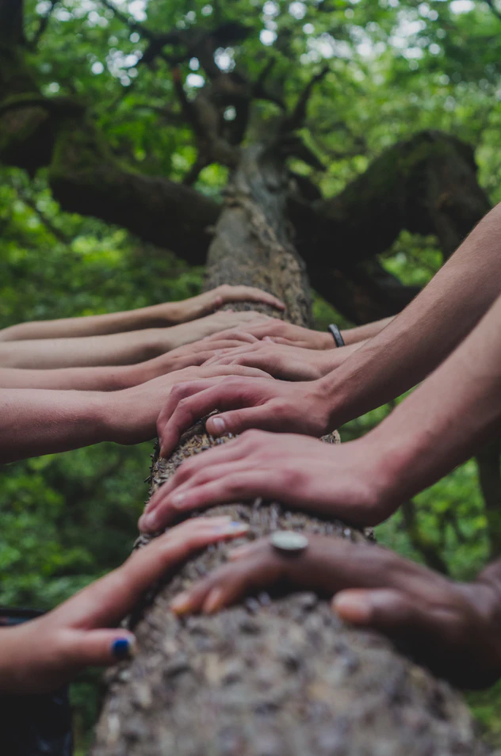
WAY OF DISCIPLESHIP:
BEING WITH GOD
Worshipping together involves everyone.
“the work of the people.”
Worshipping together involves all of who we are.
“Love the Lord your God with all your heart, with all your soul, with all your mind, and with all your strength.” (Mark 12:30)
Worshipping together celebrates variety.
It can be easy to be threatened by this, or to feel that other ways of worshipping God are not as valid.
The best group worship would enable people to express their love for God fully without embarrassment or judgment, and to rejoice at variety.
Notes:
Worshipping together involves everyone. The word which describes the script or form of group worship is liturgy. The original meaning of the word is “the work of the people.” Worshipping together involves all of who we are. The greatest commandment is to, “Love the Lord your God with all your heart, with all your soul, with all your mind, and with all your strength.” (Mark 12:30) Worshipping together celebrates variety. For this reason there are many different ways to worship God together, which involve different parts of who we are, and are more natural to who we are. Some are more physical, some are more cerebral, extrovert or introvert. It can be easy to be threatened by this, or to feel that other ways of worshipping God are not as valid. For example, Saul’s daughter, Michal, saw King David “leaping and dancing before the Lord” in a worship procession, and “she despised him in her heart.” (2 Samuel 6:16). It is extremely unlikely that everyone in our church will naturally express worship in exactly the same way. The best group worship would enable people to express their love for God fully without embarrassment or judgment, and to rejoice at variety.

Slide 26
WAY OF DISCIPLESHIP:
BEING WITH GOD
What will worshipping together always involve?

Slide 27
WAY OF DISCIPLESHIP:
BEING WITH GOD
Being gathered – we are coming together as Christ’s body.
Hearing God’s word – we are here to encounter God.
Being at peace with God and each other – we are here to remember who God is, and who we are as His people.
Thanksgiving – we are here to give thanks together.
Being sent out – we come together so that we can be sent out to be with God in the rest of our lives.
Notes:
Whether worshipping together by eating round a table, confessing, praying, studying the Bible, singing, or sharing bread and wine, these elements will always be present in some way: Being gathered – we are coming together as Christ’s body. Hearing God’s word – we are here to encounter God. Being at peace with God and each other – we are here to remember who God is, and who we are as His people. Thanksgiving – we are here to give thanks together. Being sent out – we come together so that we can be sent out to be with God in the rest of our lives.

Slide 28
WAY OF DISCIPLESHIP:
BEING WITH GOD
Why are sacraments important in worship and being with God?

Slide 29
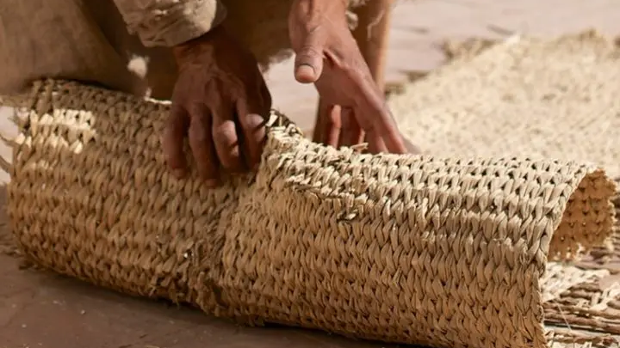
WAY OF DISCIPLESHIP:
BEING WITH GOD
Sacraments are a way in which, though physical and material realities which we can see and take part in, we can meet with God in worship.
Notes:
A significant way of worshipping God, indeed for some Christians the central way of worshipping God, is though sacraments. We can’t see God, or fully understand Him. Sacraments are a way in which, though physical and material realities which we can see and take part in, we can meet with God in worship.

Slide 30
WAY OF DISCIPLESHIP:
BEING WITH GOD
Where does breaking bread and wine come from?

Slide 31
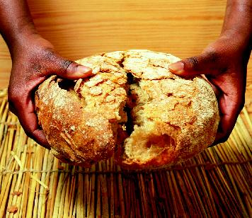
WAY OF DISCIPLESHIP:
BEING WITH GOD
Jesus had a habit of breaking bread and sharing it – two of his disciples at Emmaus recognised Him after His resurrection as He broke bread.
But it was at His last supper with His disciples that He associated the bread and the wine with his own death and gave to them a significance that continues to shape us.
Notes:
Jesus had a habit of breaking bread and sharing it – two of his disciples at Emmaus recognised Him after His resurrection as He broke bread. But it was at His last supper with His disciples that He associated the bread and the wine with his own death and gave to them a significance that continues to shape us.

Slide 32
WAY OF DISCIPLESHIP:
BEING WITH GOD
What was Jesus doing at the Last Supper?

Slide 33
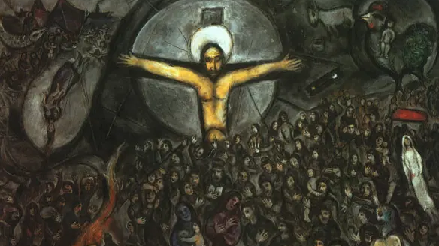
WAY OF DISCIPLESHIP:
BEING WITH GOD
At the last Supper, Jesus shockingly reinterpreted the Passover meal to reveal how God’s purposes were being fulfilled in Him.
.
The bread symbolised his body; the cup, his ‘poured out’ blood - pointing to what was going to happen to him on the cross.
The words and actions Jesus used to reinterpret the bread and cup became the foundation for the Lord’s Supper in the early Church
Notes:
On the night he was arrested, all four gospels say that Jesus was celebrating a Passover meal with His disciples. This was the annual meal in which Jewish people remembered how God had rescued them from slavery. Importantly, through bread and wine they remembered how the blood of a lamb (they ate lamb at the meal, and used bread and wine to act out the story) was used to mark their homes, and save them from death as it “passed over” them. At the last Supper, Jesus shockingly reinterpreted the Passover meal to reveal how God’s purposes were being fulfilled in Him. The bread symbolised his body; the cup, his ‘poured out’ blood - pointing to what was going to happen to him on the cross. The words and actions Jesus used to reinterpret the bread and cup became the foundation for the Lord’s Supper in the early Church. The handout “Jesus and the Passover” explores the links more fully.

Slide 34
WAY OF DISCIPLESHIP:
BEING WITH GOD
Why is remembering so important?

Slide 35
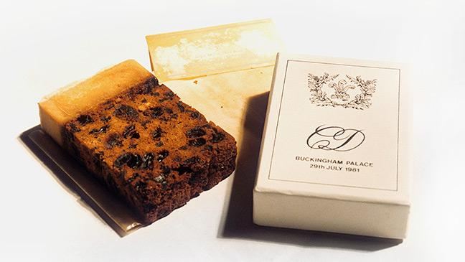
WAY OF DISCIPLESHIP:
BEING WITH GOD
It is an active remembrance.
In the Passover meal everyone who took part was imagining themselves to have personally being part of the rescue from Egypt.
So remembering Jesus in bread and wine is our way of receiving Christ’s victory in the present.
It's a sacrament that carries with it the living reality of what it signifies.
Notes:
Jesus told His disciples that now, when they broke bread and drank wine, it would no longer be to remember being rescued from slavery in Egypt, but, through Him, being rescued from death. He told them, “Do this to remember me.” It is a remembering of what God had done, telling the story again (and it is often good to be reminded), but it is far more than that. It is an active remembrance. In the Passover meal everyone who took part was imagining themselves to have personally being part of the rescue from Egypt. So remembering Jesus in bread and wine is our way of receiving Christ’s victory in the present. It's a sacrament that carries with it the living reality of what it signifies.

Slide 36
WAY OF DISCIPLESHIP:
BEING WITH GOD
What are the meanings of breaking bread and sharing wine?

Slide 37
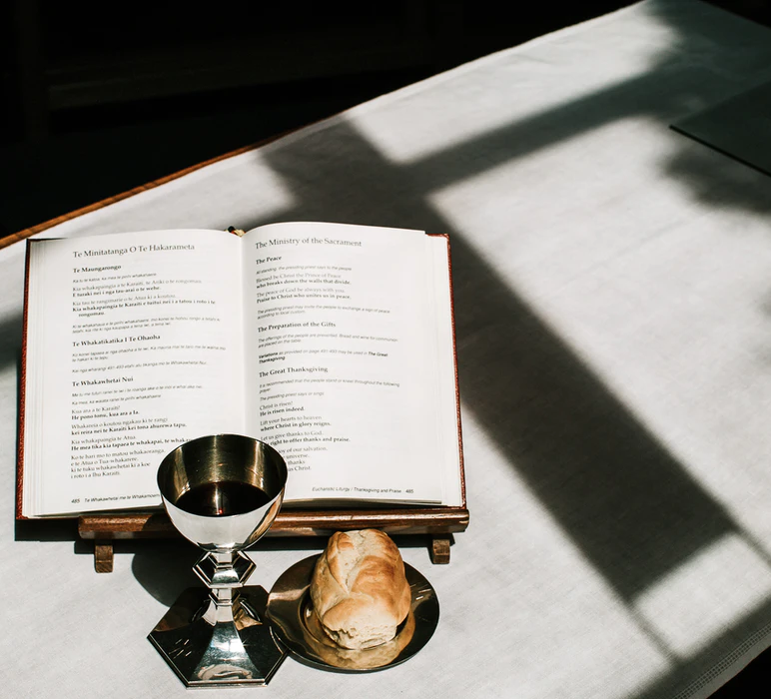
WAY OF DISCIPLESHIP:
BEING WITH GOD
There are common elements to each expression (Word / People – peace / Sacrament / Sending out)
Breaking bread. As Luke writes in Acts (about A.D. 70) the early Christians used this description.
Lord’s Supper. Paul used this in his letters from 45-60AD to describe the meal which included a liturgical recital of the words of Jesus.
Eucharist. This comes from a Greek word meaning “Thanksgiving”.
Notes:
Over time, the way we share bread and wine has developed in various ways – from simple and informal to more complex and structured. There are common elements to each expression (Word / People – peace / Sacrament / Sending out) but different names have been used which emphasise the many different gifts of this sacrament. Breaking bread. As Luke writes in Acts (about A.D. 70) the early Christians used this description, and in celebrating weekly showed that the link with the annual Passover meal was soon replaced. Nevertheless, for Christians the sense of the sacrificial act celebrated through bread and wine is central, with some seeing it as an actual sacrifice. In the Eucharistic Prayer, our worship is called ‘this our sacrifice of thanks and praise’. Lord’s Supper. Paul used this in his letters from 45-60AD to describe the meal which included a liturgical recital of the words of Jesus. Eucharist. This comes from a Greek word meaning “Thanksgiving”. It is found in an early document known as the Didache (Teachings) from as early as 60 AD.

Slide 38
WAY OF DISCIPLESHIP:
BEING WITH GOD
Mass. This name was possibly used as early as the 5th century, but definitely by the 7th century. It probably comes from a word meaning sent.
Holy Communion. To be holy is to be set apart, and to commune is to have union with. We are not observing something, but we are guests who are fed spiritually.
Love Feast or ‘Agapé’ (a Greek word meaning ‘love’) meal. By the second century this would be a shared meal, separate from the Eucharist, often linked with providing food for the poor. It died out by the eighth century, but was revived by Methodists in the 18th century.
Notes:
Mass. This name was possibly used as early as the 5th century, but definitely by the 7th century. It probably comes from a word meaning sent. It emphasises how gathering to receive bread and wine leads to us being sent out to be with God and be disciples in the world. As Pope Francis says, “Worship is not worship if it doesn’t change us.” Holy Communion. To be holy is to be set apart, and to commune is to have union with. This emphasises how when we share in the bread and wine that has been set apart, our union with Christ and with each other is strengthened in our lived experience. We are not observing something, but we are guests who are fed spiritually. Love Feast or ‘Agapé’ (a Greek word meaning ‘love’) meal. By the second century this would be a shared meal, separate from the Eucharist, often linked with providing food for the poor. It died out by the eighth century, but was revived by Methodists in the 18th century. It emphasises the hospitality of God - how in sharing bread and wine we are a family where all are invited in. A table signifies that you are welcome and that there is a place for you. It’s very human and it brings people together.

Slide 39
WAY OF DISCIPLESHIP:
BEING WITH GOD
Healing. As we identify our brokenness with Christ’s, we can meet with Him through bread and wine in a way that can lead to wholeness again.
Hope. At the last Supper Jesus looked forward to when He would “feast” with His disciples again.
Everyday life is valued. Jesus takes ordinary things like bread and wine, transforms them and gives them out.
A heightened sense of His presence. It can intensify our “being with Him.” The Eucharist doesn’t split life up - the result of encountering God here should be that we become more aware of God’s presence in our everyday lives, not less.
Notes:
Through the Eucharist God gives us a sacrament in which we find Healing. As we identify our brokenness with Christ’s, we can meet with Him through bread and wine in a way that can lead to wholeness again. Hope. At the last Supper Jesus looked forward to when He would “feast” with His disciples again. Everyday life is valued. Jesus takes ordinary things like bread and wine, transforms them and gives them out. In the same way the ordinary stuff of our lives is taken up into Jesus and given back to us. A heightened sense of His presence. God’s presence is everywhere, all the time. So how are sacraments different? They remind us specifically of how He has and is acting in our lives to make us whole. And they can intensify our “being with Him.” If God’s presence in creation is like fire, sacraments can perhaps be like the tip of a bunsen burner flame – the same presence, but experienced in a focussed way. (Yet it’s also good to know that the Eucharist doesn’t split life up - the result of encountering God here should be that we become more aware of God’s presence in our everyday lives, not less.)

Slide 40
WAY OF DISCIPLESHIP:
BEING WITH GOD
How is this presence known?

Slide 41
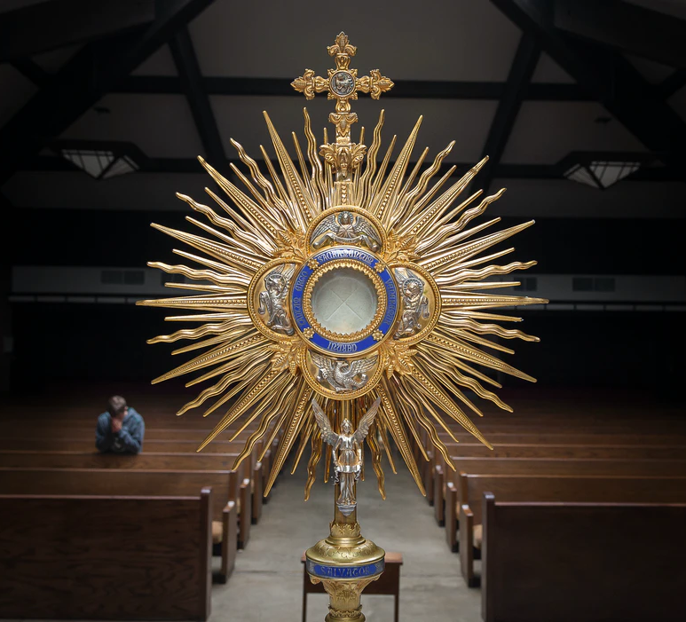
WAY OF DISCIPLESHIP:
BEING WITH GOD
For some it is about a heightened sense of memory, and the presence of Christ is known through the whole service, and His people gathered together.
For others, the presence is particularly located in the bread and wine itself in a spiritual sense.
For others, the bread and wine become the physical body and blood of Christ during the thanksgiving prayer.
The key thing is that through sharing in the bread and wine we can be with God in a unique way.
Notes:
Christians have different understandings of exactly how God’s presence is known in bread and wine. For some it is about a heightened sense of memory, and the presence of Christ is known through the whole service, and His people gathered together. The word and the sacrament are linked together. (Luther called the sacrament a “visible word”.) For others, the presence is particularly located in the bread and wine itself in a spiritual sense. For others, the bread and wine become the physical body and blood of Christ during the thanksgiving prayer. While this had led to disputes down the centuries, within the Anglican church these perspectives are held together – the key thing is that through sharing in the bread and wine we can be with God in a unique way.

