Slide 1
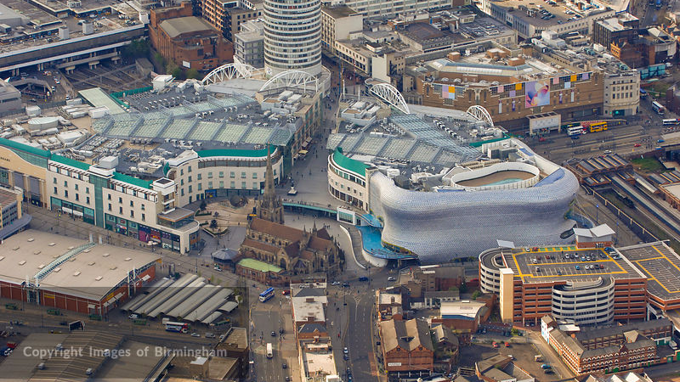
WAY OF DISCIPLESHIP:
BEING WITH GOD
WAY OF DISCIPLESHIP: BEING WITH GOD:
BEING WITH GOD IN PRAYER

Slide 2
WAY OF DISCIPLESHIP:
BEING WITH GOD
What is prayer?

Slide 3
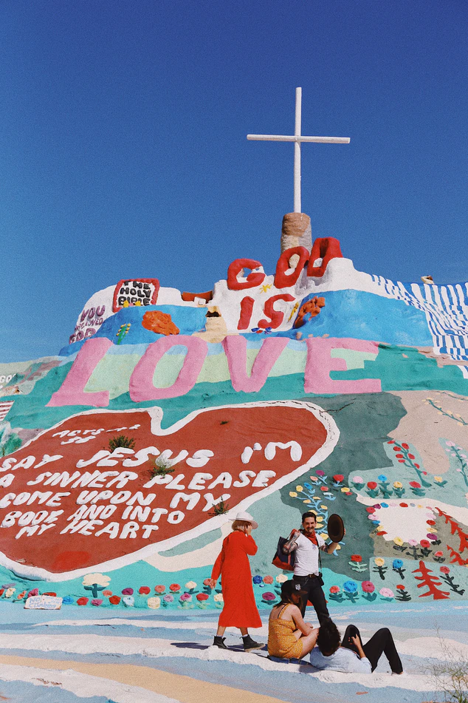
WAY OF DISCIPLESHIP:
BEING WITH GOD
Being with God - attentive to him in our daily lives, and responding to what he is doing.
Prayer is simply the “love language” which helps us to connect with God in this way.
Being in active relationship with God.
Notes:
The starting point for discipleship is simply what this module says – Being with God. So far, we’ve explored how being with God is about being attentive to Him in our daily lives, and responding to what He is doing.
Prayer is simply the “love language” which helps us to connect with God in this way. There are many aspects to prayer, and various practices that help with this, just as there are many different ways we relate to each other as human beings. This session we start with the simple idea of being in active relationship with God. (We will explore the asking and wrestling aspects of prayer later on).

Slide 4
WAY OF DISCIPLESHIP:
BEING WITH GOD
Doing whatever helps us deepen our friendship with God, in A life-giving, regular way.
“Practising the presence of God”.
“Our constant activity is fruitless without first making that humble act of kneeling to pray. …Prayer is not only our greatest privilege, but also our greatest source of power.”
“I have been driven many times to my knees by the overwhelming conviction that I had nowhere else to go….”
Notes:
Prayer is “talking with God”, but it’s much more than “saying our prayers” – it’s doing whatever helps us deepen our friendship with God, in a life-giving, regular way. It’s “practising the presence of God”. Pete Grieg, writer of the Prayer Course, says, “I am convinced….that our constant activity is fruitless without first making that humble act of kneeling to pray. I am convinced that prayer is not only our greatest privilege, but also our greatest source of power.” Abraham Lincoln put it like this: “I have been driven many times to my knees by the overwhelming conviction that I had nowhere else to go; my own conviction and that of those around me seemed insufficient for the day.”

Slide 5
WAY OF DISCIPLESHIP:
BEING WITH GOD
How did Jesus pray?

Slide 6
WAY OF DISCIPLESHIP:
BEING WITH GOD
Prayer was completely central to Jesus' life.
He taught his disciples to pray. He battled in prayer.
He often withdrew to lonely places and prayed (Luke 5:15-16)
He prayed honestly and in anguish “Father, if you are willing, take this cup from me; yet not my will, but yours be done.” (Luke 22:42)
Notes:
Prayer was completely central to Jesus’ life. He prayed by himself, with his disciples, in the synagogue, before big decisions, for his disciples, as part of His ministry, in every kind of situation. He went into the desert to pray, He prayed for long periods and during the night. He taught His disciples to pray. He battled in prayer. He often withdrew to lonely places and prayed (Luke 5:15-16) He prayed honestly and in anguish “Father, if you are willing, take this cup from me; yet not my will, but yours be done.” (Luke 22:42)

Slide 7
WAY OF DISCIPLESHIP:
BEING WITH GOD
His last words were a prayer - Jesus called out with a loud voice, “Father, into your hands I commit my spirit.” (Luke 23:34)
He prayed naturally and out loud: “Father, I thank you that you have heard me....I said this for the benefit of the people standing here, that they may believe that you sent me.” (John 11:41-42)
He prayed out of deep sense of being loved, and loving, his Father (John 17:13-26). He did nothing without praying – for him it was neither a duty nor a burden.
Notes:
His last words were a prayer Jesus called out with a loud voice, “Father, into your hands I commit my spirit.” (Luke 23:34) He prayed naturally and out loud: “Father, I thank you that you have heard me....I said this for the benefit of the people standing here, that they may believe that you sent me.” (John 11:41-42) He prayed out of deep sense of being loved, and loving, His Father (John 17:13-26). He did nothing without praying – for Him it was neither a duty nor a burden. You can read everything Jesus said about prayer on a handout.

Slide 8
WAY OF DISCIPLESHIP:
BEING WITH GOD
Why is it difficult?

Slide 9
WAY OF DISCIPLESHIP:
BEING WITH GOD
“It is the most natural thing as people who yearn for God to pray.”
It is something that needs to be learnt.
Teach us to pray.
“Trying to pray is prayer and it is very good prayer.”
Notes:
The paradox of prayer for us is that, while it is the most natural thing as people who yearn for God to pray, it is at the same time something that needs to be learnt. That is why His disciples asked, “Teach us to pray.” We might feel we don’t really enjoy prayer, or feel guilty about how little we pray. We might find it hard to know where to start, or get distracted. The good news is that God delights in our simplest attempts at prayer (much like a parent gets excited about a child’s first steps).
Cardinal Basil Hume said, “Trying to pray is prayer and it is very good prayer.” As disciples, we are all learners, and there is a lot of wisdom and resource we can draw on. This session will give a number of suggestions for growing in Being with God in prayer. At its heart is something very simple, which this story might help us to experience.

Slide 10
WAY OF DISCIPLESHIP:
BEING WITH GOD
Apparently, just before Daddy died, he leaned over and rested his head on a chair beside the bed.
Notes:
A man's daughter had asked the local vicar to come and pray with her father. When the vicar arrived, he found the man lying in bed with his head propped up on two pillows and an empty chair beside his bed. The vicar assumed that the old fellow had been informed of his visit. "I guess you were expecting me," he said. "No, who are you?" "I'm the new vicar at your local church," the vicar replied. "When I saw the empty chair, I figured you knew I was going to show up."
"Oh yes, the chair," said the bedridden man. "Would you mind closing the door?" Puzzled, the vicar shut the door. "I've never told anyone this, not even my daughter," said the man. "But all of my life I have never known how to pray. At church I used to hear the vicar talk about prayer, but it always went right over my head."
"I abandoned any attempt at prayer," the old man continued, "until one day about four years ago my best friend said to me, 'Joe, prayer is just a simple matter of having a conversation with Jesus. Here's what I suggest. Sit down on a chair; place an empty chair in front of you, and in faith see Jesus on the chair. It's not spooky because he promised, 'I'll be with you always. ' Then just speak to him and listen in the same way you're doing with me right now."
"So, I tried it and I've liked it so much that I do it a couple of hours every day. I'm careful, though. If my daughter saw me talking to an empty chair, she'd either have a nervous breakdown or send me off to the funny farm." The vicar was deeply moved by the story and encouraged the man to continue on the journey. Then he prayed with him, and returned to the church.
Two nights later the daughter called to tell the vicar that her father had died that afternoon. "Did he seem to die in peace?" he asked. "Yes, when I left the house around two o'clock, he called me over to his bedside, told me one of his corny jokes, and kissed me on the cheek. When I got back from the shops an hour later, I found him dead. But there was something strange, in fact, beyond strange—kind of weird. Apparently, just before Daddy died, he leaned over and rested his head on a chair beside the bed."

Slide 11
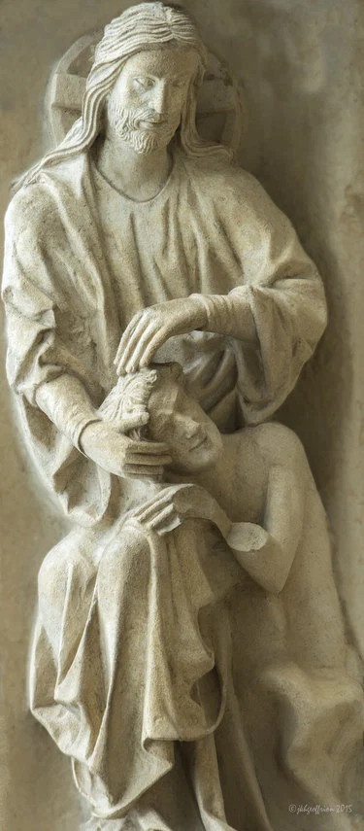
WAY OF DISCIPLESHIP:
BEING WITH GOD
The creation of Adam.
Notes:
This picture is “The Creation of Adam” from Chartres Cathedral in France. How do you think it may help us to understand how God sees us in prayer?

Slide 12
WAY OF DISCIPLESHIP:
BEING WITH GOD
What do I need to know that will help me?

Slide 13
WAY OF DISCIPLESHIP:
BEING WITH GOD
God cares about our daily needs, and knows every hair on our heads.
We can trust in the goodness of God’s character.
Notes:
Before we even start to pray, these three perspectives may help.
God cares about our daily needs, and knows every hair on our heads. We can trust in the goodness of God’s character.

Slide 14
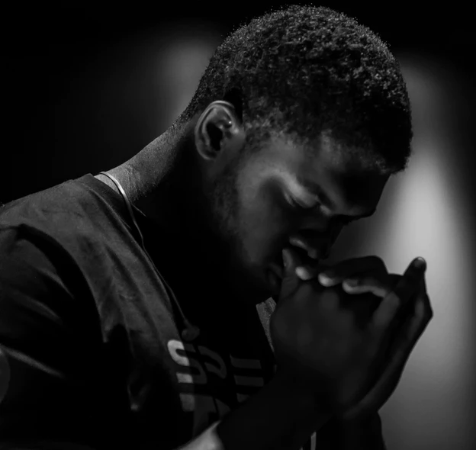
WAY OF DISCIPLESHIP:
BEING WITH GOD
We can be completely ourselves before God without pretence.
“May it be the real me, speaking with the real you.”
Notes:
We can be completely ourselves before God without pretence. CS Lewis said that the prayer that comes before all other prayers is, “May it be the real me, speaking with the real You.”

Slide 15
WAY OF DISCIPLESHIP:
BEING WITH GOD
God wants us to pray with total honesty about the things we find hard – we call this lament.
“Our minds are confused. Our hearts are in distress. Have mercy on this child, Lord, have mercy! Do not prolong the agony! Do not allow the pain and suffering to increase! Give us faith, for we believe, O Lord; help our unbelief.”
Notes:
God wants us to pray with total honesty about the things we find hard – we call this lament. You can find a very honest 3 and a half minute video prayer here, in which someone uses Psalm 23 to ask all kinds of questions of God. https://www.facebook.com/100003018377804/posts/2678257242284862/?d=n It is possible to be respectful of God, and yet completely honest about our doubts, fears and anger. In the book, “The Good and Beautiful God” the writer describes a very honest prayer from an orthodox priest for someone’s two year old daughter who was suffering terribly, Have mercy on this child, Lord, have mercy! Do not prolong the agony! Do not allow the pain and suffering to increase! We know not what to ask You; give us the grace only to say, ‘Your will be done on earth as it is in heaven.’ Give us faith, for we believe, O Lord; help our unbelief.”

Slide 16
WAY OF DISCIPLESHIP:
BEING WITH GOD
God is praying in us. Romans 8: 26 “...The Spirit helps us in our weakness. We do not know what we ought to pray for, but the Spirit himself intercedes for us through wordless groans.”
Notes:
God is praying in us. Because we are covenant-partners with God, He prays in us. He can take the tangle of thoughts in our heads, or our deepest longings, as prayer. This is the meaning of Romans 8: 26 “...the Spirit helps us in our weakness. We do not know what we ought to pray for, but the Spirit himself intercedes for us through wordless groans.”

Slide 17
WAY OF DISCIPLESHIP:
BEING WITH GOD
Does my personality affect the way I pray?

Slide 18
WAY OF DISCIPLESHIP:
BEING WITH GOD
God has chosen to make us all different from one another, and doesn’t want us to be clones in the way we pray.
We may simply start to pray “as we can, not as we can’t.”
Our differences don’t make us better or worse than other people.
Notes:
God has chosen to make us all different from one another, and doesn’t want us to be clones in the way we pray. Just as there are many different personality types, so there are many ways we can connect with God. There are many different ways people pray in the Bible, and it’s another sign of God’s grace that we may simply start to pray “as we can, not as we can’t.” The Connecting with God in Prayer Survey will help you to discover which particular ways of praying with God you might find most helpful – it comes from a book called “The Nine Sacred Pathways”. It’s important to note that exercises like this are not about putting people into boxes – there may be a number of ways we pray – and it’s not about comparing ourselves with others. Our differences don’t make us better or worse than other people. However, in thinking about your own approaches, it may be that you recognise how people in your own church pray differently and that you have something particular to bring.

Slide 19
WAY OF DISCIPLESHIP:
BEING WITH GOD
Is being a physical person a help or a hindrance and how do I deal with distractions?

Slide 20
WAY OF DISCIPLESHIP:
BEING WITH GOD
Our bodies are a good gift, and important in our praying.
Jesus became flesh, He didn’t turn away from it.
In prayer, God invites us to bring our whole selves – body, mind and spirit.
We get distracted in prayer – we are learners.
Notes:
Being a disciple is not about becoming less of a physical person, in order to somehow be more “spiritual”. Sadly this idea has sometimes been brought into Christianity, as people have seen the body as a burden, or even the enemy. But our bodies are a good gift, and be important in our praying. Jesus became flesh, he didn’t turn away from it. In prayer, God invites us to bring our whole selves – body, mind and spirit. Thinking about how we use our bodies can be a help, not a hindrance. We might kneel, lie down, walk, dance, think about how we are sitting, hold out our hands, cross ourselves. This is all part of prayer. When thoughts come uninvited into our minds when we pray, this is part of prayer too. Rather than being frustrated, we can simply notice the distraction, and ask the Lord to receive it as part of our prayer.

Slide 21
WAY OF DISCIPLESHIP:
BEING WITH GOD
What will help me get into prayer?

Slide 22
WAY OF DISCIPLESHIP:
BEING WITH GOD
Some principles: Giving time.
“The reason why we don’t take time is a feeling that we have to keep moving. This is a real sickness. Today, time is a commodity, and for each one of us time is mortgaged…we must approach the whole idea of time in a new way.”
Notes:
Giving time
Thomas Merton wrote, “If we really want prayer, we’ll have to give it time. We must slow down to a human tempo….The reason why we don’t take time is a feeling that we have to keep moving. This is a real sickness. Today, time is a commodity, and for each one of us time is mortgaged…we must approach the whole idea of time in a new way.”

Slide 23
WAY OF DISCIPLESHIP:
BEING WITH GOD
Some principles: Finding a daily pattern. A regular habit is part of “training, not trying.”
Not transaction with God, but connection with God. #wintheday
Notes:
Finding a daily pattern.
The fact is, like all practices, prayer needs us to be intentional, and a regular habit is part of “training, not trying.” By praying regularly, I become a praying person. With a daily routine, it’s important that prayer doesn’t become a transaction with God but is about connection with God. Jesus often got up early in the morning to pray. A church in Australia encourages its members to #wintheday in prayer. In other words, before looking at any screens, phones, messages, news, emails to begin the day by praying.

Slide 24
WAY OF DISCIPLESHIP:
BEING WITH GOD
Some principles: Four key practices: silence, solitude, fasting, meditation.
Notes:
Four key practices: silence, solitude, fasting, meditation.
We will be exploring these in more detail in later modules, but being silent, being alone (Being with God session 7), reminding ourselves of our dependence on God through fasting (Joining in with the Spirit session 5), and meditating on God and His word (Being with God session 6) can all help create the environment in which we can grow in being with God in prayer.

Slide 25
WAY OF DISCIPLESHIP:
BEING WITH GOD
Some principles: Praying with others. “Where two or three are gathered together, there I am in the midst of them.” (Matthew 18:20).
It can help us because prayer is modelled to us – we learn by doing, and we can model it for others.
Notes:
Praying with others.
Throughout the Bible people prayed together – the people of Israel often prayed together, the Psalms are prayers and songs mostly to be used by groups of people. Jesus often prayed in front of others – that’s why we have some of His prayers written down, and why His disciples were prompted to ask, “Teach us to pray.” Most profoundly, when Jesus gave them His prayer, He began it with the words “Our Father”. It’s a prayer for a community. Praying with others can increase our awareness of God’s presence. “Where two or three are gathered together, there I am in the midst of them.” (Matthew 18:20). It can help us because prayer is modelled to us – we learn by doing, and we can model it for others.

Slide 26
WAY OF DISCIPLESHIP:
BEING WITH GOD
What different ways are there to help me pray?

Slide 27
WAY OF DISCIPLESHIP:
BEING WITH GOD
Using our own words to be with God.
No one else has your personality, your experience, and precisely your relationship with God. God desires to connect with each of us as we are.
Writing prayers
“Arrow” prayers
“Thank you. Sorry. and help!”
Notes:
Using our own words to be with God.
While there are many “tools” in this section, it’s probably most helpful to think of them as scaffolding to help you pray from the heart. No one else has your personality, your experience, and precisely your relationship with God. God desires to connect with each of us as we are. Therefore the more these tools can help you be confident in expressing your inner thoughts to God, with your words, the more useful they will be. Some people find writing their prayers a good way of being able to do this. Some people find firing off short and regular prayers throughout the day helpful. These are sometimes referred to as “arrow” prayers – short, one line prayers which just cry out to God. One writer says there are three prayers she needs, “Thank you. Sorry. And Help!”

Slide 28
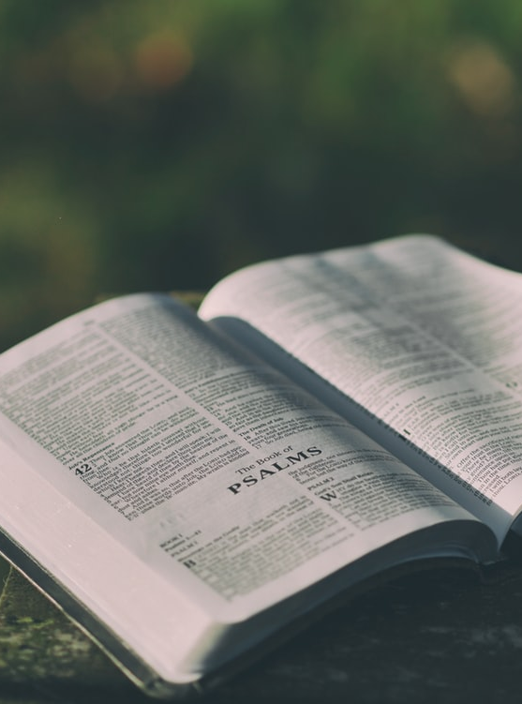
WAY OF DISCIPLESHIP:
BEING WITH GOD
Using other people’s words to be with God. Jesus prayed the Psalms
They were written for particular situations, but can be used by anyone. A vocabulary for prayer, helping us to bring the range of our emotion and experience to God.
Notes:
Using other people’s words to be with God.
Because of the unique relationship God wants with us, some people find the idea of using other written prayers, even as “scaffolding”, unhelpful. But, perhaps particularly for Anglican Christians, written prayers have become a resource which forms our identity in significant ways. Here are four types of written prayers which are a gift to us: The Psalms Jesus prayed the psalms. Getting to know and use the psalms can give us a vocabulary for prayer, helping us to bring the range of our emotion and experience to God. This is why in a lot of Anglican worship, the psalms continue to be prayed each week or each day.

Slide 29
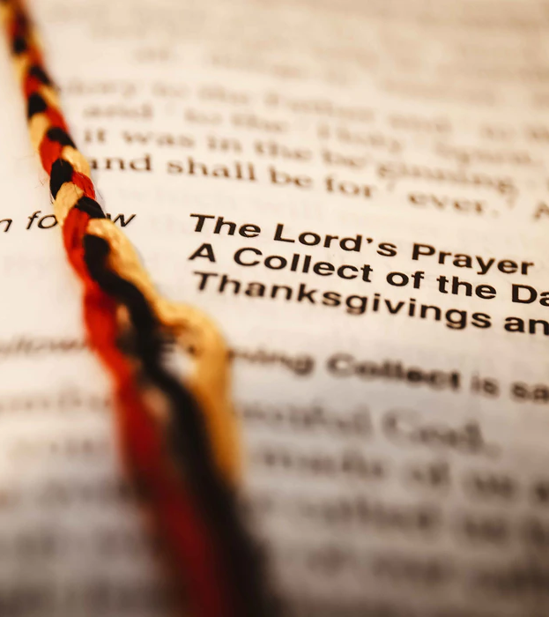
WAY OF DISCIPLESHIP:
BEING WITH GOD
Liturgy. “The work of the people.”
Formal or informal, simple or complicated.
Not dependent on our various moods. Liturgy gives the basic melody upon which we can improvise.
Notes:
Liturgy.
As we have seen, prayers written by others which give a structure to prayer and worship are “the work of the people.” Liturgy can be formal or informal, simple or complicated. Some find it liberating, some find it dead. Sometimes the words of liturgy can be seen in opposition to the life of God’s Spirit. Of course, any written, repetitive prayer can become lifeless. But at its best liturgy gives a framework for the Spirit; and the Spirit gives life to liturgy. There are all kinds of daily structures which can help – there are handouts on various phone apps which can help you pray each day, a handout from 24/7 prayer on how to have a regular quiet time with God, and a Shalom (Wholeness) Prayer, which gives words to bring every part of who we are to God.

Slide 30
WAY OF DISCIPLESHIP:
BEING WITH GOD
Jesus prayer. Used repetitively to help us “pray at all times”, and to practise God’s presence.
The Lord’s prayer.
A journey of prayer which helps us to approach God with love and reverence, and to pray all that needs to be prayed.
Notes:
Jesus Prayer.
This is a very simple prayer which can be used repetitively to help us “pray at all times”, and to practise God’s presence – there is a handout on this.
The Lord’s Prayer.
When His disciples asked Him to teach them to pray, Jesus gave them the attitude of prayer (see above) but He also gave them the words of prayer. The Lord’s Prayer is not a mantra to be prayed mechanically but a journey of prayer which helps us to approach God with love and reverence, and to pray all that needs to be prayed. As a daily way of praying it provides a perfect route, and there is a logic in how it starts and develops. See the handout to give you a simple guide as to how to get the most from praying the Lord’s Prayer.

Slide 31
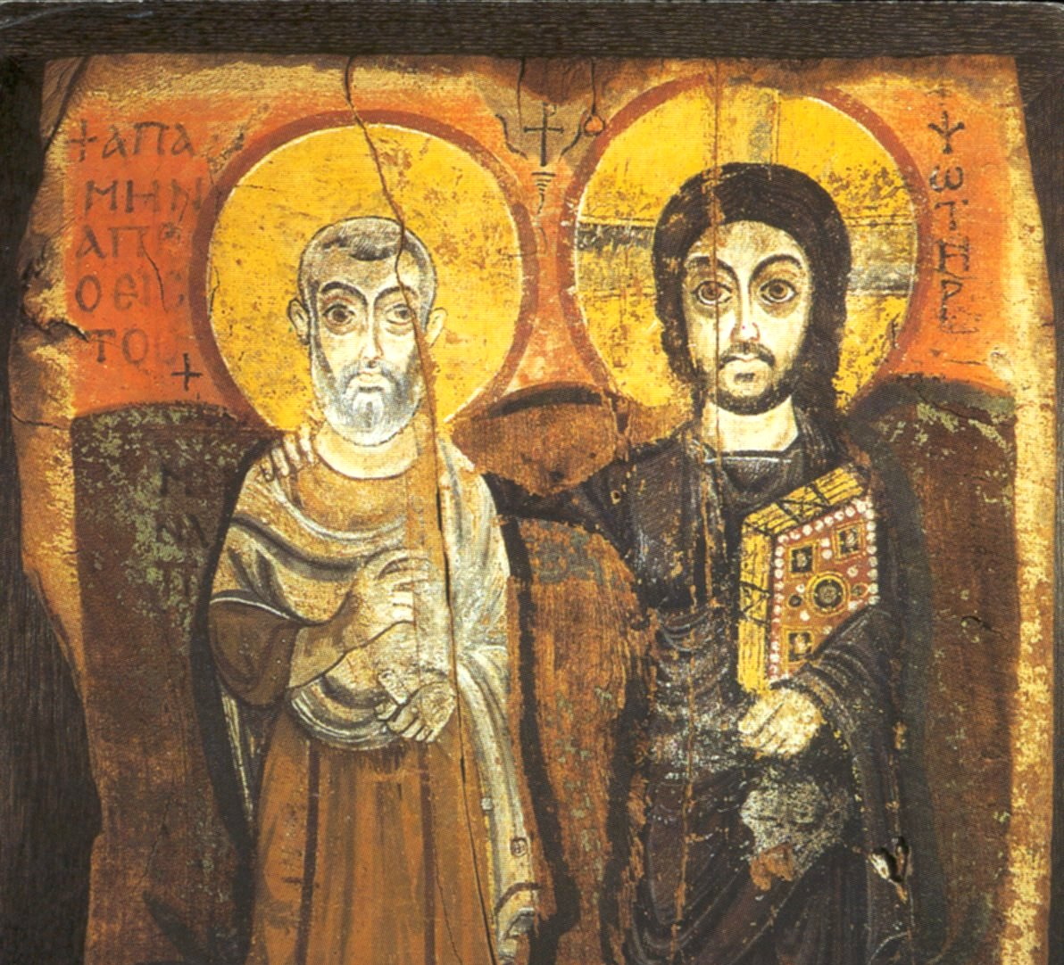
WAY OF DISCIPLESHIP:
BEING WITH GOD
Four other ways into praying. Icons and pictures. “Eikon” means image.
“Windows into heaven”
Speaking in tongues.
Praying through us in words we cannot understand. Not everyone has this gift but Paul desired that everyone should be able to have it.
Notes:
Four other ways into praying.
Icons and pictures.
The Greek word “eikon” means image. In a very visual culture, pictures or icons can help us visualise the reality of God’s presence. From the beginning pictures of Christ, the apostles, or saints have been used for public and private prayer. Commonly painted in a Byzantine style, every part of the icon — colours, figures, clothing, hand gestures, objects, and lettering — has a specific meaning. They are often called “windows into Heaven,” and are designed with that goal in mind. The artist does not want the Christian to admire the icon as a beautiful piece of artwork, but to use it to be drawn into prayer, raising the mind and heart to God. This is why icons are not signed by the artist.
Speaking in tongues.
The gift of tongues is a heavenly prayer language, given by the Holy Spirit, praying through us in words we cannot understand (though sometimes they can be interpreted as a message if used publicly). When you speak in tongues you surrender control of your prayer to God, praying with your spirit, instead of your mind. Not everyone has this gift (it is not a status symbol), but Paul desired that everyone should be able to have it. In terms of “Being with God” the gift of tongues can be a wonderful way of praying when we don’t have the words to express how we feel. We will explore it more in Module 3 – Joining in with the Spirit.

Slide 32
WAY OF DISCIPLESHIP:
BEING WITH GOD
Four other ways into praying. Singing “...Speak to each other with psalms, hymns, and spiritual songs; sing and make music to the Lord in your hearts…” Ephesians 5:19.
At the end of the day: using the Examen.
Notes:
Singing
“...speak to each other with psalms, hymns, and spiritual songs; sing and make music to the Lord in your hearts…” Ephesians 5:19. Singing, or listening to songs, can unlock prayer whether on our own, or with others.
At the end of the day: Using the Examen.
The idea of being with God as being attentive to God and responding to Him is expressed well in the simple practice called the examen, which can be used at the end of the day to recognise where God has been present, and been at work. A handout gives a way into using this prayer.

