Slide 1
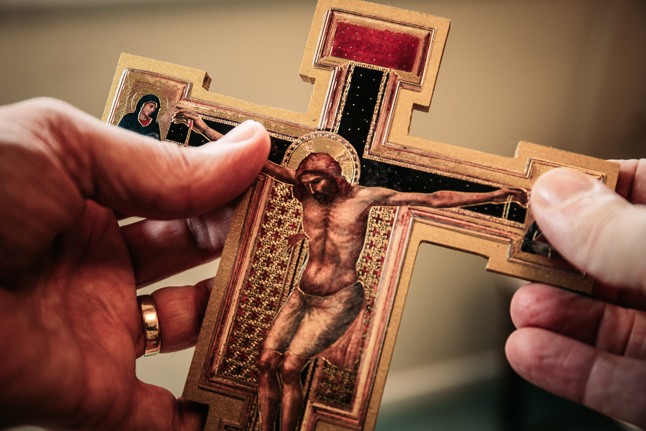
WAY OF DISCIPLESHIP:
BECOMING LIKE CHRIST
WAY OF DISCIPLESHIP: BECOMING LIKE CHRIST:
JESUS – HIS DEATH

Slide 2
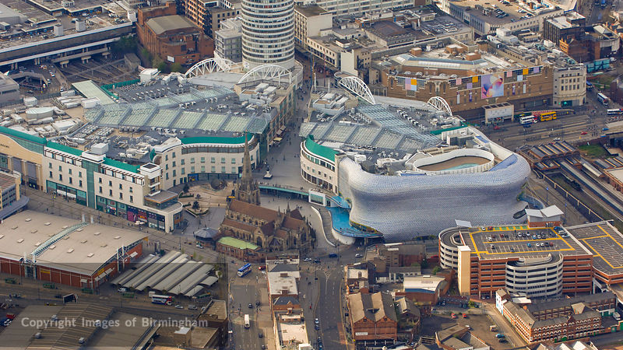
WAY OF DISCIPLESHIP:
BECOMING LIKE CHRIST
How is it possible that I can approach God?

Slide 3
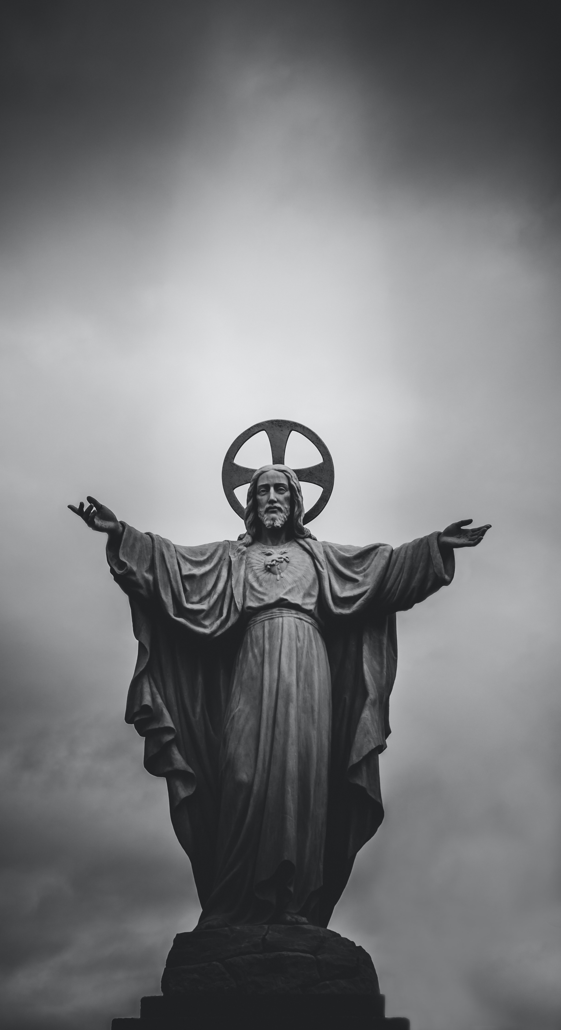
WAY OF DISCIPLESHIP:
BECOMING LIKE CHRIST
Session 1
Two of the three reasons why disciples seek to ‘become like Christ’:
because He is the one through whom we can know God
because He deserves our allegiance
Notes:
In session 1 we have explored two of the three reasons why disciples seek to “become like Christ”- because He is the one through whom we can know God – He is “Emmanuel”, God with us and the “Son of Man” who reveals God in human likeness – and because He deserves our allegiance - He is the anointed King (Messiah) who in His coming brings God’s kingdom – God’s healing and loving rule – on earth as it is in heaven.

Slide 4
WAY OF DISCIPLESHIP:
BECOMING LIKE CHRIST
Third reason
He is the one who has made this possible. He is the one who rescues us from evil, or what the Bible diagnoses as sin.
The name “Jesus” in itself reveals this as the centre of His purpose – it means “God saves.”
Notes:
The third reason we are exploring for becoming like Christ is because He is the one who has made this possible. He is the one who rescues us from evil, or what the Bible diagnoses as sin. The name “Jesus” in itself reveals this as the centre of His purpose – it means “God saves.”

Slide 5
WAY OF DISCIPLESHIP:
BECOMING LIKE CHRIST
Where do we see this being saved in the New Testament?

Slide 6
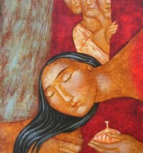
WAY OF DISCIPLESHIP:
BECOMING LIKE CHRIST
“Her many sins have been forgiven – as her great love has shown. But whoever has been forgiven little loves little.” (Luke 7:47).
Notes:
One of the stories that is found in all four of the gospels describes how a “sinful woman” anoints Jesus’ feet with perfume and her tears and dries them with her hair. She is pouring out her love and gratitude to Him because she has experienced the freedom of forgiveness. Jesus tells a story to show the guests who are there that, “her many sins have been forgiven – as her great love has shown. But whoever has been forgiven little loves little.” (Luke 7:47).

Slide 7
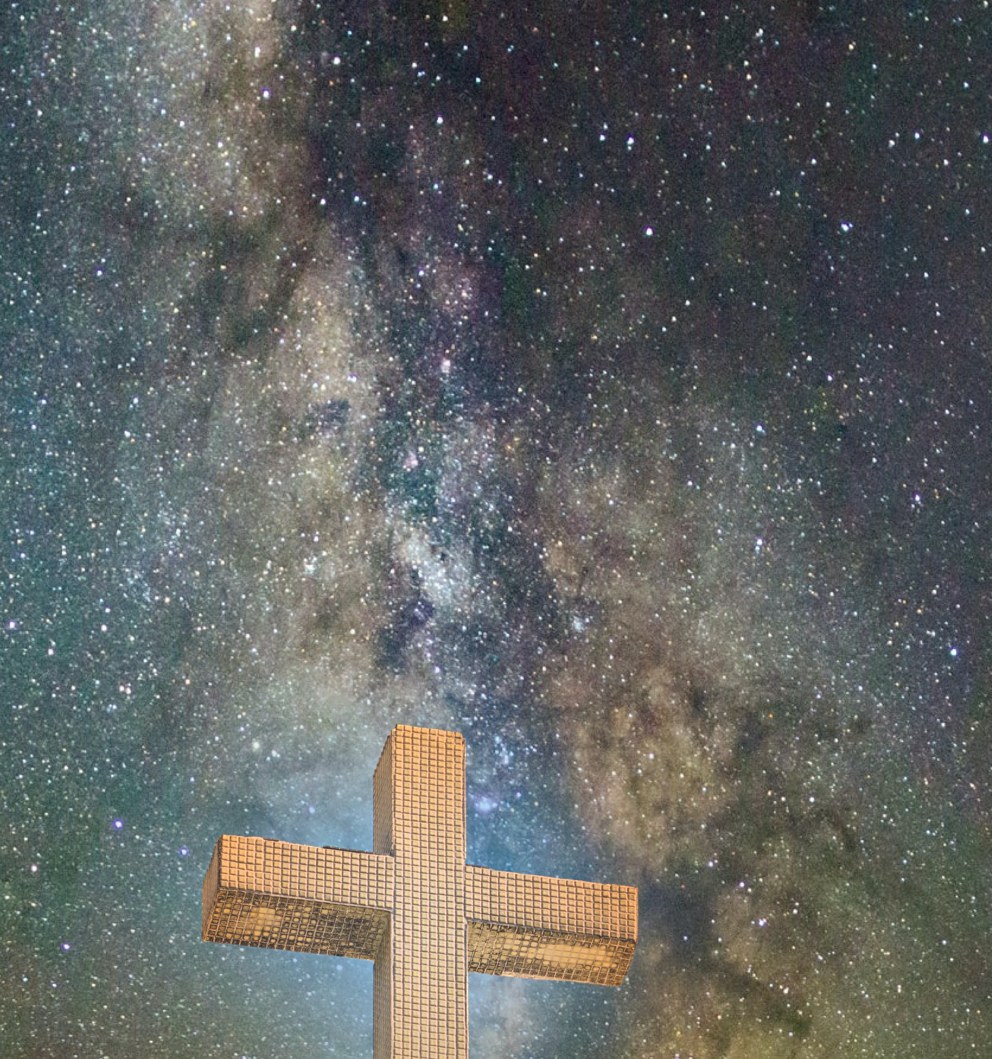
WAY OF DISCIPLESHIP:
BECOMING LIKE CHRIST
Forgive us our sins.
He came “for us and our salvation” (Nicene Creed).
Notes:
In the middle of the prayer Jesus taught us is the invitation to pray regularly, “Forgive us our sins…” In one of his letters Paul writes, “Bear with each other and forgive one another if any of you has a grievance against someone. Forgive as the Lord forgave you.” (Colossians 3:13) Being restored (saved) through forgiveness is at the heart of the good news of being a Christian, and at the heart of who Jesus is. For Jesus, His death and resurrection were necessary to fulfil God’s plan to bring the world back to Himself. He came “for us and our salvation” (Nicene Creed). By becoming human, dying and rising again, God through Christ has rescued the world from sin and death.

Slide 8
WAY OF DISCIPLESHIP:
BECOMING LIKE CHRIST
Does thinking I need forgiveness lead to low self-esteem?

Slide 9
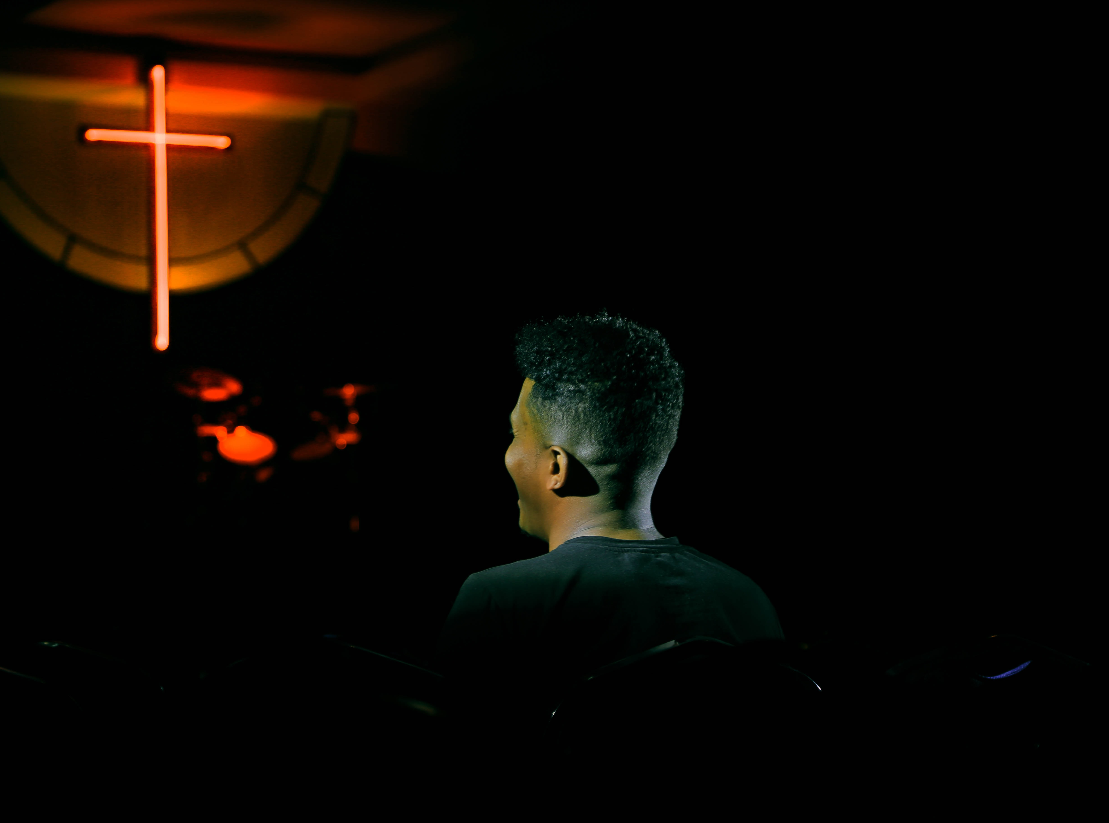
WAY OF DISCIPLESHIP:
BECOMING LIKE CHRIST
“Here is a trustworthy saying that deserves full acceptance: Christ Jesus came into the world to save sinners – of whom I am the worst.” (1 Timothy 1:15)
Notes:
In one of his letters Paul gives himself a blunt assessment, but without any hint of this being anything but a healthy approach: “Here is a trustworthy saying that deserves full acceptance: Christ Jesus came into the world to save sinners – of whom I am the worst.” (1 Timothy 1:15). While most religions teach about “sin”, it’s true that there are many examples of people who have been crippled by guilt, shame and even “bad religion” in a life and soul-destroying way. Even while coming as Saviour, Jesus angrily criticised religious leaders who “tie up heavy, cumbersome loads and put them on other people’s shoulders.” At a time when identity and mental health can be fragile, it is vital to have an understanding of sin, forgiveness and salvation which offers a real diagnosis of our condition and is about restoring people in God’s image. The best starting place for our wellbeing has to offer a realistic view of God and of ourselves and the world.

Slide 10
WAY OF DISCIPLESHIP:
BECOMING LIKE CHRIST
In what ways do we need to be realistic about approaching God?

Slide 11
WAY OF DISCIPLESHIP:
BECOMING LIKE CHRIST
“Do not come any closer…Take off your sandals, for the place where you are standing is holy ground.”
“Woe to me!” I cried. “I am ruined! For I am a man of unclean lips, and I live among a people of unclean lips, and my eyes have seen the King, the Lord Almighty.”
Notes:
Moses once came across the presence of God in the desert. Yet when he approached the bush God said, “Do not come any closer…Take off your sandals, for the place where you are standing is holy ground.” Similarly, the prophet Isaiah had a vision of God being worshipped by angels singing, “Holy, holy, holy is the Lord Almighty; the whole earth is full of his glory.” His response to seeing God was, “Woe to me!” I cried. “I am ruined! For I am a man of unclean lips, and I live among a people of unclean lips, and my eyes have seen the King, the Lord Almighty.” Again and again throughout the Bible God is described as “holy”. The more realistic our approach to God, the more we will be overwhelmed by His holiness.

Slide 12
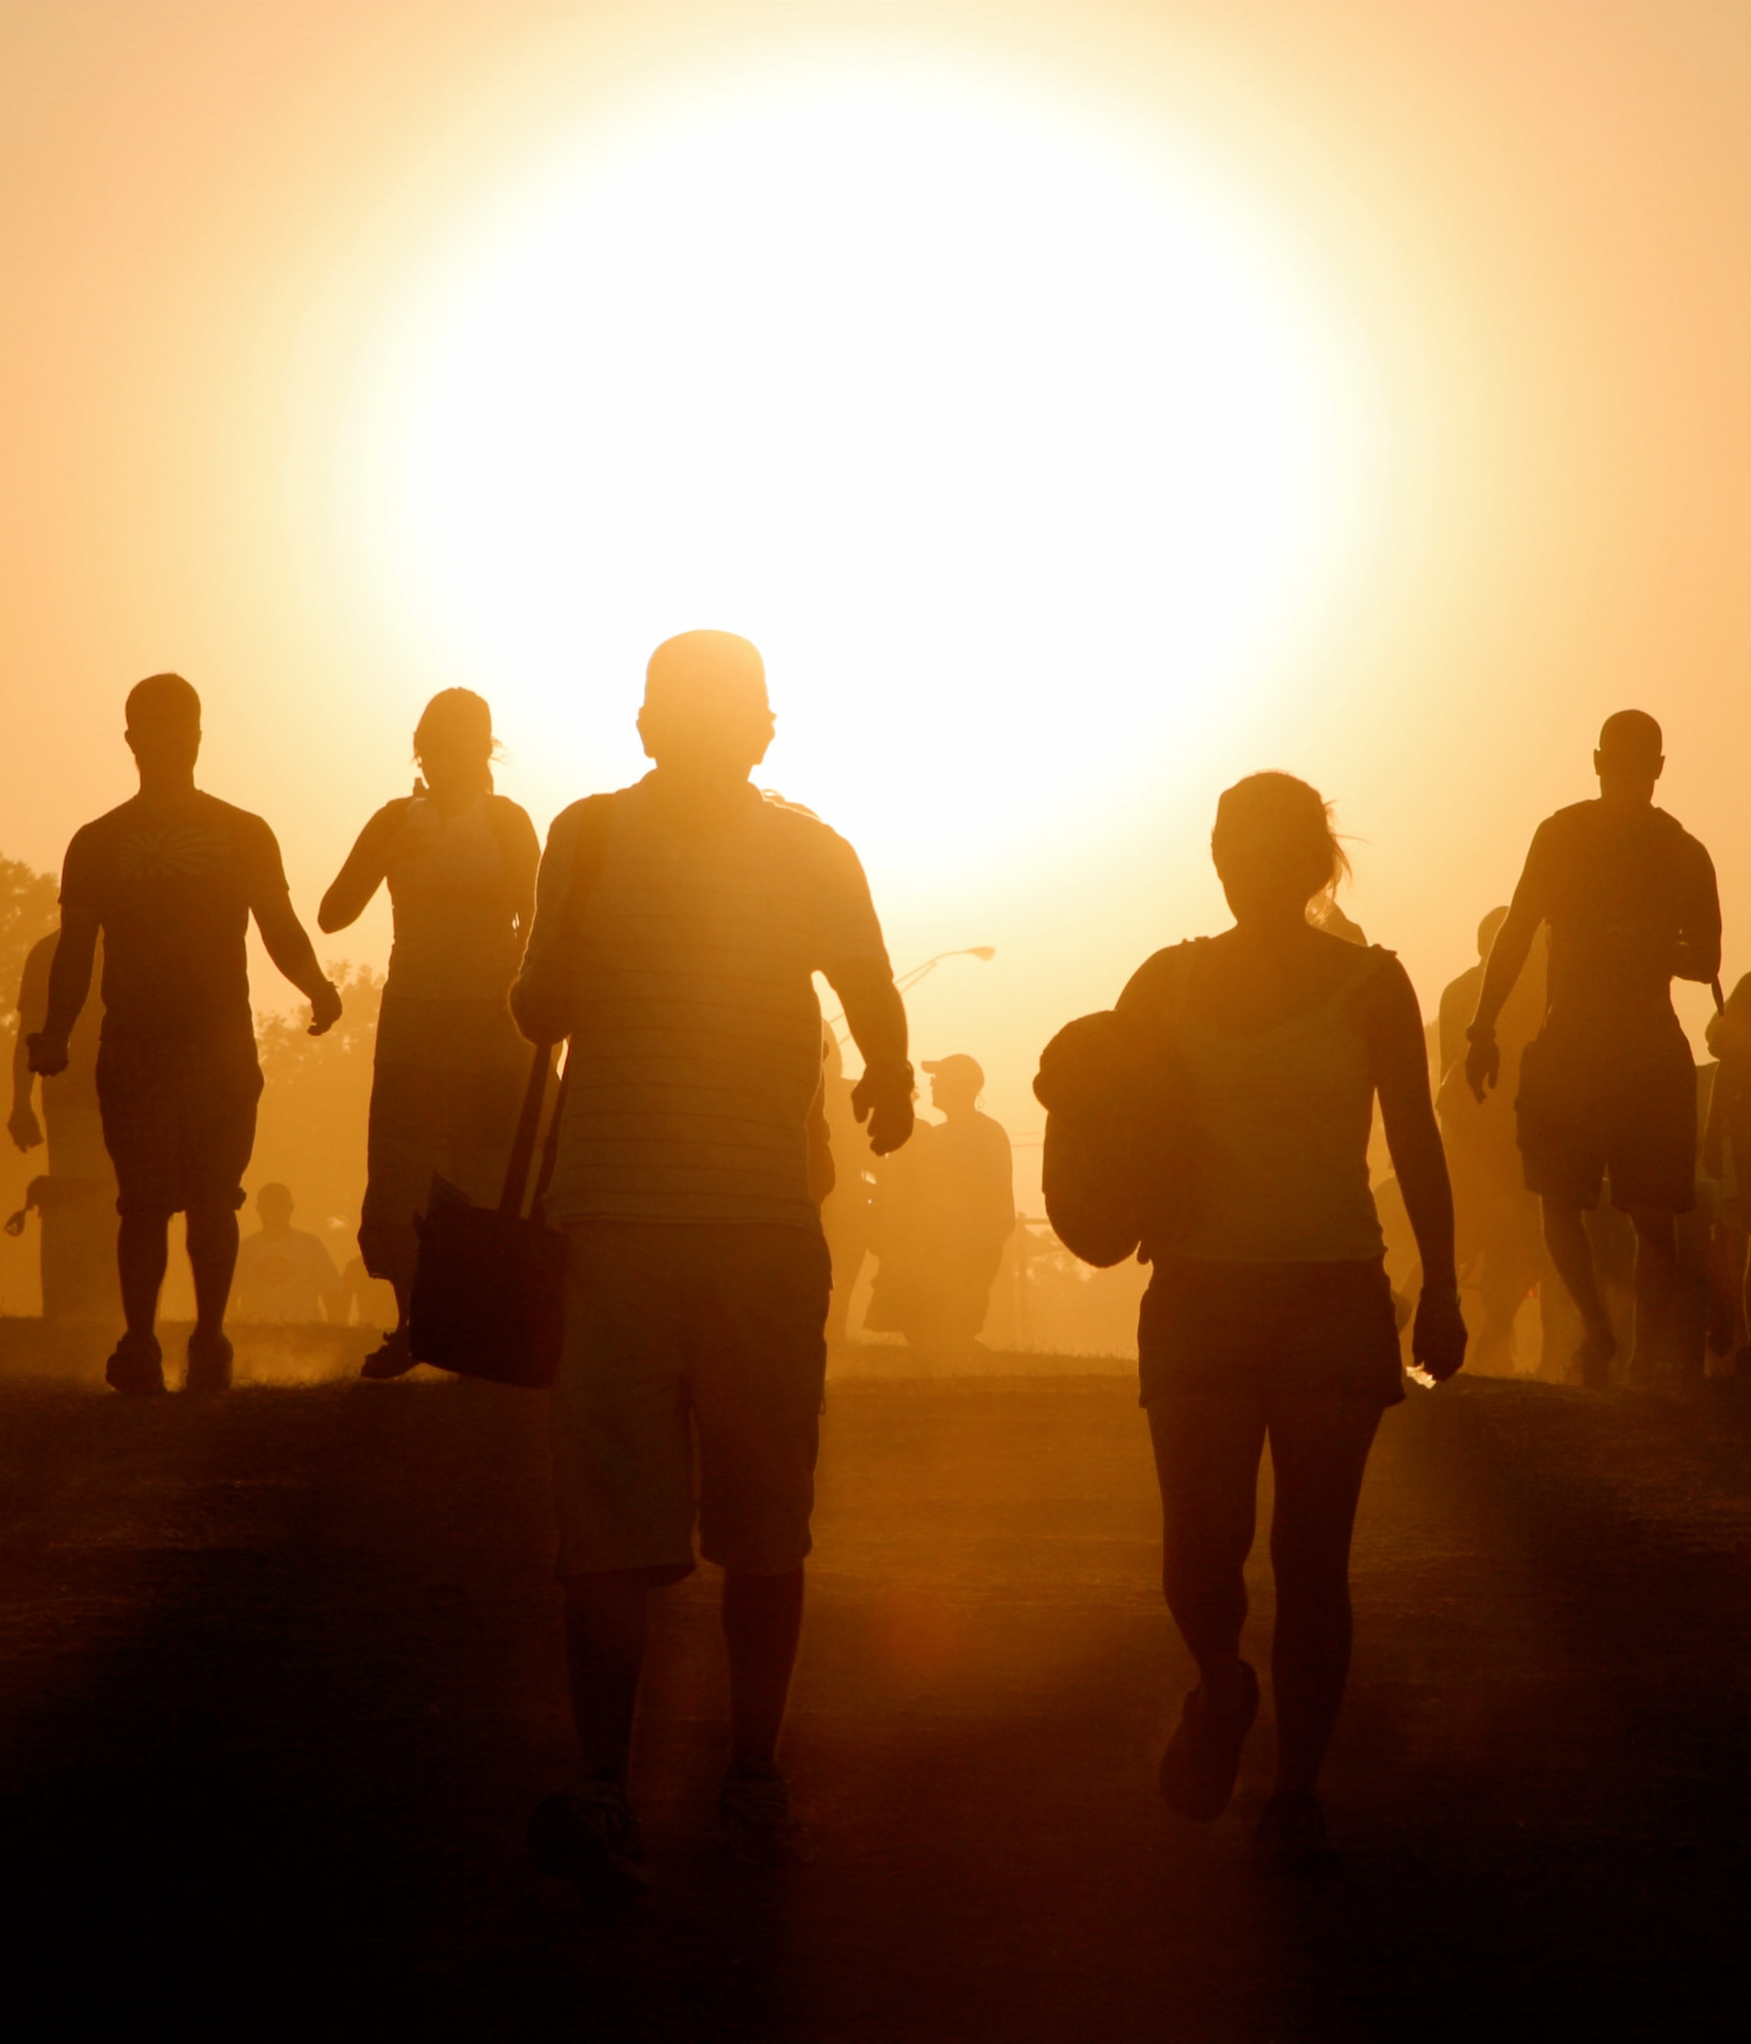
WAY OF DISCIPLESHIP:
BECOMING LIKE CHRIST
Just as the same radiant light and heat from the sun gives life or destroys depending on how close you are to it, so God’s intense love for people, and His “wrathful” judgement are from the same burning “white heat” of His Holy Love – but experienced in different ways.
The more accurate our view of the unique, loving, holy God the more we will have a realistically healthy understanding of ourselves…
Notes:
The unique holiness of God is like the sun which is life-giving to all around it. But the sun is also dangerous – you cannot get too close. The paradox at the heart of God’s holiness is that it will destroy anything that is not equally holy, not because it is bad, but because it is good. This attribute of God is described as a “consuming” or “refining” fire in the Bible. (See the Bible Project more on this image and detailed notes on God’s holiness).

Slide 13
WAY OF DISCIPLESHIP:
BECOMING LIKE CHRIST
In what ways do we need to be realistic about ourselves and the world?

Slide 14
WAY OF DISCIPLESHIP:
BECOMING LIKE CHRIST
I found myself trying to love the right things without God’s help, and it was impossible. I tried to go one week without thinking a negative thought about another human being, and I couldn’t do it.
“For I do not do the good I want to do, but the evil I do not want to do – this I keep on doing.” (Romans 7:19)
“Sin is the one doctrine you can’t dispute.”
Notes:
The writer Donald Miller has this reflection on trying to be good: “I found myself trying to love the right things without God’s help, and it was impossible. I tried to go one week without thinking a negative thought about another human being, and I couldn’t do it. Before I tried that experiment, I thought I was a nice person, but after trying it, I realized I thought bad things about people all day long, and that my natural desire was to love darkness.” If we are made to love God and love other people as ourselves, Miller is honest that he both fails to do it and finds it impossible to do. He knows what is good but falls short. Or as St Paul says, “For I do not do the good I want to do, but the evil I do not want to do – this I keep on doing.” (Romans 7:19). This reflects the robust description of the reality of the human condition we find in the Bible, and which accurately portrays our world today. As G.K. Chesterton put it, “Sin is the one doctrine you can’t dispute.”

Slide 15
WAY OF DISCIPLESHIP:
BECOMING LIKE CHRIST
Sin:
a description of what happens when we fall short of the goal – it’s a failure of the truly human calling to love God and love others
the break down of relationship between people or between people and God – when we betray trust we transgress
when something originally good has been bent out of shape or distorted, or what should be a blessing is corrupted
Notes:
Sin is not a religious word for bad behaviour, but a description of what happens when we fall short of the goal – it’s a failure of the truly human calling to love God and love others, and the Bible views it as embedded in the story of humanity like a chain reaction, creating a kind of slavery to sin. There is a word which describes the breakdown of relationship between people or between people and God – when we betray trust we transgress. By ignoring God’s will, Adam breaks trust. There is a word which describes what happens when something originally good has been bent out of shape or distorted, or what should be a blessing is corrupted – iniquity is distorted behaviour which leads to wickedness and guilt. (In the Bible, the idea of punishment is more often about people being left to deal with the consequences of their own disfigurement).

Slide 16
WAY OF DISCIPLESHIP:
BECOMING LIKE CHRIST
What are the results of this Fall?

Slide 17
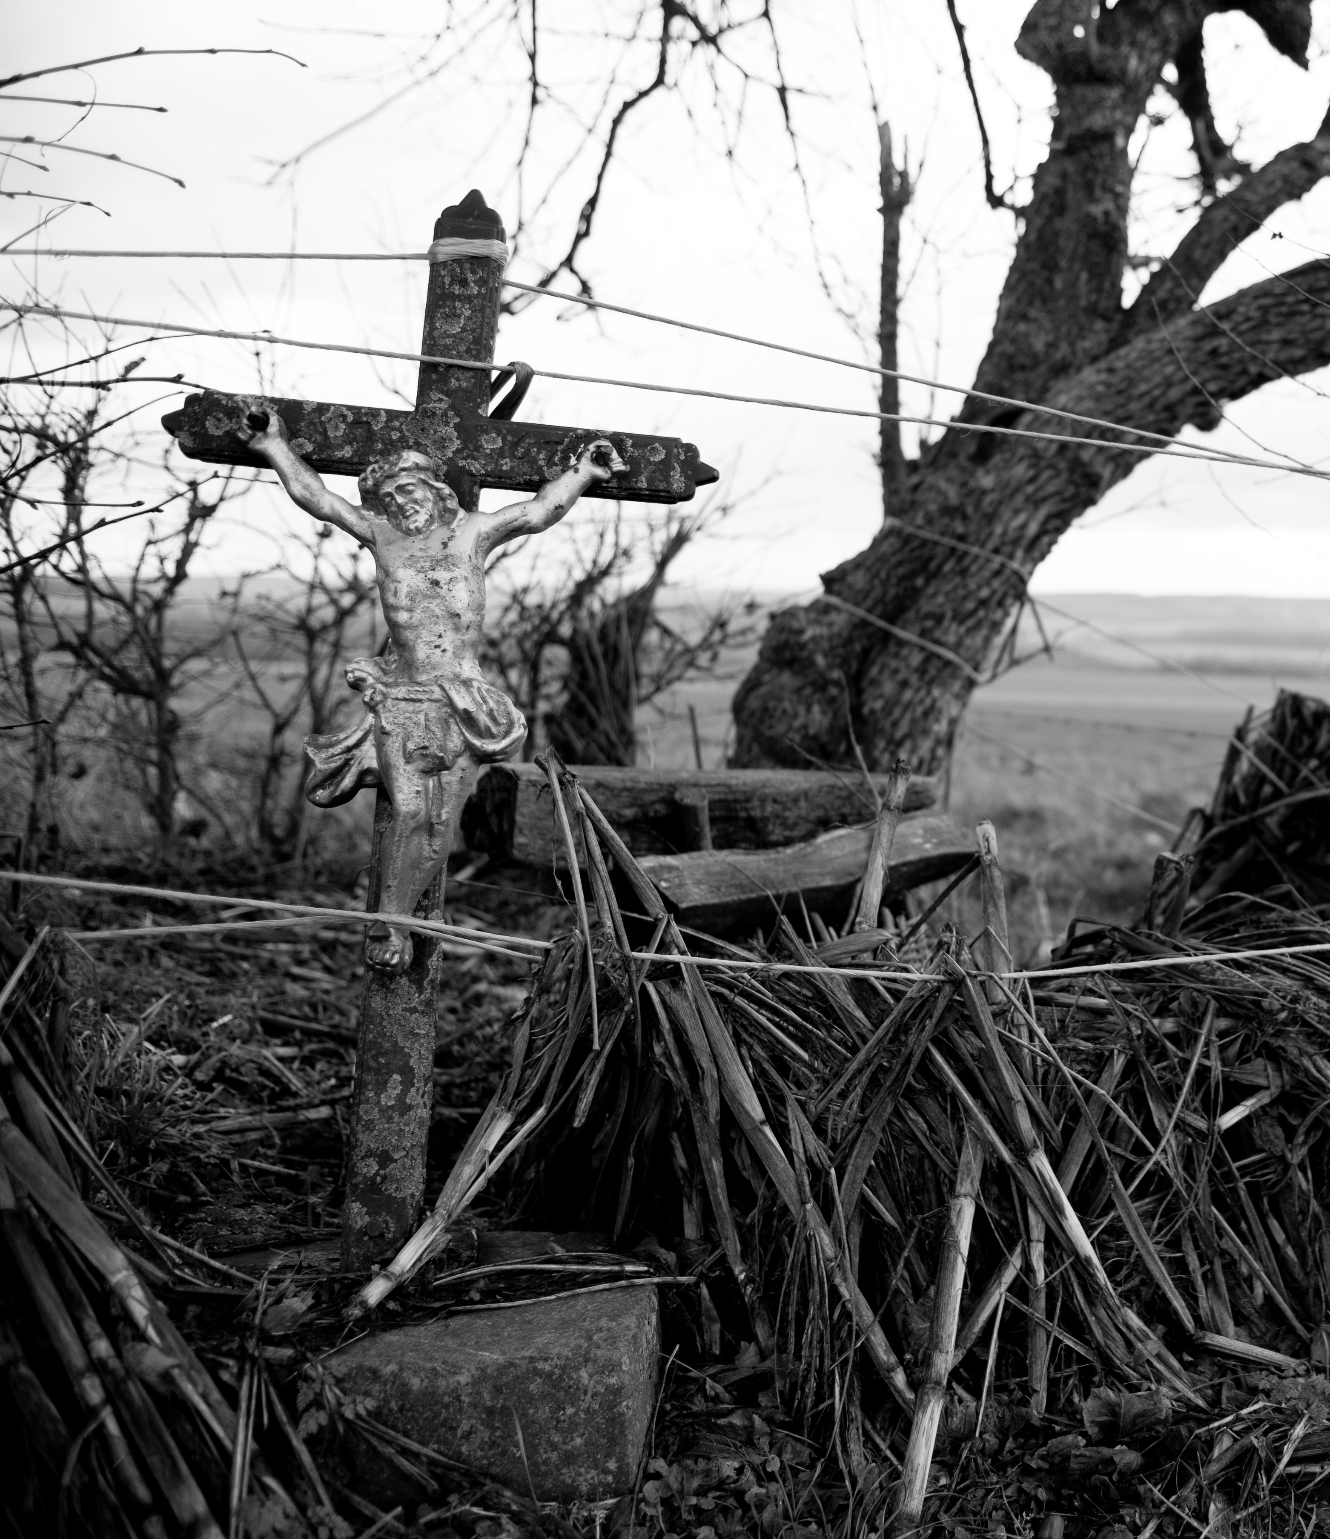
WAY OF DISCIPLESHIP:
BECOMING LIKE CHRIST
The destructive effects of sin need to be defeated.
Not just in the individual person, but in which the environment of our relationship with God, with others and with creation has been polluted.
We long for liberation in the physical world.
And from the unseen conflict in ‘the heavens’.
We fight “not against flesh and blood, but against the rulers, against the authorities, against the powers of this dark world and against the spiritual forces of evil in the heavenly realms.”
(Ephesians 6:12)
Notes:
The Bible reflects a world in which the effect of this fall affects not just the individual person, but in which the environment of our relationship with God, with others and with creation has been polluted. The world is not as God wants it to be. We long for liberation in two ways: from the chaos, disease, war, decay and ultimately death which dominate the physical world. But this is linked to an unseen conflict in “the heavens”, in which prideful spiritual forces of evil, represented as a snake, or satan, or “principalities and powers”, seek to undermine God’s kingdom.

Slide 18
WAY OF DISCIPLESHIP:
BECOMING LIKE CHRIST
What did Jesus do for us on the cross?

Slide 19
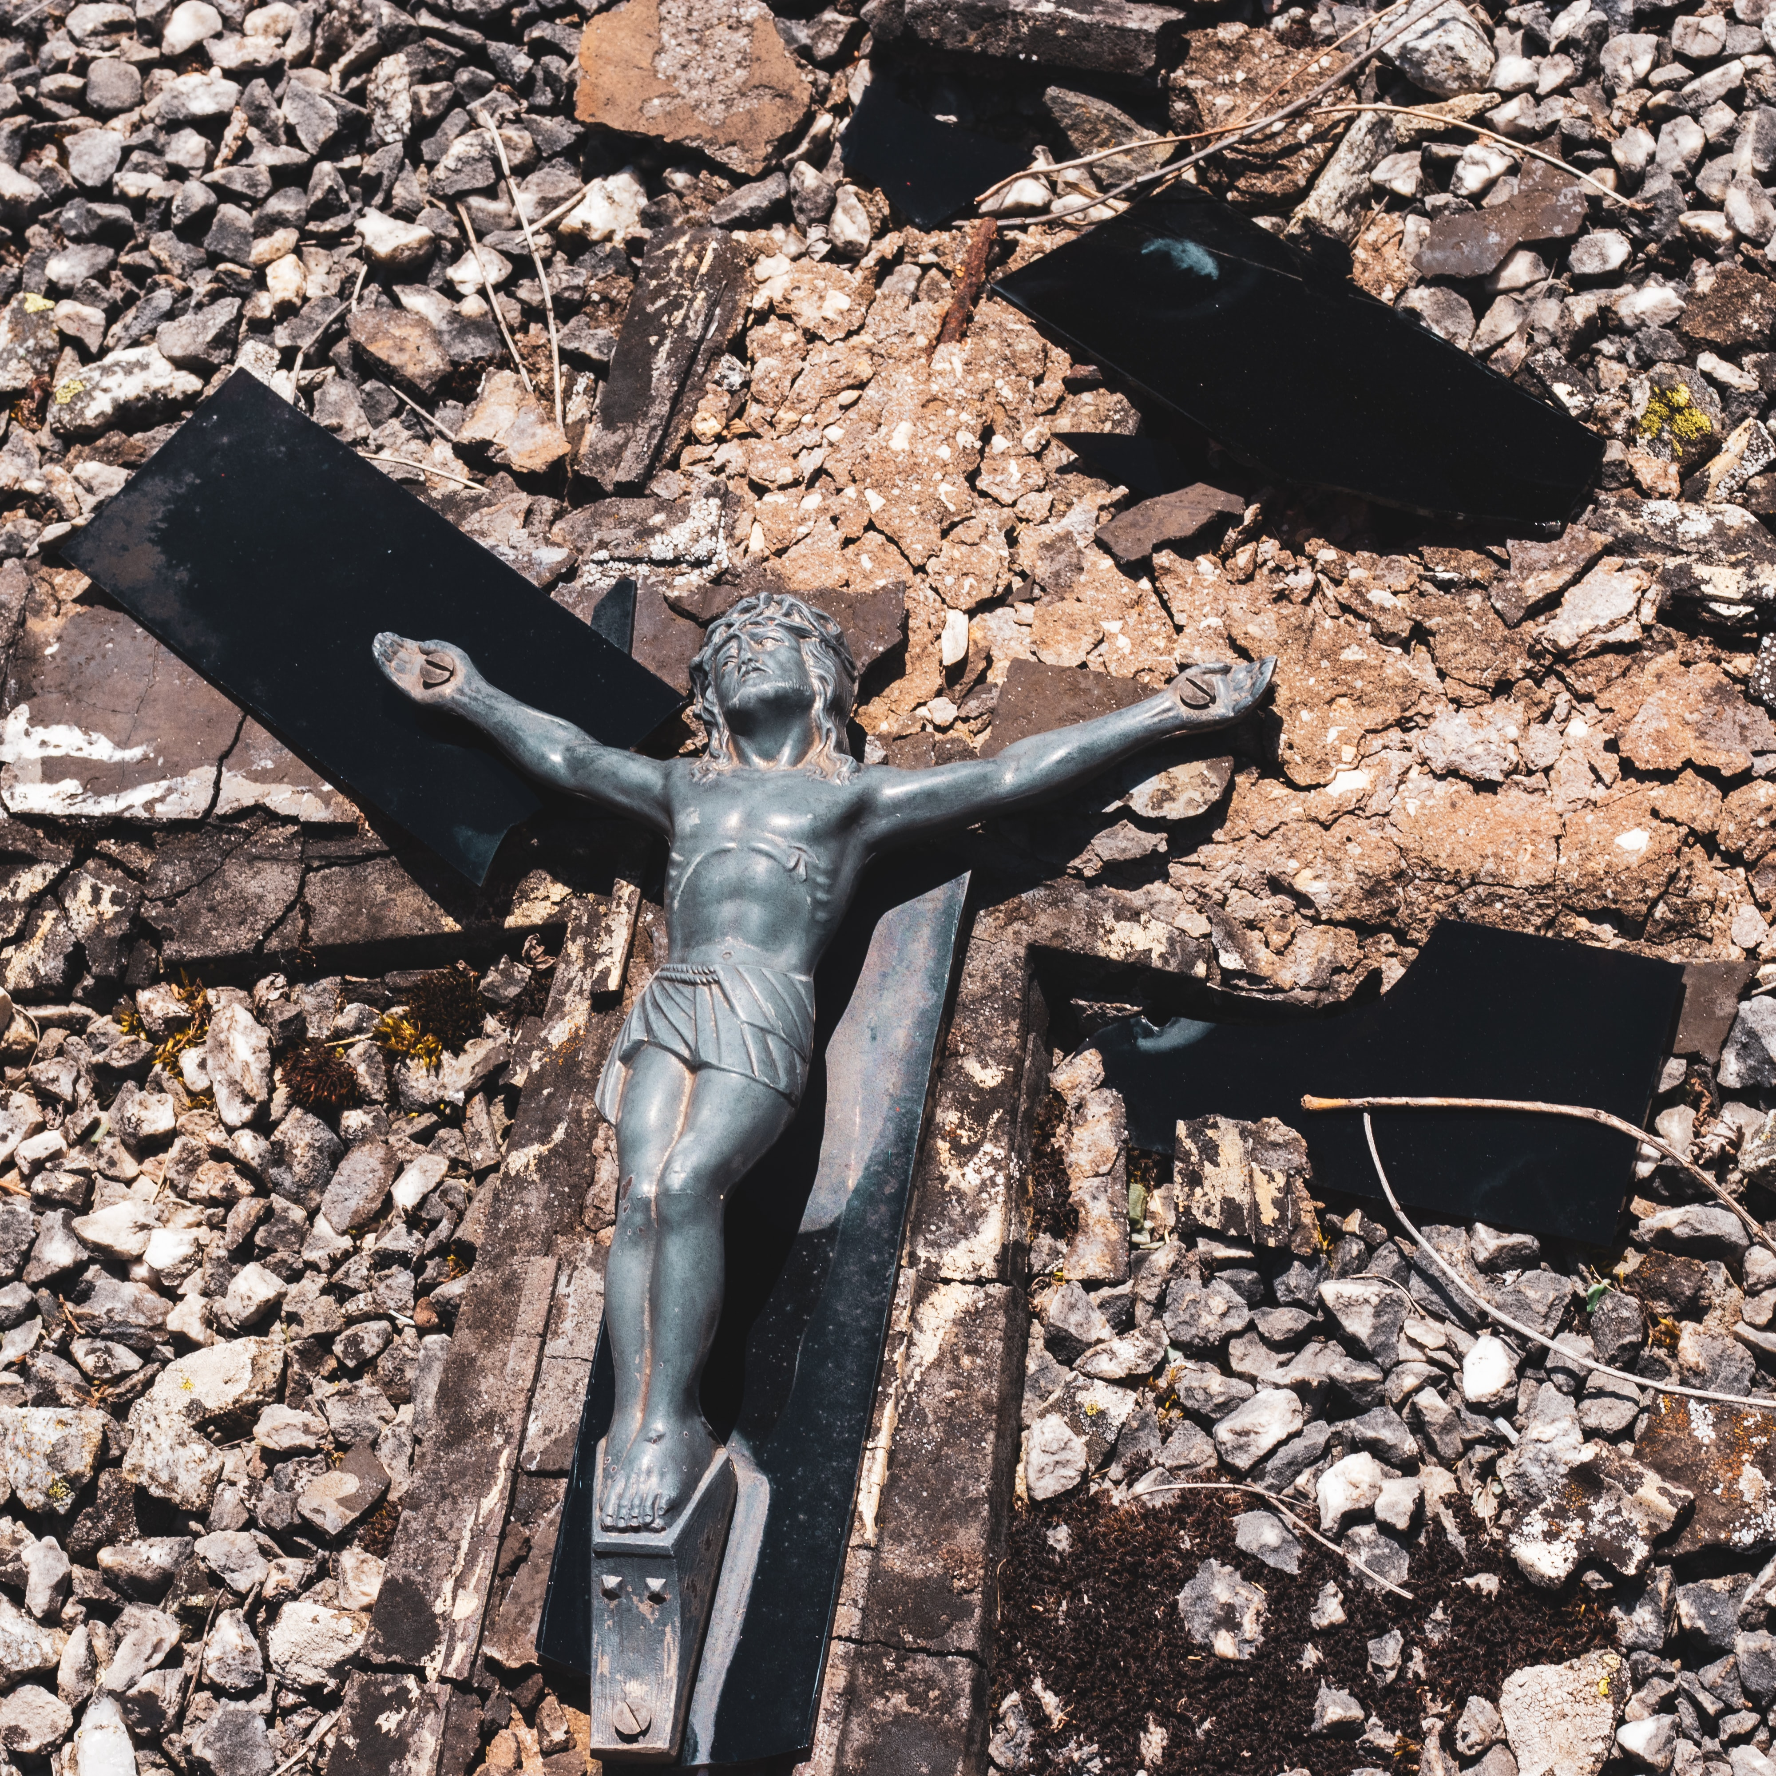
WAY OF DISCIPLESHIP:
BECOMING LIKE CHRIST
By dying and rising again Jesus achieved (at least) two things for us which we could not do for ourselves:
Dealing with sin through complete forgiveness which saves us and puts us right with God
Dealing with its destructive effects through victory over the fallen powers which pollute the world and lead to death
Notes:
The meaning of the cross is like a diamond – one gift but with many different ways to see it. Over the next few sessions we will explore a number of these (and handout summaries are available). But in the letter to the Colossians Paul writes that by dying and rising again Jesus achieved (at least) two things for us which we could not do for ourselves: Dealing with sin through complete forgiveness which saves us and puts us right with God: When you were dead in your sins and in the uncircumcision of your flesh, God made you alive with Christ. He forgave us all our sins, having cancelled the charge of our legal indebtedness, which stood against us and condemned us; he has taken it away, nailing it to the cross. Dealing with its destructive effects through victory over the fallen powers which pollute the world and lead to death: And having disarmed the powers and authorities, he made a public spectacle of them, triumphing over them by the cross. (Colossians 2:14-15). So the meaning of the cross is personal and cosmic – and it is at the centre of God’s purpose.

Slide 20
WAY OF DISCIPLESHIP:
BECOMING LIKE CHRIST
What helps me understand Jesus’ death?

Slide 21
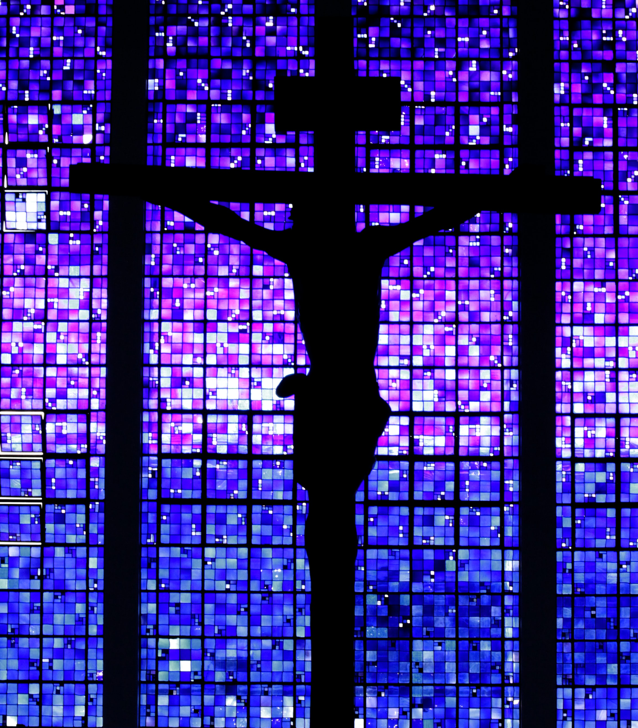
WAY OF DISCIPLESHIP:
BECOMING LIKE CHRIST
At the heart of the cross is “atonement”. To cover over someone’s debt
The story of the Old Testament is that this became a temporary solution – it did not effect the change God was looking for.
God promises an atoning sacrifice which will deal with sin once and for all, through a person – a King – who would become a “suffering Servant” – and die for the people.
“But he was pierced for our transgressions, he was crushed for our iniquities; the punishment that brought us peace was on him, and by his wounds we are healed.”
(Isaiah 53)
Notes:
The word “crucial” refers to something that we cannot do without – and literally means “like a cross.” The teaching of the Bible is that we cannot put ourselves right with God. But through His torture, death and resurrection Jesus “ransoms, heals, restores and forgives” us in a way that nothing else can achieve. At the heart of the cross is “atonement”. God always wants to be reconciled with His covenant people. But in order for the forgiveness which restores the relationship to be possible, there must be a way to make amends for the damage caused – to “atone” for it in a way that heals its effects forever. To atone literally means to cover over someone’s debt – whether that is a direct debt because of specific harm done or, as in much of our experience, how our sin can indirectly pollute our relationships with God, creation and each other. Rather than the sinner ceasing to exist because of sin, in the Old Testament an animal had taken their place. Not only that, but the priests would then sprinkle the animal’s blood to show that the animal’s death dealt with the destructive consequences of sin in the wider community. Not only did God want to forgive His people, but to restore them in His image – purify them again. The story of the Old Testament is that this became a temporary solution – it did not effect the change God was looking for. But God promises an atoning sacrifice which will deal with sin once and for all, through a person – a King – who would become a “suffering Servant” – and die for the people. Isaiah promised that this person would bear the consequences of all the kinds of brokenness we have described: “But he was pierced for our transgressions, he was crushed for our iniquities; the punishment that brought us peace was on him, and by his wounds we are healed. We all, like sheep, have gone astray, each of us has turned to our own way; and the Lord has laid on him the iniquity of us all….For he was cut off from the land of the living; for the transgression of my people he was punished….Yet it was the Lord’s will to crush him and cause him to suffer, and though the Lord makes his life an offering for sin.” (Isaiah 53: 4-10 abridged)

Slide 22
WAY OF DISCIPLESHIP:
BECOMING LIKE CHRIST
How does Jesus’ death reconcile us to God?

Slide 23
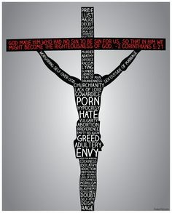
WAY OF DISCIPLESHIP:
BECOMING LIKE CHRIST
Who He is on the cross:
Ransom
Sacrifice
Representative
Fully God and fully human
Notes:
Jesus and the New Testament writers rarely use the actual word atonement to describe His death and resurrection. Different words emphasise the wonderful way in which Jesus saves us by taking the consequences of sin upon Himself. These different pictures serve to reveal the completeness of what God has done. Who He is on the cross: Ransom Through the cross Jesus gives “His life as a ransom for many” (Mark 10:45). He is the “…one God and one mediator between God and mankind, the man Christ Jesus, who gave himself as a ransom for all people. (1 Timothy 2: 5-6). Sacrifice He is the “sacrifice” (Ephesians 5:2), the “Lamb of God, who takes away the sin of the world!” (John 1:29) “….our Passover lamb, (who) has been sacrificed.” (1 Corinthians 5:7). He is the way God revealed His love as He “sent his Son as an atoning sacrifice for our sins.” (1 John 4:10) “through the shedding of his blood” (Romans 3:25). Representative. He represents us, standing in our place and bearing the punishment for our sins: “God made him who had no sin to be sin for us…” (2 Corinthians 5: 21). “He himself bore our sins” in his body on the cross…” (1 Peter 2:24). He becomes “a curse for us, for it is written: “Cursed is everyone who is hung on a pole.” (Galatians 3:13). Fully God and fully human: Only by being fully divine and fully human is Jesus able to do this. Because He is divine Jesus lives a sinless life – God “made Him who knew no sin to be sin for us” (2 Corinthians 5:21). We “have one who has been tempted in every way, just as we are—yet he did not sin” (Hebrews 4:15) and is uniquely able to offer the redeeming ransom through “the precious blood of Christ, a lamb without blemish or defect.” (1 Peter 1:19). Only someone who is not standing in quicksand can pull others free. By being divine Jesus isn’t only able to take sin into God at the cross – He destroys it as sin dissolves on contact with the undiluted holiness of God. But only by becoming fully human is it possible for a holy God enter into the full depths of sin, evil and death, taking our place and responsibility for our history of failure. Unless He is one of us, He can be our judge but not our saviour.

Slide 24
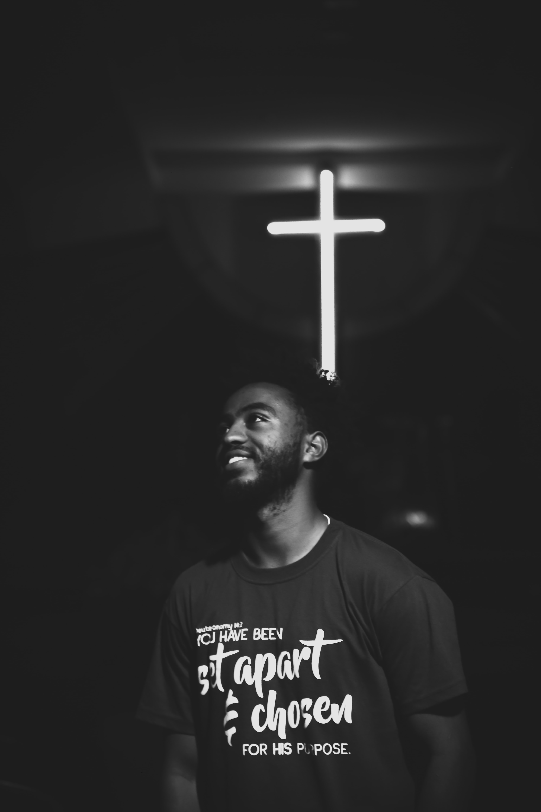
WAY OF DISCIPLESHIP:
BECOMING LIKE CHRIST
How this reconciles us to God:
Redemption and freedom.
Justification and no condemnation
Cleansing and purification
Reconciliation
Notes:
How this reconciles us to God: Redemption and freedom. To be redeemed is to be bought out of slavery and the bondage of sin and being under a law we could never keep. Justification and no condemnation. Atonement also means that the consequences we might expect from a holy God for sin are removed. There is now “no condemnation for those in Christ Jesus.” (Romans 8:1) Cleansing and purification. Just as the sprinkled blood in the Temple symbolically purified the community, so on the cross while Jesus takes on the sin of the world, human beings now receive His purity in exchange: “God made him who had no sin to be sin for us, so that in him we might become the righteousness of God.” (2 Corinthians 5:21). Reconciliation. Through the cross, the peace with God we could never earn for ourselves is achieved. “…we also boast in God through our Lord Jesus Christ, through whom we have now received reconciliation.” (Romans 5:11)

Slide 25
WAY OF DISCIPLESHIP:
BECOMING LIKE CHRIST
Did Jesus protect us from an angry Father?

Slide 26
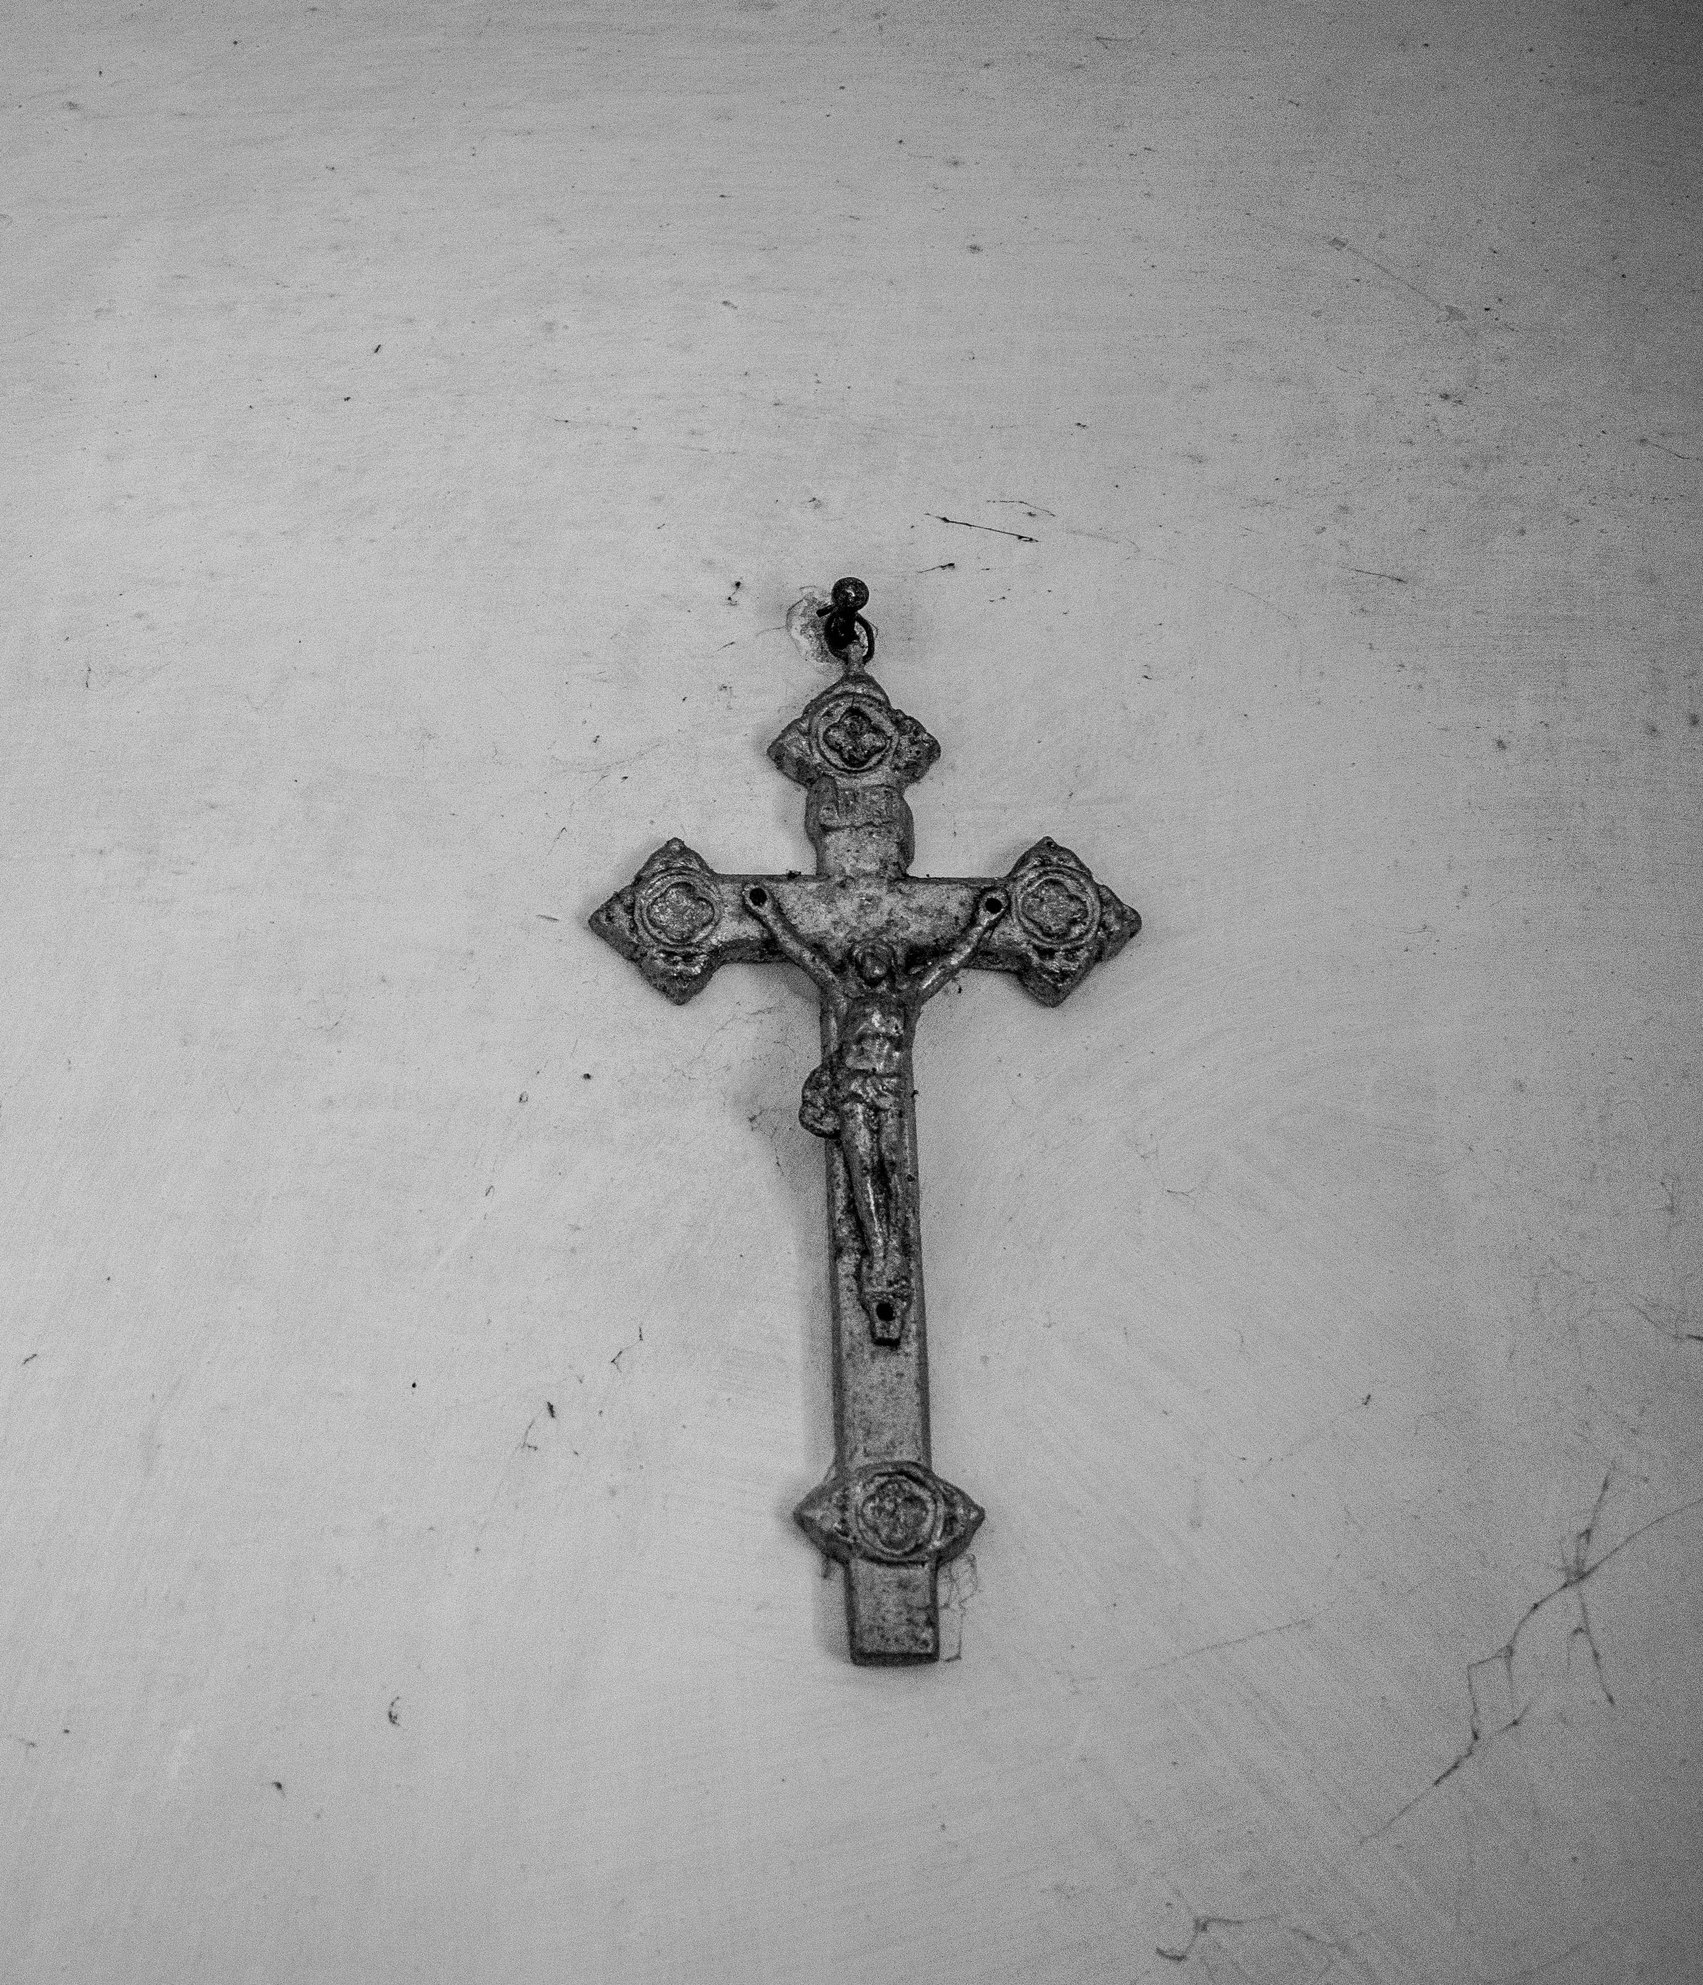
WAY OF DISCIPLESHIP:
BECOMING LIKE CHRIST
If the picture we have of God is the most defining thing about us, it is vital that at the cross we see that:
God is fully involved in every way.
The love of God for us is on display.
“Nails were not enough to hold God-and-man fastened to the cross, had not love held him there.”
Notes:
One possible understanding of the cross is to see a “good Son” protecting the world from an “angry Father” – as if God has a split personality. Some have described it as “cosmic child abuse”. Rather than being good news of freedom and forgiveness the cross becomes a place of fear and guilt. Rather than seeing a God of love and grace we see a God of contained anger. If the picture we have of God is the most defining thing about us, it is vital that at the cross we see that: God is fully involved in every way. As So while the various pictures God gives us to understand the atonement speak in many different ways, the foundational truth is that on the cross “God was in Christ reconciling the world to himself.” (2 Corinthians 5:19) pouring Himself out in the only way His nature allows. The love of God for us is on display. God IS love and therefore cannot do anything but love. Even before the cross Christ revealed the nature of that love in forgiving sins and restoring people. John 3:16, perhaps the most famous verse in the Bible, says, “For God so loved the world that He gave His only Son.” The cross is not just something that God who is love does; it is the expression of who He is. One saint said that “God’s Incarnation is not only an act of restoration in response to our sin, but also and more fundamentally as an act of love, an expression of God’s own nature.” St Catherine of Siena said, “Nails were not enough to hold God-and-man fastened to the cross, had not love held him there.”

Slide 27
WAY OF DISCIPLESHIP:
BECOMING LIKE CHRIST
How does Jesus’ life and death help me to become like Christ in my lived experience?

Slide 28
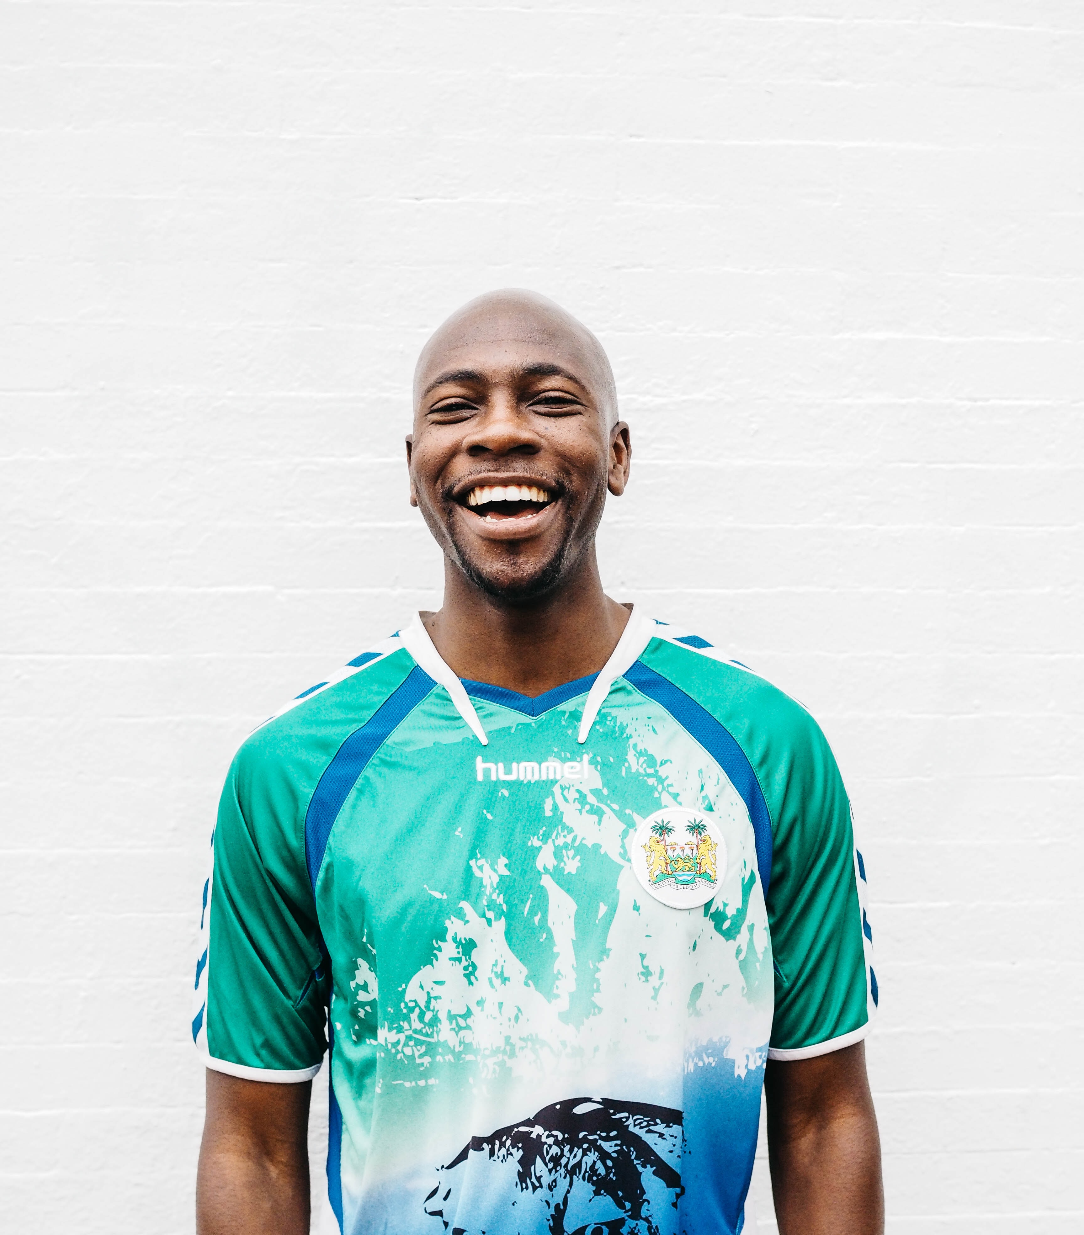
WAY OF DISCIPLESHIP:
BECOMING LIKE CHRIST
If God is to genuinely change us, we need to be able to come to Him with confidence and trust.
God builds the bridge towards humanity and becomes the sacrifice. His “perfect love casts out fear.” (1 John 4:18)
Notes:
If God is to genuinely change us, we need to be able to come to Him with confidence and trust. As the writer to Hebrews puts it, “Let us then approach God’s throne of grace with confidence, so that we may receive mercy and find grace to help us in our time of need.” (Hebrews 4:16). Religion can be about how human beings build a bridge to God through a series of outward behaviours or sacrifices. This can lead to “performance anxiety” – we are never quite sure if we have done enough to earn God’s favour. But through His life, death and resurrection, Jesus reverses this direction – God builds the bridge towards humanity and becomes the sacrifice. His “perfect love casts out fear.” (1 John 4:18)

Slide 29
WAY OF DISCIPLESHIP:
BECOMING LIKE CHRIST
To become like Christ, we need to be set free from guilt or shame at our core.
In a “guilt culture” we could say that God deals with what I have done by taking its consequences away.
In a “shame culture” we could say that God restores who I am and my relationship with Him and others.
Notes:
To become like Christ, we need to be set free from guilt or shame at our core. In our Western context, we are familiar with the idea that our guilt has been dealt with through Jesus’ atoning death making us righteous before God. Instead of us having to be pure to come to Him, His purity transforms us. But other Christians (from the more Eastern Orthodox tradition) have emphasised that the cross takes away the shame that creates distance from God and others. In fact, the idea that God replaces our shame with honour and restored relationship has been called “the pivotal cultural value” of the Bible. (See handout on three ways to understand salvation). Most people in the world identify more with an honour/shame understanding than a guilt/innocence one, and the issue of shame is referred to far more widely in the Bible than that of guilt. In a “guilt culture” we could say that God deals with what I have done by taking its consequences away. In a “shame culture” we could say that God restores who I am and my relationship with Him and others. This is the message of the lost sheep or coin that has been found. Of the Prodigal Son who returns to His father and is restored to relationship.

Slide 30
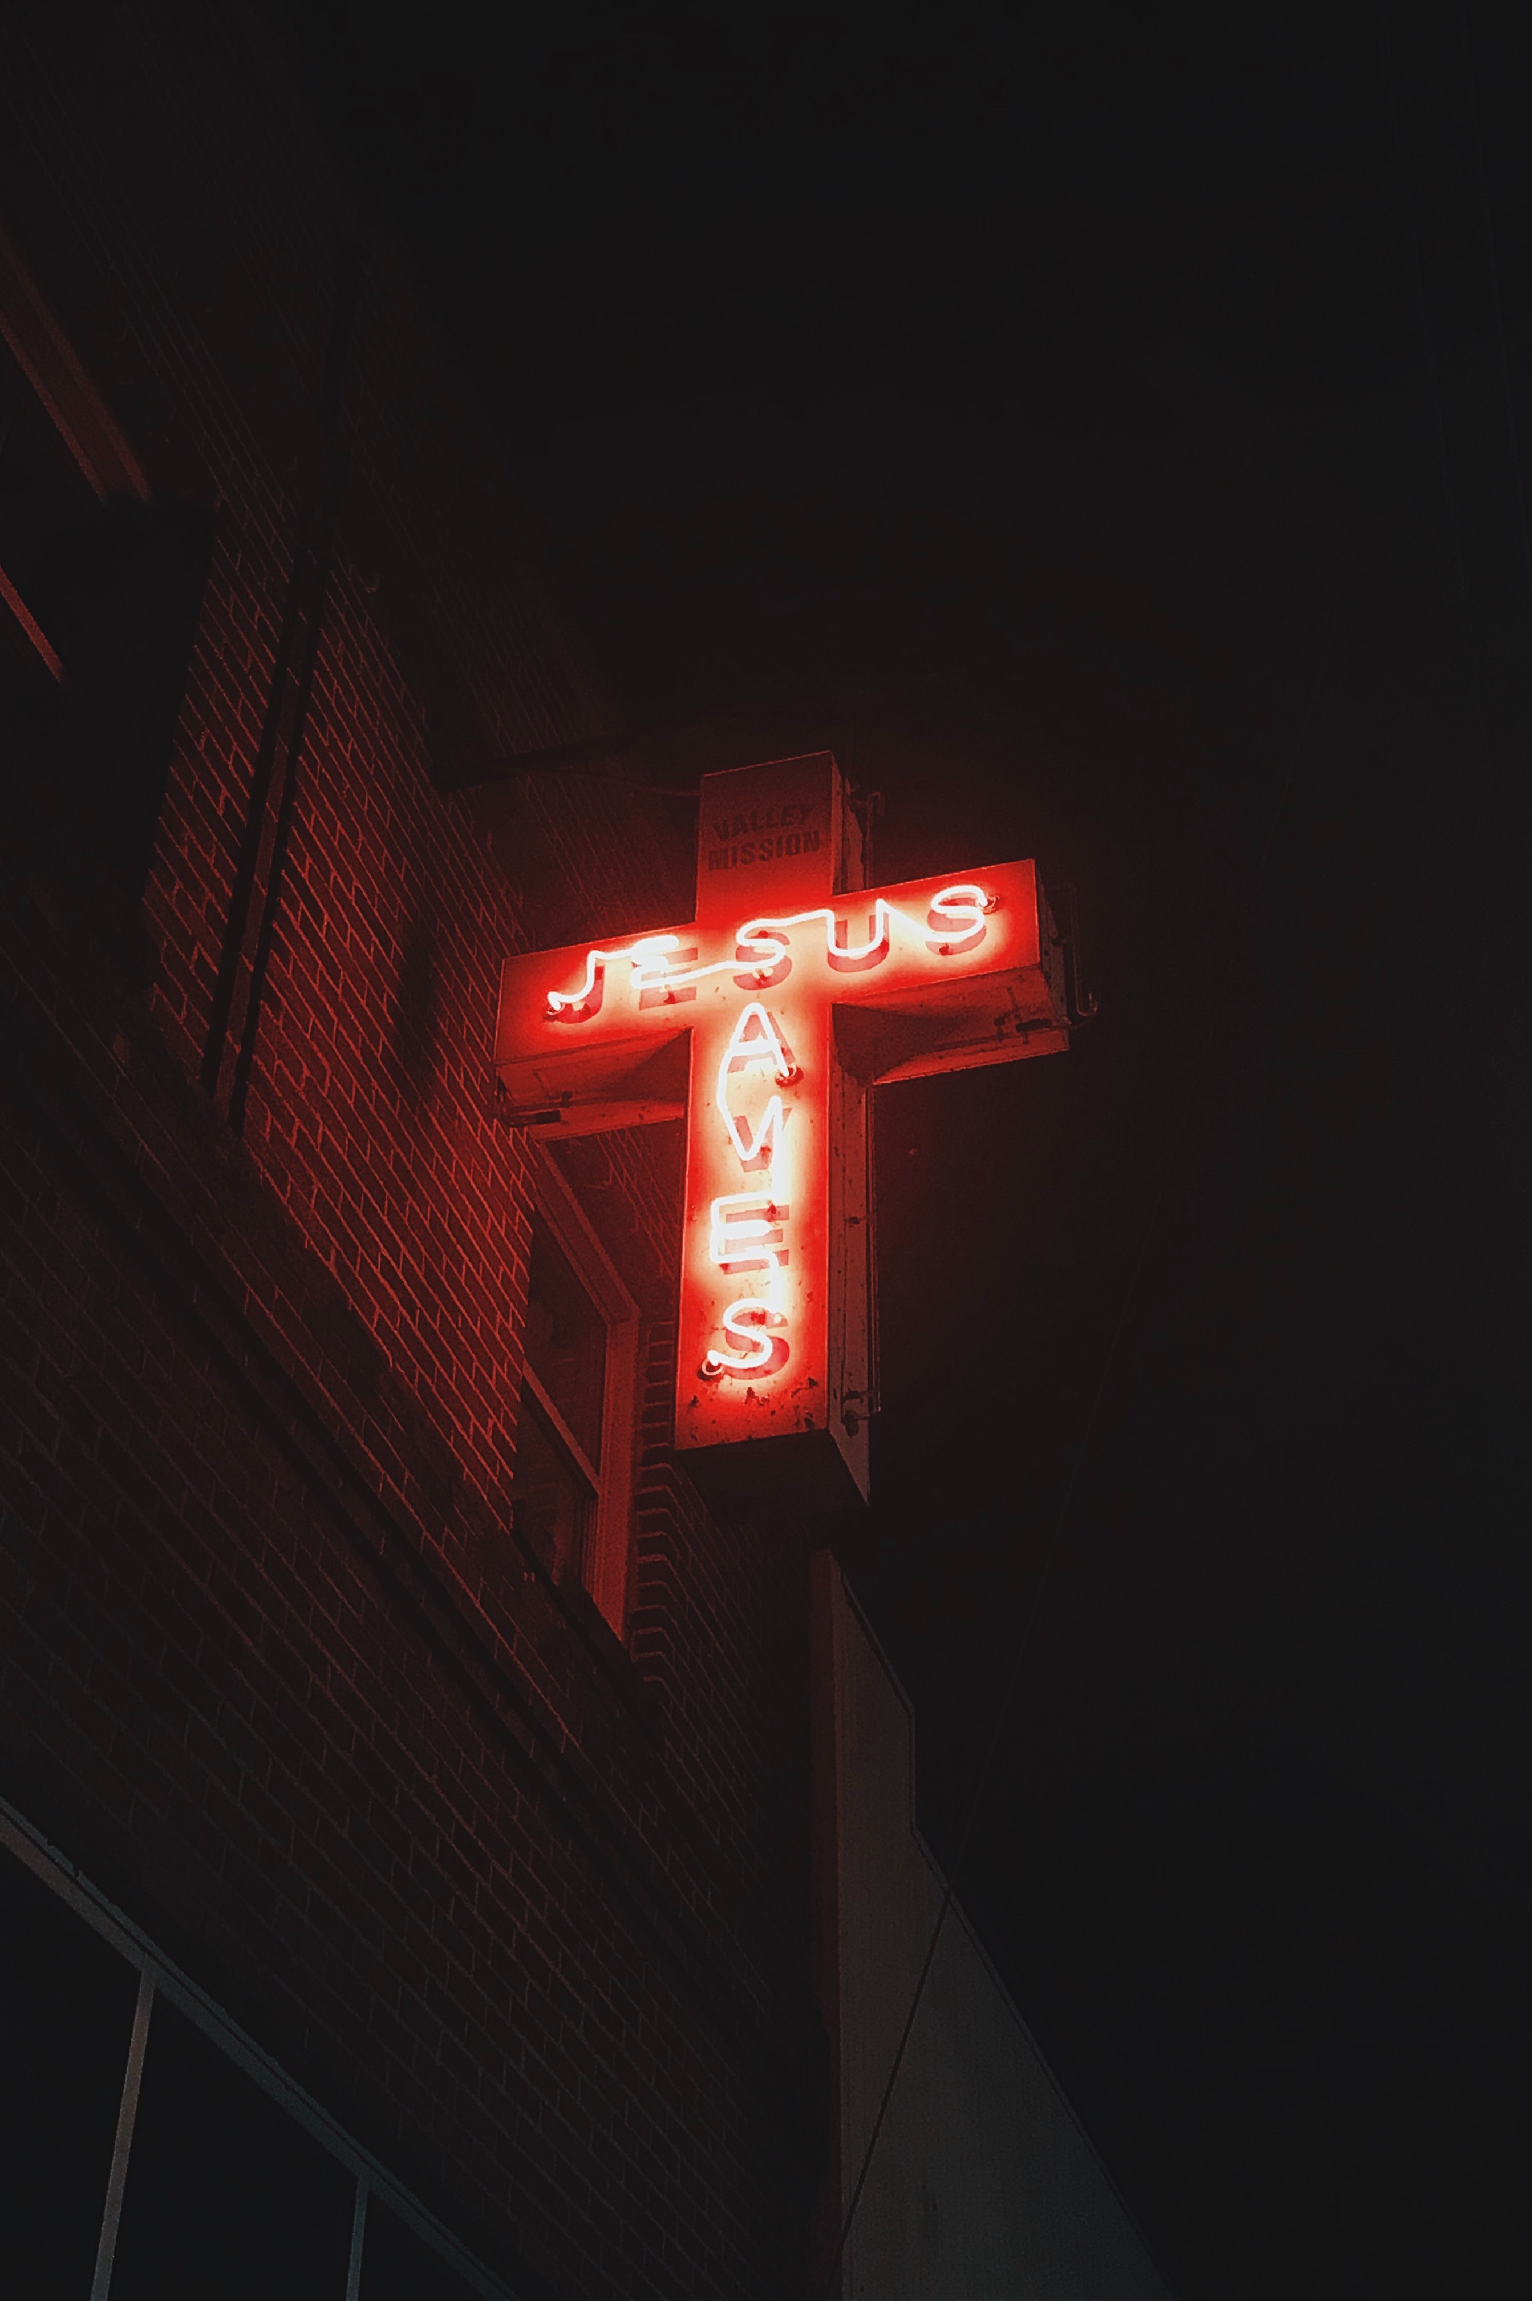
WAY OF DISCIPLESHIP:
BECOMING LIKE CHRIST
Being freed from the need to earn God’s favour.
“For it is by grace you have been saved, through faith—and this is not from yourselves, it is the gift of God - not by works, so that no one can boast.”
(Ephesians 2:8-9).
Notes:
Linked to this is being freed from the need to earn God’s favour. The elder brother in the story of the Prodigal Son illustrates how difficult human beings can find it not to have a relationship with God based on a “contract”. But the basis for becoming like Christ is knowing that God’s favour is given to us without regard to whether we deserve it or not. “For it is by grace you have been saved, through faith—and this is not from yourselves, it is the gift of God - not by works, so that no one can boast.” (Ephesians 2:8-9).

Slide 31
WAY OF DISCIPLESHIP:
BECOMING LIKE CHRIST
The more we see people as those for whom Christ died, the less likely we are to judge others.
“have the same mindset as Christ Jesus….in humility value others above yourselves, not looking to your own interests but each of you to the interests of the others.” (Philippians 2: 4,5,8)
Genuine change comes not from fear, but from love for a Saviour .
Paul wanted to “live for God…who loved me and gave himself for me.” (Galatians 2: 19-20) .
Notes:
The most revealing aspect of our sinfulness can be the easy way in which we mentally judge or compare ourselves with others. But the more we understand the cross, and the more we see people as those for whom Christ died, the less likely we are to judge others. “When I survey the wondrous cross, on which the Prince of glory died, My richest gain I count but loss, and pour contempt on all my pride.” When Paul reminds the Philippian Christians of how Jesus, “humbled himself by becoming obedient to death - even death on a cross!” he frames it by reminding them to “have the same mindset as Christ Jesus….in humility value others above yourselves, not looking to your own interests but each of you to the interests of the others.” (Philippians 2: 4,5,8) Ultimately genuine change comes not from fear, but from love for a Saviour (and, as we shall explore next week, allegiance to a Lord). Paul wanted to “live for God…who loved me and gave himself for me.” (Galatians 2: 19-20)

Slide 32
WAY OF DISCIPLESHIP:
BECOMING LIKE CHRIST
How do I receive salvation in my lived experience?

Slide 33
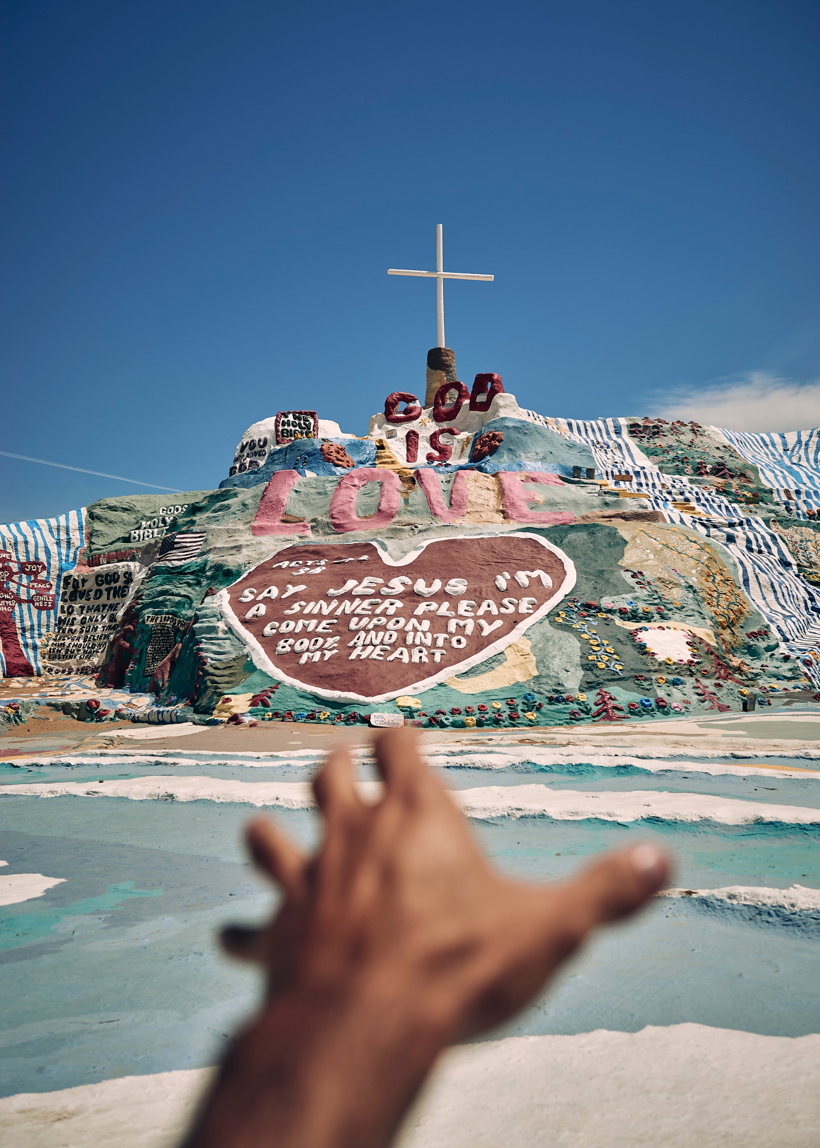
WAY OF DISCIPLESHIP:
BECOMING LIKE CHRIST
Two attitudes which are expressed through one habit
Repentance. To “return” or “turn round”, literally to change your mind.
We, “Made a decision to turn our will and our lives over to the care of God as we understood Him.”
Faith. Receiving God’s salvation is about turning towards Him and having confident trust.
Notes:
As we grow in being with God and becoming like Christ in our lived experience, the covenant relationship God offers us means that He never forces His love on us but invites us to respond in our daily lives. In doing so, the confidence, healing and restoration that God offers can move from idea to reality through embracing two attitudes which are expressed through one habit. The attitudes are repentance and faith. The habit of confession can help us to be rooted in these attitudes in our daily lives. Repentance. Jesus’ call to people was “repent and believe” (Mark 1:15). In the Bible, being able to repent is the first step that “leads to life.” (Acts 1:18). It is much more than feeling sorry. It means “return” or “turn round”, literally to change your mind. It is the decision to go God’s way – the first essential step towards change and healing. Faith. The Bible repeatedly contrasts the fruitless path of trying to be put right with God by obeying the law with instead receiving His righteousness through faith. Paul writing to the Romans reminds them that “Abraham believed God, and it was credited to him as righteousness.” (and so)…to the one who does not work but trusts God who justifies the ungodly, their faith is credited as righteousness.” (Romans 4:3-5) Receiving God’s salvation is about turning towards Him and having confident trust, “faith in” Christ. John’s gospel is written so that, “…you may believe that Jesus is the Christ, the Son of God; and that believing you may have life in His name.” (John 20:30-31). As we explored in module 1, faith is not so much about giving intellectual assent to Jesus’ existence, but more about entrusting and surrendering to Him.

Slide 34
WAY OF DISCIPLESHIP:
BECOMING LIKE CHRIST
How does the habit of confession help in this and change me?

Slide 35
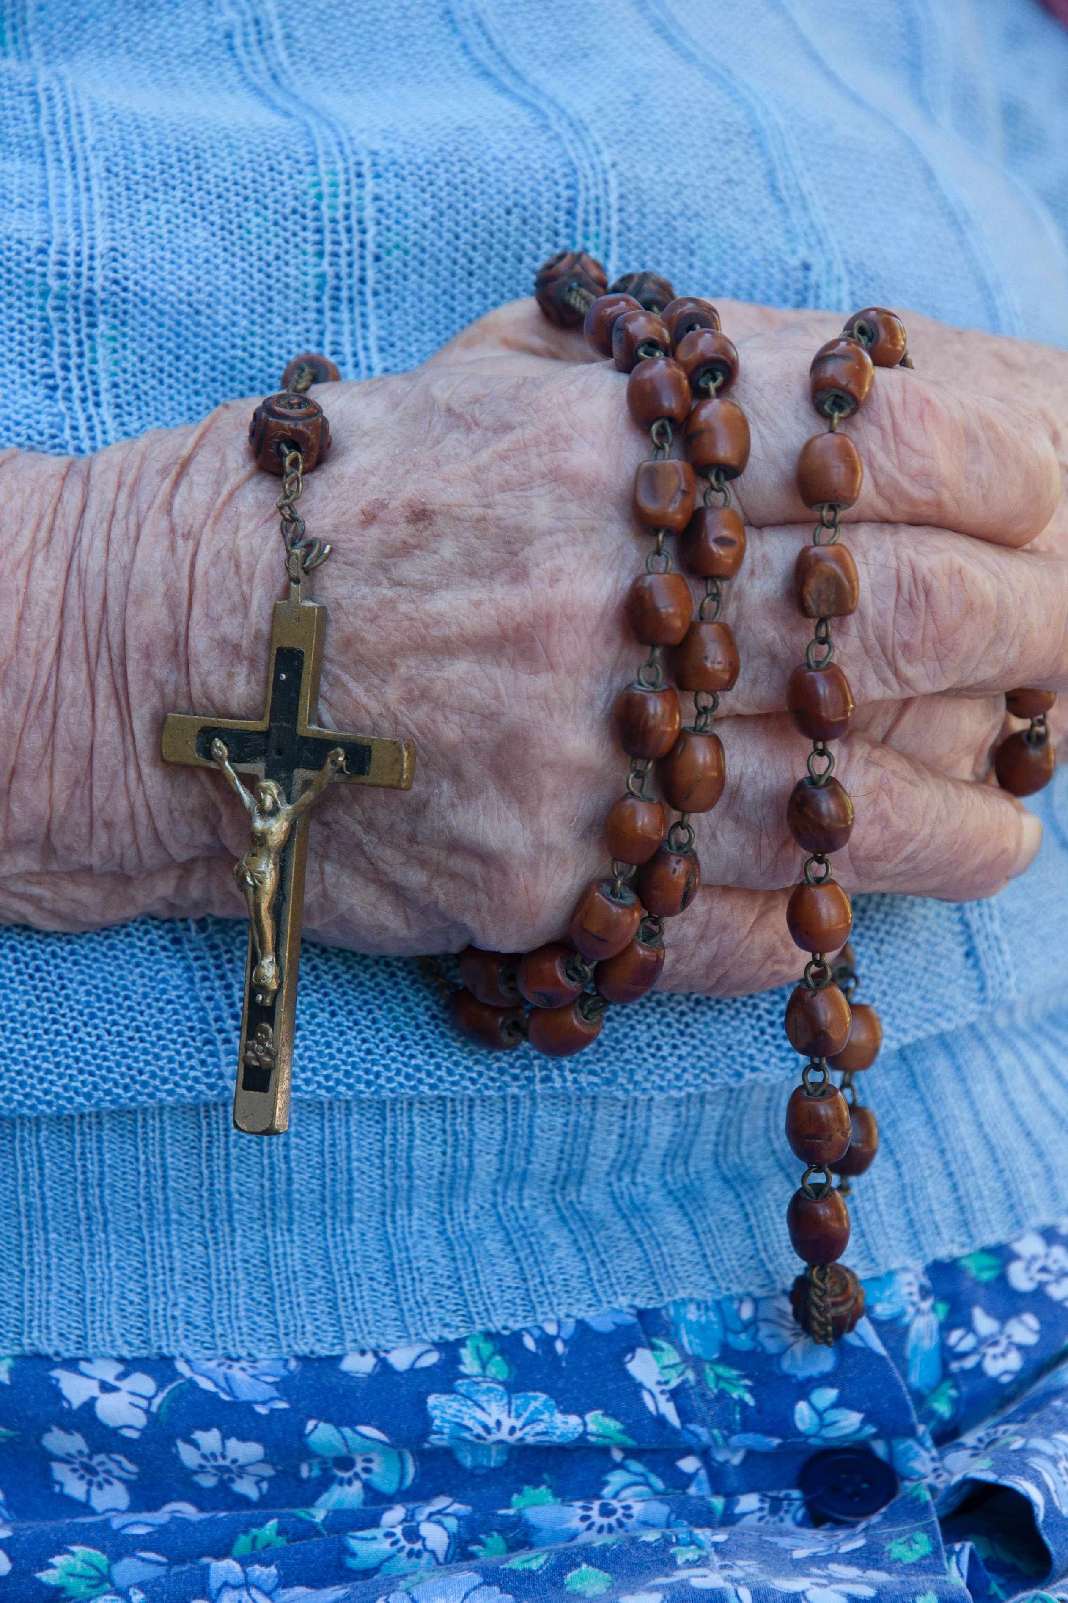
WAY OF DISCIPLESHIP:
BECOMING LIKE CHRIST
Confession: Why is it necessary?
“If we confess our sins, He is faithful and just to forgive us our sins and to cleanse us from all unrighteousness.” (1 John 1:9)
“We have been cleansed once for all, but our feet still need to be washed from the defilement of our daily walk as children of God.”
Notes:
Confession is a practice or habit through which we can consciously receive God’s forgiveness. It involves repenting and placing our faith in the faithfulness of Jesus. Why is it necessary? “If we confess our sins, He is faithful and just to forgive us our sins and to cleanse us from all unrighteousness.” (1 John 1:9). There is a symbolic way we can see this in the Bible. During the Last Supper when Simon Peter refuses to let Jesus wash his feet Christ replies, ‘Unless I wash you, you have no part with me.’ ‘Then, Lord,’ Simon Peter replied, ‘not just my feet but my hands and my head as well!’ Jesus answered, ‘Those who have had a bath need only to wash their feet; their whole body is clean. And you are clean…” (John 13: 8-10) The preacher Charles Spurgeon linked this to confession when he said, “We have been cleansed once for all, but our feet still need to be washed from the defilement of our daily walk as children of God.” Confession is a practice for those who are fundamentally “already clean”.

Slide 36
WAY OF DISCIPLESHIP:
BECOMING LIKE CHRIST
Confession: How do we do it?
“To say the same thing”. In other words, to agree with God about our sins – not to cover up.
“Sorrow for sin is necessary, but it should not involve endless self-preoccupation. You should dwell also on the glad remembrance of the loving kindness of God.”
We are, first and foremost, confessing to God alone. However, the Bible also offers the possibility of confessing before other people.
Notes:
How do we do it? In terms of the attitude we bring to confession, the word used in the Bible means “to say the same thing”. In other words, to agree with God about our sins – not to cover up. Bernard of Clairvaux offers this counsel in terms of feelings of sorrow: “Sorrow for sin is necessary, but it should not involve endless self-preoccupation. You should dwell also on the glad remembrance of the loving kindness of God.” Practically speaking, there is no specific rule about how often confession is good, but it is always wise to keep short accounts with God and to give time to think through the things we need or want to confess. We are, first and foremost, confessing to God alone: “I acknowledged my sin to You, and I did not cover my iniquity…” (Psalm 32:5). However, the Bible also offers the possibility of confessing before other people, whether this is through using particular forms of words when we gather, or with a specific person. “Therefore, confess your sins to one another, and pray for one another so that you may be healed.” (James 5:16). Some Christians - Roman Catholics, Eastern Orthodox, and some Anglicans – do this through the sacrament of confession (also called the sacrament of penance or the sacrament of reconciliation), as they confess their sins to a priest. Others find they can confess to trusted Christian friends.

Slide 37
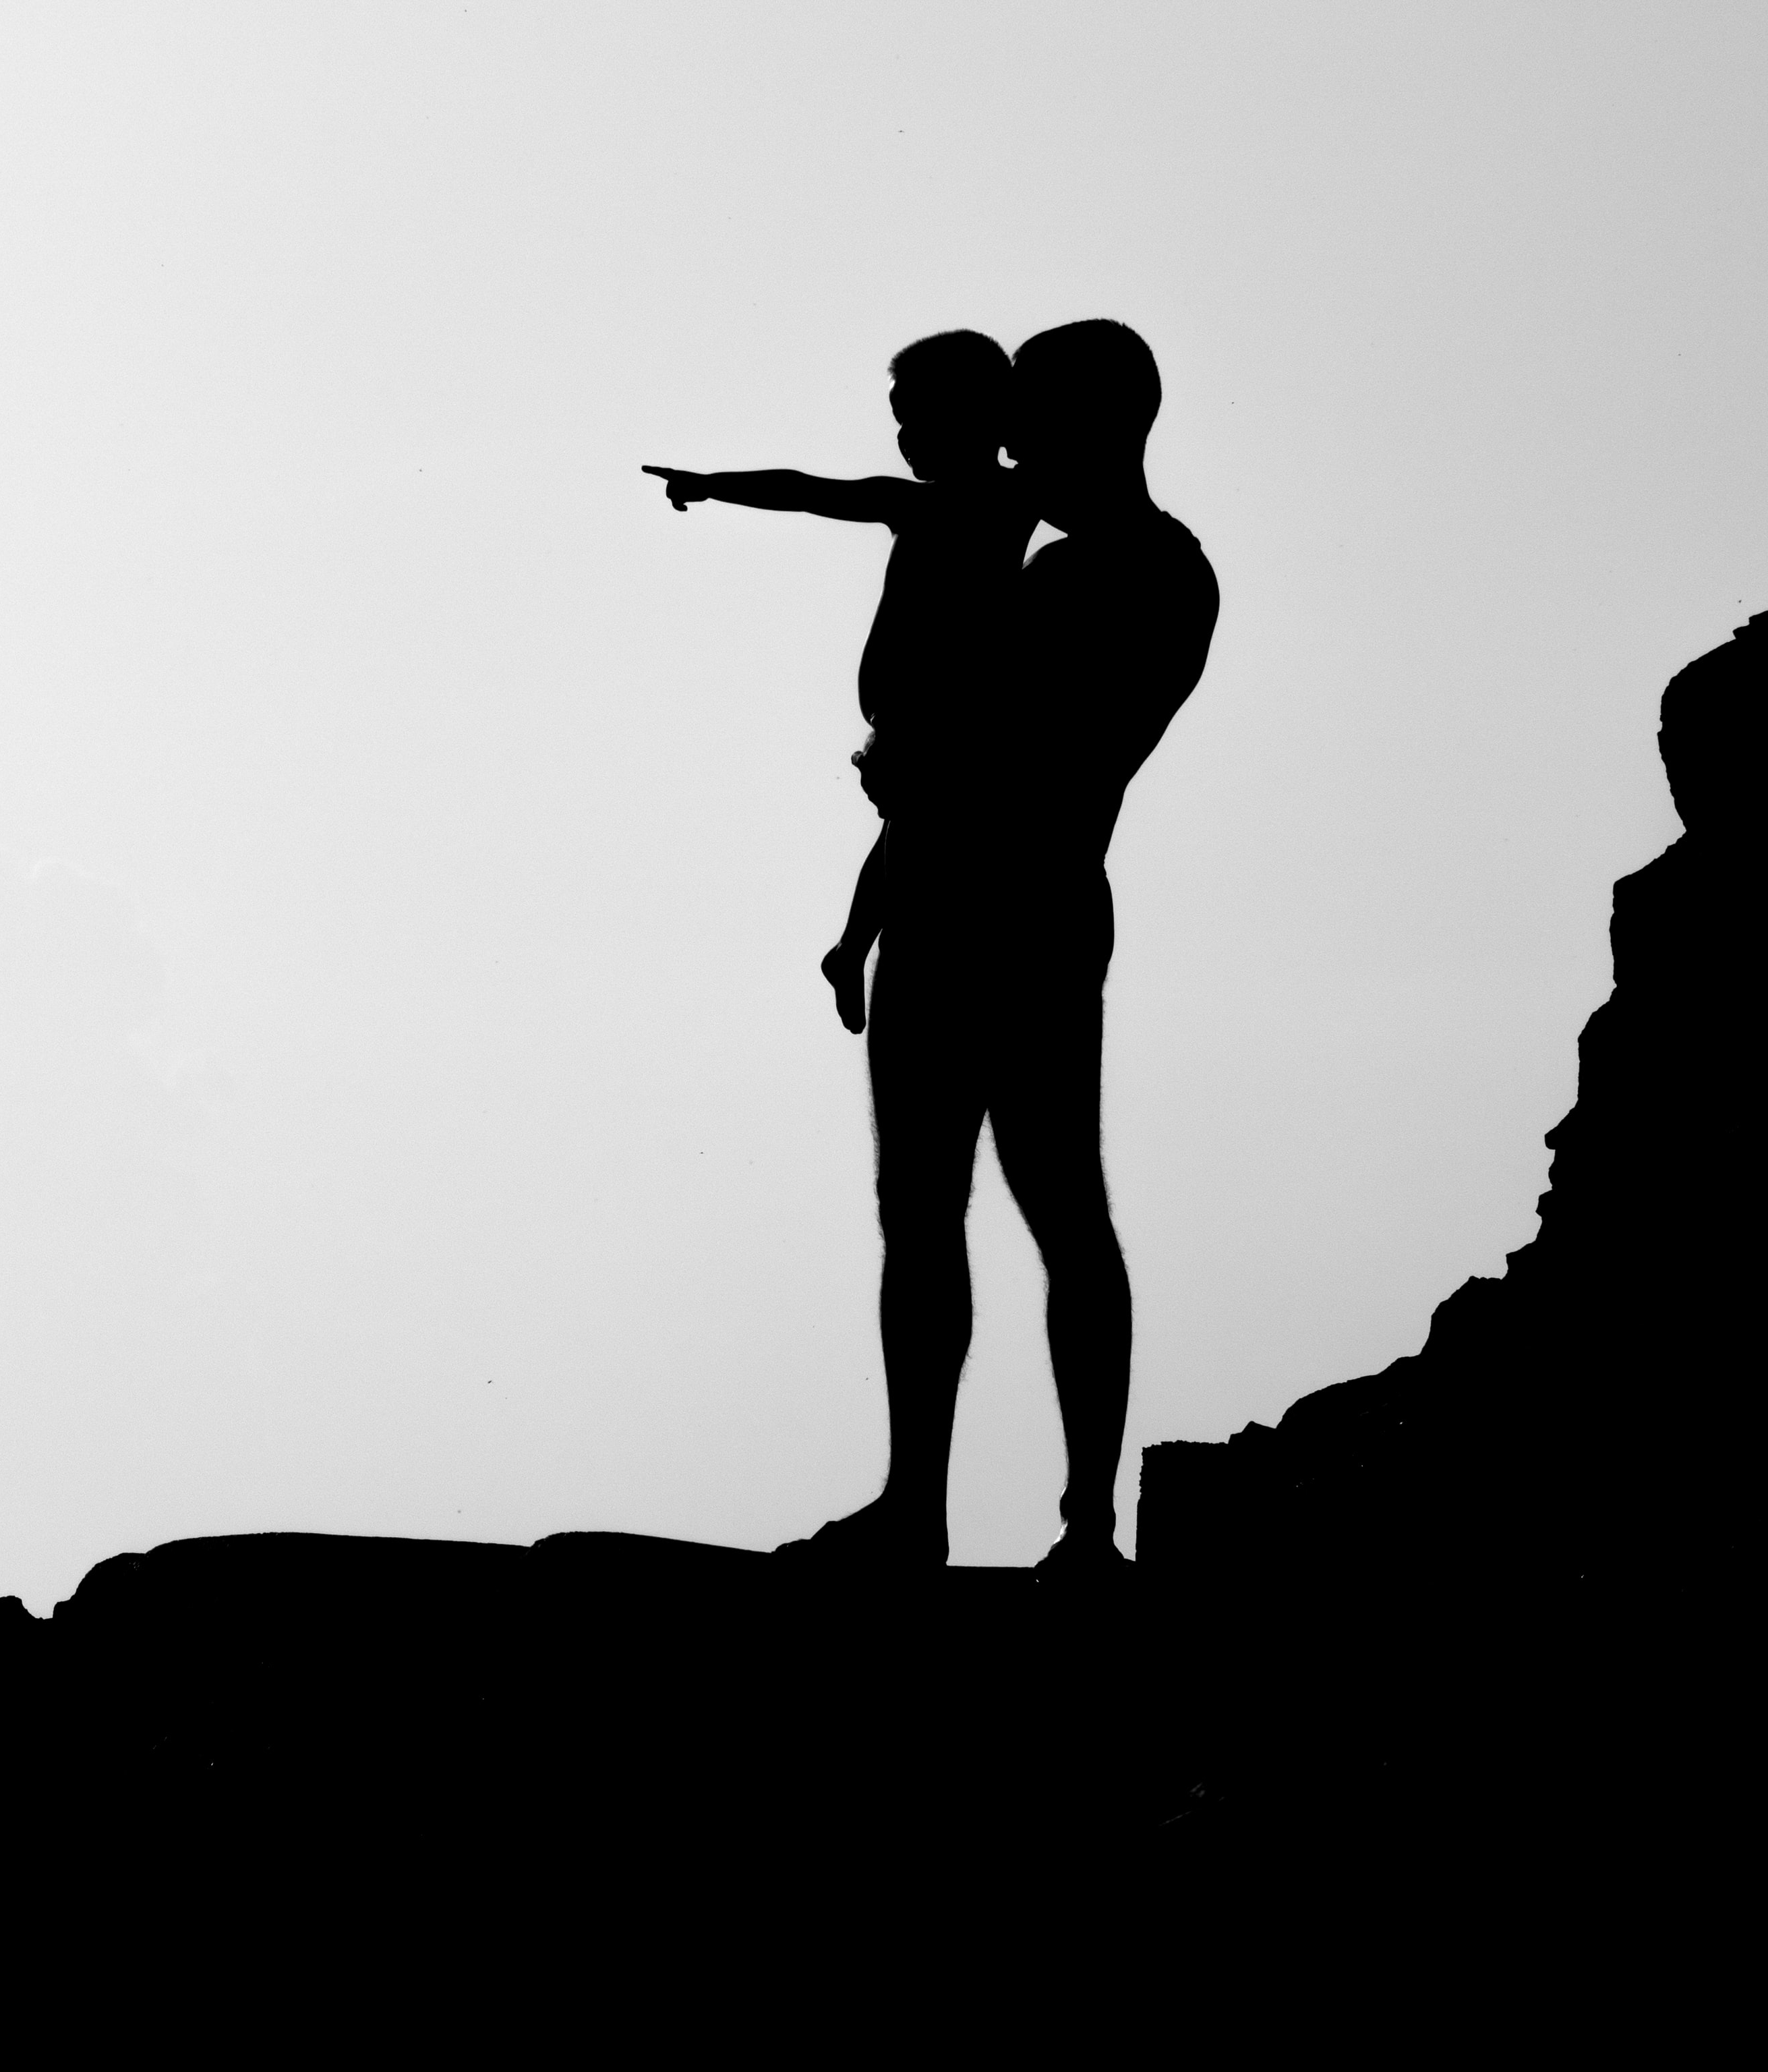
WAY OF DISCIPLESHIP:
BECOMING LIKE CHRIST
Confession: What does it do?
Greater closeness to God, opening us up to God working in our lives
It deals with pride and brings psychological wholeness
It rebels against individualism by opening us up to one another and creating community
“Sin must be brought into the light. What is unspoken is said openly and confessed. All that is secret and hidden comes to light.”
Notes:
What does it do? The purpose of the practice of confession is greater closeness to God, opening us up to God working in our lives as we are “entrusting ourselves, beyond sin, to the mercy of a loving and forgiving God.” (Pope John Paul II) It deals with pride and brings psychological wholeness… “it breaks the build up of shame within which happens when we hoard our mistakes and keep them to ourselves. The fear of rejection gets shattered when we sit in front of someone and get to hear the sweet words, “You are forgiven.”” (KXC website). It rebels against individualism by opening us up to one another and creating community. It helps us acknowledge that our behaviours have consequences while healing the “loneliness of sin”. “Sin wants to be alone with people. It takes them away from the community. The more lonely people become, the more destructive the power of sin over them. The more deeply they become entangled in it, the more unholy is their loneliness. Sin wants to remain unknown. It shuns the light. In the darkness of what is left unsaid sin poisons the whole being of a person… In confession the light of the gospel breaks into the darkness and closed isolation of the heart. Sin must be brought into the light. What is unspoken is said openly and confessed. All that is secret and hidden comes to light.” (Dietrich Bonhoeffer)

