Slide 1
WAY OF DISCIPLESHIP:
BECOMING LIKE CHRIST
OPENING WORSHIP
Lord, let me seek you in desiring you,
And desire you in seeking you.
Let me find you by loving you,
And love you in finding you.
Amen
Anselm

Slide 2
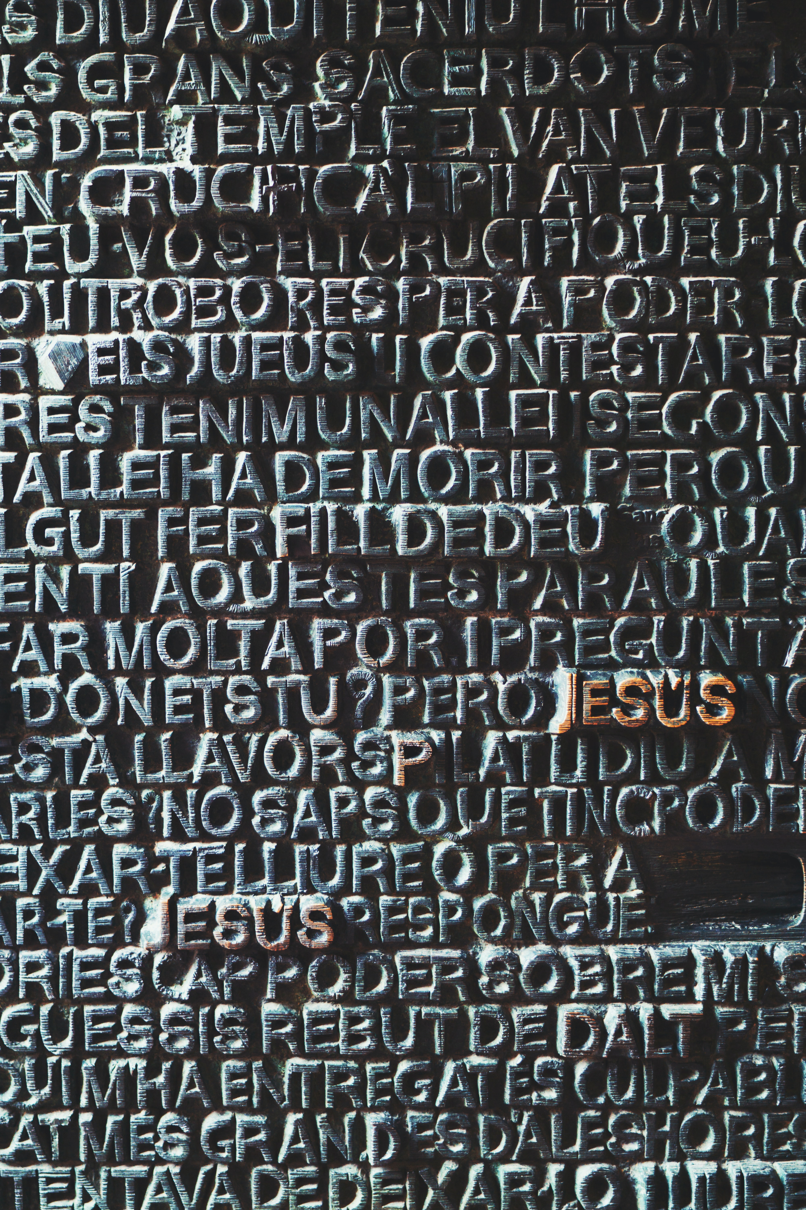
WAY OF DISCIPLESHIP:
BECOMING LIKE CHRIST
AIMS OF TONIGHT’S SESSION (1)
To understand why imitating Christ is at the heart of discipleship.
To have a sense of all four gospels and the different perspectives they offer.
To understand how Jesus reveals the character of God, and the significance of Him being fully God and fully human.
To understand how Jesus fulfils the story of the Old Testament.
To understand the nature of God’s kingdom and how that shapes us in becoming like Christ.
To reflect on the pattern of Jesus’ relationships and how that shapes a spiritually healthy life.

Slide 3
WAY OF DISCIPLESHIP:
BECOMING LIKE CHRIST
CLOSING PRAYER
Colossians 1: 15-17: The Son is the image of the invisible God, the firstborn over all creation. For in him all things were created: things in heaven and on earth, visible and invisible, whether thrones or powers or rulers or authorities; all things have been created through him and for him. He is before all things, and in him all things hold together.

Slide 4
WAY OF DISCIPLESHIP:
BECOMING LIKE CHRIST
CLOSING PRAYER
If Christ is with me, whom shall I fear? Though the waves and the sea and the anger of princes are roused against me, they are less to me than a spider’s web. For I always say “Lord, your will be done”; not what this fellow or that would have me do, but what you want me to do. That is my strong tower, my immovable rock, my staff that never gives way.
John Chrysostom.

