Slide 1
WAY OF DISCIPLESHIP:
BECOMING LIKE CHRIST
OPENING WORSHIP
John 3:16-17: 16 For God so loved the world that he gave his one and only Son, that whoever believes in him shall not perish but have eternal life. 17 For God did not send his Son into the world to condemn the world, but to save the world through him.

Slide 2
WAY OF DISCIPLESHIP:
BECOMING LIKE CHRIST
OPENING WORSHIP
We pray for strength to follow Jesus. Saviour, we hear your call.
Help us to follow.
Jesus said: ‘Happy are the humble; they will receive what God has promised.’ Saviour, we hear your call. Help us to follow.
Jesus said: ‘Be merciful as your Father is merciful; love your enemies and do good to them.’ Saviour, we hear your call.
Help us to follow.

Slide 3
WAY OF DISCIPLESHIP:
BECOMING LIKE CHRIST
OPENING WORSHIP
Jesus said: ‘Love one another, as I love you; there is no greater love than this, to lay down your life for your friends.’ Saviour, we hear your call.
Help us to follow.
Jesus said: ‘Go to people everywhere and make them my disciples, and I will be with you always, to the end of time.’ Saviour, we hear your call.
Help us to follow.

Slide 4
WAY OF DISCIPLESHIP:
BECOMING LIKE CHRIST
OPENING WORSHIP
God of mercy, you know us and love us and hear our prayer. Keep us in the eternal fellowship of Jesus Christ our Saviour.
Amen.

Slide 5
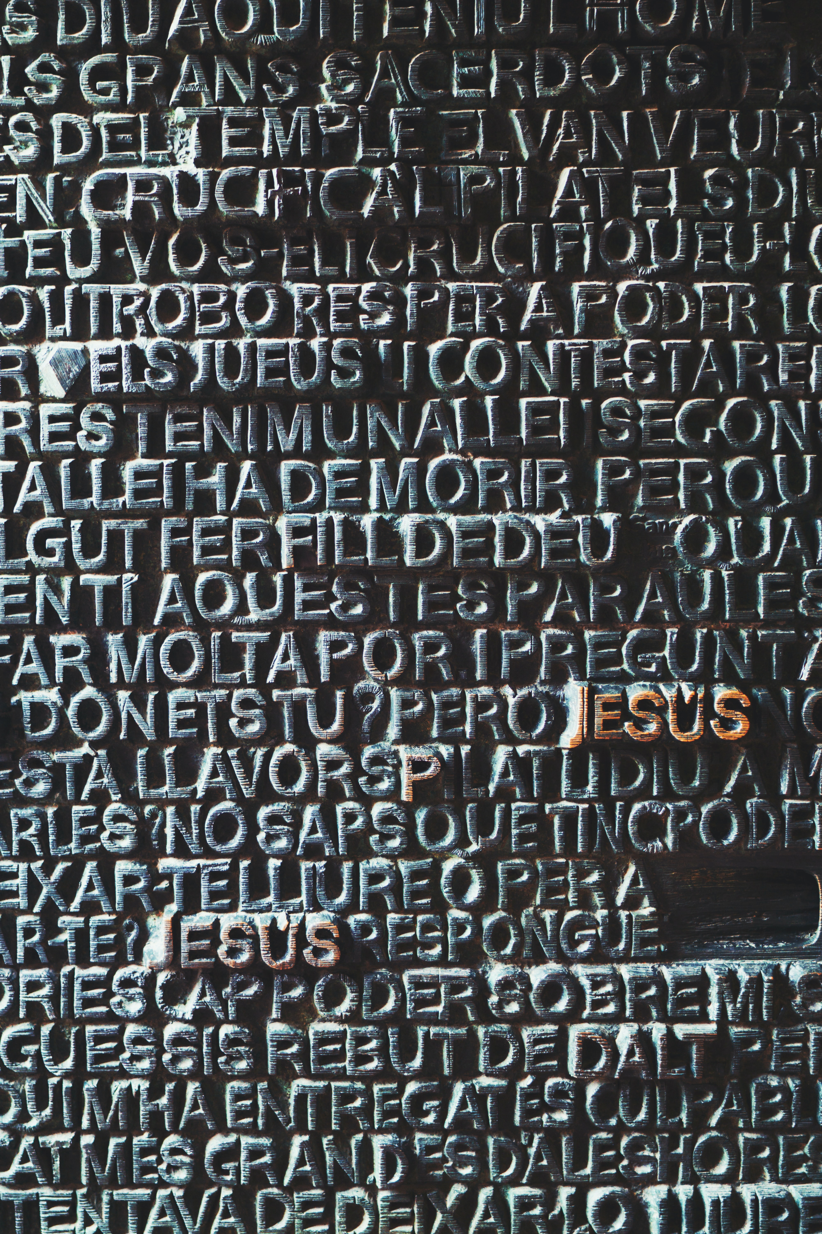
WAY OF DISCIPLESHIP:
BECOMING LIKE CHRIST
AIMS OF TONIGHT’S SESSION (2)
To reflect on the meaning of God’s holiness and the reality of sin.
To understand the nature of salvation – personal and cosmic.
To understand how I receive salvation in my lived experience.
To understand how God is involved in the work of the cross.
To grow in the practice of confession.

Slide 6
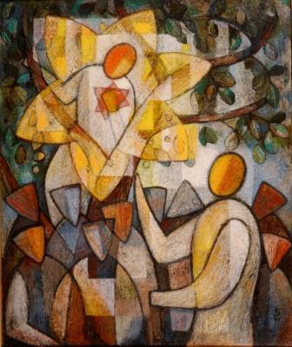
WAY OF DISCIPLESHIP:
BECOMING LIKE CHRIST
DISCOVERY BIBLE STUDY PASSAGE
Luke 19
Jesus entered Jericho and was passing through. 2 A man was there by the name of Zacchaeus; he was a chief tax collector and was wealthy. 3 He wanted to see who Jesus was, but because he was short he could not see over the crowd. 4 So he ran ahead and climbed a sycamore-fig tree to see him, since Jesus was coming that way. 5 When Jesus reached the spot, he looked up and said to him, “Zacchaeus, come down immediately. I must stay at your house today.” 6 So he came down at once and welcomed him gladly.

Slide 7
WAY OF DISCIPLESHIP:
BECOMING LIKE CHRIST
DISCOVERY BIBLE STUDY PASSAGE
Luke 19
7 All the people saw this and began to mutter, “He has gone to be the guest of a sinner.”
8 But Zacchaeus stood up and said to the Lord, “Look, Lord! Here and now I give half of my possessions to the poor, and if I have cheated anybody out of anything, I will pay back four times the amount.”
9 Jesus said to him, “Today salvation has come to this house, because this man, too, is a son of Abraham. 10 For the Son of Man came to seek and to save the lost.”

Slide 8
WAY OF DISCIPLESHIP:
BECOMING LIKE CHRIST
DISCOVERY BIBLE STUDY QUESTIONS
What do we learn about God?
What do we learn about humanity?
What does this passage say about obedience?
In the light of what we now know about this passage, what is God calling you to do? (I will……..)
Who might you share this story with this week?

Slide 9
WAY OF DISCIPLESHIP:
BECOMING LIKE CHRIST
CLOSING PRAYER
Psalm 103: 10–12:
“He does not treat us as our sins deserve or repay us according to our iniquities. For as high as the heavens are above the earth, so great is his love for those who fear him; as far as the east is from the west, so far has he removed our transgressions from us.”

