Slide 1
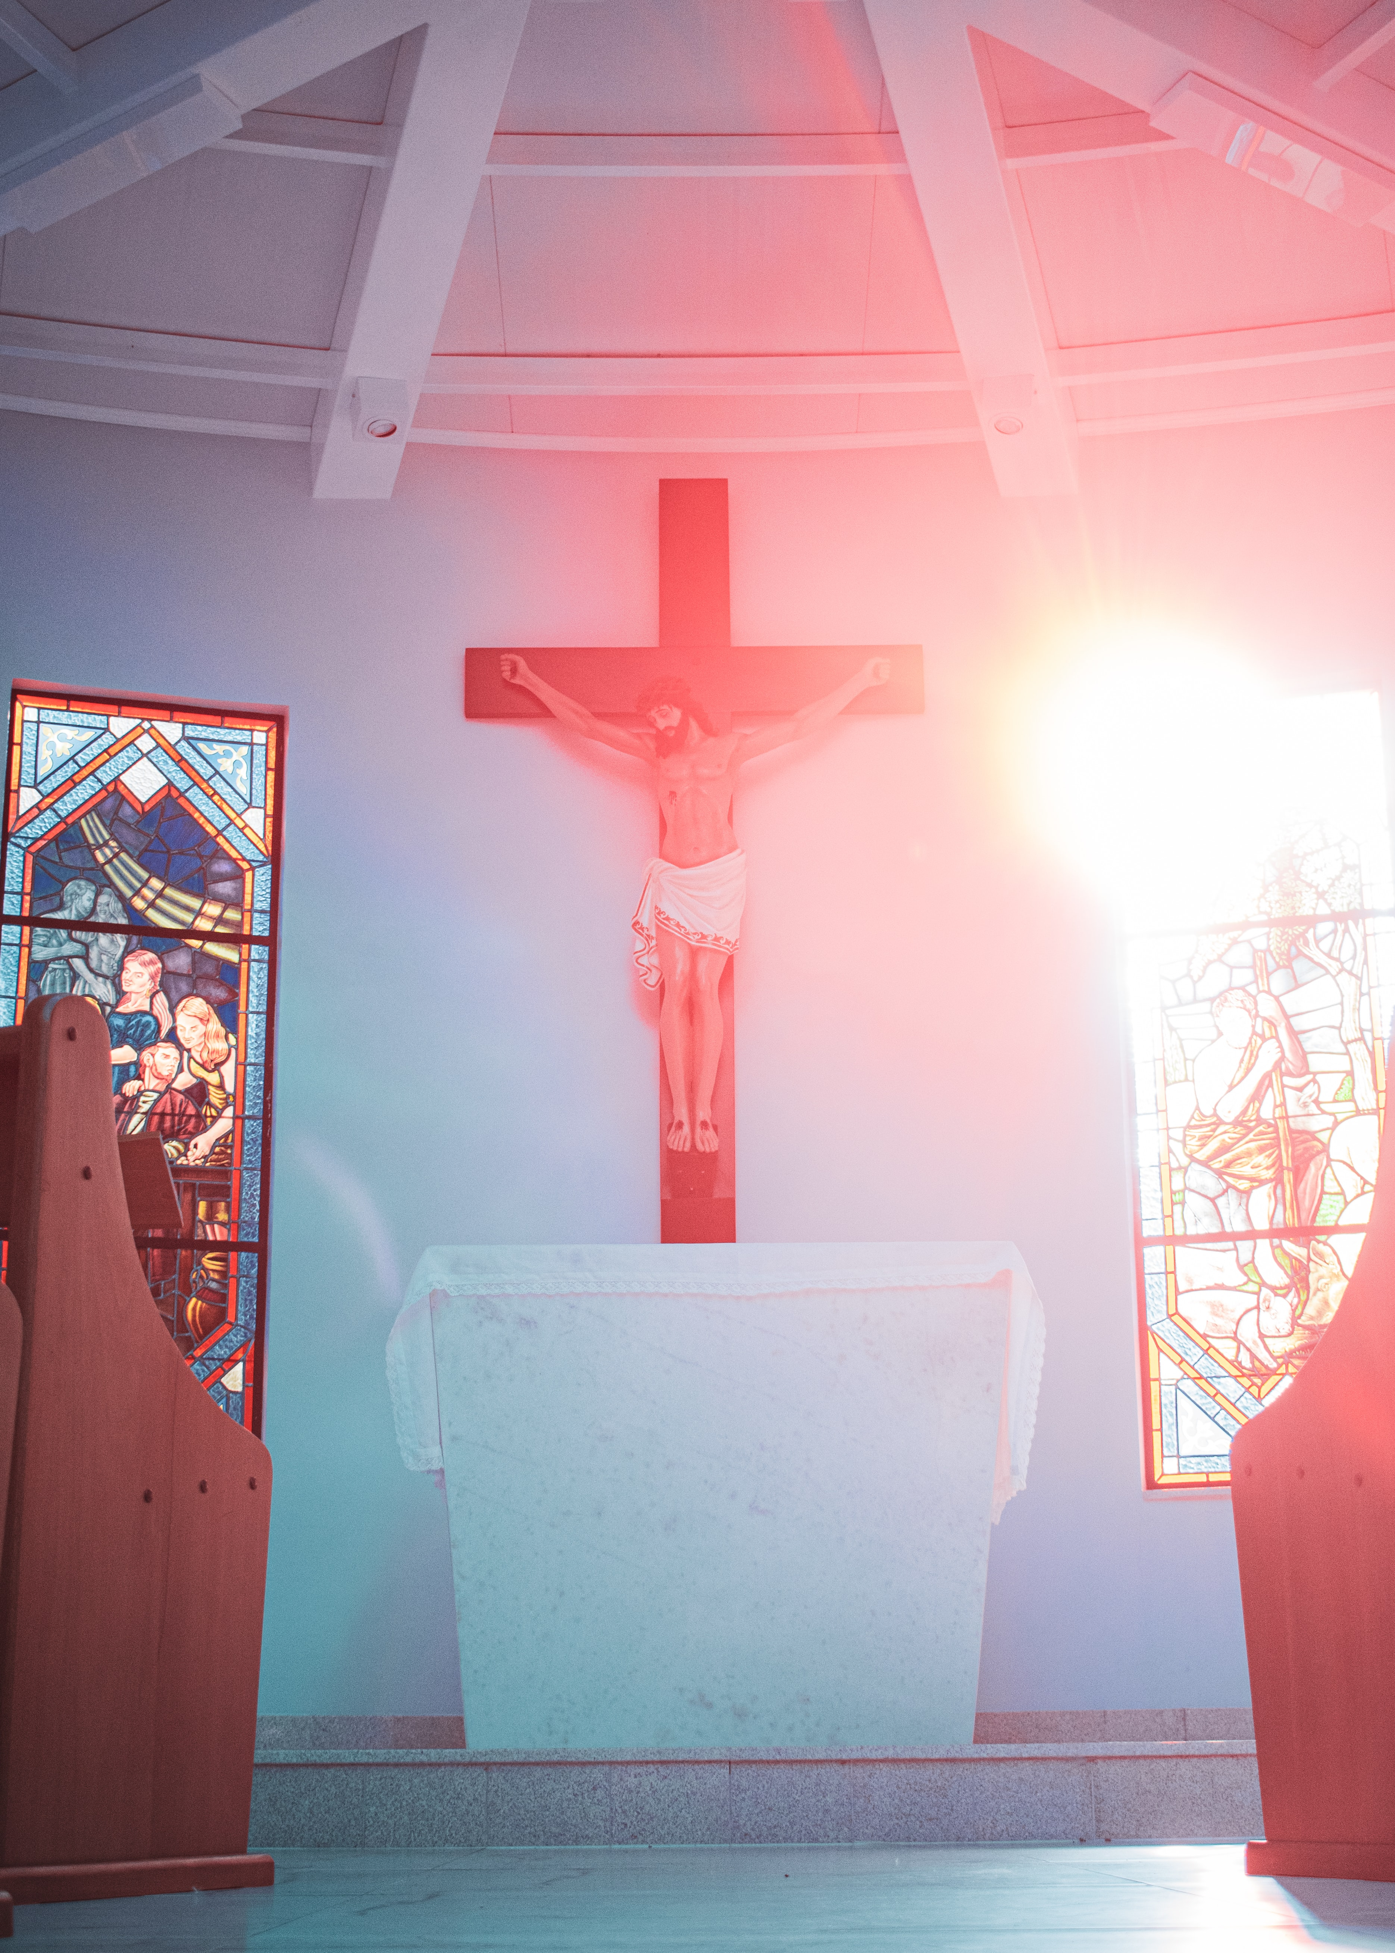
WAY OF DISCIPLESHIP:
BECOMING LIKE CHRIST
WAY OF DISCIPLESHIP: BECOMING LIKE CHRIST:
BECOMING LIKE CHRIST IN MY RELATIONSHIPS AND CHARACTER – CHOOSING SELF-GIVING LOVE OVER WORLDLY POWER.

Slide 2
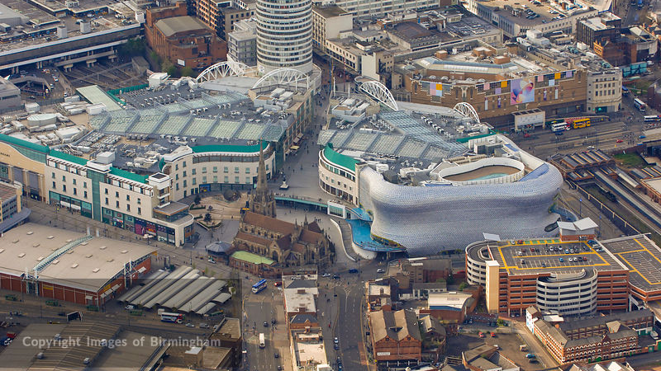
WAY OF DISCIPLESHIP:
BECOMING LIKE CHRIST
What is Christian character?

Slide 3
WAY OF DISCIPLESHIP:
BECOMING LIKE CHRIST
Becoming like Christ is not just what we choose to do, but who we are.
He is a person of “love, joy, peace, patience, kindness, goodness, faithfulness, gentleness and self-control.”
“And over all these virtues put on love, which binds them all together in perfect unity.”
Notes:
Becoming like Christ is not just what we choose to do, but who we are. Whether we are Christian disciples or not, we are all becoming someone, and our characters are being shaped in some way by those who influence us.
But what is Christ’s character? What should we be growing into becoming? In the gospels Jesus is gentle: “Let the little children come to me…” (Mark 10:14) and compassionate to the woman caught in adultery (John 8:4), but He is also sometimes angry and challenging - passionately opposed to injustice: “You hypocrites!” (Matthew 15:7) and unafraid turn over tables in the temple. (John 2:15) He combines love and justice.
There are various lists of character qualities in the New Testament. The “fruit of the Spirit” is the clearest summary of Jesus’ character. He is a person of “love, joy, peace, patience, kindness, goodness, faithfulness, gentleness and self-control.” (Galatians 5:22-23) In Colossians Paul gives another description: “…clothe yourselves with compassion, kindness, humility, gentleness and patience…forgive one another….” (Colossians 3: 12-13).
How can we helpfully summarize all these Christlike qualities? The New Testament says they all spring from one source: “And over all these virtues put on love, which binds them all together in perfect unity.” (Colossians 2: 14).
The command to love God and your neighbour is the greatest command, encompassing all others (Luke 10:27) “…whoever loves others has fulfilled the law.” (Romans13:8) “The only thing that counts is faith expressing itself through love.” (Galatians 5:6).
But this begs the question…

Slide 4
WAY OF DISCIPLESHIP:
BECOMING LIKE CHRIST
What is love?

Slide 5
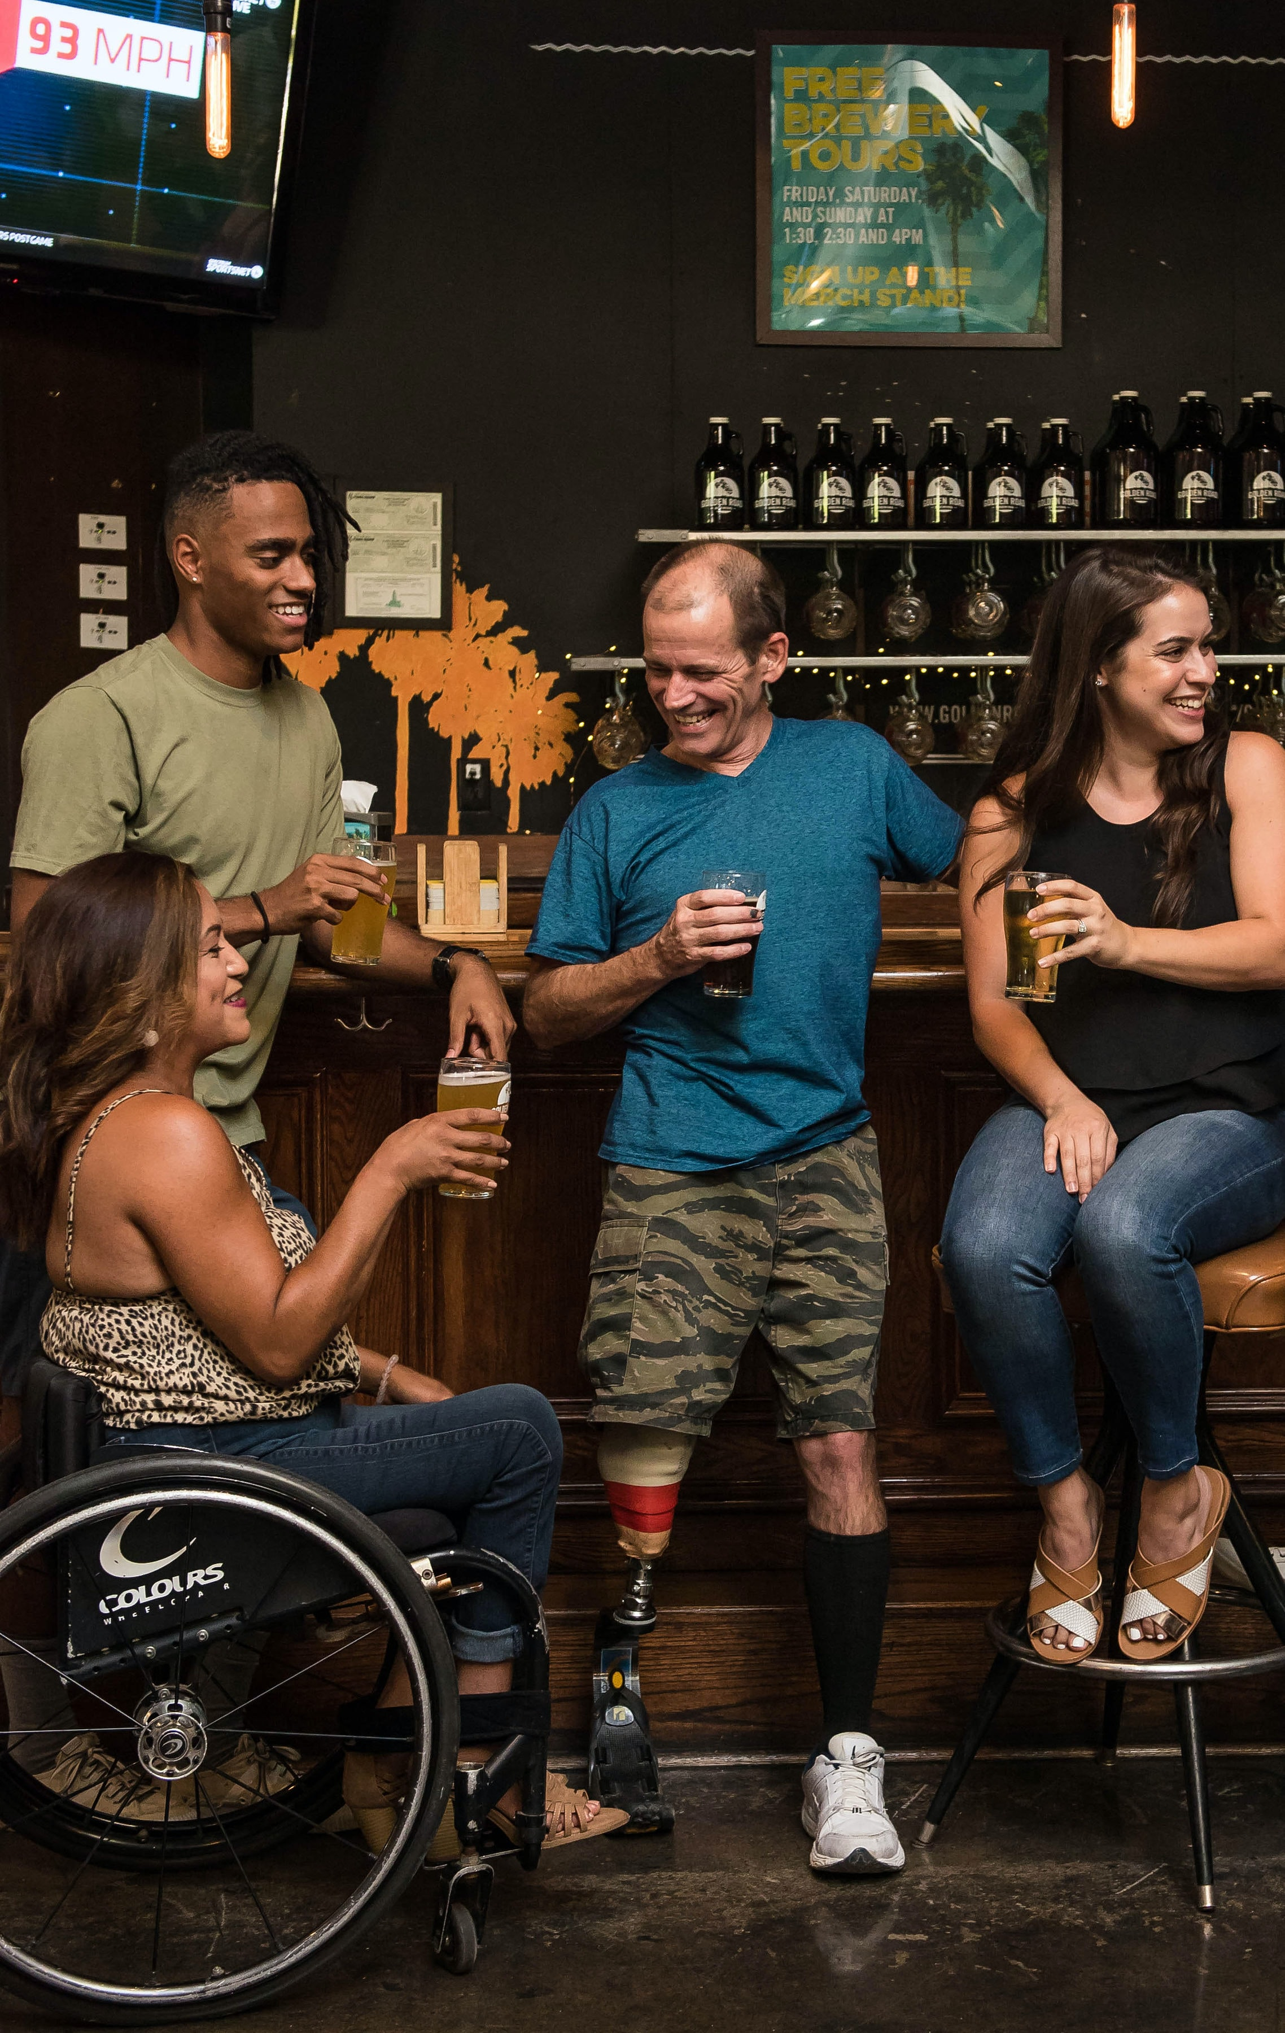
WAY OF DISCIPLESHIP:
BECOMING LIKE CHRIST
“This is how we know what love is…”
Four words for love:
Looking AT someone or something and finding them attractive in some way. storge
Looking WITH someone – sharing purpose or values.. philia
Looking INTO someone – intimacy, soul touching soul.. eros
Notes:
The Bible says, “This is how we know what love is…” While there are things about God that we rightly cannot understand, the covenant love that God is, and which He wants us to be shaped by, has been fully revealed.
There are different ways to understand love, and so its power can be misunderstood, but the Bible offers four words (in the New Testament Greek) which we can compare to help us fully understand the nature of God’s love. The writer C.S. Lewis explored these in a book entitled “The Four Loves”.
There is the kind of love that looks AT someone or something and finds them attractive in some way. (I love your hair/your car/your smile.) (The Greek word for this is storge).
There is the kind of love that looks at life WITH someone, sharing friendship, a sense of purpose and values. (I love your opinions/outlook/the way you see life.) (The Greek word for this is philia).
There is the kind of love that looks INTO someone – the love of intimacy, soul touching soul. (The Greek word for this is eros).

Slide 6
WAY OF DISCIPLESHIP:
BECOMING LIKE CHRIST
“This is how we know what love is: Jesus Christ laid down His life for us.” (1 John 3:16)
Agape –Jesus dying for us. It is the kind of love that bears the cost of emptying itself on behalf of others.
Agape is blind: because it has nothing to do with “looking” for qualities in other people.
Agape sees: a choice at the centre of who we are to see other people as those who were worth Christ dying for. It is blind to others’ qualities but sees beyond those to view them through the lens of how God sees them.
Notes:
While all these things are good gifts, when the Bible defines the love of Christlike character it uses a different word. And it does not give us an abstract definition of this kind of love, but says, “This is how we know what love is: Jesus Christ laid down His life for us.” (1 John 3:16).
The Greek word for love here is agape – and we see it demonstrated in Jesus dying for us. It is the kind of love that bears the cost of emptying itself on behalf of others.
Agape is blind: Unlike storge (looking at) philia (looking with) or eros (looking into) it is blind because it has nothing to do with “looking” for qualities in other people. The first three can come and go depending on the relationship – you can fall in or out of storge, philia or eros.
But it was while “we were still sinners” that Christ died for us (Romans 5:8) – His agape gave at cost to itself without looking at the merits, or otherwise, of the other He was dying for.
Agape sees: Ultimately, agape is a choice at the centre of who we are to see other people as those who were worth Christ dying for. In terms of loving people, it is blind to their qualities but sees beyond those to view them through the lens of how God sees them. To do this is how the Bible defines love.

Slide 7
WAY OF DISCIPLESHIP:
BECOMING LIKE CHRIST
How is the cross the greatest revelation of God’s character and love?

Slide 8
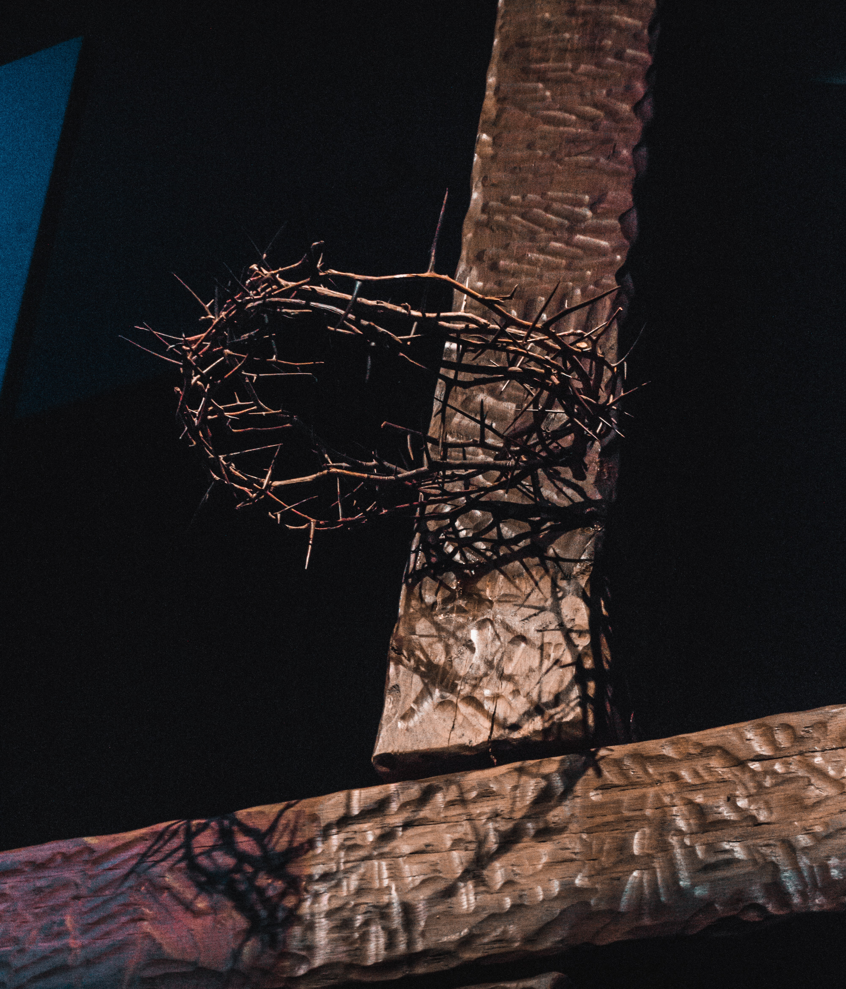
WAY OF DISCIPLESHIP:
BECOMING LIKE CHRIST
The depth of love one has for a beloved can be measured by the sacrifice the lover is willing to make for the beloved.
“Be imitators of God. Live in love as Christ loved us and gave himself for us…” (Ephesians 5:1-2)
Notes:
The depth of love one has for a beloved can be measured by the sacrifice the lover is willing to make for the beloved. This is the fullest picture we have of the nature of God’s character and love which overflows to us.
Theologian Jurgen Moltmann puts it like this:
“When the crucified Jesus is called the ‘image of the invisible God’, the meaning is that THIS is God, and God is like THIS. God is not greater than he is in this humiliation. God is not more glorious than he is in this self-surrender. God is not more powerful than he is in this helplessness. God is not more divine than he is in this humanity.”
To become like Christ is to grow in this self-sacrificial agape, being willing to go as far in love towards others as He does. Paul says, “Be imitators of God. Live in love as Christ loved us and gave himself for us…” (Ephesians 5:1-2).

Slide 9
WAY OF DISCIPLESHIP:
BECOMING LIKE CHRIST
What does this show about the main way God works in the world?

Slide 10
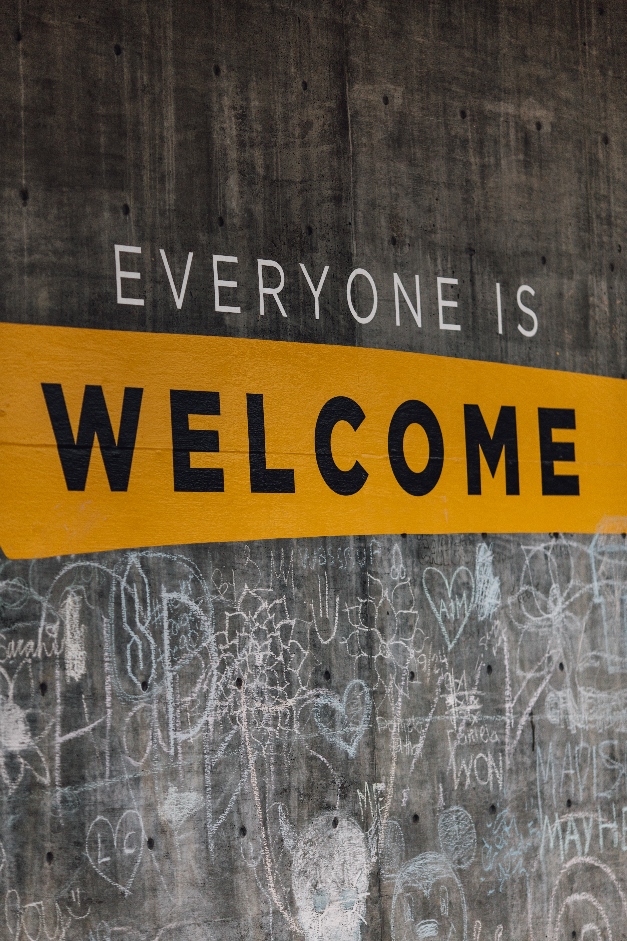
WAY OF DISCIPLESHIP:
BECOMING LIKE CHRIST
In every aspect of Jesus’ life brought in God’s kingdom and pushed against the way evil had warped the world with precisely the same kind of agape He demonstrated on the cross.
Against the powers of religious legalism and tradition by lovingly and radically welcoming prostitutes and sinners, and healing on the Sabbath.
He resisted the powers of racism and the way people are marginalized by speaking well of outsiders like Samaritans and compassionately touching lepers.
He overcame the sexism of the patriarchy of His time by treating women with dignity and respect.
Everything in His life was a beautiful anticipation of the cross, defying evil with love while taking no earthly power for Himself.
Notes:
While Jesus’ death was the fullest expression of God’s power, everything He did led up to it and was part of it. In every aspect of His life brought in God’s kingdom and pushed against the way evil had warped the world with precisely the same kind of agape He demonstrated on the cross.
He pushed back against the powers of religious legalism and tradition by lovingly and radically welcoming prostitutes and sinners, and healing on the Sabbath.
He resisted the powers of racism and the way people are marginalized by speaking well of outsiders like Samaritans and compassionately touching lepers.
He overcame the sexism of the patriarchy of His time by treating women with dignity and respect.
Everything in His life was a beautiful anticipation of the cross, defying evil with love while taking no earthly power for Himself.

Slide 11
WAY OF DISCIPLESHIP:
BECOMING LIKE CHRIST
How should this make Christian love distinctive?

Slide 12
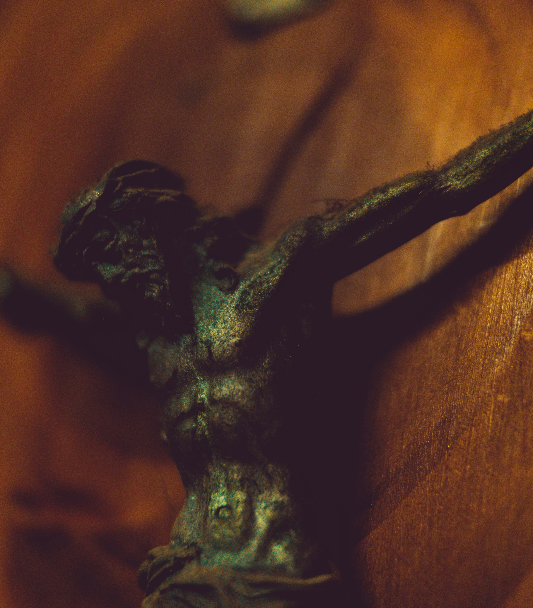
WAY OF DISCIPLESHIP:
BECOMING LIKE CHRIST
What makes Christian love distinctive is choosing to act for the good for others whether they can repay you or not or whether they love you back or not.
The true hallmark of becoming like Christ is in our capacity to love our enemies
Self-sacrificial agape is a “weapon” because it stops us from becoming similarly evil and instead overcomes evil with good.
Notes:
Cross-shaped agape for people means that what often makes Christian love distinctive is choosing to act for the good for others whether they can repay you or not, whether you storge, philia or eros them or not, or whether they love you back or not.
Even further than that, the true hallmark of becoming like Christ is in our capacity to love our enemies – giving worth to them not because of what they do, but because of their true value as those Christ was willing to die for. Our enemies are not only those who do not love us, but even those who actively oppose us.
As Jesus says, “If you love those who love you, what credit is that to you? Even sinners love those who love them. And if you do good to those who are good to you, what credit is that to you? Even sinners do that. And if you lend to those from whom you expect repayment, what credit is that to you? Even sinners lend to sinners, expecting to be repaid in full.
But love your enemies, do good to them, and lend to them without expecting to get anything back. Then your reward will be great, and you will be children of the Most High, because he is kind to the ungrateful and wicked. Be merciful, just as your Father is merciful.”
Being able to love even our enemies is the jewel of what it means to become like Jesus Christ in our character.
“But to you who are listening I say: Love your enemies, do good to those who hate you, bless those who curse you, pray for those who mistreat you. If someone slaps you on one cheek, turn to them the other also. If someone takes your coat, do not withhold your shirt from them…do not resist an evil person…pray for those who persecute you…” (Luke 6:27-28; Matthew 5 39 and 44).
It is important to know that Jesus is not telling us to be passive in the face of evil. Rather, He is showing us the most powerful way that evil can be truly resisted.
Self-sacrificial agape is a “weapon” because it stops us from becoming similarly evil and instead overcomes evil with good. It shows evil up for what it is, breaks the cycle of people hurting one another, and is the only way of creating the opportunity for genuine change.

Slide 13
WAY OF DISCIPLESHIP:
BECOMING LIKE CHRIST
Doesn’t this make God look weak?

Slide 14
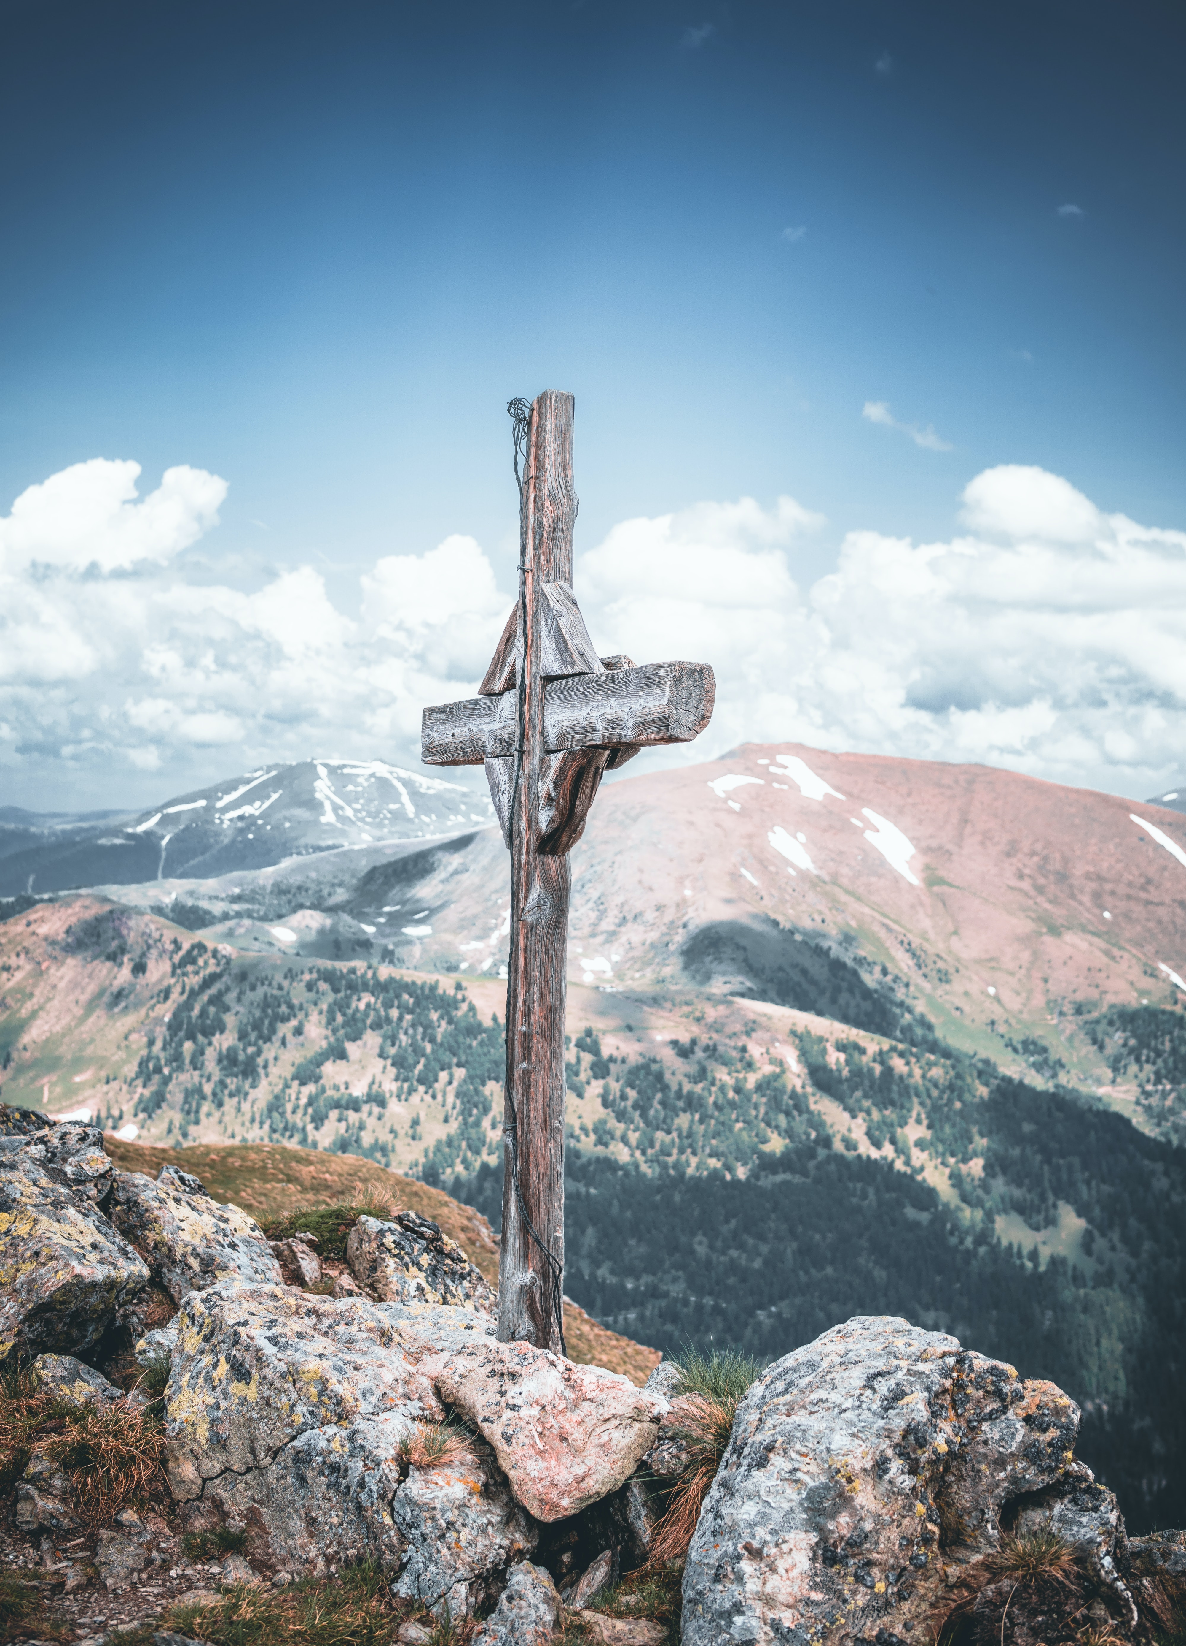
WAY OF DISCIPLESHIP:
BECOMING LIKE CHRIST
A stumbling block because it is offensive to believe that a holy, powerful God could take on sinful flesh, let alone be crucified.
Foolishness because in a world where power is so often about the ability to force your will on others, Jesus did precisely the opposite.
By becoming a crucified human being, God’s love and power are not compromised, but fully revealed.
God’s power is not restricted by being crucified, but rather He overcomes evil in the only way truly possible - through self-sacrificial love.
Notes:
From the beginning, Paul recognized that “…we preach Christ crucified: a stumbling block to Jews and foolishness to Gentiles…” A stumbling block because it is offensive to believe that a holy, powerful God could take on sinful flesh, let alone be crucified. Foolishness because in a world where power is so often about the ability to force your will on others, Jesus did precisely the opposite.
Many people in the world today continue to find the idea of a human and crucified God offensive, or even foolish for the same kind of reasons. But Paul goes on to write that “…to those whom God has called, both Jews and Greeks, Christ the power of God and the wisdom of God. For the foolishness of God is wiser than human wisdom, and the weakness of God is stronger than human strength.” (1 Corinthians 1: 24-25)
Christians believe that God is ultimately all loving and powerful, and able to work His will for the world. However, by becoming a crucified human being, God’s love and power are not compromised, but fully revealed.
God does not reveal His loving essence by imposing His will on people – any “god” can do that. God reveals the glory of His love by being willing to stoop to the furthest extreme of weakness possible.
And God’s power is not restricted by being crucified, but rather He overcomes evil in the only way truly possible - through self-sacrificial love.

Slide 15
WAY OF DISCIPLESHIP:
BECOMING LIKE CHRIST
How do I become like Christ in my relationships?

Slide 16
WAY OF DISCIPLESHIP:
BECOMING LIKE CHRIST
Including and welcoming.
“We have to love them for their own good, not for the good we get out of them.”
Not judging.
The agape love of Christ on the cross gives us the most powerful way to stop judging others.
Honouring.
Expressing in the most vulnerable way possible the complete God-given worth of the other person
Notes:
Including and welcoming.
Those who are truly welcomed and included in God’s kingdom, the truly “well off”, are the people who feel on the edge spiritually, those who feel wretched, or who can’t stand up for themselves, or who are starving for things to be put right, or who long to do right, or who don’t fight back, or who are ostracized.
This was an upside-down order of things. But as we grow in Christ’s agape love, like Him we will become the kind of people who notice and invite those who are at the bottom of the world’s pile. The monk Thomas Merton said a key to this is loving a person in such a way that we are “able to see things as he sees them, love what he loves, experience the deeper realities of his own life as if they were our own.” The more we can do this, the more we will love someone “for what he is in himself, and not for what he is to us. We have to love him for his own good, not for the good we get out of him.”
Practically this might be expressed the more we can reach out to those who cannot repay us.
Not judging.
In making a judgement on others we are imitating the first way humans disobeyed God. Rather than letting God be the judge of what is good and what is bad, the story of Adam and Eve eating the fruit of the “knowledge of good and evil” paints a picture of human beings who want to be those who can judge for themselves. Rather than looking at life, and others, as God does, we take on that “godlike” role for ourselves.
But the more God becomes king in our lives, the more we will let go of the right to judge others. Jesus is clear: “Do not judge…” (Matthew 7:1). Yet we live at a time when, as well as our own internal habits of assessing others for their opinions, looks, tastes, the polarized external chatter in which people judge one another is constantly in front of us.
The agape love of Christ on the cross gives us the most powerful way to stop judging others. It first reminds us to see ourselves as those who have been forgiven and accepted by God. Being realistic about ourselves is the first step away from a judgemental character. “How can you say to your brother, ‘Let me take the speck out of your eye,’ when all the time there is a plank in your own eye? You hypocrite, first take the plank out of your own eye, and then you will see clearly to remove the speck from your brother’s eye.” (Matthew 7:4-5)
Practically this might mean first of all noticing when we are being judgemental of others, remembering God’s grace to us, and choosing to see them as God sees them.
Honouring.
To honour someone means affirming their God-given worth in such a way that we help draw out the goodness in them, to deliberately treat them as Christ.
Agape love and honour are the foundations for the most intimate relationships of all. For example, in the Bible the context for the beautiful gift of sex is portrayed as being for the sealing of a covenant relationship in which two people self-sacrificially honour each other completely, becoming “one flesh”.
A sexual relationship centred on agape and honour makes sex into something in which two people put the other first. They honour one another by expressing in the most vulnerable way possible the complete God-given worth of the other person. Sex without honour and agape loses the purpose for which it was made when God said, “It is very good.”
Practically this will mean that we love people in a Christlike way the more our first priority is to honour them by showing them what they are worth to God.

Slide 17
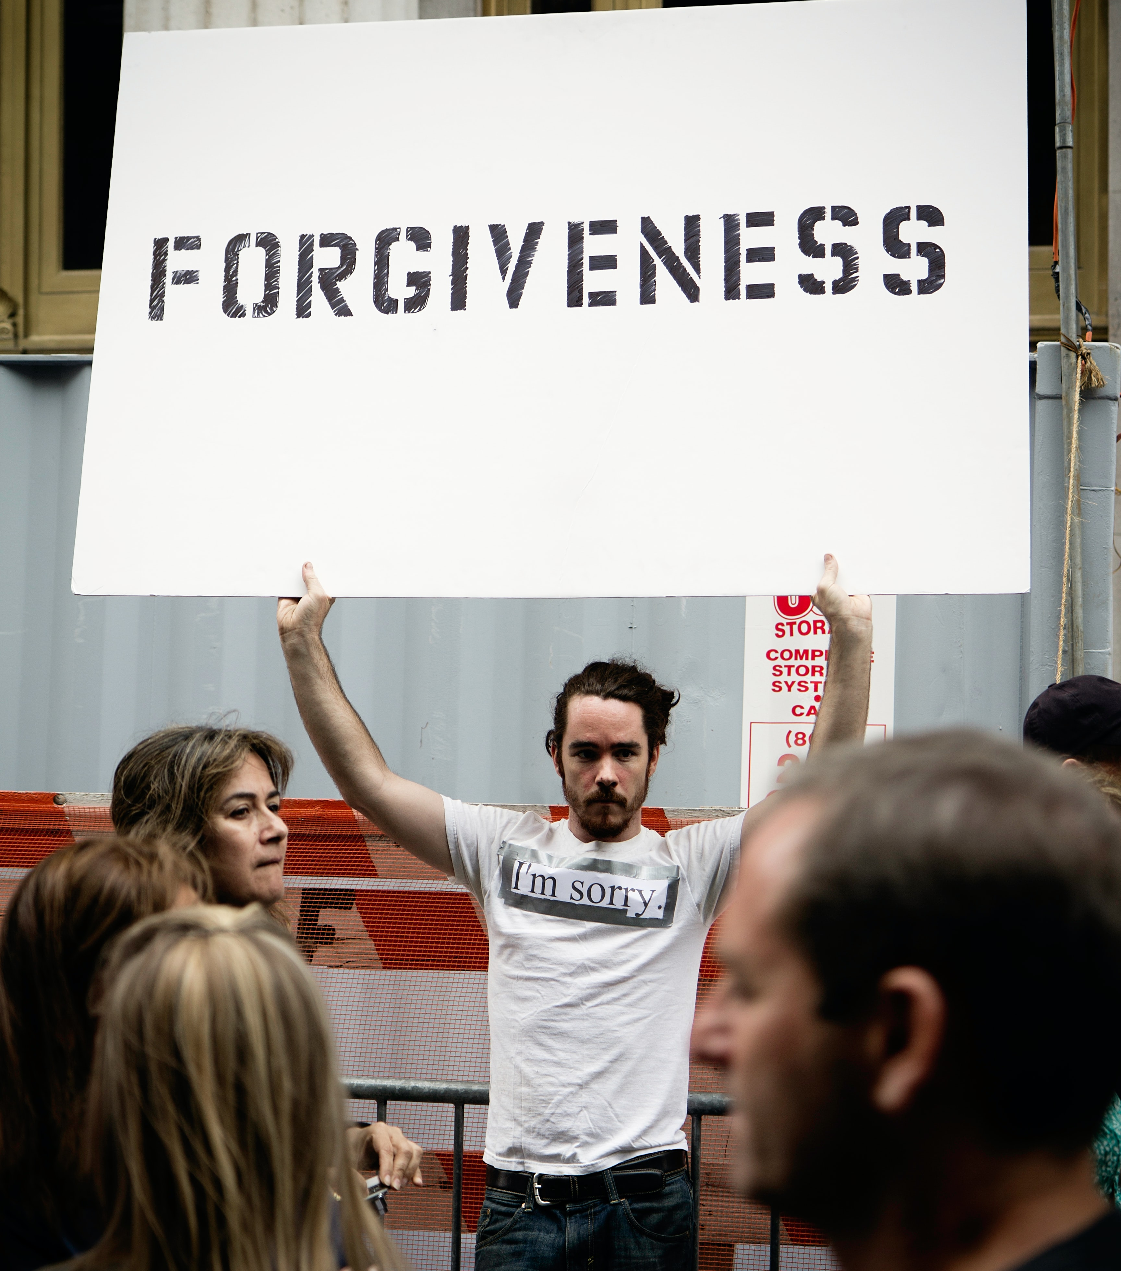
WAY OF DISCIPLESHIP:
BECOMING LIKE CHRIST
Forgiving.
Jesus and Paul always link our ability to forgive others with knowing how much we have been forgiven.
Coming against things in the opposite spirit.
This will mean checking our first “fight or flight” reaction, and asking, “What is the opposite reaction to what I am experiencing?”
Notes:
Forgiving.
At the centre of the Lord’s prayer is the sentence, “Forgive us our sins as we forgive those who sin against us.” As hard as forgiving people can be (and it is often a journey we need to help each other with) Jesus said that there should be no limit on how much we forgive others. Peter suggests forgiving people up to seven times (thinking he is being generous). But Jesus’ replies, “I tell you, not seven times, but seventy-seven times.” (Matthew 18:21-22). In other words, always.
Jesus and Paul always link our ability to forgive others with knowing how much we have been forgiven. “Be kind and compassionate to one another, forgiving each other, just as in Christ God forgave you.” (Ephesians 4: 32).
Practically this will always mean when we are seeking to forgive others that we always start by looking at ourselves first.
Coming against things in the opposite spirit.
In some forms of martial art the way you defeat your enemy is not by responding with greater aggression, but acting in such a way (for example stepping aside at the right moment) that your opponent is brought down by the force of their own attack.
In many ways this is a good picture of how agape love overcomes evil. By replying to an insult, not with another insult, but with silence, or even with blessing, the insult is robbed of its power.
Time and again, we see this in the way Jesus demonstrated love. He refused to answer back, He said that if someone slaps you on one cheek offer them the other. He allowed evil to run its course on the cross, but ultimately triumphed. As we have seen, this was not a surrender to evil, but the way of truly defeating it. Again, as Martin Luther King said, “Darkness cannot drive out darkness; only light can do that. Hate cannot drive out hate; only love can do that.”
Christlike love comes against things in the opposite spirit.
Practically if we are in a difficult relationship this will mean checking our first “fight or flight” reaction, and asking, “What is the opposite reaction to what I am experiencing?” In this way we will be becoming more like Christ.

Slide 18
WAY OF DISCIPLESHIP:
BECOMING LIKE CHRIST
How does this shape the church community?

Slide 19
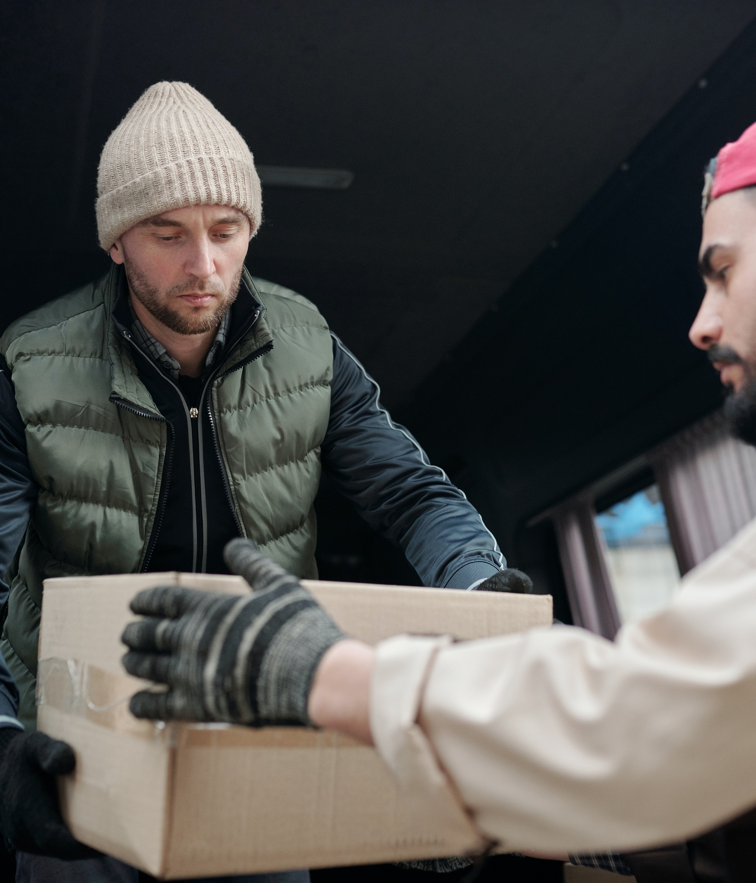
WAY OF DISCIPLESHIP:
BECOMING LIKE CHRIST
More than anything else, Jesus said people would come to see us a disciples when they see the love that we have for each other.
No hierarchy or division.
“…those parts of the body that seem to be weaker are indispensable, and the parts that we think are less honourable we treat with special honour.” (1 Corinthians 12:22-23).
Offering my gifts.
“From him the whole body…grows and builds itself up in love, as each part does its work.” (Ephesians 4:16).
Notes:
To be a church is to be filled with the same kind of agape for one another that God has shown to us: “This is love: not that we loved God, but that he loved us and sent his Son as an atoning sacrifice for our sins. Dear friends, since God so loved us, we also ought to love one another. No one has ever seen God; but if we love one another, God lives in us and his love is made complete in us.” (1 John 4: 10-12)
More than anything else, Jesus said people would come to see us a disciples when they see the love that we have for each other. He gave His final command to them at the Last Supper: “A new command I give you: Love one another. As I have loved you, so you must love one another. By this everyone will know that you are my disciples, if you love one another.” (John 13: 34-35)
The Argentinian pastor Juan Carlos Ortiz saw a radical change in his church when he preached “Love one another” until people started doing it. (See handout).
Above everything else, it is the love that disciples have for each other that reveals the love of God in the world and attracts others to the love of God.
Practically speaking, growing in agape love will be expressed in at least two important ways:
No hierarchy or division.
It is true that some roles in the church are more public than others. But in a community of agape love, no one will be more important than anyone else.
In fact, agape love which honours others will lead to those seen as least significant in human terms being given special attention. Using the picture of the church as a body, Paul writes, “…those parts of the body that seem to be weaker are indispensable, and the parts that we think are less honourable we treat with special honour.” (1 Corinthians 12:22-23).
Whereas outside the church community people might be divided up by being in this tribe, or in this social grouping, or in that gender, these have no longer have relevance in a family in which the main thing about its members are that they are “in Christ”.
With this in mind, the essential qualification for those who want to lead is a desire to be downwardly mobile. Telling a story about a wedding feast in which people often want the seat of honour, Jesus counselled us not to look for the highest place. Instead “….when you are invited, take the lowest place, so that when your host comes, he will say to you, “Friend, move up to a better place.” Then you will be honoured in the presence of all the other guests. For all those who exalt themselves will be humbled, and those who humble themselves will be exalted.” (Luke 14: 10-11)
Offering my gifts.
If there is a perceived division in the church between those at the front who are leading and the rest of the community, it can feel hard to build the equal family which Paul writes about in which each part of the body can share gifts.
Yet it is clear that every disciple is given gifts to share. “Now you are the body of Christ, and each one of you is a part of it.” (1 Corinthians 12:27) “From him the whole body, joined and held together by every supporting ligament, grows and builds itself up in love, as each part does its work.” (Ephesians 4:16). It is impossible for the church to flourish properly if only some parts are working. But there can be at least two reasons why this some don’t use their gifts.
We may not be aware of what the gifts God has given us or lack confidence.
We can encourage each other by recognising and naming the gifts we see in each other. There are many resources which help us see what our strengths are. In “The Way of Servant-Leadership” two of the sessions are focussed on helping people discover and use their gifts.
We might misunderstand humility.
There can be a false humility (or even an upside-down pride: “I don’t want to look stupid or fail”) about not being able to offer my gifts. But true humility is not thinking of yourself too little, or too much. It is the freedom that comes from not having to think about ourselves at all. The freedom to offer what we have without worrying what others will think. As we become like Christ, agape love will free us so that we can “… let your light shine before others, that they may see your good deeds” knowing that above all this will “glorify your Father in heaven.” (Matthew 5:16)

Slide 20
WAY OF DISCIPLESHIP:
BECOMING LIKE CHRIST
Can I really become the kind of Christlike person who can agape others - loving enemies and forgiving those who hurt me?

Slide 21
WAY OF DISCIPLESHIP:
BECOMING LIKE CHRIST
Genuine change happens from the inside out.
“For the mouth speaks what the heart is full of.” (Luke 6: 45).
It is through the habits we live by that we are transformed in two areas
Our minds are renewed so we see the world and people more and more as God sees them.
Our innermost selves (hearts) are changed by allowing God’s Holy Spirit to change us from the inside out.
Notes:
Genuine change happens from the inside out. While human beings “look at the outside, God looks at the heart.” (1 Samuel 16:7). In the Sermon on the Mount it is not the actions we do that matter to God, but the inner attitudes we have. Jesus taught that it is the inner person that generates our outward responses and actions. “A good man brings good things out of the good stored up in his heart, and an evil man brings evil things out of the evil stored up in his heart. For the mouth speaks what the heart is full of.” (Luke 6: 45).
Over time he did the things Christ does because they became things he wanted to do. The natural choices he made were to do what Christ would do if He were in Paul’s situation, in the strength that He gives. Paul’s habitual thoughts, feelings and actions became more like Christ’s.
We have already looked in Module 1 at how it is through the habits we live by that we are transformed in two areas: Our minds are renewed so we see the world and people more and more as God sees them. Our innermost selves (hearts) are changed by allowing God’s Holy Spirit to change us from the inside out.
For most people the problem is not that we do not want to change, nor is the problem that we are not trying to change. The problem is that we have never been apprenticed in a way of changing that is reliable.

Slide 22
WAY OF DISCIPLESHIP:
BECOMING LIKE CHRIST
How is my mind renewed?

Slide 23
WAY OF DISCIPLESHIP:
BECOMING LIKE CHRIST
The first step to change is always the renewal of our minds – seeing things as much as we can as God sees them.
“have the same mindset as Christ Jesus”. (Philippians 2:5).
The more we walk that way, the easier and more visible the path becomes.
Notes:
Whatever we focus our minds on, and the ideas we have about God, ourselves and others, is the gateway to changing. What we think about shapes us. In many ways we live at the mercy of our ideas. We become what we believe.
The first step to change is always the renewal of our minds – seeing things as much as we can as God sees them. When Jesus called people to turn back to God the first step was to “repent” – literally to change their way of thinking.
Paul encourages us to “have the same mindset as Christ Jesus”. (Philippians 2:5).
The more we think about something, the more it becomes a natural part of the way we understand reality. Our thought patterns are like the development of a footpath in a field. When people first start walking through an overgrown field it is hard work, and the path is barely visible. But over time, the more we walk that way, the easier and more visible the path becomes.

Slide 24
WAY OF DISCIPLESHIP:
BECOMING LIKE CHRIST
How do I grow in wanting what God wants?

Slide 25
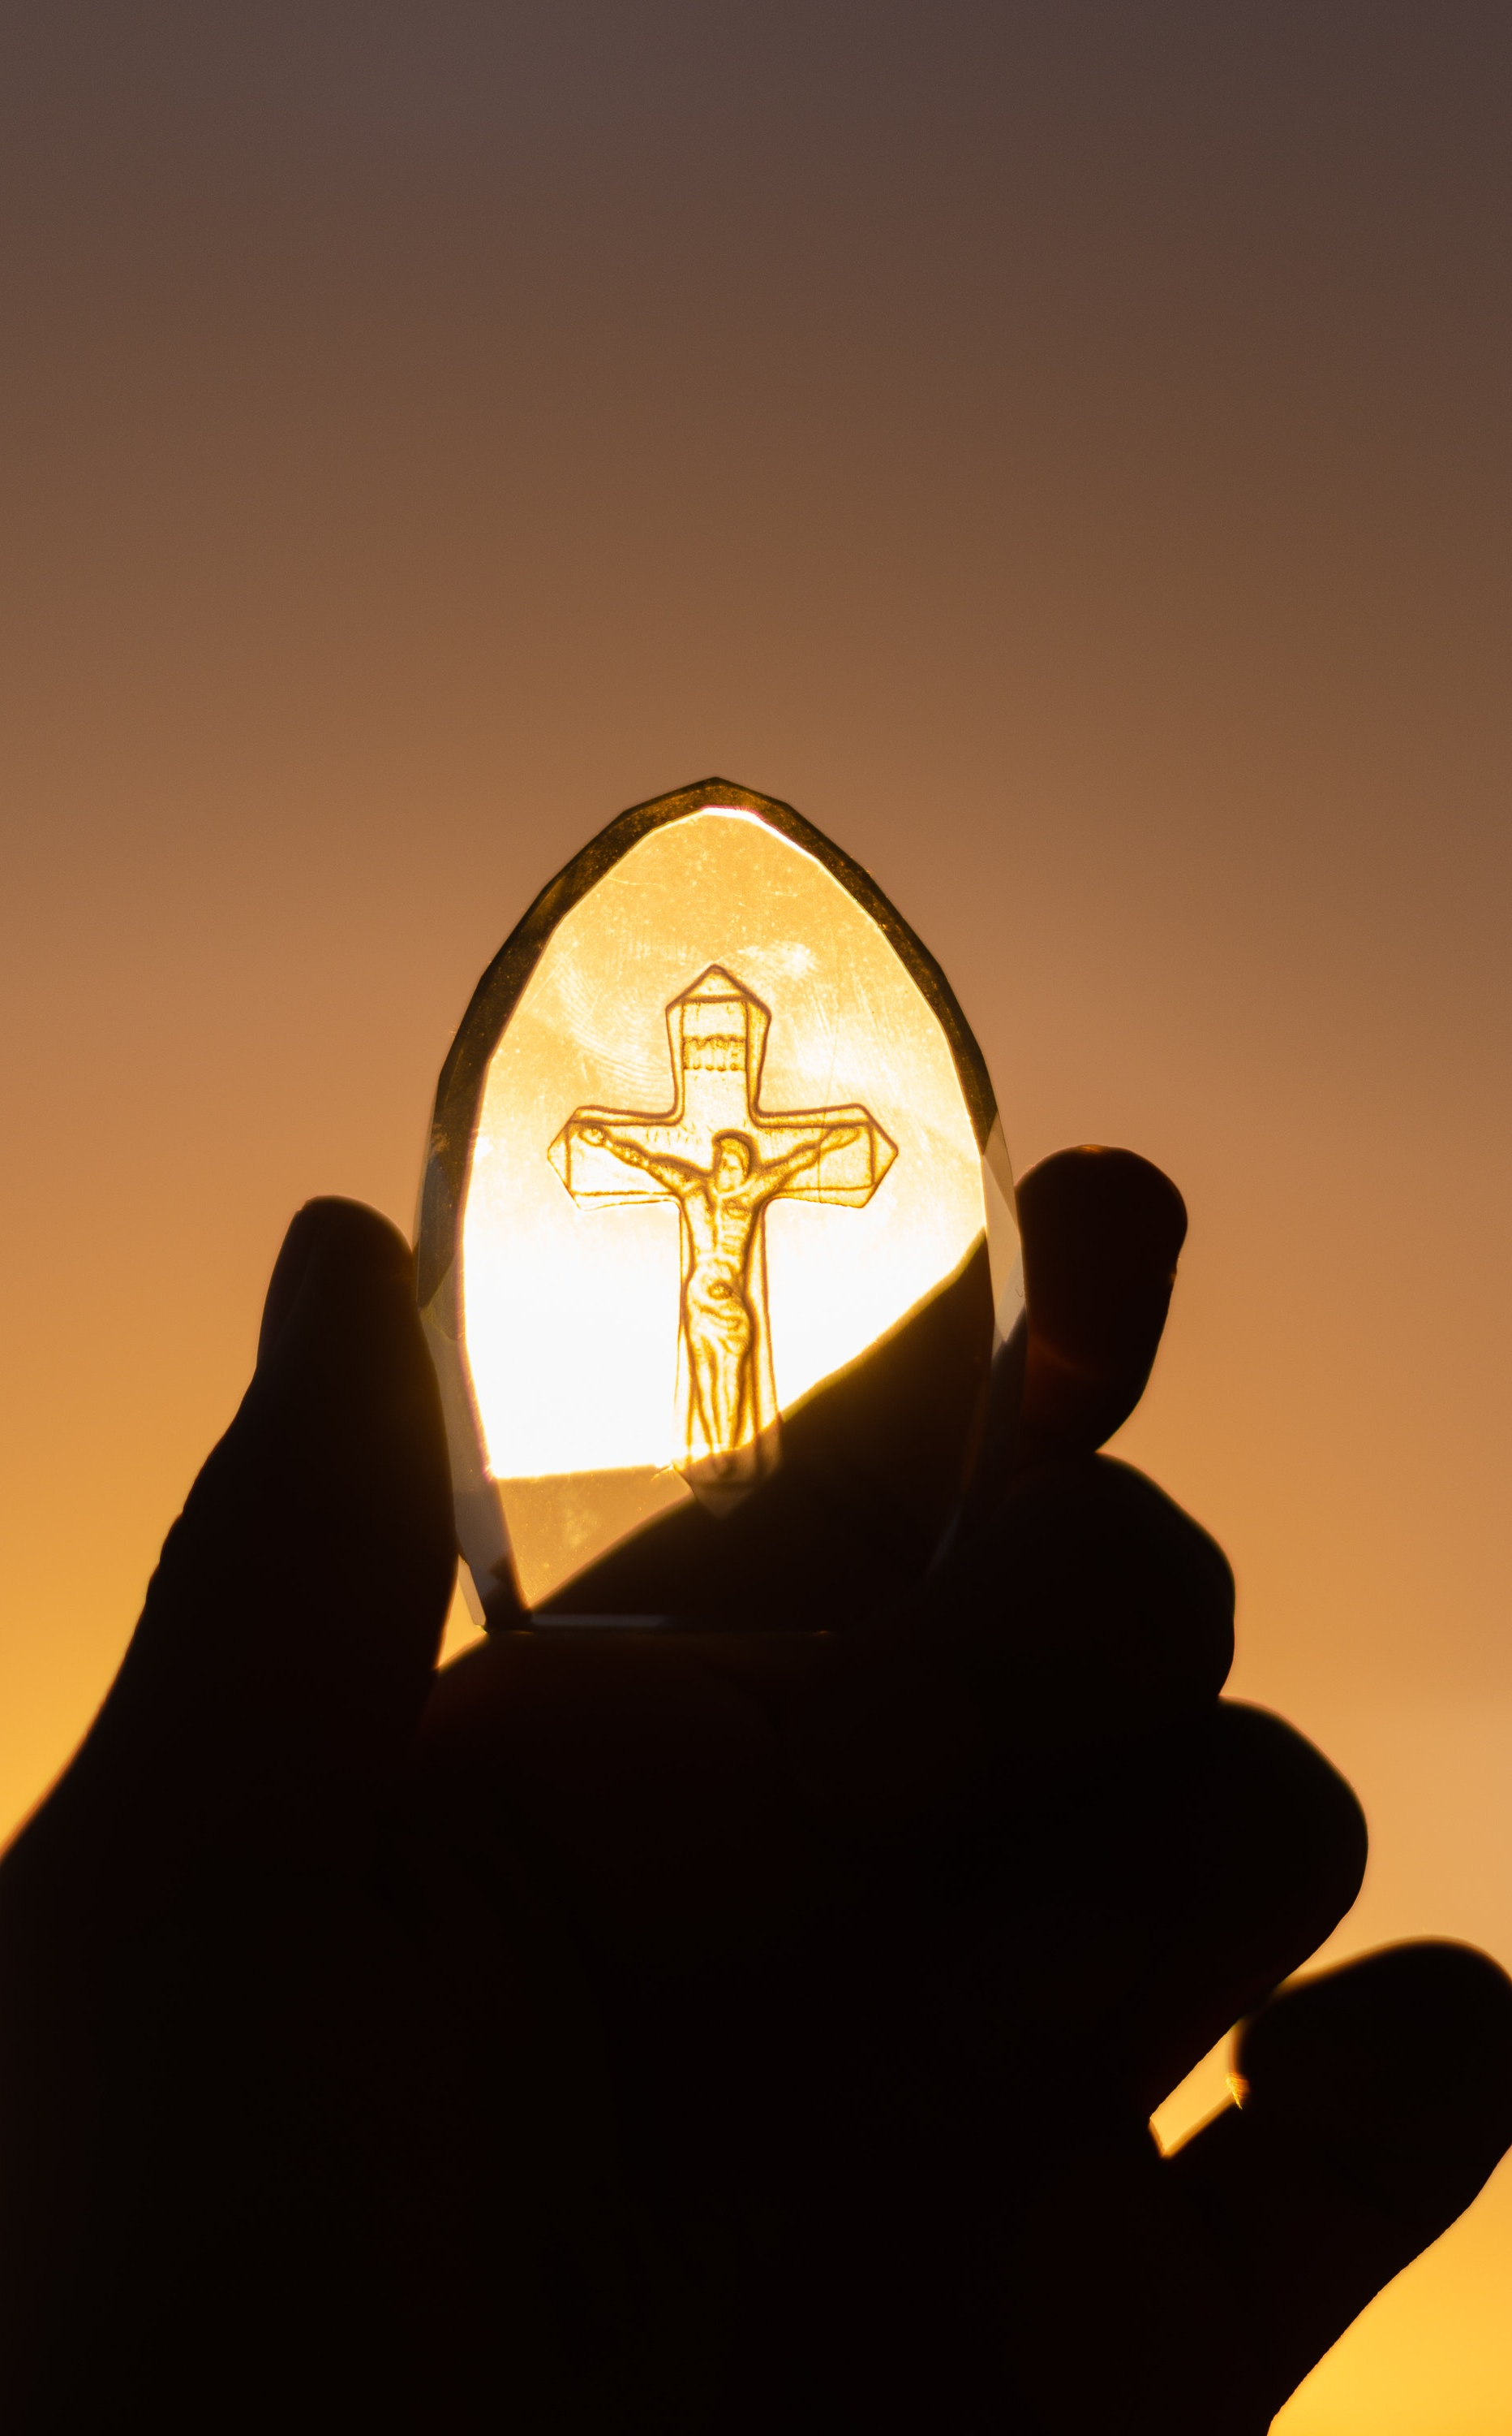
WAY OF DISCIPLESHIP:
BECOMING LIKE CHRIST
Genuine change occurs as we grow into wanting what God wants.
The deepest desires that shape us come from the heart / “will”. The part of us that wills things. Our will is what controls us.
“Automatic” and immediate aspect of our will, driven by appetites. (The New Testament calls this the “flesh”).
Our “heart” is the deeper “reflective” will – the place where we sometimes “want to want” things. It’s where we want to do the right thing.
Notes:
Genuine change occurs as we grow into wanting what God wants. In the Bible, the word used to describe where the deepest desires that shape us come from is the heart. Another word we could use is the “will”. The part of us that wills things. Our will is what controls us.
There is an “automatic” and immediate aspect of our will, driven by appetites. It’s the part of us, for example, which sees someone’s shiny new car and reacts by wanting it. (The New Testament calls this the “flesh”).
But our “heart” is the deeper “reflective” will, from which the true, long-term choices, longings and visions for our life come – the place where we sometimes “want to want” things. It’s where we want to do the right thing. While our “flesh” might want to eat that éclair, our deeper will wants to diet in order to be healthy. It’s where our character is born.

Slide 26
WAY OF DISCIPLESHIP:
BECOMING LIKE CHRIST
To be a disciple is to let the character of Jesus’ will become our will.
"Without me you can do nothing." (John 15:5)
The deepest desires we have can become more like what God wants by allowing Him to flow in our hearts.
Notes:
To be a disciple is to let the character of Jesus’ will become our will.
Thankfully, becoming like Christ in our will and character is much less about what we do, and much more about what God does in us. In fact, becoming like Christ always takes more than our own will power. Jesus said, "Without me you can do nothing." (John 15:5)
Paul writes that “...we all… are being transformed into his image with ever-increasing glory, which comes from the Lord, who is the Spirit.” (2 Corinthians 3:18)
Our wills and character can only become more Christlike as allow God to work in us and give Him the space to do this.
The “Keeper of the Spring” story (see handout) shows us how by doing small and simple things like picking up leaves that allowed a spring to continue to flow, an old man helped it flourish and stay alive. In the same way, the deepest desires we have can become more like what God wants by allowing Him to flow in our hearts.

Slide 27
WAY OF DISCIPLESHIP:
BECOMING LIKE CHRIST
How do I give God the space to change me?

Slide 28
WAY OF DISCIPLESHIP:
BECOMING LIKE CHRIST
The habits and practices we live by that we create an environment in our lives in which the Spirit of God can create character change. We give space for God to work.
It is things we do which set the direction of what we love.
Most of us only grow in becoming Christlike over time through the process of day-to-day life
Notes:
Module 1 introduced the idea that it is through the habits and practices we live by that we create an environment in our lives in which the Spirit of God can create character change. We give space for God to work.
In the verse we just read Paul writes that it is as “we all…with unveiled faces contemplate the Lord’s glory…” that we experience the Spirit changing us into God’s image. In other, the more we arrange our lives so that we can see God’s glory, the more we are changed.
Just as long before a footballer takes a World Cup penalty, it is the hours and hours of repetitive practice that have made her into the kind of person who can naturally aim well, so it is the everyday habits which open us up to God over a long period which make us into people who naturally want what God wants.
It is our habits which shape our desires and which make us want the things we know in our minds are true and good.
For example, the habit of shopping shapes us. Most people know that the more we get the more you want. But whenever we buy something we think that will satisfy us. Yet the habit of shopping ends up making us want more. The more we shop, or the more we eat…the more we want. It is things we do which set the direction of what we love.
If someone is addicted to pornography and is tempted to watch it at night, simple will power won’t be enough.
What will count is whether, long before the moment of temptation, they have been shaped by in their mind and heart by habits through which they are allowing God to change them into someone who wants to turn away from it. Only then will they have the “soul reflex” to be able to say no to what they want in the moment, and yes to what they really want in their heart.
One picture from the Pacific islands puts it this way. A man keeps two dogs in a cave. These two dogs are in continual conflict with one another and are compared to the Holy Spirit living in us, in conflict with our self. The man has a choice about which dog he feeds. The dog that is fed and nourished will grow stronger and will gain the upper hand over the animal that is starved.
It is through habits that engage our mind and heart with God that we access the power of God’s Spirit, enabling Him to deal with the parts of us that need to change.
While it is possible for God to change our character in “Damascus” moments, most of us only grow in becoming Christlike over time through the process of day-to-day life. God works through the everyday, as we make space for Him.
By “waxing on and off” the Karate Kid can perform fantastic karate moves when needed. By reading the Scriptures over time we might more easily see our difficult neighbour as God sees them. By worshipping regularly with others our openness to God’s presence may grow.

Slide 29
WAY OF DISCIPLESHIP:
BECOMING LIKE CHRIST
How much is God’s work, and how much is mine?

Slide 30
WAY OF DISCIPLESHIP:
BECOMING LIKE CHRIST
He will only change us to the extent that we are willing to allow Him
By adopting the practices of Christ, we are playing our part – creating the conditions for God’s Spirit to change us. “Without Him we can’t, but without us He won’t.”
Notes:
Our relationship with God is a partnership in which God never forces His will on us. Because He is agape love, God always invites us to be in covenant with Him.
This means that He will only change us to the extent that we are willing to allow Him. In any kind of relationship, both parties have a part to play.
By adopting the practices of Christ, we are playing our part – creating the conditions for God’s Spirit to change us.
“Without Him we can’t, but without us He won’t.” God’s cooperation with us is another example of His self-giving love.
Richard Foster describes this as ‘the path of disciplined grace.’ “It is ‘grace’ because it is free; it is ‘disciplined’ because there is something for us to do.”

Slide 31
WAY OF DISCIPLESHIP:
BECOMING LIKE CHRIST
Can this happen on my own?

Slide 32
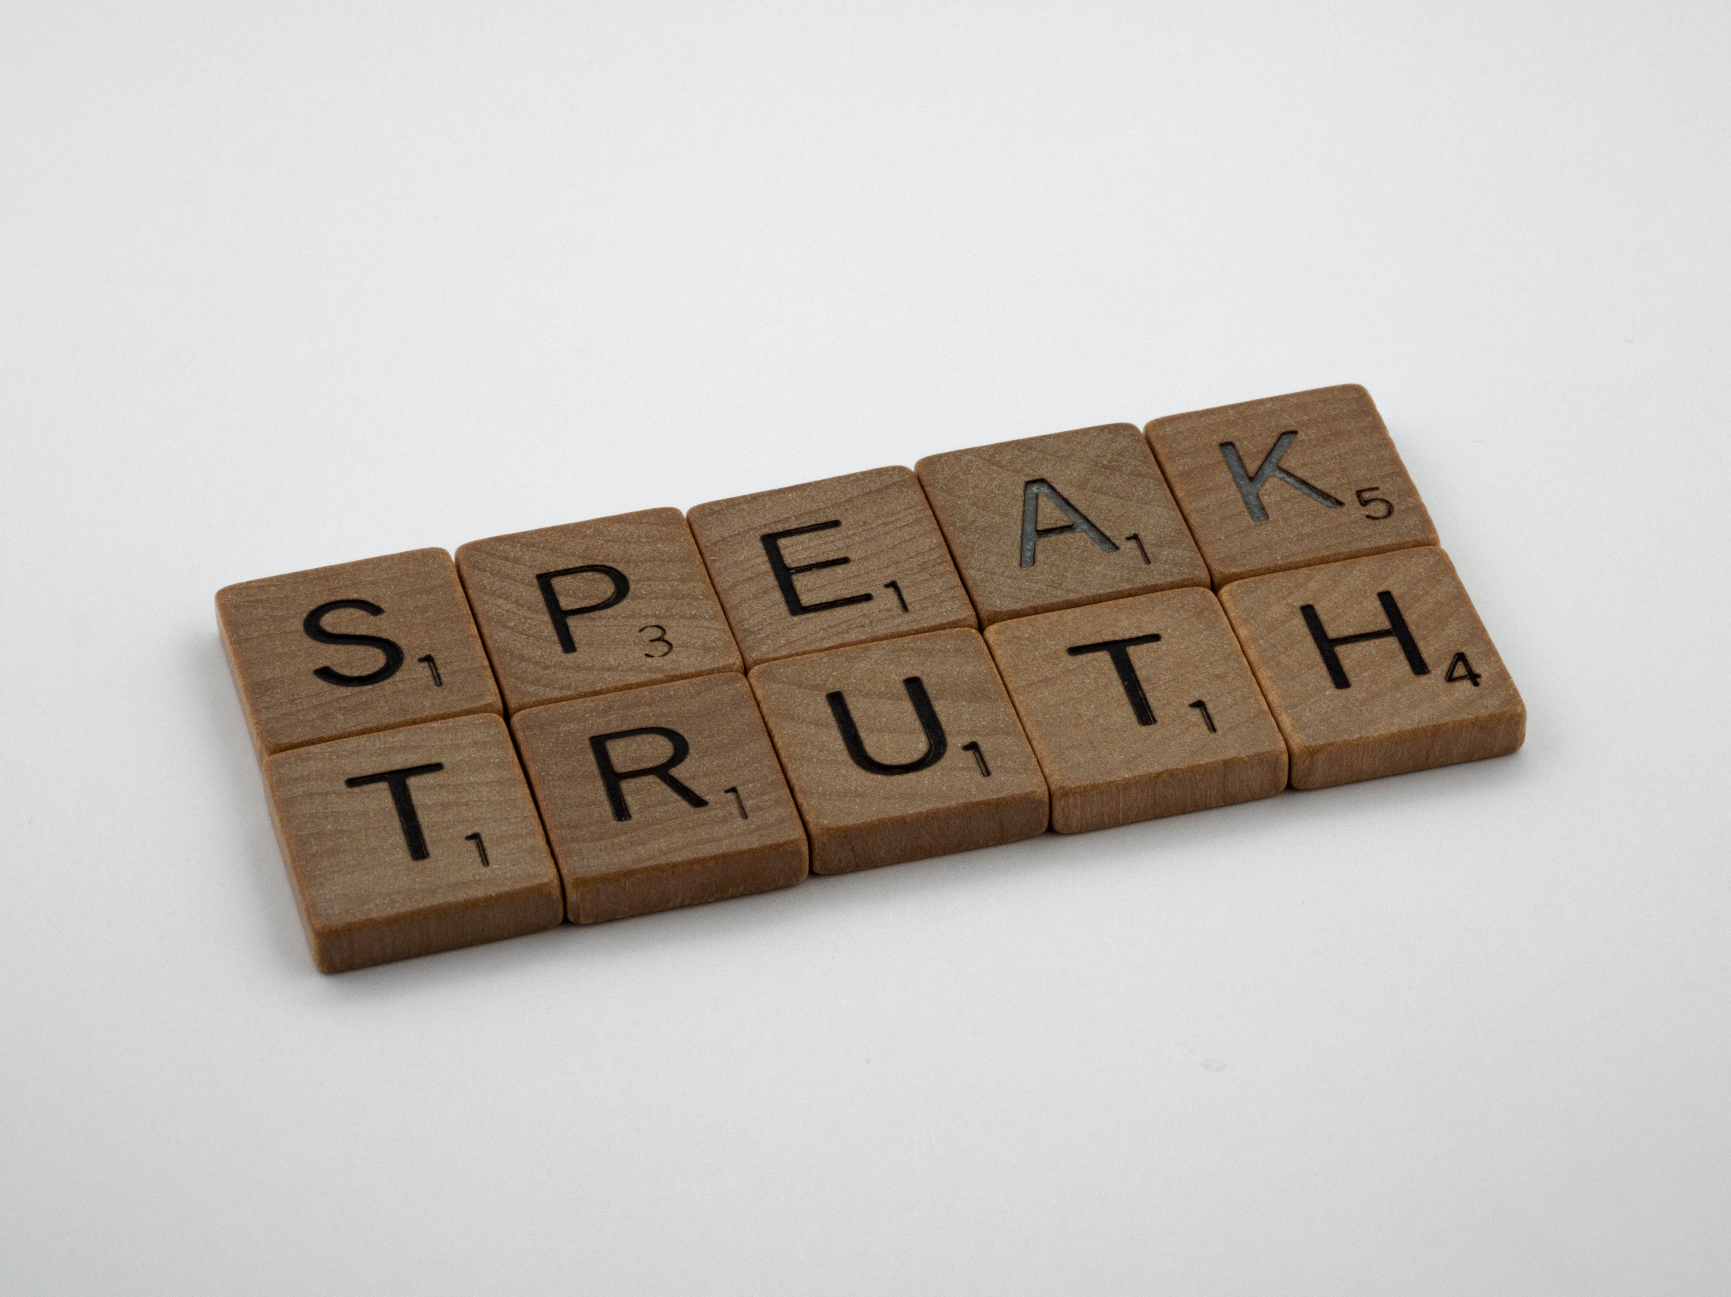
WAY OF DISCIPLESHIP:
BECOMING LIKE CHRIST
Relationship with other disciples, in which we are intentional about growing together.
Relationships which are genuine and close enough to reveal the parts of us which need to change, but which we might be unconscious of when we are on our own.
Notes:
The character of Christ grows in us as the beliefs in our minds are renewed and the desires of our hearts are shaped by God working in us. The “method” of this is simply by giving God room as we centre our lives around the life-giving practices of Jesus. But there is one more essential way in which we can open ourselves up to God’s work in us, and that is through relationship with other disciples, in which we are intentional about growing together.
Community with others will change us if relationships are genuine and close enough to reveal the parts of us which need to change, but which we might be unconscious of when we are on our own. Particularly in the Christian community, where we do not choose our brothers and sisters, we can come face to face with the ways in which we need to be shaped by agape love.

