Slide 1
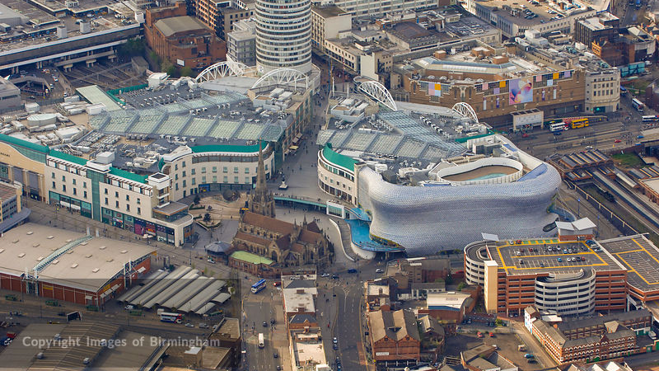
WAY OF DISCIPLESHIP:
BIBLE CONFIDENCE AND KNOWING THE STORY
WAY OF DISCIPLESHIP:
BIBLE CONFIDENCE AND KNOWING THE STORY
CHURCH AND FUTURE HOPE

Slide 2
WAY OF DISCIPLESHIP:
BIBLE CONFIDENCE AND KNOWING THE STORY
What does the New Testament emphasise about the relationship God wants with us?
(Being with God)

Slide 3
WAY OF DISCIPLESHIP:
BIBLE CONFIDENCE AND KNOWING THE STORY
The love of God. “God is love….” (1 John 4:8-10).
God’s relationship with human beings.
Reconciling us and all creation to Himself, bringing peace and wholeness (Colossians 1: 19-20). We are no longer cut off from God in any way.
Adopting us as His children (Ephesians 1: 5-6)
“a new life, a new home, a new father.”
Notes:
The love of God. The starting point for a relationship with God is His love, and in Christ the nature of that self-giving that love has been fully revealed. John writes, “God is love….This is love: not that we loved God, but that he loved us and sent his Son as an atoning sacrifice for our sins. (1 John 4:8-10).
God’s relationship with human beings. Reconciling us and all creation to Himself, bring peace and wholeness “For God was pleased to have all his fullness dwell in him, and through him to reconcile to himself all things, whether things on earth or things in heaven, by making peace through his blood, shed on the cross.” (Colossians 1: 19-20). Rather than having to wait until the end of time, in Jesus the fulness of God’s promise to restore the order and wholeness of creation and people is offered now. We are no longer cut off from God in any way. The New Testament unfolds the intimacy and privilege we are given by God in this relationship:
Adopting us as His children. “In love he predestined us for adoption to sonship through Jesus Christ, in accordance with his pleasure and will— to the praise of his glorious grace, which he has freely given us in the One he loves.” (Ephesians 1: 5-6) By using the language of adoption, the New Testament emphasises how much we receive as God’s heirs. In the film Ben-Hur Judah (a Jew) escapes from a sinking ship in which he is a slave. In doing so, he saves the life of a Roman commander, Arrius, whose son has been killed. Arrius adopts Judah, leading to his being forgiven for his supposed crimes, being given a new name, “young Arrius,” and receiving a full inheritance. Arrius declares the adoption by giving his ancestral signet ring to young Arrius, who says he has received “a new life, a new home, a new father.” In the same way, a relationship of adoption as Christians means our debts are cancelled, and receive all that belongs to heirs of God.

Slide 4
WAY OF DISCIPLESHIP:
BIBLE CONFIDENCE AND KNOWING THE STORY
God’s relationship with human beings.
Justifying us.
We find ourselves before God in a place in which it is as if we had never done anything to disobey Him.
"He said, 'I don't remember.’” God’s final judgement has already taken place on the cross.
God restores us through grace.
“…it is by grace you have been saved, through faith-and this is not from yourselves, it is the gift of God-not by works, so that no one can boast.” (Ephesians 2: 8-9)
Notes:
Justifying us. Justification by faith has rightfully been emphasised as an important part of understanding salvation. It emphasises the complete forgiveness and right relationship we gain with God because of what Jesus did. It means we find ourselves before God in a place in which it is as if we had never done anything to disobey Him. A much-loved priest in the Philippines carried around the burden of a secret sin he had committed many years before. He had asked for forgiveness but still had no peace. In his parish was a woman who loved God and who claimed to be able to speak with Christ and He with her. The sceptical priest wanted to test her and said, "The next time you speak with Jesus, I want you to ask Him what sin I committed while I was in training college." The woman agreed. A few days later they met and the priest asked her, "Well, did Christ visit you in your dreams?" "Yes, he did," she replied. "And did you ask him what sin I committed in college?" "Yes." "And what did he say?" "He said, 'I don't remember.'" God’s final judgement has already taken place on the cross.
God restores us through grace. God’s grace is not just a New Testament revelation – the Jewish people were never driven by works or effort - Judaism was always a religion of grace. Jewish people believed that they were saved because they had been chosen by God. Nevertheless, they were marked out by ways of life given to them by God and by signs of His relationship with Him – such as circumcision, or keeping certain food laws. The good news is that no one is excluded because they haven’t obeyed particular laws which act as “boundary-markers”. “…it is by grace you have been saved, through faith-and this is not from yourselves, it is the gift of God-not by works, so that no one can boast.” (Ephesians 2: 8-9)
In the booklet we look again at what it means to “have enough faith” – a theme we cover in module 2.

Slide 5
WAY OF DISCIPLESHIP:
BIBLE CONFIDENCE AND KNOWING THE STORY
What does the New Testament emphasise about who we are as human beings?
(Becoming like Christ)

Slide 6
WAY OF DISCIPLESHIP:
BIBLE CONFIDENCE AND KNOWING THE STORY
Humans are renewed creations.
“Therefore, if anyone is in Christ, the new creation has come: The old has gone, the new is here!” (2 Corinthians 5: 16-17)
A restored person becomes more like Christ.
“Christ is formed in you.” (Galatians 4:19)
The meaning of baptism (Romans 6:4)
Our natural response to what God has done is to live differently.
“…put on the new self, created to be like God in true righteousness and holiness.” (Ephesians 4: 22-24).
Notes:
Humans are renewed creations. Just as God’s plan is to restore all things, He wants to restore us. We look at others, and ourselves, differently: “So from now on we regard no one from a worldly point of view. Though we once regarded Christ in this way, we do so no longer. Therefore, if anyone is in Christ, the new creation has come: The old has gone, the new is here!” (2 Corinthians 5: 16-17) A restored person becomes more like Christ. In the New Testament, a fully human life is one in which “Christ is formed in you.” (Galatians 4:19) For disciples our baptism is a time when we died to our own way of living, and from now on live a new life – totally identifying with Christ, and living life as He would live it: “We were therefore buried with him through baptism into death in order that, just as Christ was raised from the dead through the glory of the Father, we too may live a new life.” (Romans 6:4) Our natural response to what God has done is to live differently. Many of the letters unfold what God has done, and then pivot to challenge or invite Christians to live in response to that. Paul writes that those who hear “about Christ and were taught in him in accordance with the truth that is in Jesus” will “put on the new self, created to be like God in true righteousness and holiness.” (Ephesians 4: 22-24).

Slide 7
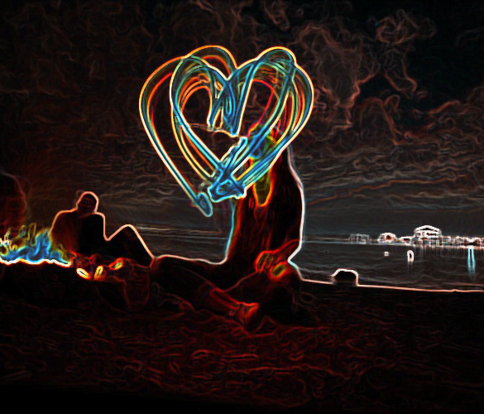
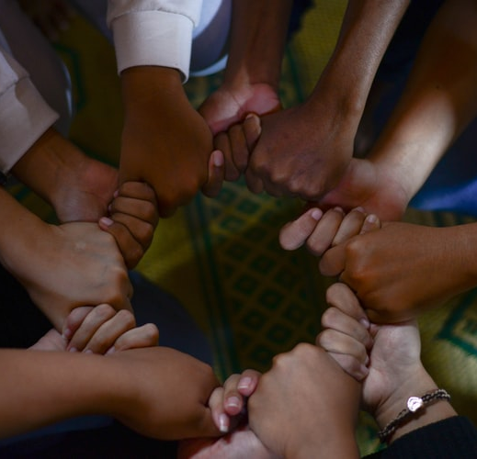
WAY OF DISCIPLESHIP:
BIBLE CONFIDENCE AND KNOWING THE STORY
Change comes as we cooperate with the Holy Spirit
Those “who are led by the Spirit of God are the children of God” (Romans 8:14)
We cannot do it “by the flesh” (our own efforts) but by the Spirit. (Romans 8:1-13)
The Holy Spirit’s work in restoring humanity to each other.
Through Christ God has broken down the wall of hostility (Ephesians 2:14)
“There is neither Jew nor Gentile, neither slave nor free, nor is there male and female, for you are all one in Christ Jesus.” (Galatians 3:26-28)
“…a great multitude that no one could count, from every nation, tribe, people and language, standing before the throne and before the Lamb.” (Revelation 7:9-10) .
Notes:
Change comes as we cooperate with the Holy Spirit The New Testament describes and explores how the world now lives in the age of God’s Spirit. The presence of God’s Holy Spirit in the world, the power that raised Jesus from death and brings the reality of God’s future promise into the present, is the source of any meaningful change in our lives. As we seek to become more like Christ, the only path offered is in cooperation with God’s Spirit. Those “who are led by the Spirit of God are the children of God” (Romans 8:14) and while Christians seek to live to God’s eternal standards, we cannot do it “by the flesh” (our own efforts) but by the Spirit. (Romans 8:1-13) The Holy Spirit’s work in restoring humanity to each other. In Acts we see how at Pentecost God reverses the way humans are split off from each other in two amazing ways – He uses all the languages of those who are present to communicate – He affirms their differences – but He gives His Spirit to all of them – making them one community in Christ. The story of Acts describes this creation of a new family, as the Jewish followers of Jesus began to see and respond to how God was now calling all people. Through Christ God has broken down the wall of hostility (Ephesians 2:14) between different people groups…”in Christ Jesus you are all children of God through faith, for all of you who were baptized into Christ have clothed yourselves with Christ. There is neither Jew nor Gentile, neither slave nor free, nor is there male and female, for you are all one in Christ Jesus.” (Galatians 3:26-28) The ultimate promise in the book of Revelation is of “…a great multitude that no one could count, from every nation, tribe, people and language, standing before the throne and before the Lamb.” (Revelation 7:9-10)

Slide 8
WAY OF DISCIPLESHIP:
BIBLE CONFIDENCE AND KNOWING THE STORY
What does the New Testament emphasise about our calling as human beings?
(Joining in with the Spirit)

Slide 9
WAY OF DISCIPLESHIP:
BIBLE CONFIDENCE AND KNOWING THE STORY
The purpose and life of the church: Who we are.
God’s chosen and “holy” people
“dearly loved” (Colossians 3:12).
God’s “bride” (Revelation 21:2).
“each member belongs to the others” (Romans 12:5),
a “family of believers” (Galatians 6:10),
“fellow citizens with God’s people and also members of his household” (Ephesians 2:19). God’s temple and priesthood.
“a chosen people, a royal priesthood, a holy nation, God’s special possession….” (1 Peter 2:5,9)
“We are therefore Christ’s ambassadors, as though God were making his appeal through us.” (2 Corinthians 5: 20)
Notes:
The New Testament describes how our calling as Jesus’ body – His church – is to join in with His work in the world as we look in hope for God’s Kingdom to come to earth in its fulness. The purpose and life of the church As we have seen in module 3, the church is called to be a “sign of God’s reign and a foretaste of His rule” - who we are is as significant as what we do. The New Testament offers many images and descriptions to help us grasp this identity and task. Who we are. Paul describes disciples as God’s chosen and “holy” people – set apart by Him to continue His purposes in the world. We do this as people who know we are “dearly loved” (Colossians 3:12). The Bible finishes by celebrating us as God’s “bride” (Revelation 21:2). Throughout the Bible God has called people into covenant relationship with Him. Paul describes how the way in which a husband and wife are united as “one flesh” is a picture of the deep covenant intimacy God wants with His people, (Ephesians 5:21-22) under Christ as the “head of the church.” (Ephesians 1:22). Knowing ourselves to be loved and united in this way, we live as one body, the fulfilment of God’s plan for a newly created humanity in which “each member belongs to the others” (Romans 12:5), a “family of believers” (Galatians 6:10), no longer strangers, separated by ethnicity or background, but “fellow citizens with God’s people and also members of his household” (Ephesians 2:19). God’s plan was always to call a people to be a blessing to the world, set apart for Him, worshipping Him, demonstrating His love, acting in a priestly way to connect God to people, and people to God. The New Testament reveals this calling to Israel is now extended to all people. The church becomes God’s temple and priesthood. No longer is God’s presence focussed in a particular building, but in Christ we “are being built together to become a dwelling in which God lives by his Spirit.” (Ephesians 2:22). “Don’t you know that you yourselves are God’s temple and that God’s Spirit dwells in your midst?” (1 Corinthians 3:16) We are “like living stones…being built into a spiritual house to be a holy priesthood, offering spiritual sacrifices acceptable to God through Jesus Christ.” In Christ we are “a chosen people, a royal priesthood, a holy nation, God’s special possession, that you may declare the praises of him who called you out of darkness into his wonderful light.” (1 Peter 2:5,9) As such, we are living representatives of Christ in the world. “We are therefore Christ’s ambassadors, as though God were making his appeal through us.” (2 Corinthians 5: 20)

Slide 10
WAY OF DISCIPLESHIP:
BIBLE CONFIDENCE AND KNOWING THE STORY
The purpose and life of the church: How we live.
Uniquely multi-ethnic, breaking down barriers and marked by love.
Salt and light within surrounding cultures.
Living with integrity under a different Lord – Christ. By treating men and women, slaves and their owners, rich and poor as equals within God’s people, Christians challenged the very structures of societies around them.
Notes:
How we live. The New Testament describes the life of the church as being distinctive in world-changing ways. As we have seen, the life of this new temple, creation and humanity is uniquely multi-ethnic, breaking down barriers and marked by love. The New Testament also describes how these early Christian churches live as salt and light within surrounding cultures. They have a calling to bring life to their wider communities, but challenge many of its values through their life together. Within a context in which Christians were supposed to obey Caesar as the highest authority, a continuing theme is how to live with integrity under a different Lord – Christ. By treating men and women, slaves and their owners, rich and poor as equals within God’s people, Christians challenged the very structures of societies around them.

Slide 11
WAY OF DISCIPLESHIP:
BIBLE CONFIDENCE AND KNOWING THE STORY
The purpose and life of the church: What we do.
Active witness.
“But you will receive power when the Holy Spirit comes on you; and you will be my witnesses in Jerusalem, and in all Judea and Samaria, and to the ends of the earth.” (Acts 1:8)
The life of the community. (Acts 2: 42-47)
They were devoted to God, living out the practices that helped them to be with Him, and open to His presence.
They demonstrated the life of God’s kingdom in their life together and in their individual lives. The church is the prime example of what the future kingdom will look like
They experienced people being drawn into God’s salvation through the visibility of their life together.
Notes:
What we do. The New Testament describes in very practical terms what it looked like for God’s people to be joining in with the Spirit, as they lived within the salvation of God’s kingdom and sought to offer that salvation to others. They did so both through their active witness and a Spirit-empowered life which put the message on display, transformed every part of life, and was energised by hope. Active witness. “But you will receive power when the Holy Spirit comes on you; and you will be my witnesses in Jerusalem, and in all Judea and Samaria, and to the ends of the earth.” (Acts 1:8) The life of the community. Acts gives us two pictures of the life of the church, meeting together daily in the temple. In other words, this new community is demonstrating what the Temple, as the place where heaven and earth meet, should be. Luke describes this young church as having three defining features, which act as a framework for a healthy church (Acts 2: 42-47) They were devoted to God, living out the practices that helped them to be with Him, and open to His presence. As Jesus’ body on earth, they demonstrated the life of God’s kingdom in their life together and in their individual lives. The church is the prime example of what the future kingdom will look like – a “film trailer” for the ultimate masterpiece of God’s recreated world. They experienced people being drawn into God’s salvation through the visibility of their life together. They were “enjoying the favour of all the people. And the Lord added to their number daily those who were being saved.”

Slide 12
WAY OF DISCIPLESHIP:
BIBLE CONFIDENCE AND KNOWING THE STORY
Reading it well:
How do we apply the Bible well to the questions we wrestle with today?

Slide 13
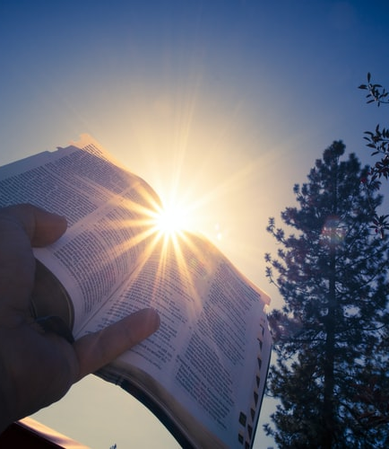
WAY OF DISCIPLESHIP:
BIBLE CONFIDENCE AND KNOWING THE STORY
We continue to “see through a glass darkly” (1 Corinthians 13:12). Progressive revelation.
Four lenses (or “sources of God’s revelation”) have been developed through which we can seek to get as close as we can to a faithful Christian response.
Three (Scripture, Reason, Tradition) were developed by Richard Hooker (1554–1600),
A fourth (Experience) was added by John Wesley (1703-1791).
These four sources of guidance work together, often overlapping to act as legs of a table, helping us discern in a balanced way.
Notes:
The New Testament reveals Christians working through issues and controversies together. While Christ is the fullest revelation of God we have, Paul writes that until the world and human beings are completely restored, we continue to “see through a glass darkly” (1 Corinthians 13:12). We continue to live in a time of progressive revelation. When we approach difficult questions, four chief lenses (or “sources of God’s revelation”) have been developed through which we can seek to get as close as we can to a faithful Christian response. Three (Scripture, Reason, Tradition) were developed by Richard Hooker (1554–1600), a prominent Anglican priest, and a fourth (Experience) was added by John Wesley (1703-1791), who was responding to his sense of God’s Spirit at work in his life and speaking to him. These four sources of guidance work together, often overlapping to act as legs of a table, helping us discern in a balanced way.

Slide 14
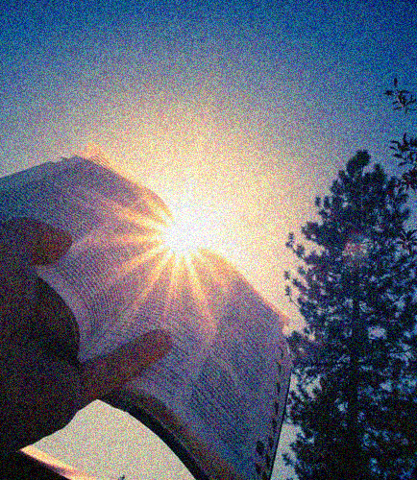
WAY OF DISCIPLESHIP:
BIBLE CONFIDENCE AND KNOWING THE STORY
Scripture: What does the Bible say?
The supreme source of authority, and the testing measure for everything else.
First order (in other words, essential) or second order in Scripture.
That which has been believed everywhere, always and by all people.
Am I giving the Bible the full weight it needs?
Am I aware of my own interpretations?
What are first order and second order issues?
Notes:
Scripture: What does the Bible say? For Christians the Bible is always the supreme source of authority, and the testing measure for everything else. A key principle in interpreting well is reflecting on whether issues are seen as first order (in other words, essential) or second order in Scripture. In 1 Corinthians 15 Paul begins the chapter by reminding them “For what I received I passed on to you as of first importance: that Christ died for our sins according to the Scriptures….” In 434 AD Vincent of Lerins was asked a question: What should every Christian believe for sure? He replied: quod ubique, quod semper, quod ab omnibus creditum est. That which has been believed everywhere, always and by all people. For centuries this has acted as a guide for first order parts of the Bible. Questions to ask: Am I giving the Bible the full weight it needs? Am I aware of my own interpretations? What are first order and second order issues?

Slide 15
WAY OF DISCIPLESHIP:
BIBLE CONFIDENCE AND KNOWING THE STORY
Reason: What makes sense?
God has gifted us with the ability to think and feel, and with conscience.
Reason is not the opposite of faith – reason can be exercised with faith, and faith can be defended by reason.
While faith might always go beyond reason, it never goes against it.
Do I see my ability to think as a gift as I interpret the Bible and listen to others?
Am I humble about my own brokenness as I consider this question?
Notes:
Reason: What makes sense? Hooker believed God had gifted us (as His partners in creation) with the ability to think and feel, and with conscience. Reason helps us to connect and analyse various ideas, concepts, and arguments. It can help us define and defend how we view Scripture, but also our traditions and even our experiences. Reason is not the opposite of faith – reason can be exercised with faith, and faith can be defended by reason. As Christians we are transformed by the “renewing of our minds.” (Romans 12:2). While faith might always go beyond reason, it never goes against it, and sound arguments can be made to explore and defend positions. Nevertheless, we will always be aware that no one person can be completely objective. Questions to ask: Do I see my ability to think as a gift as I interpret the Bible and listen to others? Am I humble about my own brokenness as I consider this question?

Slide 16
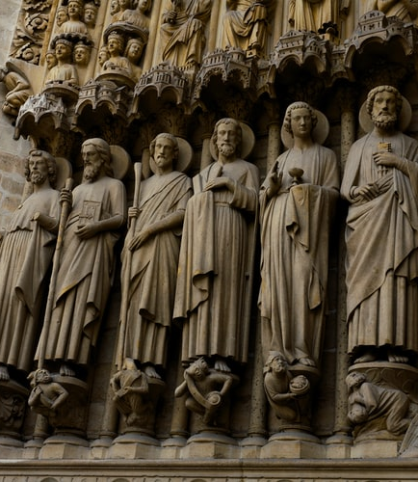
WAY OF DISCIPLESHIP:
BIBLE CONFIDENCE AND KNOWING THE STORY
Tradition: What have voices before us said?
God has been active in the lives of those who have passed on their living tradition to us.
These voices have an important, but secondary role. The early church “fathers and mothers”
These teachings are useful only as much as they are “agreeable to the…scriptures” (Canon A5).
What voices and wisdom do I need to pay attention to?
Notes:
Tradition: What have voices before us said? Each generation of Christians does not come from nowhere, but we have inherited wisdom from those who have gone before as they have sought to apply the Bible. They have developed principles of interpreting Scripture well and living it out. God has been active in the lives of those who have passed on their living tradition to us. These voices have an important, but secondary role. The Church of England has historically drawn on the thinking of the early church “fathers and mothers” yet always sees these teachings as being useful only as much as they are “agreeable to the…scriptures” (Canon A5). Questions to ask: What voices and wisdom do I need to pay attention to?

Slide 17
WAY OF DISCIPLESHIP:
BIBLE CONFIDENCE AND KNOWING THE STORY
Experience: How have I and others sensed God’s direct action?
God is always at work in all His creation, and in our daily lives.
Experience can only reinforce our opinion, rather than inform it.
How much is our interpretation of the experience subjective?
It is in the context of a Spirit-led community that the peace of God to guide us will most likely be found.
Am I open to God speaking to me today in this question? How am I listening to the experiences of those who can help me understand better?
Where is God at work in the world?
Notes:
Experience: How have I and others sensed God’s direct action? God is always at work in all His creation, and in our daily lives, and therefore we expect Him to be revealing Himself in new ways. Wesley believed it was only when we experienced something personally that we could have true confidence in our understanding. We can be suspicious of experience because it is subjective. At best it can only reinforce our opinion, rather than inform it. Yet experiences have always really happened, whether physical or psychological. The question is how much is our interpretation of the experience subjective? In addition, in making decisions, the experience of others can enable us to pay attention to perspectives we would be otherwise unable to understand or consider, particularly those who have been marginalised. In making good decisions, a final principle is that it is in the context of a Spirit-led community – in which we are open to the Holy Spirit, learn from each other, and read Scripture together, that the peace of God to guide us will most likely be found. Questions to ask: Am I open to God speaking to me today in this question? How am I listening to the experiences of those who can help me understand better? Where is God at work in the world?

Slide 18
WAY OF DISCIPLESHIP:
BIBLE CONFIDENCE AND KNOWING THE STORY
Practical suggestions:
How do we read the Bible well together?

Slide 19
WAY OF DISCIPLESHIP:
BIBLE CONFIDENCE AND KNOWING THE STORY
New Testament letters were mostly written, and intended to be read, by groups of people – they are community documents. Paul often collaborated with people. Our practice of reading Scripture aloud in services has a long tradition.
Being able to lead a Bible study does not need to be the task of experts. Any Christian should be able to do this with others.
Notes:
One of the features of New Testament letters is that they were mostly written, and intended to be read, by groups of people – they are community documents.
Paul often collaborated with people (such as Timothy or Silas) to work on the material, they would then hire a professional scribe to write it, and give specific instructions to those delivering the letter as to how it should be read aloud. Our practice of reading Scripture aloud in services has a long tradition.
Most letters were obviously read from beginning to end, enabling those hearing to catch the flow of Paul’s argument, and would follow a standard pattern – an opening greeting between author and receiver, a prayer of thanks, the main points of the letter, and then the more personal conclusion.
The letters were expected to be able to be understood by everyone, not just by the “educated”, and would be discussed by the community and passed around.
This gives us a sense of how to read the Bible well. If we lack confidence because we don’t know where to start, or feel we are not clever enough to understand, we can be reassured by knowing that the Bible is intended to be for everyone – and that the best way of approaching it is always with others.
In addition, being able to lead a Bible study does not need to be the task of experts. Any Christian should be able to do this with others.

Slide 20
WAY OF DISCIPLESHIP:
BIBLE CONFIDENCE AND KNOWING THE STORY
Discovery Bible Study
Emphasises discovery, not teaching.
Discovering truth is far more powerful than being told it.
Avoids over-dependence on a gifted individual.
Helps us not only to understand what the Bible says but also to respond in our own lives, putting into practice what we feel God is showing us.
Notes:
In recent years the Discovery Bible Study method has led to significant growth in the church around the world, and offers us a way of reading the Bible with anybody. It is a method that emphasises discovery, not teaching, and is particularly aimed at empowering people who may not have read the Bible before to be able to start.
Discovering truth is far more powerful than being told it. The process allows the Holy Spirit to be the teacher rather than a person, helping to avoid over-dependence on a gifted individual.
Crucially, it helps us not only to understand what the Bible says but also (as in so many New Testament letters) to respond in our own lives, putting into practice what we feel God is showing us. This is why it helps us grow as disciples.
There is a bookmark available with the questions on in our extended materials, and suggestions of passages that could be looked at over time, if, for example, you want to disciple someone.
As we finish the “Way of Discipleship”, Discovery Bible Study gives us a way of discipling others which any Christian can use.

