Slide 1
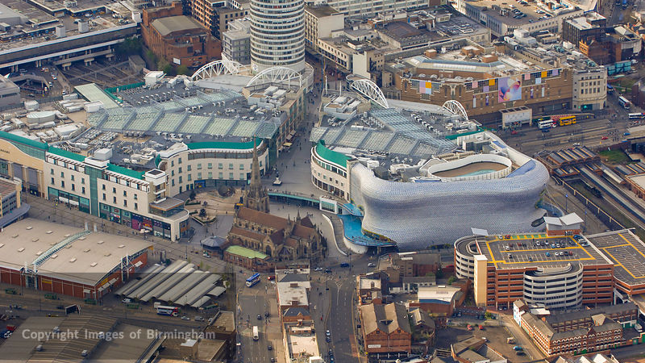
WAY OF DISCIPLESHIP:
JOINING IN WITH THE SPIRIT
WAY OF DISCIPLESHIP:
JOINING IN WITH THE SPIRIT
IN ALL OF LIFE

Slide 2
WAY OF DISCIPLESHIP:
JOINING IN WITH THE SPIRIT
What is our mission?

Slide 3
WAY OF DISCIPLESHIP:
JOINING IN WITH THE SPIRIT
God is working to “bring unity to all things in heaven and on earth under Christ….the re-creation of the world, when the Son of Man will rule gloriously.”
God is looking to “restore all things” (Acts 3:21).
It is not that the church has a mission, but that “the mission of God has a church.”
Notes:
We have started to see how vast God’s mission is. God is working to “bring unity to all things in heaven and on earth under Christ….the re-creation of the world, when the Son of Man will rule gloriously.” God is looking to “restore all things” (Acts 3:21). Our calling as disciples is to do what the one we follow did, in the way that He did it. It is not that the church has a mission, but that “the mission of God has a church.”

Slide 4
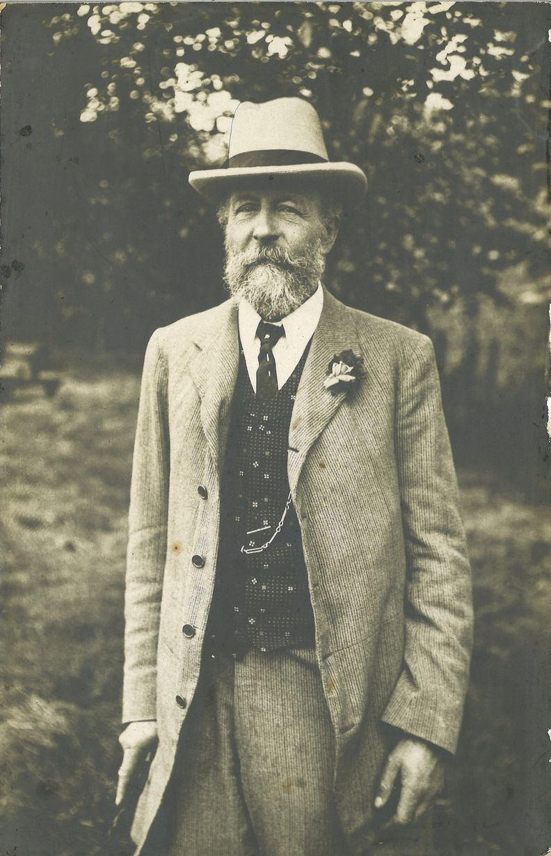
WAY OF DISCIPLESHIP:
JOINING IN WITH THE SPIRIT
At the heart of Birmingham the George Cadbury story is about someone who joined in with the mission of God in such a way that it touched every aspect of his life and has left a legacy of what society might look like when God’s reign – His kingdom – is experienced.
Notes:
At the heart of Birmingham the George Cadbury story is about someone who joined in with the mission of God in such a way that it touched every aspect of his life and has left a legacy of what society might look like when God’s reign – His kingdom – is experienced.

Slide 5
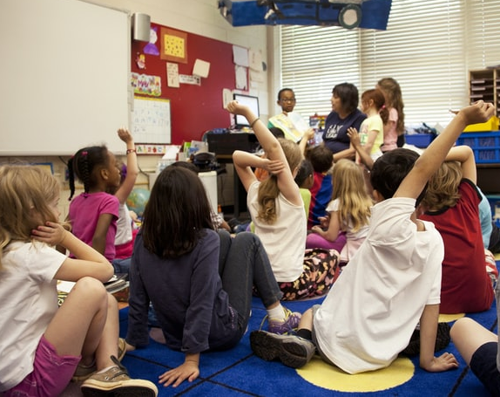
WAY OF DISCIPLESHIP:
JOINING IN WITH THE SPIRIT
“She has taught them to pray, shared biblical stories with them, introduced them to Christian worship and has engaged them in Kingdom activities
She is a primary school teacher faithfully doing her best to follow Jesus and bring transformation to the lives of the children she serves and the community in which the school is set. All at the same time as equipping their children with the learning skills necessary for life.”
Notes:
In the book “Holy Habits” Andrew Roberts tells the story of Shona who “…over the years has introduced hundreds of children to Jesus. She has taught them to pray, shared biblical stories with them, introduced them to Christian worship and has engaged them in Kingdom activities including the support of Fairtrade and providing gifts for other children by filling shoe boxes with toys. All at the same time as equipping the children with the foundational learning skills that they need to flourish, and being a listening, prayerful support to colleagues struggling with illness and bereavement.
Shona is not ordained or employed by the church. She is a primary school teacher faithfully doing her best to follow Jesus and bring transformation to the lives of the children she serves and the community in which the school is set. All at the same time as equipping their children with the learning skills necessary for life.”

Slide 6
WAY OF DISCIPLESHIP:
JOINING IN WITH THE SPIRIT
What might discourage us from seeing our daily work as part of God’s mission?

Slide 7
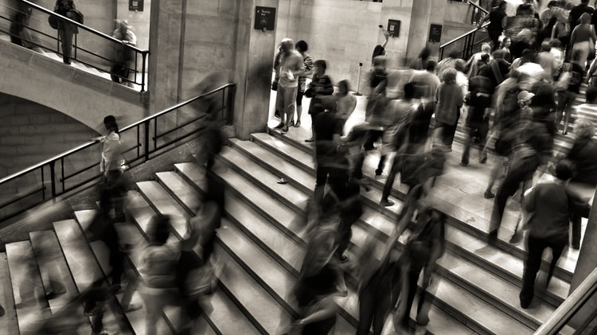
WAY OF DISCIPLESHIP:
JOINING IN WITH THE SPIRIT
“The Church’s approach to an intelligent carpenter is usually confined to exhorting him not to be drunk and disorderly in his leisure hours, and to come to church on Sundays. What the Church should be telling him is this: that the very first demand that his religion makes upon him is that he should make good tables.”
“I now know of course that you can be a bus conductress or a television person and love God completely.”
Notes:
We can grow up with the sense that certain activities matter less to God. Decades ago, Dorothy Sayers wrote, “The Church’s approach to an intelligent carpenter is usually confined to exhorting him not to be drunk and disorderly in his leisure hours, and to come to church on Sundays. What the Church should be telling him is this: that the very first demand that his religion makes upon him is that he should make good tables.”
Or we can absorb the idea that certain callings are more acceptable expressions of discipleship. On Desert Island Discs Sister Wendy Beckett was asked, “When did you first decide you wanted to be a nun?” She replied, “I was a baby. It was the only thing I wanted because I didn’t know there were other ways to love God completely. I now know of course that you can be a bus conductress or a television person and love God completely.”

Slide 8
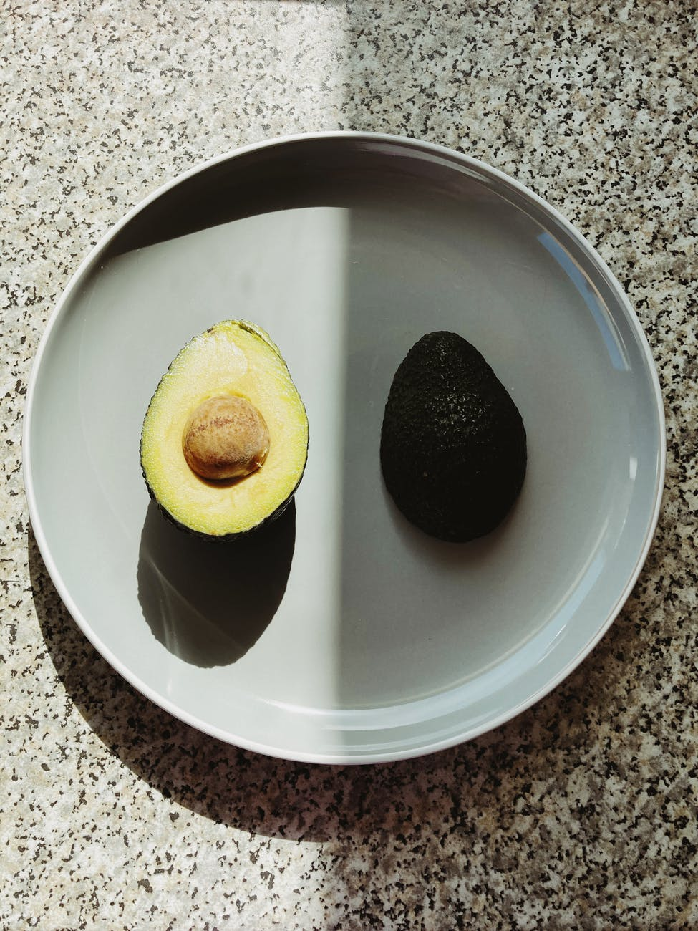
WAY OF DISCIPLESHIP:
JOINING IN WITH THE SPIRIT
“I do Sunday school for one hour a week, and my church get me up to the front and pray for me. I teach 30 children for 39 hours a week and no one ever mentions it in church.”
Notes:
This can lead to us having a split view of life and God’s mission. We can split life up into “sacred” and “secular” and as churches, we can reinforce this sacred/secular split-living. Jean is discouraged. She’s an athlete, who could go far. But people at her local church have put on a discipleship course and a few prayer meetings at the same time as her hurdle practice. What should she do? Her fellow Christians are encouraging but make her feel that the meetings should come first. That if she really wants to worship she should do it in the meeting room, and not on the race track.
When a teacher says, “I do Sunday school for one hour a week, and my church get me up to the front and pray for me. I teach 30 children for 39 hours a week and no one ever mentions it in church,” we see this split-living and thinking. We see it in the phrase “Full time Christian Worker” when it is only applied to those working in churches. We see it in the way that people who have enormous skills in their working lives may be unable to transfer those skills into the church area of life. Or in the lack of a weighty Christian presence in the arts, politics, music, academia or business. Or when we give money to someone going to preach the gospel in Transylvania, but not to support a struggling Christian artist who seeks to bring the yeast of the kingdom into the world of art.

Slide 9
WAY OF DISCIPLESHIP:
JOINING IN WITH THE SPIRIT
Why might we struggle with joining in with God in everyday life?

Slide 10
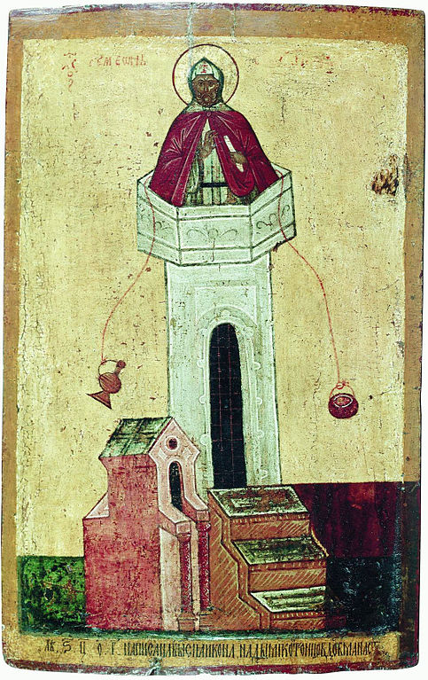
WAY OF DISCIPLESHIP:
JOINING IN WITH THE SPIRIT
“They are at worst essentially evil, and at best distractions from the real business of life, which is following God alone.”
Notes:
Simeon Stylites was a monk who lived on a 60 foot pillar situated thirty miles from Antioch in a sun-scorched wilderness. On this perch Simeon lived uninterrupted for thirty years, exposed to rain and sun and hail, praying and posturing or standing with arms outstretched in the form of a cross for as long as eight hours at a time.
Simeon’s view of the world and what it means to be “spiritual” affected his whole approach to life. He believed that the world, and therefore his body, was essentially evil – a corrupted creation in need of redemption. The purest form of discipleship was therefore to be removed from the earth (literally 60 feet above it!) in order to be closer to God and await rescue from matter. If you had asked him what a Christian approach to art, education, politics, food, sexuality, business was, you know, all those things God has created – he would probably have replied, “They are at worst essentially evil, and at best distractions from the real business of life, which is following God alone.”

Slide 11
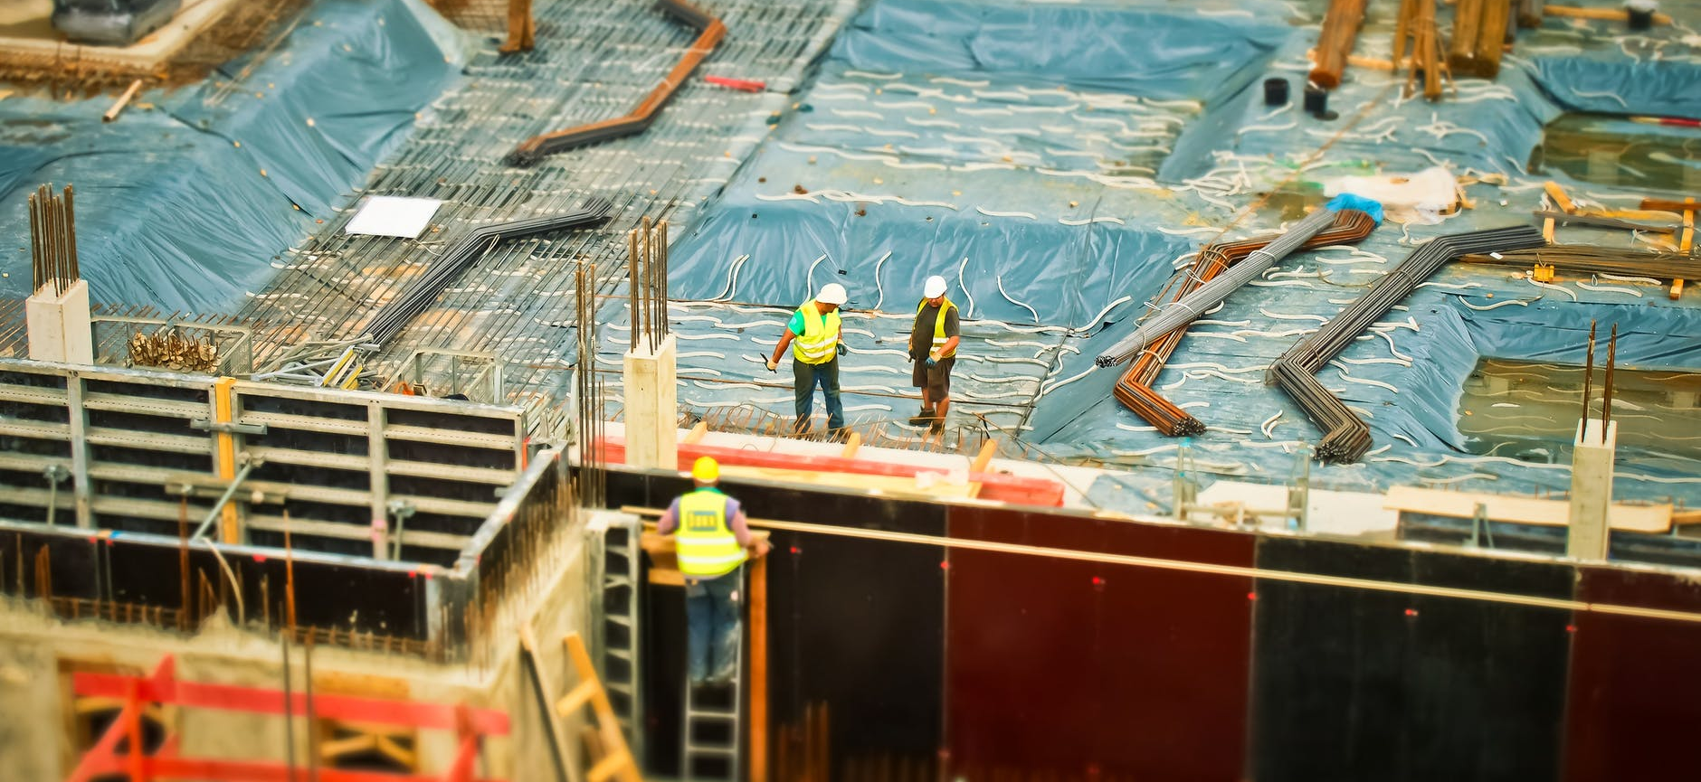
WAY OF DISCIPLESHIP:
JOINING IN WITH THE SPIRIT
The main aim of life becomes preparing for heaven and winning souls for God. The earth is simply the temporary stage on which this is played out.
All these questions may make it very tempting for us to compartmentalize life into parts in which God is involved, and those in which He is not.
Notes:
While he might be an extreme example, he illustrates what has been a common struggle in discipleship – the relationship between the soul and body, between “sacred” and “secular”. It is common among religions to see the body as something to “escape from”.
The path you take through life is shaped by where you think your destination is. A common misunderstanding is the belief that ultimately the earth will no longer exist, and instead our souls (without our bodies) will go to be in a place called heaven when we die. The main aim of life becomes preparing for heaven and winning souls for God. The earth is simply the temporary stage on which this is played out.
We will come across issues where knowing what to do might not seem clear cut, and we struggle to work out what a Christian ethical response should be. We may ask in a general sense whether work should be experienced as a blessing or a curse. All these questions may make it very tempting for us to compartmentalize life into parts in which God is involved, and those in which He is not.

Slide 12
WAY OF DISCIPLESHIP:
JOINING IN WITH THE SPIRIT
What was the original task God gave us?

Slide 13
WAY OF DISCIPLESHIP:
JOINING IN WITH THE SPIRIT
“Be fruitful and increase in number; fill the earth and subdue it.….He brought (animals) to the man to see what he would name them; and whatever the man called each living creature, that was its name. (Genesis 1:28; 2:19)
God gives humans genuine influence in how the world develops
We are made to “rule over” and “subdue” creation in the sense of protecting it and keeping destruction at bay.
Notes:
After God and human beings rested on the seventh day, God gave Adam and Eve their task. This first task is a part of us living out what it means to be made in God’s image and describes the shape of the daily existence God made us for. “God blessed them and said to them, “Be fruitful and increase in number; fill the earth and subdue it. Rule over the fish in the sea and the birds in the sky and over every living creature that moves on the ground….He brought (animals) to the man to see what he would name them; and whatever the man called each living creature, that was its name. (Genesis 1:28; 22:19)
God gives humans genuine influence in how the world develops – we name the animals. While we are not equal co-creators with God, our participation is meaningful, and honoured by God.
We are made to “rule over” and “subdue” creation in the sense of protecting it and keeping destruction at bay.

Slide 14
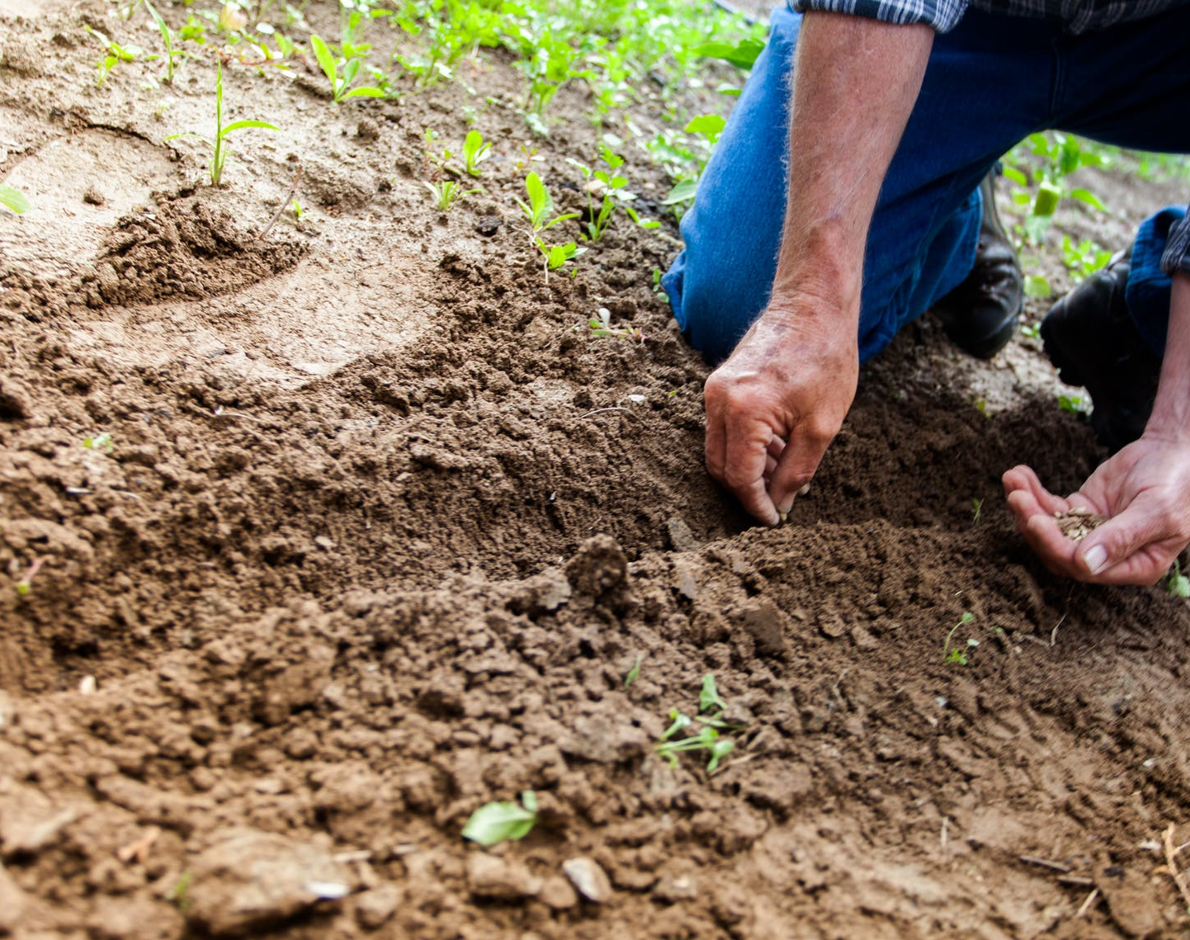
WAY OF DISCIPLESHIP:
JOINING IN WITH THE SPIRIT
“Fill the earth, not just with babies, but with music, creativity, technology, learning, art, architecture, parks, photography. Make it interesting."
Stewardship is more than maintenance, keeping things ticking over until he comes again.
Notes:
Most fundamentally in terms of our daily work, God makes human beings to be “fruitful…fill the earth” by unlocking the potential of the world that He has placed within it. This of course means creating more humans, but it also means so much more. Everything God has made is good, from the minutest cell to the furthest galaxy. It all belongs to him, and all brings him praise. But what does he want humankind to do on this earth? Keep it as it is? Sit around waiting for it all to end so that we can enter some higher non-material sphere of existence?
He places them on the stage and says "Act! Use whatever you can to bring glory to my name." Fill the earth, not just with babies, but with music, creativity, technology, learning, art, architecture, parks, photography. Make it interesting." Stewardship is more than maintenance, keeping things ticking over until he comes again. The task Adam and Eve got, and the role that we have inherited as a result, is one of building a civilisation which teases out of God's creation all that he primed it to be able to do to the glory of his name.

Slide 15
WAY OF DISCIPLESHIP:
JOINING IN WITH THE SPIRIT
What is going to happen to the earth and our daily work?

Slide 16
WAY OF DISCIPLESHIP:
JOINING IN WITH THE SPIRIT
God will restore the world, not rescue us from it.
The mission of God aims to bring healing to every aspect of life.
Everything has been created and will one day be redeemed.
Notes:
God will restore the world, not rescue us from it.
God’s mission is more like Spiderman than a fireman. A fireman will rescue people by getting them out of a dangerous place and taking them to a safe place. A lot of people think that Jesus came to take them from a nasty place – earth – to a safe place – heaven. To get them out before the whole thing goes up in flames. But that is a worldview which can lead us to abandoning any sense of real purpose for being on this earth whatsoever. If redemption is about waiting around to escape, what’s the point? Jesus was much more like Spiderman. Spiderman’s mission is to get rid of the enemy so that the people can once more live in safety and peace in what was originally a good city.
The mission of God aims to bring healing to every aspect of life. Everything has been created and will one day be redeemed.

Slide 17
WAY OF DISCIPLESHIP:
JOINING IN WITH THE SPIRIT
How does God’s mission include helping us recover our original task?

Slide 18
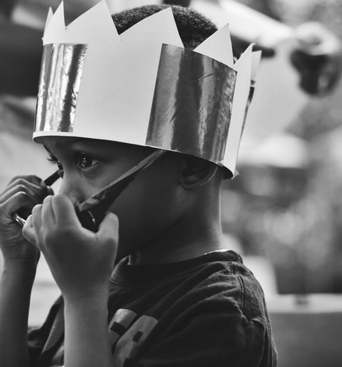
WAY OF DISCIPLESHIP:
JOINING IN WITH THE SPIRIT
If we have died with him, we will also live with him; if we endure, we will also reign with him.” (2 Timothy 2:11–13).
“His master replied, ‘Well done, good and faithful servant! You have been faithful with a few things; I will put you in charge of many things. Come and share your master’s happiness!’” (Matthew 25:21)
Notes:
Part of resurrection hope includes a promise that our original human task will be completely restored to us in the life to come. Paul promises Timothy, ““The saying is trustworthy, for: If we have died with him, we will also live with him; if we endure, we will also reign with him.” (2 Timothy 2:11–13). Jesus tells a parable to show that those who have been faithful in this life will be entrusted with more in the age to come: “His master replied, ‘Well done, good and faithful servant! You have been faithful with a few things; I will put you in charge of many things. Come and share your master’s happiness!’” (Matthew 25:21)

Slide 19
WAY OF DISCIPLESHIP:
JOINING IN WITH THE SPIRIT
What happens to the fruit of our work when God renews all things?

Slide 20
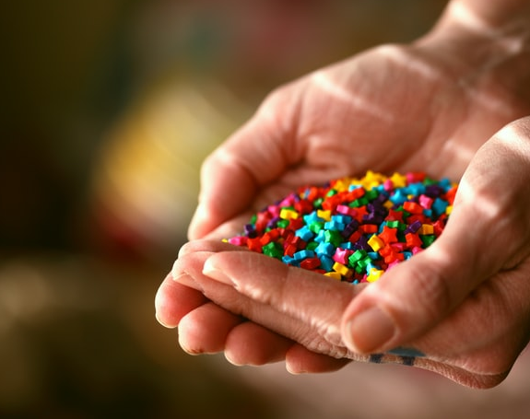
WAY OF DISCIPLESHIP:
JOINING IN WITH THE SPIRIT
The renewal of all things is shown as a city, and not a restored garden (Revelation 21). It is a promise which includes human work.
“…the kings of the earth will bring their splendour into it.”
(Revelation 21: 24)
Notes:
God’s mission to restore the world is not a return to the Garden of Eden, before human beings were able to make any changes to the world, but a renewal in which everything we do in our lifetimes, which reflects His goodness, will be included in God’s future.
This is why the renewal of all things is shown as a city, and not a restored garden (Revelation 21). It is a promise which includes human work. When John describes this future “city”, he writes how “…the kings of the earth will bring their splendour into it.” (Revelation 21: 24) In other words, all that is a true reflection of human worth is brought in.

Slide 21
WAY OF DISCIPLESHIP:
JOINING IN WITH THE SPIRIT
Are some things sacred and some things secular?
Notes:
Are some things sacred and some things secular?

Slide 22
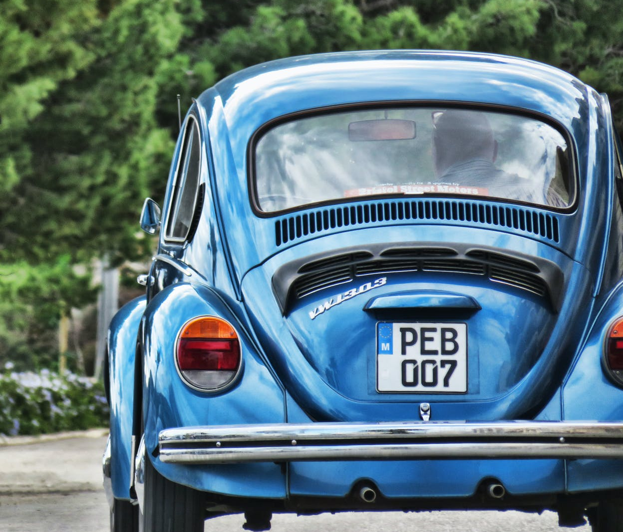
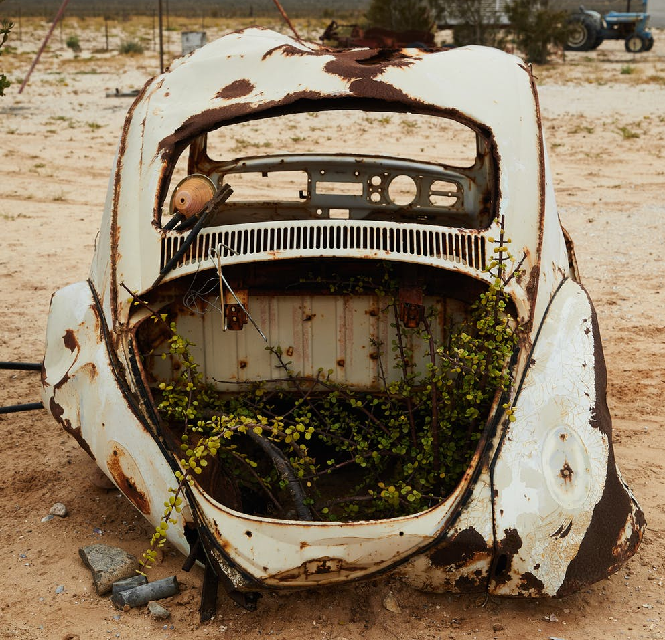
WAY OF DISCIPLESHIP:
JOINING IN WITH THE SPIRIT
“There is not one square inch of creation over which Christ does not say, “It is mine!””
“How is this aspect of life or my work originally good?” and “Is the direction it is going reflecting God’s kingdom, or is it being secularised?”
Notes:
The Dutch Prime Minister Abraham Kuyper famously said, “There is not one square inch of creation over which Christ does not say, “It is mine!”” Every part of life belongs to God, every part can be spiritual. To call some things “sacred” and other things “secular” creates a false gap between areas of life God created and those we think He did not. There is no job or world in itself that is purely “secular”.
However, any area of life made by God can be going in one of two directions. It can be reflecting and shaped around the goodness of God’s kingdom – such as George Cadbury’s approach to business. Or it can be shaped around the values of the present world, as if God has nothing to do with it. To be secular literally means to be only shaped around the values of this particular age or world.
So while nothing God has made can be secular in itself, it can still be heading in a secularised direction. Every sphere of life can be lived according to God’s rule, or not.
Instead of calling things “sacred” or “secular” it is more helpful to ask, “How is this aspect of life or my work originally good?” and “Is the direction it is going reflecting God’s kingdom, or is it being secularised?”

Slide 23
WAY OF DISCIPLESHIP:
JOINING IN WITH THE SPIRIT
What is my calling and how do I know it?

Slide 24
WAY OF DISCIPLESHIP:
JOINING IN WITH THE SPIRIT
Most of God’s mission occurs as disciples serve their callings outside of the gathered church community.
“The place God calls you to is the place where your deep gladness and the world’s deep hunger meet.”
Notes:
In joining in with God’s mission, every disciple has a calling from God, and there are no callings that are more or less important than others. To think that those who have callings within the church sphere have a “vocation”, while those who have a calling to God’s mission in a hospital do not creates a destructive split in our individual lives, but also in the church. The truth is that most of God’s mission occurs as disciples serve their callings outside of the gathered church community.
Discovering our own particular calling can need prayer and advice from others but Frederich Buechner’s definition makes “vocation” into something which can bring joy and resonate with the way we have been made and gifted. He writes, “The place God calls you to is the place where your deep gladness and the worlds deep hunger meet.” In other words, if I ask myself, “What makes me happy?” and, “Which needs do I care about in the world?” the answers to those two questions will point to our God-given calling.

Slide 25
WAY OF DISCIPLESHIP:
JOINING IN WITH THE SPIRIT
How do I celebrate ordinary, everyday things well?

Slide 26
WAY OF DISCIPLESHIP:
JOINING IN WITH THE SPIRIT
Finding God in the ordinary things of life becomes much more possible when we remember He has created every aspect of life.
Notes:
Finding God in the ordinary things of life becomes much more possible when we remember He has created every aspect of life. In his book “No Splits” Steve Shaw describes how laying a table for dinner with friends can be a joyful response to God, handling all the “ingredients” of God’s creation in a holy way.
Celtic Christians, with their emphasis on heaven overlapping with earth, have a long history of celebrating God in the ordinary things of life. This prayer, by Bruce Prewer, in a Celtic style, offers a farmer’s daily work to God:

Slide 27
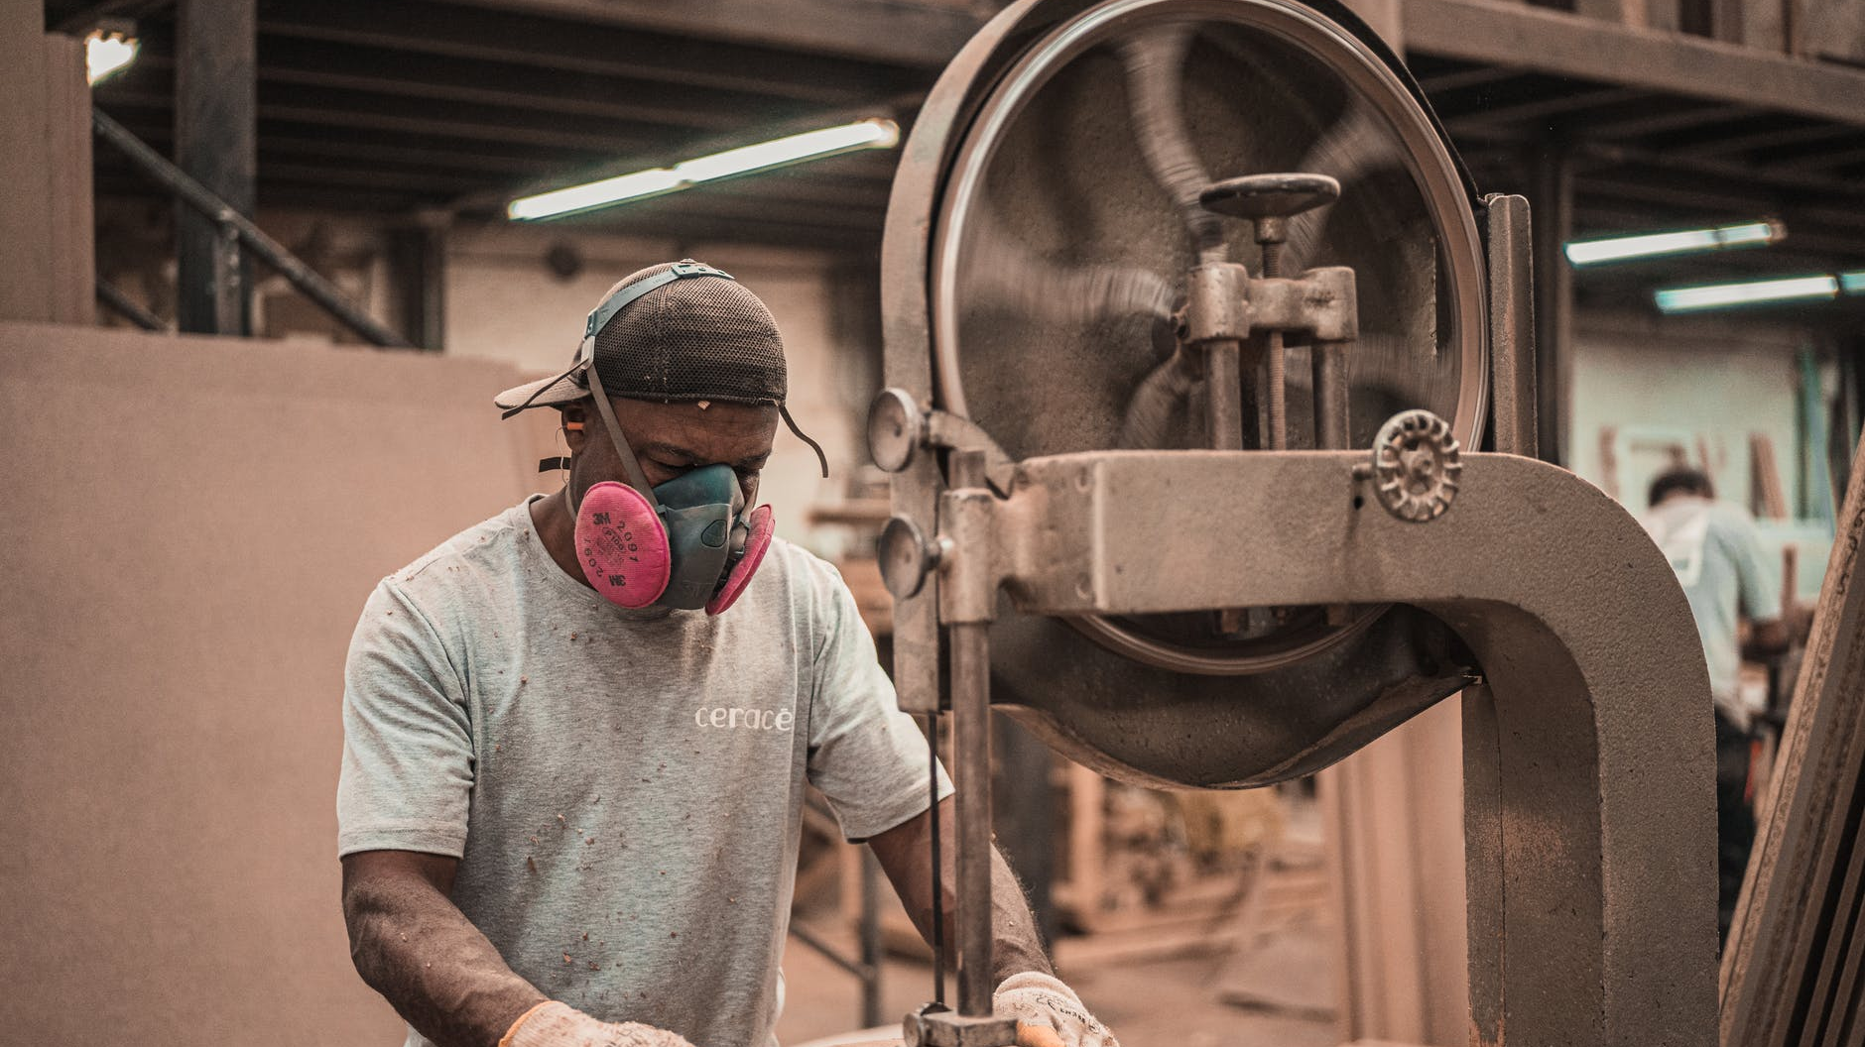
WAY OF DISCIPLESHIP:
JOINING IN WITH THE SPIRIT
Bless, Lord God, my little plot of land,
and the strength with which I’m tilling it,
bless the seed I’m carefully planting,
and the prayers I’m sowing with it.
Bless the seasons that are coming,
and the sunshine and the rain.
Bless the days and shortening nights,
and the hopes of my small barn.
Bless, O Father of good giving,
Bless, O Son of redeeming.
Bless, O Spirit of the living,
Bless, O Holy Three all-loving.
Notes:
Bless, Lord God, my little plot of land,
and the strength with which I’m tilling it,
bless the seed I’m carefully planting,
and the prayers I’m sowing with it.
Bless the seasons that are coming,
and the sunshine and the rain.
Bless the days and shortening nights,
and the hopes of my small barn.
Bless, O Father of good giving,
Bless, O Son of redeeming.
Bless, O Spirit of the living,
Bless, O Holy Three all-loving.

Slide 28
WAY OF DISCIPLESHIP:
JOINING IN WITH THE SPIRIT
How can the Good News transform daily life and work?

Slide 29
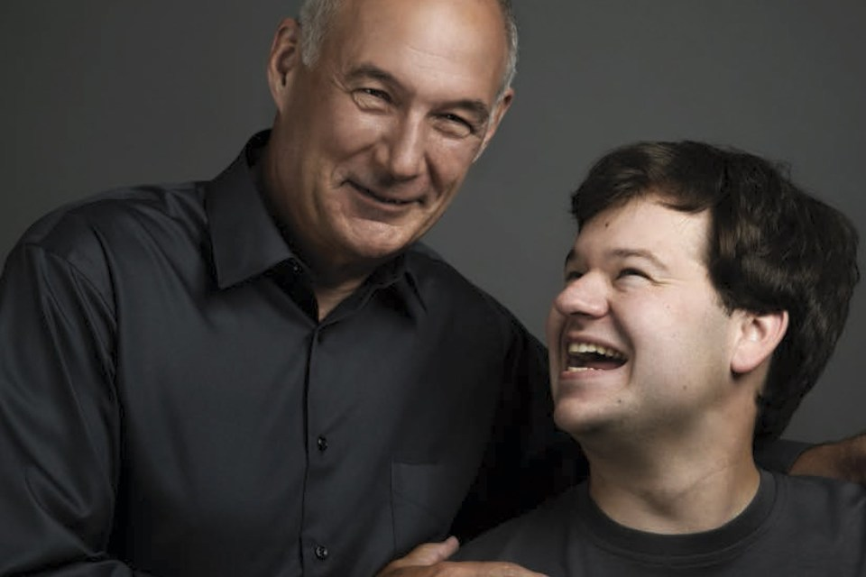
WAY OF DISCIPLESHIP:
JOINING IN WITH THE SPIRIT
Joining in with the Spirit in a workplace has the potential to bring transformation at every level – reflecting God’s “cultural mandate” and bringing healing to what is broken.
Notes:
The three stories, two real and one imagined, in the content booklet – of John, Randy Lewis and Walgreen’s and a reimagined Manchester United demonstrate how joining in with the Spirit in a workplace, while involving prayer, witness and kindness, has the potential to bring transformation at every level – reflecting God’s “cultural mandate” and bringing healing to what is broken.

Slide 30
WAY OF DISCIPLESHIP:
JOINING IN WITH THE SPIRIT
How can my church reinforce the value of everyday faith in God’s mission?

Slide 31
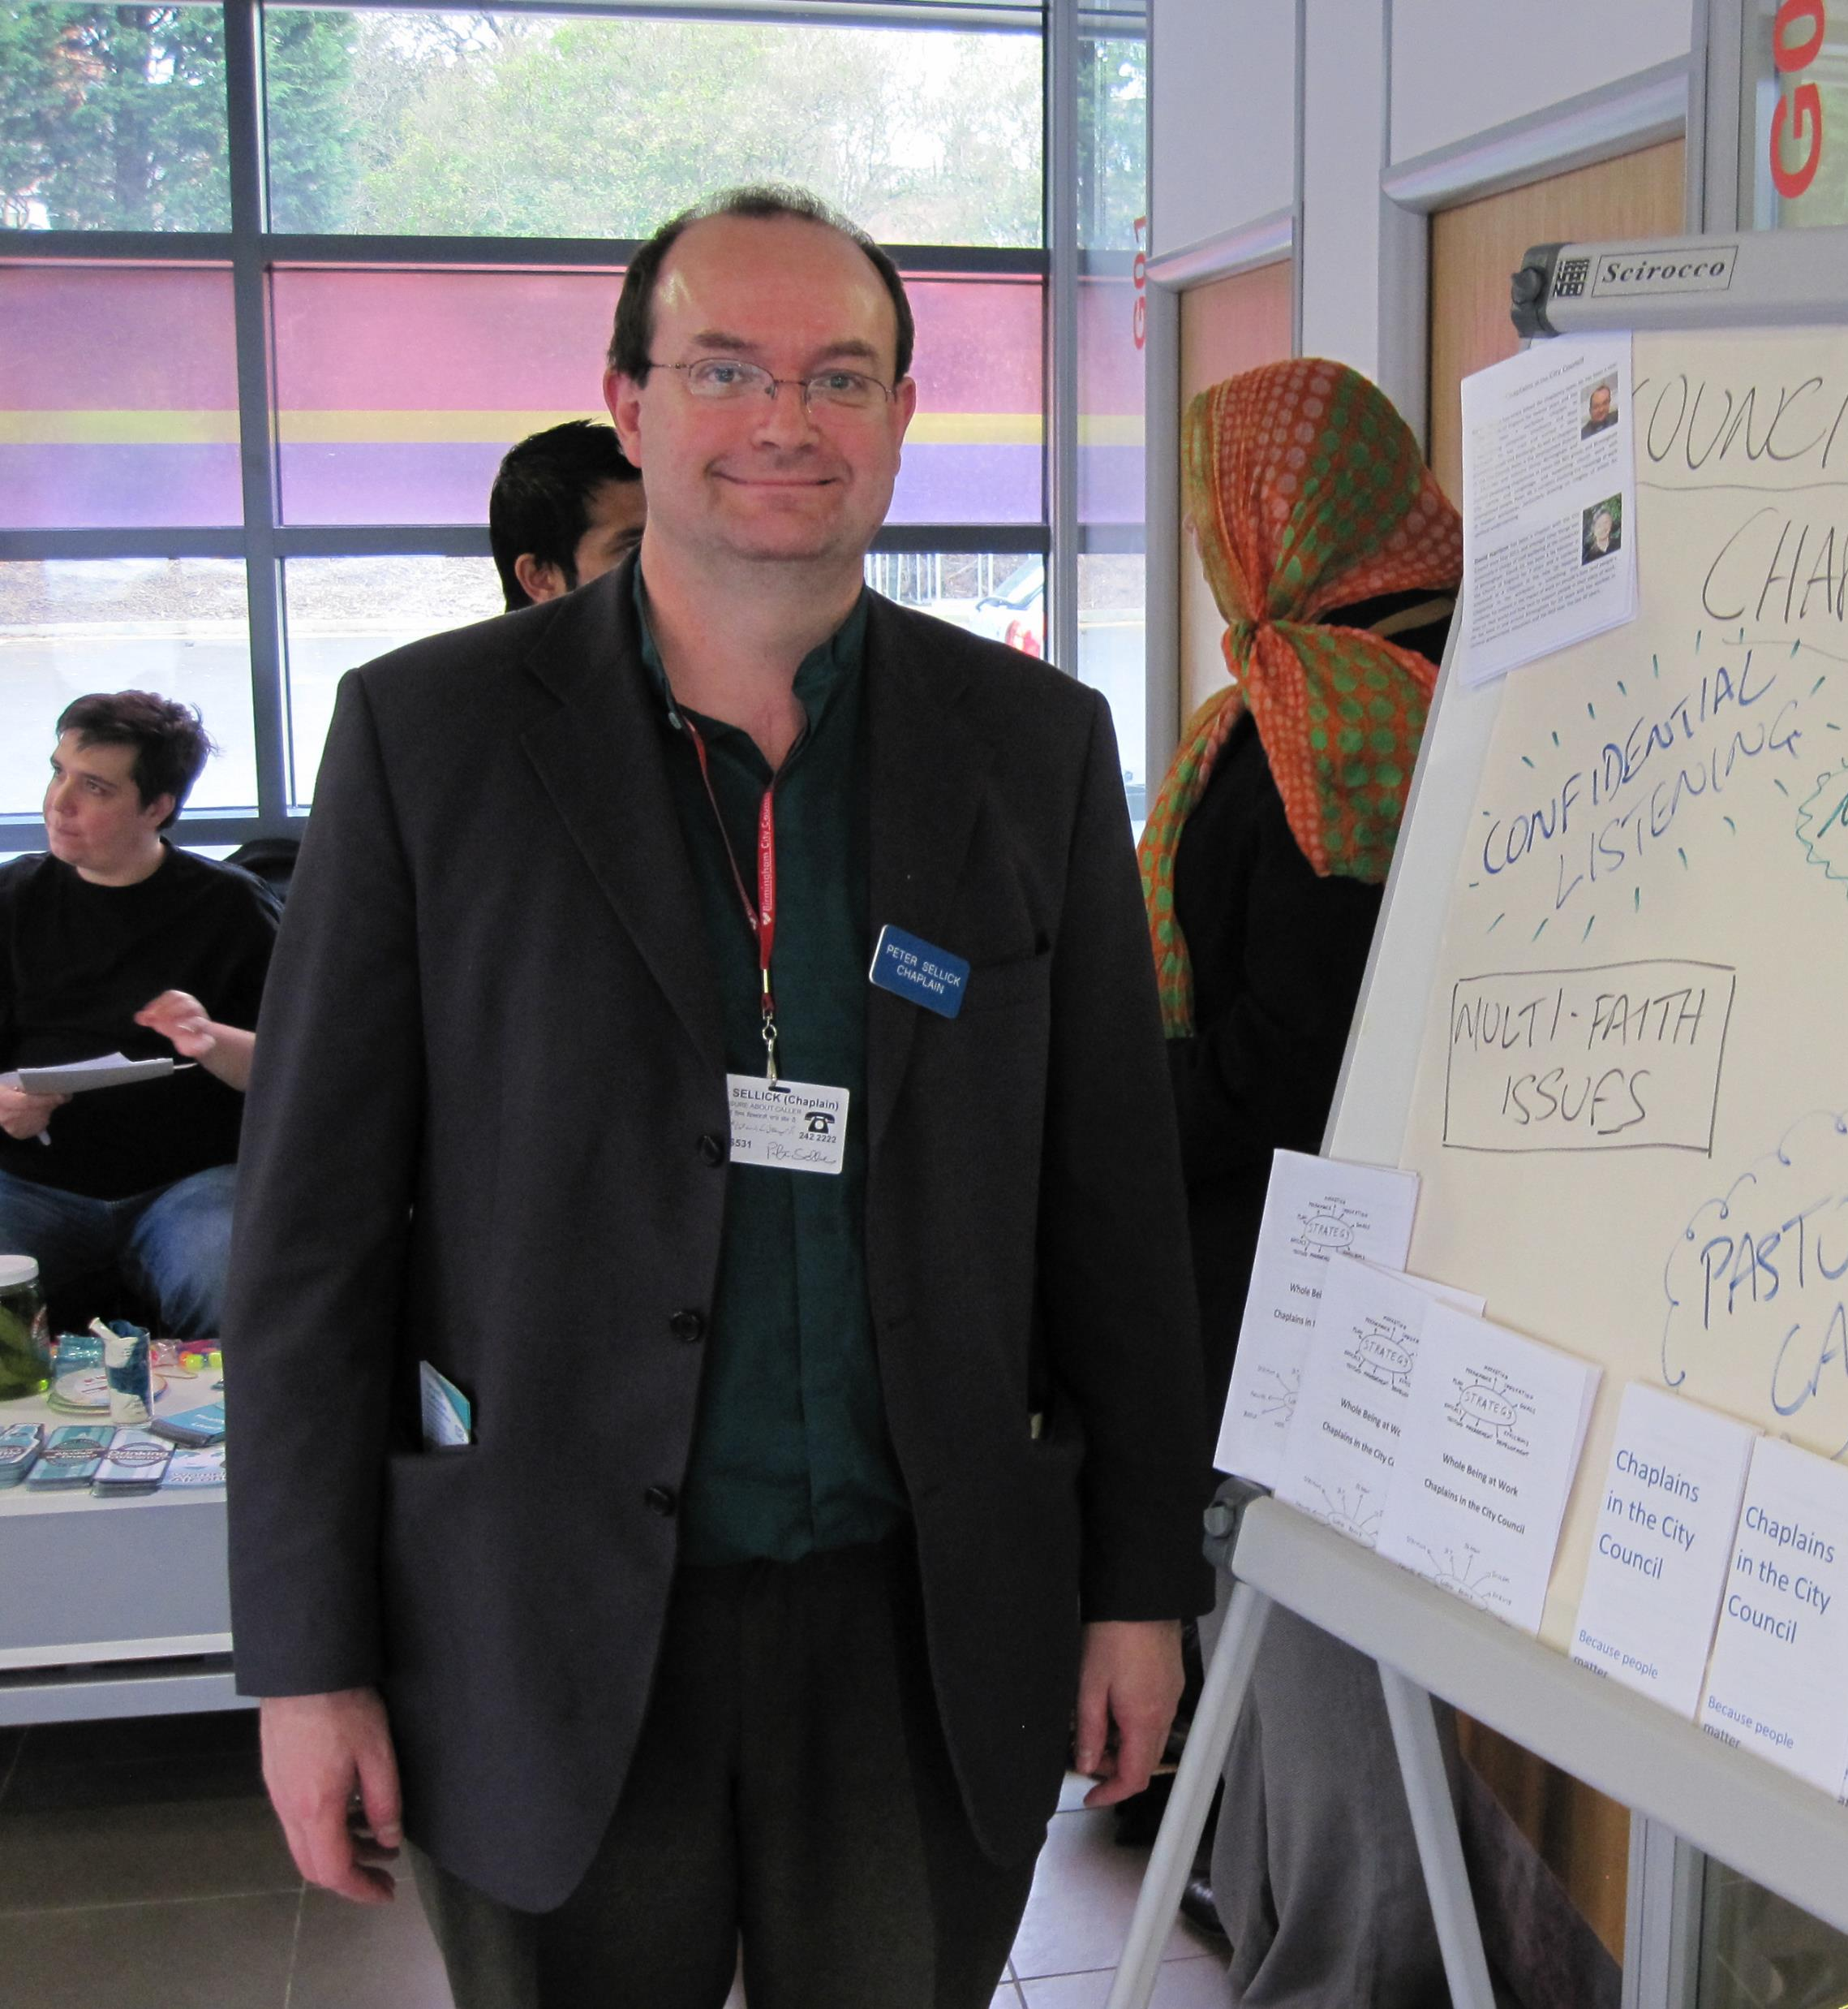
WAY OF DISCIPLESHIP:
JOINING IN WITH THE SPIRIT
Praying and supporting.
Prayer and chaplaincy in the workplace.
Notes:
Most of the time the church is scattered into different areas of life. But when we gather together there are many ways in which we can support and develop this whole-life mission. Here are three particular opportunities.
Praying and supporting. Ruth’s story shows how the prayer and support of her church enabled her to stay in a difficult work environment and witness to Christ.
Prayer and chaplaincy in the workplace. We are all “chaplains” in one sense, but the chaplaincy team in Birmingham shows the value of networking and praying with others – and the ecumenical advantages this can bring.

Slide 32
WAY OF DISCIPLESHIP:
JOINING IN WITH THE SPIRIT
Learning to change with others.
a two-year learning community to help each other address this, making seven shifts.
Notes:
Learning to change with others. We are all on the journey but making the changes to place God’s mission in everyday faith at the heart of being church can be a challenge. As we have seen, we are seeking to undo habits and thought-patterns which are centuries old.
In Church of England Birmingham we offer a very practical response to any church which wants to develop in this way. We get small teams from our churches together over a two-year period in a learning community to help each other address this. Journeying together, we seek to put seven changes in place over two years which will help our churches be increasingly growing into valuing every calling, and seeing every disciple as equally called. These changes will depend on where people are starting from, but they cover the things we do, the people we encourage in leadership and ministry, and the choices we prioritise. A handout explains the scheme in detail.

