Slide 1
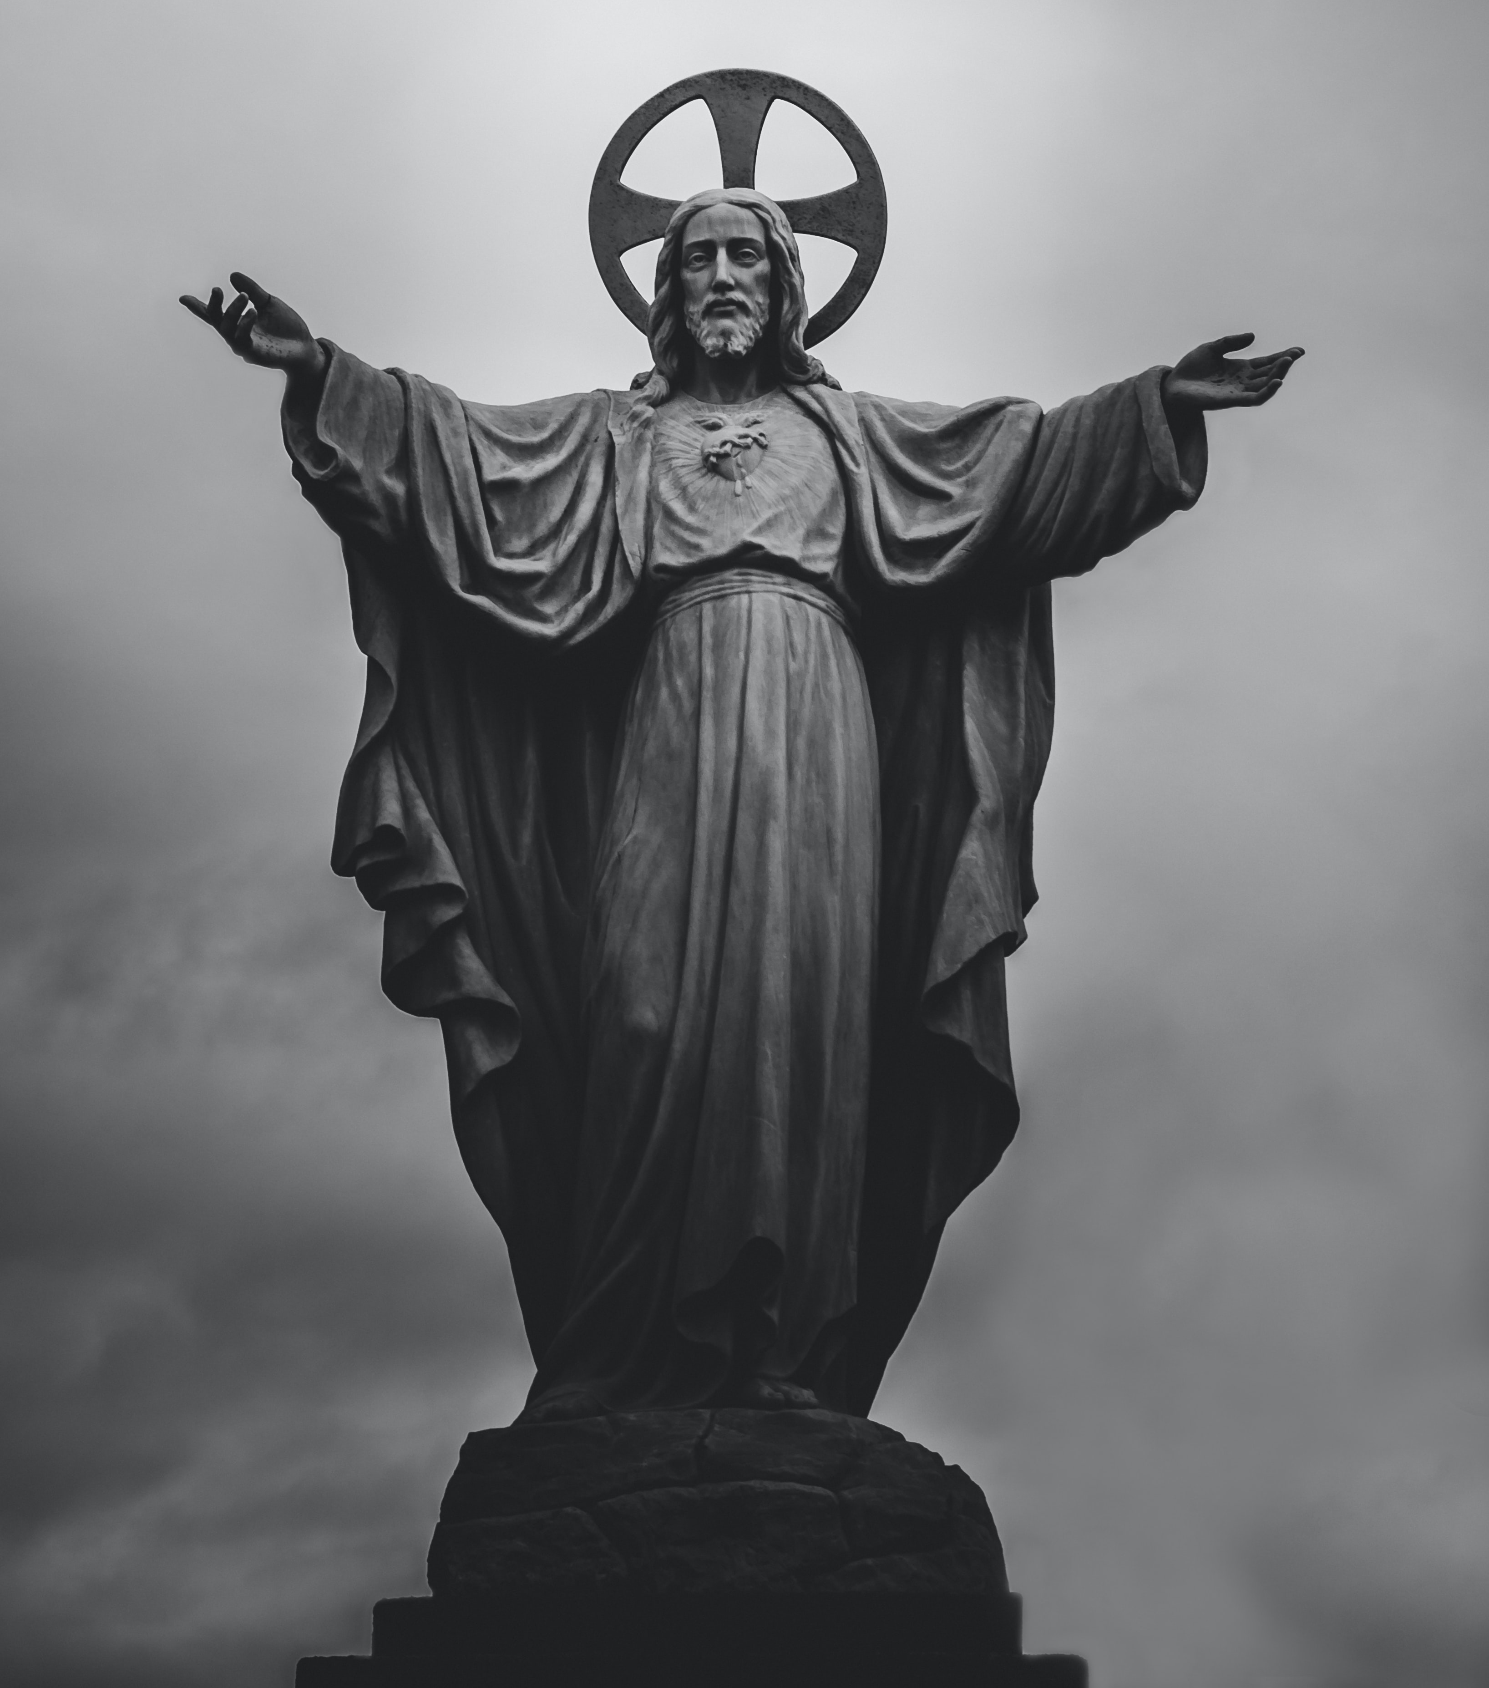

WAY OF DISCIPLESHIP:
BECOMING LIKE CHRIST
WAY OF DISCIPLESHIP: BECOMING LIKE CHRIST:
BECOMING LIKE CHRIST IN MY PRIORITIES – LETTING CHRIST BE LORD.

Slide 2
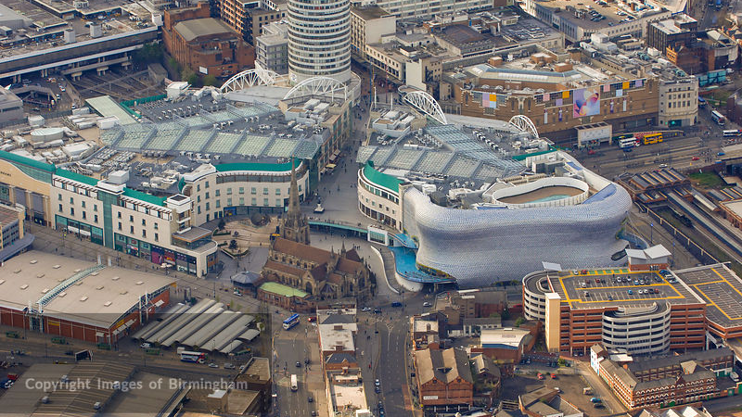
WAY OF DISCIPLESHIP:
BECOMING LIKE CHRIST
How much does Christ deserve to be at the centre of my life and why?

Slide 3
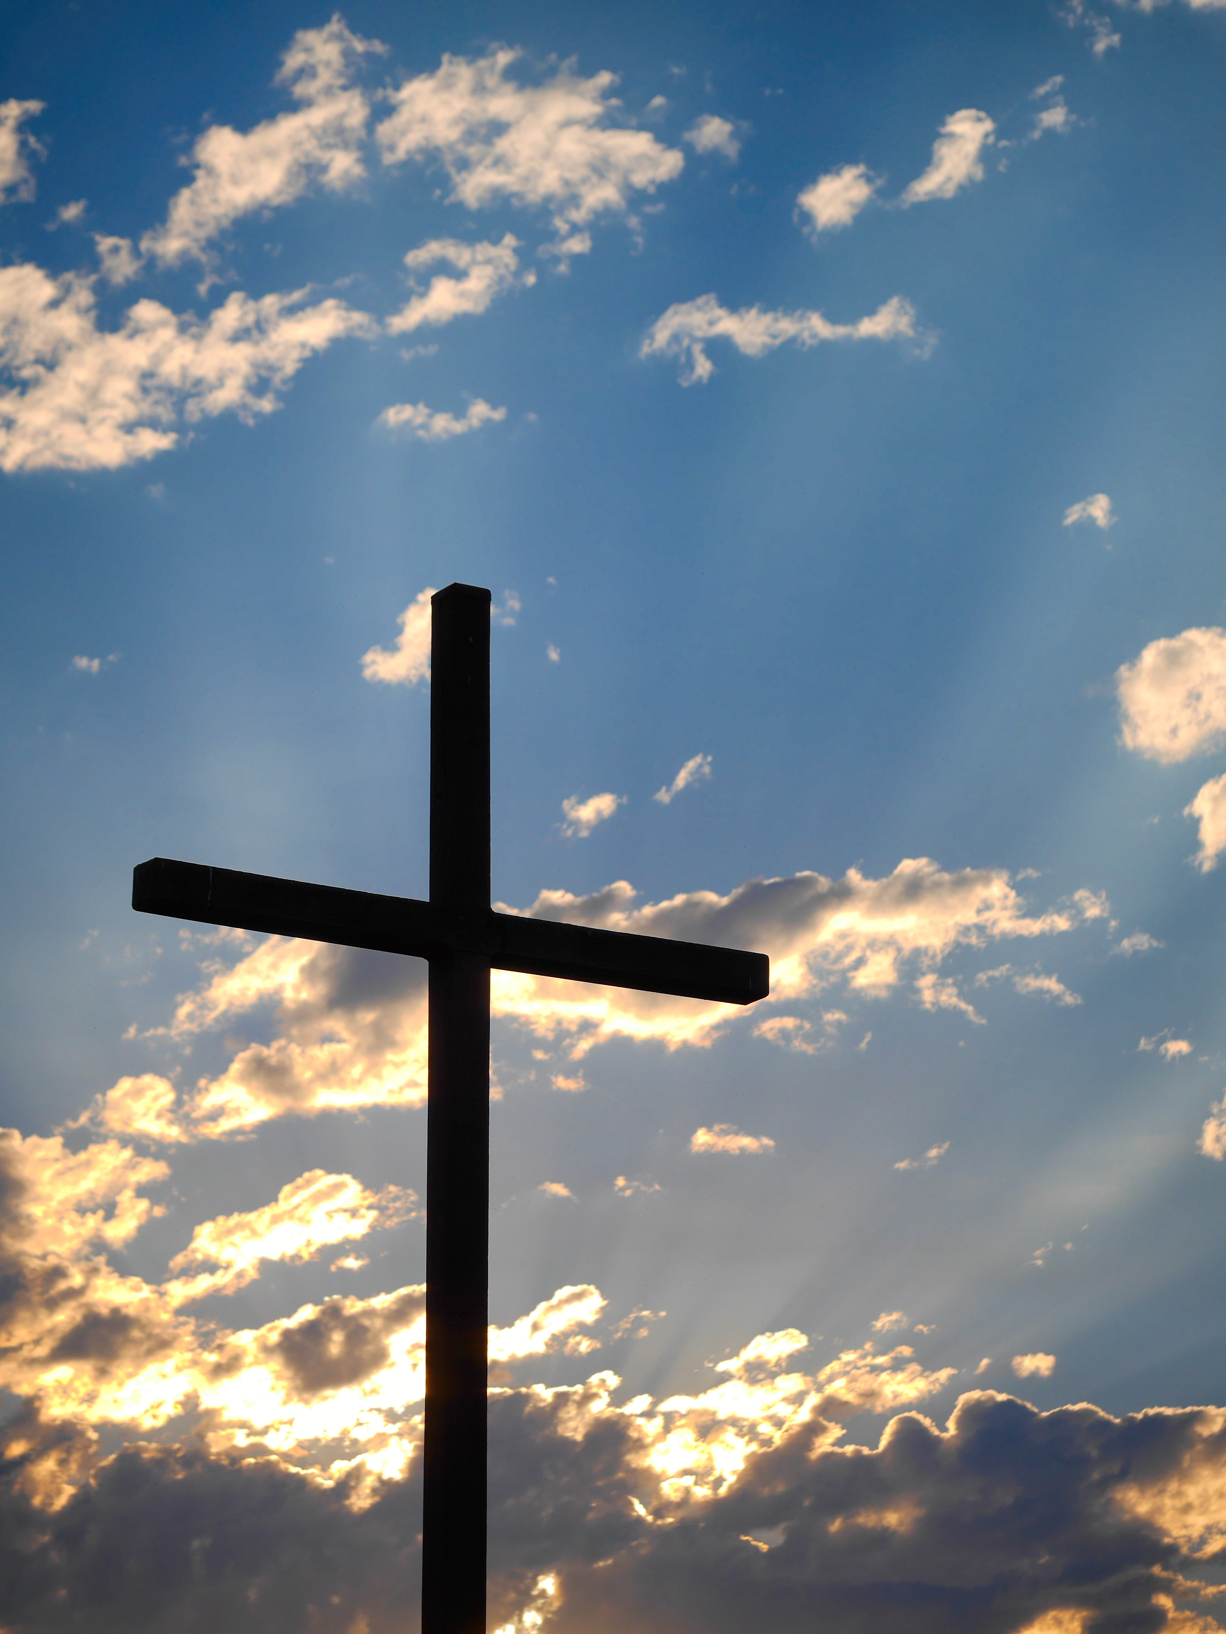
WAY OF DISCIPLESHIP:
BECOMING LIKE CHRIST
Jesus as “Saviour” and as “Lord” – the one who has broken the powers of evil and death through His life, death and resurrection.
“Do you submit to Christ as Lord?”
Notes:
One way of thinking about why we might want to “become like Christ” is to ask: how much of my allegiance does Jesus really deserve?
In this session, we look at why, as well as loving and receiving Jesus as “Saviour” – the one reconciles us to God by who taking our sins upon Himself – Christians have predominantly recognised and obeyed Him as “Lord” – the one who has broken the powers of evil and death through His life, crucifixion and resurrection. In fact, seeing Jesus as “victorious” in this way (known as “Christus Victor”) can justifiably be said to be the main way Christians have understood God’s atonement on the cross.
Lord is the name with which the early disciples responded to Christ and it is why we ask people at baptism, “Do you submit to Christ as Lord?”
As we seek to become like Christ, over these three sessions we explore how Jesus being both Saviour and Lord shapes our priorities in life, affects the way we relate to other people, and frames the way we face life’s difficulties, including our own mortality.

Slide 4
WAY OF DISCIPLESHIP:
BECOMING LIKE CHRIST
What is wrong with the world?

Slide 5

WAY OF DISCIPLESHIP:
BECOMING LIKE CHRIST
Old Testament priests would sprinkle blood over the “land” to symbolise how God needed to cleanse the world from the polluting effects of people’s sin.
Just as we need to be realistic about ourselves, so we need to be realistic about the impact we have.
Notes:
We have seen how the cross covers over the debt (atones) for the fact that human beings are affected by sin – whether that is through falling short of what it means to be made in God’s image, through broken trust, or through being “bent out of shape.” God in Christ wonderfully absorbs our sin so that we can be restored and can approach a loving and holy God with confidence.
But the Bible teaches how God wants to do much more than rescue individual people. There is a bigger task to be done. We have seen how in the Old Testament priests would sprinkle blood over the “land” to symbolise how God needed to cleanse the world from the polluting effects of people’s sin. There is no doubt that the origin of much of the pain caused in the world stems from the decisions of human beings, and the harm we do to ourselves, one another and the planet.
God wants to deal with evil and oppression. People in the (perhaps more comfortable) West are used to understanding the cross through the lens of our individual atonement – being set free from guilt or shame. But as we examine how on the cross Jesus defeats evil and oppressive powers we will be connecting with an understanding which offers liberation to those who suffer under the weight of evil in the world. Not surprisingly, this perspective (including an awareness of supernatural powers) is often more emphasised by global majority Christians in countries where the realities of political oppression, poverty and spiritual conflict are more obvious.
Just as we need to be realistic about ourselves, so we need to be realistic about the impact we have. Archbishop Desmond Tutu says that we can only be healed through this kind of honesty: ““This is what healing demands. Behaviour that is hurtful, shameful, abusive, or demeaning must be brought into the fierce light of truth, and truth can be brutal.” (Desmond Tutu, The Book of Forgiving: The Fourfold Path for Healing Ourselves and Our World). He is realistic about the “random suffering and chaos that can mark human life” and says, “we all experience sadness, we all come at times to despair, and we all lose hope that the suffering in our lives and in the world will ever end.” But that, “Our God is an expert at dealing with chaos, with brokenness, with all the worst that we can imagine. God created order out of disorder, cosmos out of chaos…because God loves us.” (Desmond Tutu, God Has a Dream: A Vision of Hope for Our Time)

Slide 6
WAY OF DISCIPLESHIP:
BECOMING LIKE CHRIST
Is there an explanation for evil in the Bible?

Slide 7

WAY OF DISCIPLESHIP:
BECOMING LIKE CHRIST
The Bible consistently describes how there is also a polluting reality to evil which is bigger than, and has a wider impact than, the actions of human beings.
From the beginning to the end of the Bible that the battle between good and evil exists not only in human beings, but also between spiritual forces.
A human being would come who will “crush your head, and you will strike his heel.” (Genesis 3:15).
Notes:
The famous American psychotherapist M. Scott Peck was for many years an agnostic believing there was no such thing as evil. But as he came to Christian faith, he began to believe that sometimes people were not simply ill or confused or poorly educated.
In his book “People of the Lie” he argued that there is such a thing as a force or forces of evil which can appear to take over humans as individuals or, occasionally, complete societies.
Importantly the Bible consistently describes how there is also a polluting reality to evil which is bigger than, and has a wider impact than, the actions of human beings. Whether we are thinking of the 188 million people killed by Hitler, Stalin, or Mao, or the 10 million children in slavery in our era, or the simple ways that lies we believe about ourselves and each other can shape us, the existence of evil far outruns what just referring to human decisions is capable of explaining.
The Bible describes the reality we live in as being an overlap of “spiritual” and “material” realms – what we know as “heaven and earth”. This might sound obvious but thinking about “spiritual” realities in a world where what we can see, feel, and hear is seen as the only truth (a materialist view of the world) can feel strange. So, it is important to know that right from the beginning to the end of the Bible that the battle between good and evil exists not only in human beings, but also between spiritual forces. These are described in various ways, but, like a mosaic, build up a consistent picture of evil which results in sin, brokenness, suffering and death. There is in Scripture simply more to reality than can be described in materialistic terms.
Within the first three chapters of the Bible we see God making the earth and humans, but we are also introduced to a world in which there are other spiritual beings apart from God. For example, God speaks to other divine powers: “Let us make humans in our own image (Genesis 1:26) and says that “the human has now become like us, knowing good and evil (Genesis 3:22). A serpent (Genesis 3:1) representing evil, seeks to influence humans with a lie (Genesis 3:1) and a cherubim (angel) is placed in the garden. (Genesis 3:24) to guard it.
From the beginning we see that, just as humans turn from God and choose their own path, some spiritual beings have rebelled in the same way and seek destruction. For example, throughout the Bible there are spiritual forces that God struggles with (often described as God’s battling with hostile waters and vicious sea monsters). These forces seek to influence individuals but can also shape whole societies. Whenever the people of Israel fought a battle on earth they would understand it as also taking place among the gods – they could not win unless God went ahead of them. Isaiah talks about the Babylonian people as being a human and spiritual enemy, who has “been cast down to the earth, you who once laid low the nations! You said in your heart, “…I will raise my throne above the stars of God…” (Isaiah 14:12-13).
Evil has a bigger source and impact than human beings. Yet crucially, the first hint we get in the Bible that a “Messiah” would come to defeat it is right back at the beginning of the story. God promises the “snake” that a human being would come who will “crush your head, and you will strike his heel.” (Genesis 3:15). This is the first promise of the way in which God will deal with spiritual forces of evil decisively.

Slide 8
WAY OF DISCIPLESHIP:
BECOMING LIKE CHRIST
Did Jesus claim to be defeating evil?

Slide 9

WAY OF DISCIPLESHIP:
BECOMING LIKE CHRIST
The final defeat of evil was at the centre of Jesus’ life, death and resurrection.
Satan as the “prince of this world”. (John 12:31)
…possessing “all the kingdoms of the world”.
(Luke 4:5-6)
“The reason the Son of God appeared was to destroy the devil’s work.” (1 John 3:8)
Notes:
Jesus and His followers saw His mission as being the one who would finally crush evil in this way. The final defeat of evil was at the centre of Jesus’ life, death and resurrection. Jesus and New Testament writers continue with the Bible’s story of the cosmic battle between good and evil. Jesus names satan the “prince of this world” (John 12:31) a term which meant “the highest official in a city or a region in the Greco-Roman world.” While God was the ultimate Lord satan has functional power. Luke portrays satan as possessing “all the kingdoms of the world” believing he can give authority to rule these kingdoms to anyone he pleases, even to Jesus (Luke 4:5-6). He has come to expel the “thief” who “comes only to steal and kill and destroy; I have come that they may have life and have it to the full.” (John 10:10). John is even clearer: “The reason the Son of God appeared was to destroy the devil’s work.” (1 John 3:8).

Slide 10
WAY OF DISCIPLESHIP:
BECOMING LIKE CHRIST
How does this help us understand what the atonement means?

Slide 11
WAY OF DISCIPLESHIP:
BECOMING LIKE CHRIST
The meaning of the cross is like a diamond
The cross not just as the way God reconciles humanity to Himself, but as a cosmic victory through which God finally defeats His enemies.
“Now is the time for judgment on this world; now the prince of this world will be driven out.” (John 12:31)
Notes:
We have seen that the meaning of the cross is like a diamond which can be seen in many ways. With the background perspective of the cosmic conflict throughout the Bible and in Jesus’ ministry, we can see the cross not just as the way God reconciles humanity to Himself, but as a cosmic victory through which God finally defeats His enemies. This is known as “Christus Victor” – the victorious Messiah. By dying and rising from the dead, Jesus was enthroned as the King who freed the whole universe from its slavery to an evil ruler and the power of death. In this victory is included the salvation of people – He is Saviour and Lord. In John as Jesus speaks of His coming death He says, “Now is the time for judgment on this world; now the prince of this world will be driven out.” (John 12:31) In Luke as the end draws near “Satan entered Judas” to prompt him to betray Jesus (Luke 22:3). At His arrest Jesus tells the soldiers, “This is your hour – when darkness reigns.” (Luke 22: 53). It is as if all evil is being lured to the cross.

Slide 12
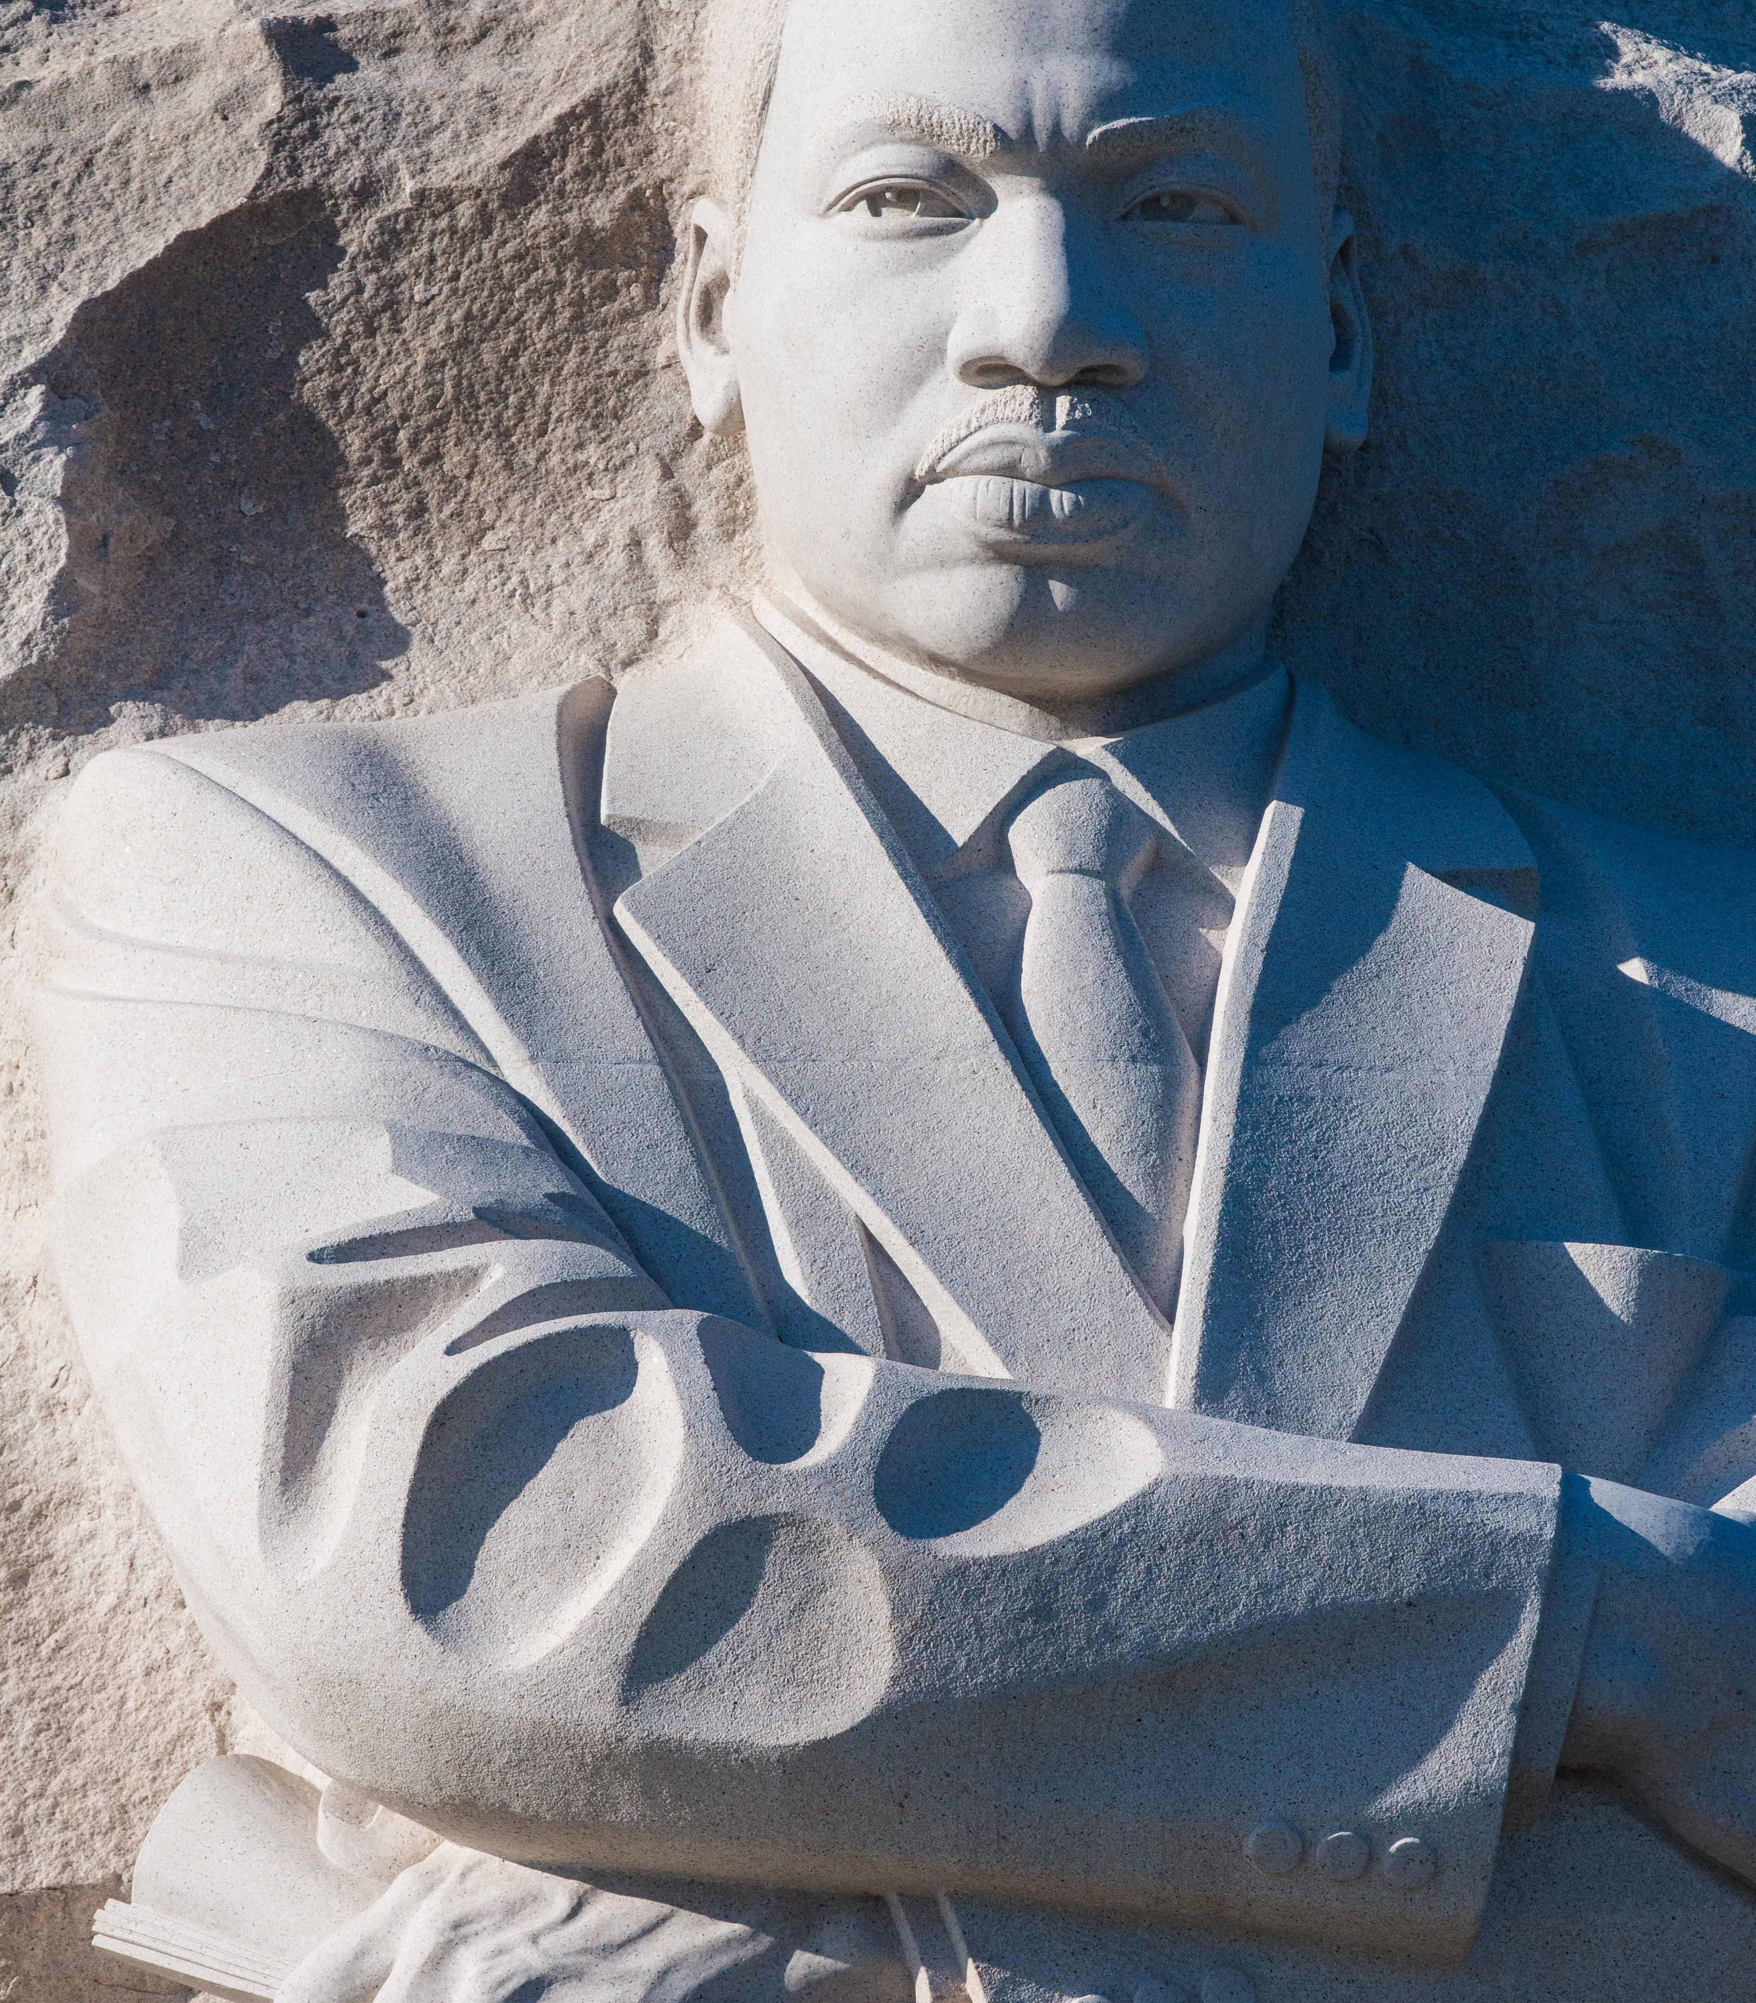
WAY OF DISCIPLESHIP:
BECOMING LIKE CHRIST
Jesus’ death make it quite clear that his execution is in fact the beginning of His being lifted up to become the divine king.
The only way anyone can rise from the dead is if evil and death have been dealt with.
Jesus’ resurrection is the proof that death, sin and evil are overcome and that Jesus is Lord.
How can apparent defeat lead to victory?
Notes:
Yet the accounts of Jesus’ death make it quite clear that his execution is in fact the beginning of His being lifted up to become the divine king. Jesus is being lifted up as the cosmic king of the world on a wooden throne, making a “royal announcement” that God’s purpose is to rescue his world by dying for it, allowing sin, evil and death to overwhelm Him. No one can fully describe exactly how this victory is achieved, but the evidence for it arrives three days later. The only way anyone can rise from the dead is if evil and death have been dealt with. Jesus resurrection is the proof that death, sin and evil are overcome and that Jesus is Lord: “Where, O death, is your victory? Where, O death, is your sting?” The sting of death is sin, and the power of sin is the law. But thanks be to God! He gives us the victory through our Lord Jesus Christ.” (1 Corinthians 15: 55-56) Just as the assassination of Martin Luther King seemed like a defeat, but resulted in a movement for peace, so Jesus’ apparent defeat overcomes evil.

Slide 13
WAY OF DISCIPLESHIP:
BECOMING LIKE CHRIST
What does Jesus’ victory mean for us as disciples?

Slide 14
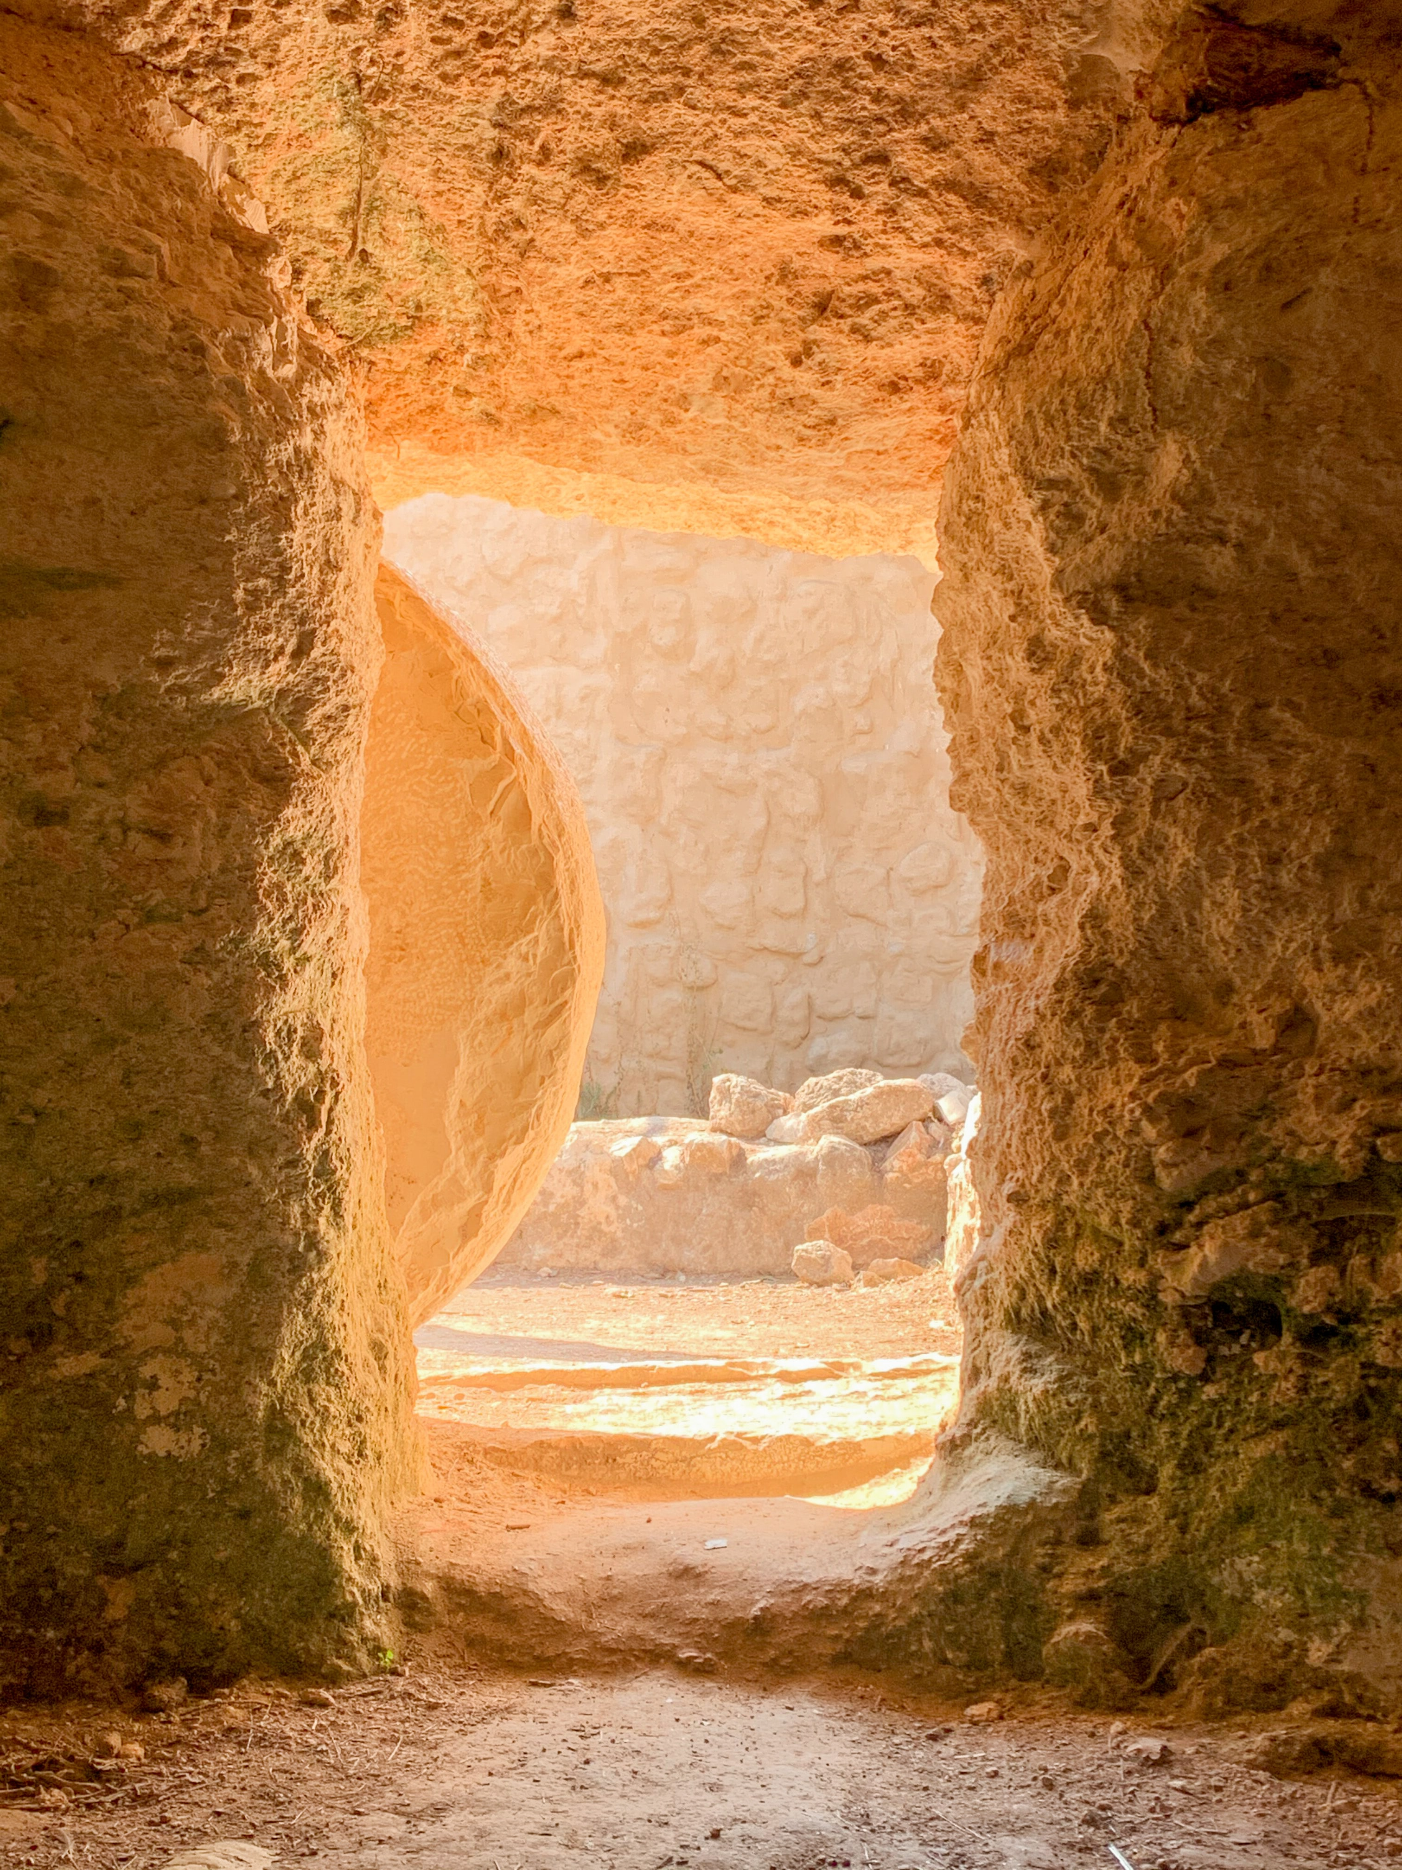
WAY OF DISCIPLESHIP:
BECOMING LIKE CHRIST
The power of death is broken.
“By his death he might break the power of him who holds the power of death.”
“Christ is risen from the dead, trampling down death by death, and to those in the tombs he has given life.”
Notes:
As the early Christians experienced the risen Jesus and reflected on His victory, they were able to grasp some life-changing realities: The power of death is broken. The full meaning of the ransom (“price of release”) paid on the cross was that in Christ God had paid to rescue His creation (including human beings) from slavery to the powers. As Eastern Orthodox Christians (who emphasise Christus Victor) say repeatedly every Easter midnight service, “Christ is risen from the dead, trampling down death by death, and to those in the tombs he has given life.”

Slide 15

WAY OF DISCIPLESHIP:
BECOMING LIKE CHRIST
Evil can no longer have the final word, and we can be who God calls us to be.
“set free from this present evil age” (Galatians 1:4)
“rescued…from the power of darkness and transferred…into the kingdom of his beloved Son.” (Colossians 1: 12-13)
Notes:
Evil can no longer have the final word, and we can be who God calls us to be. Being saved is more than individual forgiveness – it is about being “set free from this present evil age” (Galatians 1:4) and liberated from a time when “we were in slavery under the elemental spiritual forces of the world.”

Slide 16

WAY OF DISCIPLESHIP:
BECOMING LIKE CHRIST
This affects all of creation.
The “whole creation is groaning” in its “bondage to decay”.
The world itself will be rescued, or renewed, or set free.
Salvation is the liberation of the whole world of which I am only a small part.
Notes:
This affects all of creation. The suffering of the whole of creation, which is itself somehow in “slavery” due to this cosmic battle (the letter to the Romans says the “whole creation is groaning” in its “bondage to decay”), is dealt with through cross and resurrection.

Slide 17
WAY OF DISCIPLESHIP:
BECOMING LIKE CHRIST
How does this make Jesus Lord?

Slide 18
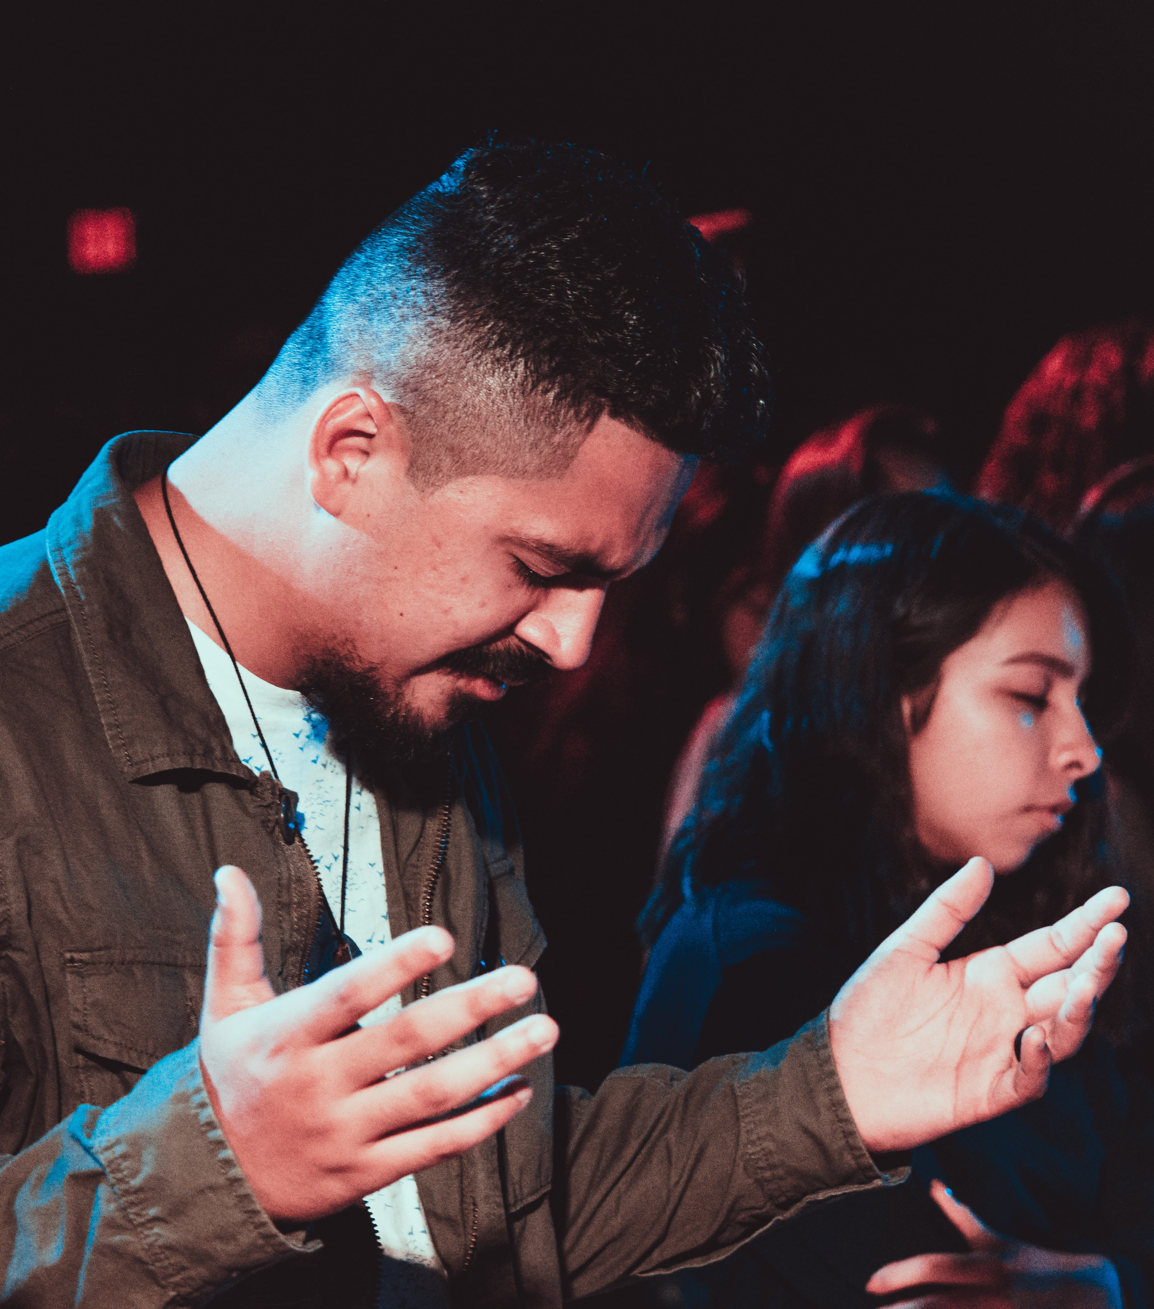
WAY OF DISCIPLESHIP:
BECOMING LIKE CHRIST
Knowing about the “life, passion, death and resurrection of Jesus Christ…leads a person to be able to say Jesus is Lord.”
“And having disarmed the powers and authorities, he made a public spectacle of them, triumphing over them by the cross.” (Colossians 2:15)
Notes:
Thomas’ response to seeing the risen Christ was to fall down and say, “My Lord and my God.” Sherry Weddell writes that knowing about the “life, passion, death and resurrection of Jesus Christ…leads a person to be able to say Jesus is Lord. Pope John Paul 2 described it as the initial ardent proclamation by which a person is one day overwhelmed and brought to the decision to entrust himself to Jesus.” A strong image Paul uses demonstrates the completeness of Jesus’ victory. He describes Jesus as a conquering ruler, bringing His defeated enemies in a humiliating procession behind Him: “And having disarmed the powers and authorities, he made a public spectacle of them, triumphing over them by the cross.” (Colossians 2:15)

Slide 19
WAY OF DISCIPLESHIP:
BECOMING LIKE CHRIST
What does this mean for my life and priorities?

Slide 20
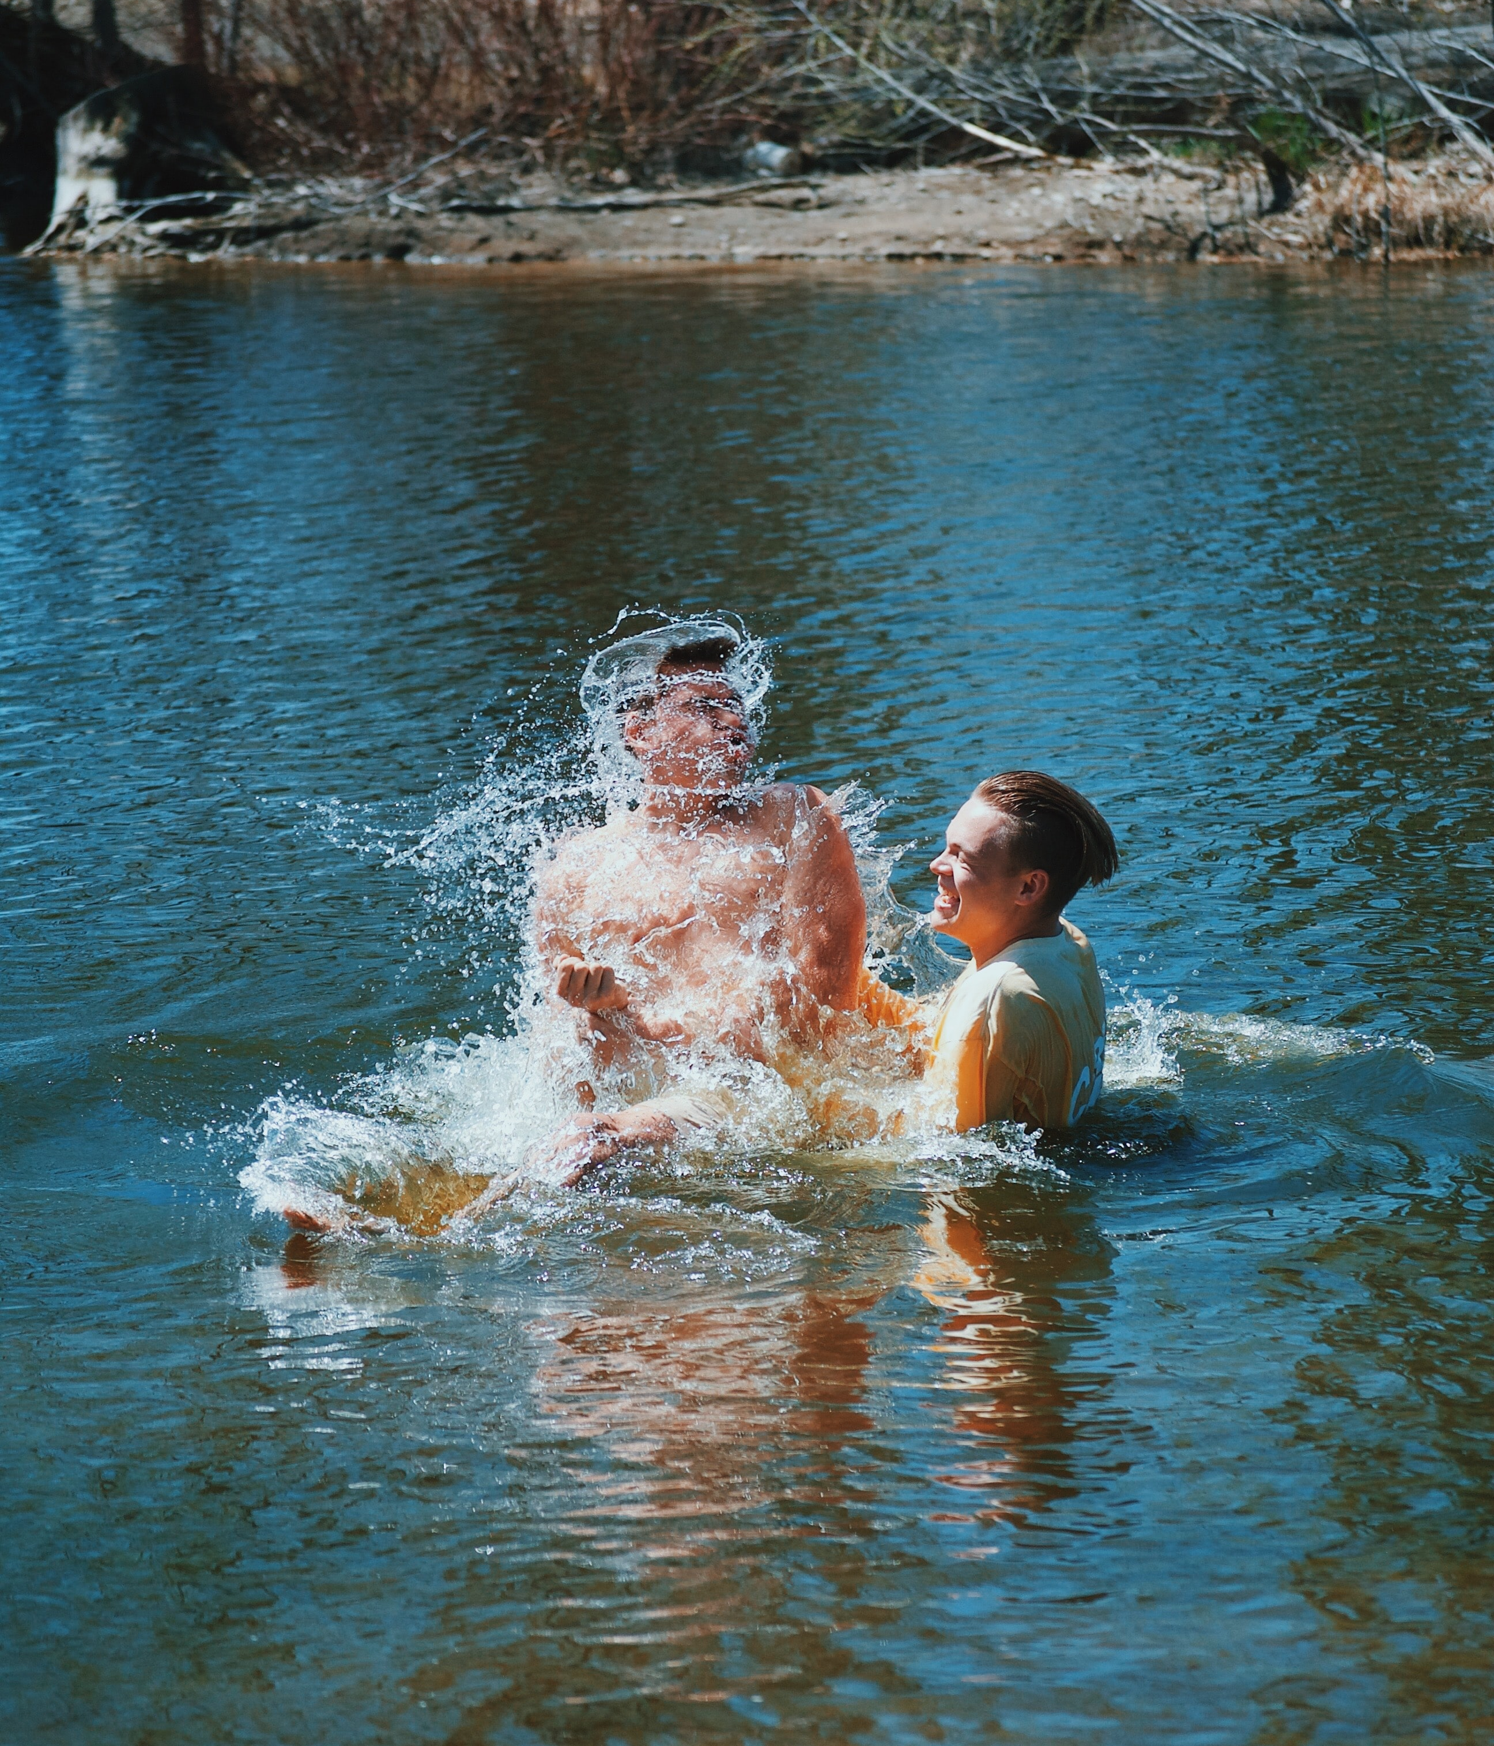
WAY OF DISCIPLESHIP:
BECOMING LIKE CHRIST
To celebrate Jesus as “personal Saviour” but not as Lord is “Christless Christianity”.
Every knee will bow "and every tongue confess that Jesus Christ is Lord, to the glory of God the Father.” (Philippians 2:11)
“Why do you call me, ‘Lord, Lord,’ and not do the things that I say?” (Luke 6:46)
Notes:
The most common statement early Christians made to describe discipleship was that “Jesus is Lord”. Today these three words are the motto for the World Council of Churches. Dietrich Bonhoeffer, a German pastor who was executed by the Nazis for resisting Hitler said that to celebrate Jesus as “personal Saviour” but not as Lord is “Christless Christianity”. When we are baptized we are asked, “Do you submit to Christ as Lord?” For early Christians to call Jesus Lord was to acknowledge both that He is God, and that, having overcome the powers, He has “all authority in heaven and on earth.” (Matthew 28: 18). Paul writes that one day every knee will bow "and every tongue confess that Jesus Christ is Lord, to the glory of God the Father.” (Philippians 2:11). To declare someone is Lord is to say they have power and authority over your life. Yet to say they are Lord without doing what they say is a self-contradiction. This is why Jesus asked, “Why do you call me, ‘Lord, Lord,’ and not do the things that I say?” (Luke 6:46) For many Christians today, and for early Christians under Roman rule, to say “Jesus is Lord” a pledge of allegiance which puts their lives on the line. Roman citizens had to say, “Caesar is Lord”. Lots of Christians lost their lives because they refused to do so – after the resurrection there was only one Lord they could submit to. (Fascinatingly, Rome had a tradition that whomever an eagle settled on would be the emperor- so when early Christians read about a dove descending on Jesus at His baptism one of the things they would have realized is that this was God’s choice to be king – though with a dove-like power totally the opposite of the emperor’s). In this context Christians saw their baptism as an oath (the original meaning of sacrament) to serve the Lord and forsake all other false rulers. (A Roman soldier would pledge a sacramentum to serve Caesar). Rather than serving the empire’s kingdom, they were serving God’s. To be baptized and say Jesus is Lord was a complete change of priorities. If Jesus is our Saviour we seek to become like Him because He is the one “who loved me and gave himself for me.” If He is Lord we place Him at the centre of our priorities because He deserves nothing less.

Slide 21
WAY OF DISCIPLESHIP:
BECOMING LIKE CHRIST
Being free from the distorted desires of materialism/other gods: Why does Jesus challenge people so much about money and material goods?

Slide 22

WAY OF DISCIPLESHIP:
BECOMING LIKE CHRIST
For Christians the reason we want to be with God, become like Christ and join in with Him is because He is Lord.
The biggest challenge to discipleship, according to Jesus, was the idolatry of making money a “lord”.
The Bible offers 500 verses on prayer, less than 500 verses on faith, but more than 2,000 verses on money and possessions.
“Those who want to get rich fall into temptation and a trap and into many foolish and harmful desires that plunge people into ruin and destruction. For the love of money is a root of all kinds of evil.” (1 Timothy 6: 9-10)
Notes:
Discipleship is essentially about what is at the centre of our lives – for Christians the reason we want to be with God, become like Christ and join in with Him is because He is Lord. Whatever or whoever we submit to is our lord. Our common idols such as money, power, reputation, ambition (or even religious ritual or status) will always fail because they cannot fill that “eternal hunger”. They leave us disappointed or worse, and our response to that lack of fulfilment can lead to behaviours in which we try and numb painful emotions by trying to find our identity through distraction (overwork, too much TV, obsessive political power) or even addiction (alcohol, drugs, pornography). We end up far from home. This is why the biggest challenge to discipleship, according to Jesus, was the idolatry of making money a “lord”. Christ says it explicitly: “No one can serve two masters. Either you will hate the one and love the other, or you will be devoted to the one and despise the other. You cannot serve both God and money.” (Matthew 6:24) In the Gospels, an amazing one out of ten verses (288 in all) deal directly with the subject of money. The Bible offers 500 verses on prayer, less than 500 verses on faith, but more than 2,000 verses on money and possessions. Paul writing to Timothy describes where the idolatry of money can lead: “Those who want to get rich fall into temptation and a trap and into many foolish and harmful desires that plunge people into ruin and destruction. For the love of money is a root of all kinds of evil.” (1 Timothy 6: 9-10)

Slide 23
WAY OF DISCIPLESHIP:
BECOMING LIKE CHRIST
Being released from having to serve these other “gods” brings freedom
“We don't have a great war in our generation, or a great depression, but we have a great war of the spirit.”
“Freedom isn't when our possessions mean nothing to us.…But the way we use our possessions can become something different:
Less about finding an identity and more about expressing an identity we've been given.
Less about excluding others and more about welcoming them.
Less about outdoing others and more about empowering them.
Less about having and more about being free to give away.
Now that is an identity. That's what I want.”
Notes:
Freedom. The writer of “Fight Club” describes how consumerism, built on advertising which always makes us want more, has led to a “depressed” society: “We don't have a great war in our generation, or a great depression, but we do, we have a great war of the spirit. We have a great revolution against the culture. The great depression is our lives. We have a spiritual depression.” The alternative, as described by Mark Powley in “Consumer Detox” is to find freedom. “Freedom isn't when our possessions mean nothing to us.…But the way we use our possessions can become something different: Less about finding an identity and more about expressing an identity we've been given. Less about excluding others and more about welcoming them. Less about outdoing others and more about empowering them. Less about having and more about being free to give away. Now that is an identity. That's what I want.”

Slide 24
WAY OF DISCIPLESHIP:
BECOMING LIKE CHRIST
Being released from having to serve these other “gods” brings contentment.
“But godliness with contentment is great gain. For we brought nothing into the world, and we can take nothing out of it. But if we have food and clothing, we will be content with that.” (1 Timothy 6: 7-8)
The real measure of our wealth is how much we would be worth if we lost all our money.
Notes:
Contentment. “But godliness with contentment is great gain. For we brought nothing into the world, and we can take nothing out of it. But if we have food and clothing, we will be content with that.” (1 Timothy 6: 7-8). The real measure of our wealth is how much we would be worth if we lost all our money.

Slide 25

WAY OF DISCIPLESHIP:
BECOMING LIKE CHRIST
Being released from having to serve these other “gods” gives us an eternal perspective
“The only thing that counts at the end of life is what we can take with us at the moment of death, which is I myself as I was in the ultimate depths of my own heart - a heart that was either full of love, or full of spite and hidden selfishness.”
Karl Rahner.
Notes:
Eternal perspective. Rather than focussing on material wealth in this life which does not last, Jesus advised His disciples to “store up for yourselves treasure in heaven” (Matthew 6:20). “The only thing that counts at the end of life is what we can take with us at the moment of death, which is I myself as I was in the ultimate depths of my own heart - a heart that was either full of love, or full of spite and hidden selfishness.” (Karl Rahner)

Slide 26
WAY OF DISCIPLESHIP:
BECOMING LIKE CHRIST
How do I have a heart like Christ’s towards money?

Slide 27
WAY OF DISCIPLESHIP:
BECOMING LIKE CHRIST
The practice of generosity in giving
“And that's why it is the Dead Sea. It receives and does not give. In the end generosity is the best way of becoming more, more, and more joyful.”
“When I have money, I get rid of it quickly, lest it find a way into my heart.”
Notes:
As we seek to let Jesus be Lord and turn away from placing our hope in money, we finish this session by looking at two transformative practices which not only give Him the place He deserves in our lives, but over time can change us to become the kind of people who live in freedom and contentment. These two practices are generosity in giving and simple living. They are the key to being freed from any “idolatrous powers” and putting Christ at the centre. Desmond Tutu says a generous heart is the way to life: “The Dead Sea in the Middle East receives fresh water, but it has no outlet, so it doesn't pass the water out. It receives beautiful water from the rivers, and the water goes dank. I mean, it just goes bad. And that's why it is the Dead Sea. It receives and does not give. In the end generosity is the best way of becoming more, more, and more joyful.” Generosity is the way to break the hold of money in our lives. John Wesley said, ‘When I have money, I get rid of it quickly, lest it find a way into my heart.’

Slide 28

WAY OF DISCIPLESHIP:
BECOMING LIKE CHRIST
Financial giving is a response to God’s love, and not a rule to obey.
“Each of you should give what you have decided in your heart to give, not reluctantly or under compulsion, for God loves a cheerful giver.” (2 Corinthians 9:7)
Notes:
Generosity can be expressed in many ways – through the giving of time, friendship, hospitality or service. But, as the area of our lives most likely to be like a “god”, the Bible has some clear teachings on how we approach giving financially to those in need. Financial giving is a response to God’s love, and not a rule to obey. Paul writes to the early Christians who were collecting for those in the church who were in need, “Each of you should give what you have decided in your heart to give, not reluctantly or under compulsion, for God loves a cheerful giver.” (2 Corinthians 9:7) Financial giving comes freely, cheerfully (the Greek word is more like hilariously – in other words shockingly extravagant!) and from the heart. The question is not, “What is the minimum I can get away with?” but, “How much can I show love for God in my extravagance?”

Slide 29
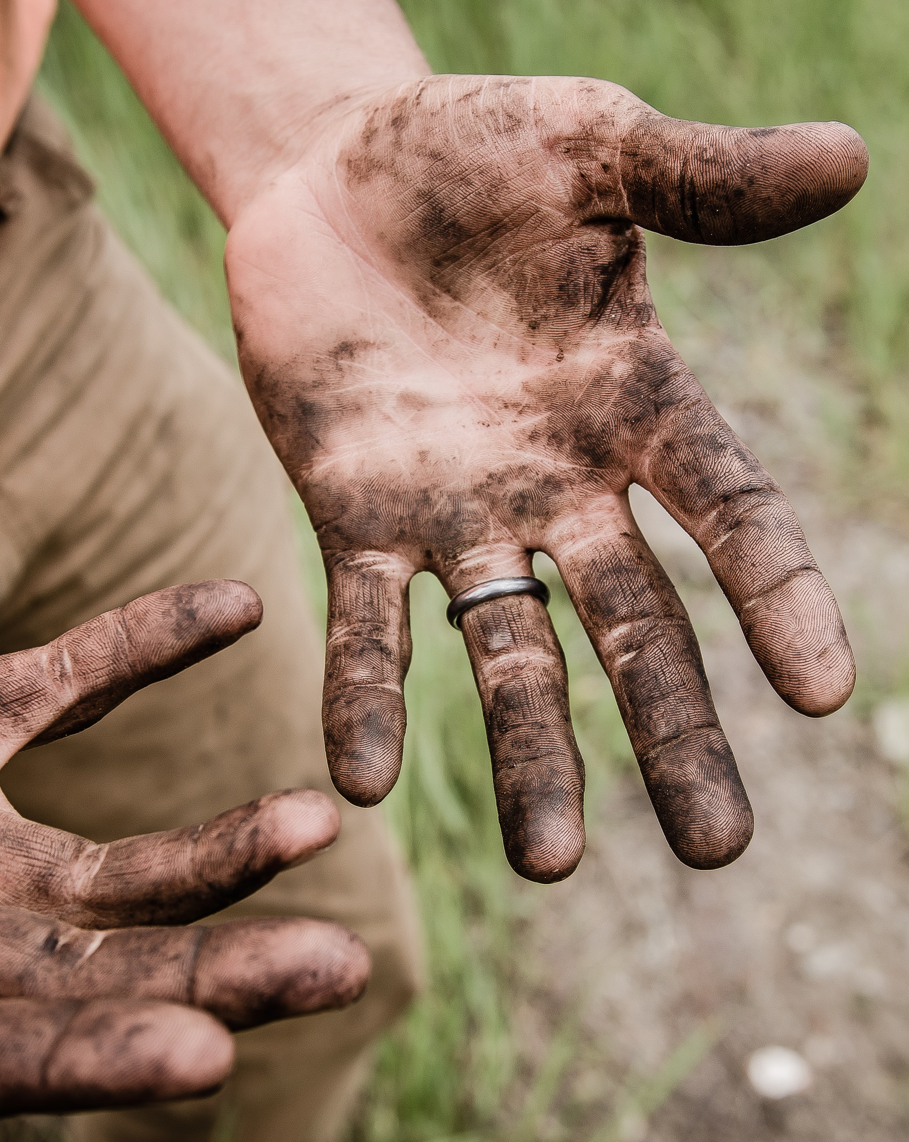
WAY OF DISCIPLESHIP:
BECOMING LIKE CHRIST
Financial giving which breaks the power of money will always be sacrificial.
‘Truly I tell you,’ he said, ‘this poor widow has put in more than all the others. All these people gave their gifts out of their wealth; but she out of her poverty put in all she had to live on.’ (Luke 21:1-4)
Notes:
Financial giving which breaks the power of money will always be sacrificial in this way. When we can give at cost to ourselves we are placing our trust in God’s wealth and provision, rather than our own. The story of the widow’s mite demonstrates how Jesus saw generosity not in what people gave, but in the amount they had left over. “As Jesus looked up, he saw the rich putting their gifts into the temple treasury. He also saw a poor widow put in two very small copper coins. ‘Truly I tell you,’ he said, ‘this poor widow has put in more than all the others. All these people gave their gifts out of their wealth; but she out of her poverty put in all she had to live on.’ (Luke 21:1-4)

Slide 30

WAY OF DISCIPLESHIP:
BECOMING LIKE CHRIST
In financial giving a tenth of income (tithe) is a useful principle.
Abram
Moses
Malachi
Proverbs
Notes:
In financial giving a tenth of income (tithe) is a useful principle. The first biblical story about tithing comes from 4600 years ago Abram gave a tenth of his goods to the priest in thanks for God’s protection in a battle. (Genesis 14:20). Moses then gave the people a law of God telling them to bring all their tithes to the priests. “I give to the Levites all the tithes in Israel as their inheritance in return for the work they do while serving at the tent of meeting.” (Numbers 18:21).

Slide 31

WAY OF DISCIPLESHIP:
BECOMING LIKE CHRIST
The tithe was never intended to be a rule, but a springboard for generosity.
Financial giving expresses love.
“We don’t think we can live generously because we have never tried. But the sooner we start the better, for we are going to have to give up our lives finally, and the longer we wait the less time we have for the soaring and swooping life of grace.”
Notes:
Yet the tithe was never intended to be a rule, but a springboard for generosity. It is a useful guide – for some it may be an aim, for others a minimum. For Jesus, the tithe was a useful principle, given originally to people who lived by laws. But if disciples, for whom financial giving comes from the heart, rightly understand that all they have is God’s, then God could easily ask them to give more than ten percent. Financial giving expresses love. In a very practical way, the early church showed their love for other parts of the church through taking an offering. Similarly, today the only people who should financially support the work of the church are disciples. For this reason, the Church of England offers an aim of 5% of income as a realistic amount for giving financially to the church community. The story of Zacchaeus shows how the practice of generous, consistent and sometimes spontaneous financial giving sets us free, changing us into people who are increasingly able to make Christ Lord. Someone said, “We don’t think we can live generously because we have never tried. But the sooner we start the better, for we are going to have to give up our lives finally, and the longer we wait the less time we have for the soaring and swooping life of grace.” A content and generous heart, able to place Christ at the centre, is worth more than any bank account contains.

