Slide 1
WAY OF DISCIPLESHIP:
BEING WITH GOD
WAY OF DISCIPLESHIP: BEING WITH GOD:
STARTING ON
THE WAY

Slide 2
WAY OF DISCIPLESHIP:
BEING WITH GOD
What is a “disciple” and where do we see discipleship today?

Slide 3
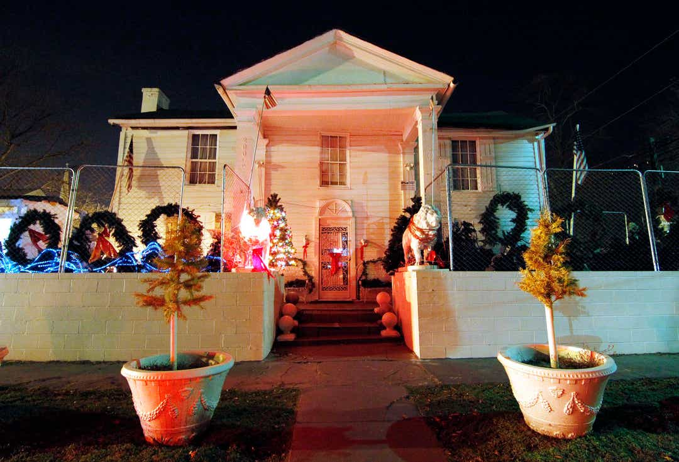
WAY OF DISCIPLESHIP:
BEING WITH GOD
Paul MacLeod and Elvis
Graceland Too
Notes:
Let’s start with three more modern examples…What do these tell us about discipleship?
The Elvis fan. Paul MacLeod was possibly the most dedicated Elvis fan in the world. His house is named after Elvis’s: Graceland Too. He made it look like Elvis’s home. His only child is called “Elvis Aaron Presley,” and he divorced his wife when she said, “It’s me or your Elvis collection.” Every room in his house is literally littered with Elvis paraphernalia.

Slide 4
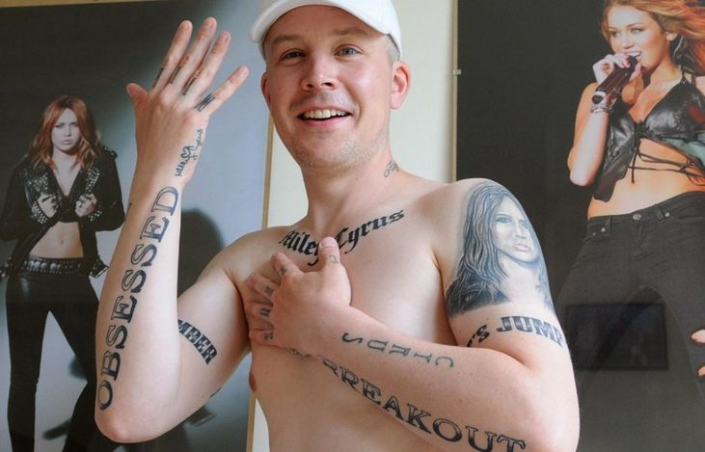
WAY OF DISCIPLESHIP:
BEING WITH GOD
Miley Cyrus tattoos
Notes:
The Miley Cyrus guy. This man has 30 tattoos of Miley Cyrus, whom he claimed got him through a divorce.

Slide 5
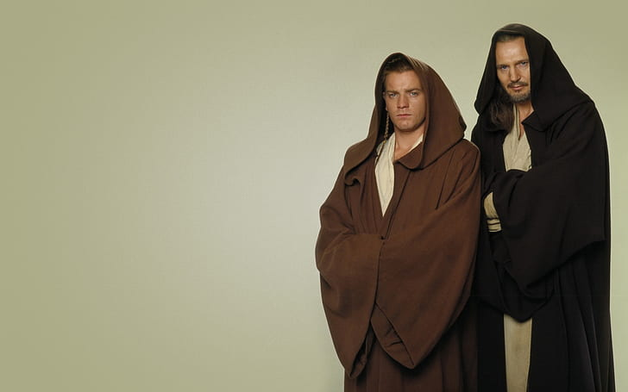
WAY OF DISCIPLESHIP:
BEING WITH GOD
Qui-gon Jinn And Obi-wan Kenobi
Star Wars, Phantom Menace.
Notes:
Qui-Gon Jinn and Obi-Wan Kenobi from Star Wars, Phantom menace.

Slide 6
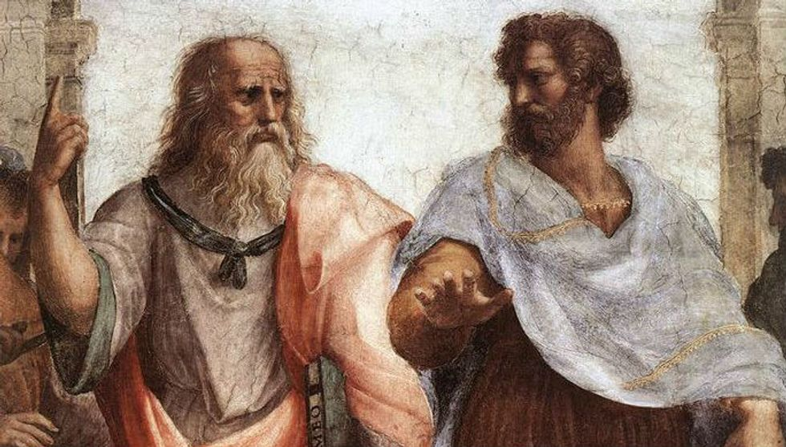
WAY OF DISCIPLESHIP:
BEING WITH GOD
An old idea
“Come and follow me.”
Notes:
Being a disciple is not just a Christian idea. Before and after Jesus, people were and had disciples. Plato was a disciple of Socrates in ancient Greece. Many Jewish teachers (Rabbis) had a set of teachings, known as their “yoke”, and disciples whom they would invite to “follow” them.

Slide 7
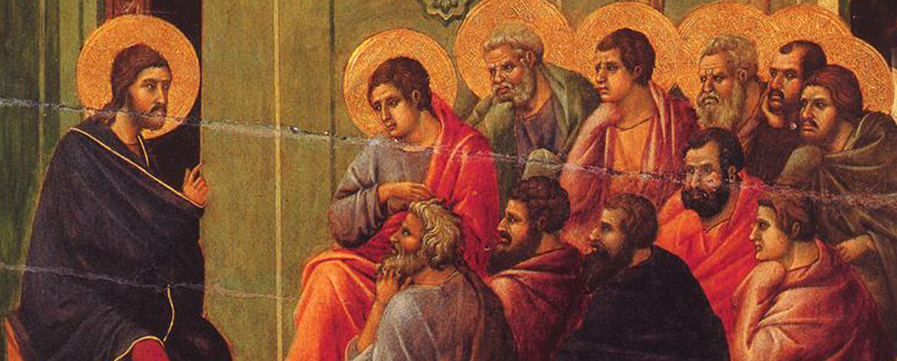
WAY OF DISCIPLESHIP:
BEING WITH GOD
Jesus the Rabbi
Disciple used 268 times.
Notes:
Most Jewish people saw Jesus as a Rabbi, a teacher – the name they give Him 90 times in the gospels – with disciples whom He invited to, “Come, follow me.” Whereas the word “Christian” only appears in the Bible three times (as an insult!), the word disciple is used 268 times.

Slide 8
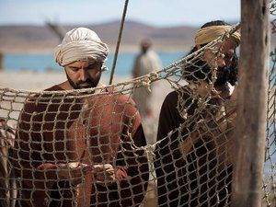
WAY OF DISCIPLESHIP:
BEING WITH GOD
First call: Follow me.
“I will send you out to fish for people.”
Notes:
Right at the beginning of His work the first thing Jesus did was to call disciples to be with Him 16 As Jesus walked beside the Sea of Galilee, he saw Simon and his brother Andrew casting a net into the lake, for they were fishermen. 17 “Come, follow me,” Jesus said, “and I will send you out to fish for people.” 18 At once they left their nets and followed him. 19 When he had gone a little farther, he saw James son of Zebedee and his brother John in a boat, preparing their nets. 20 Without delay he called them, and they left their father Zebedee in the boat with the hired men and followed him.

Slide 9
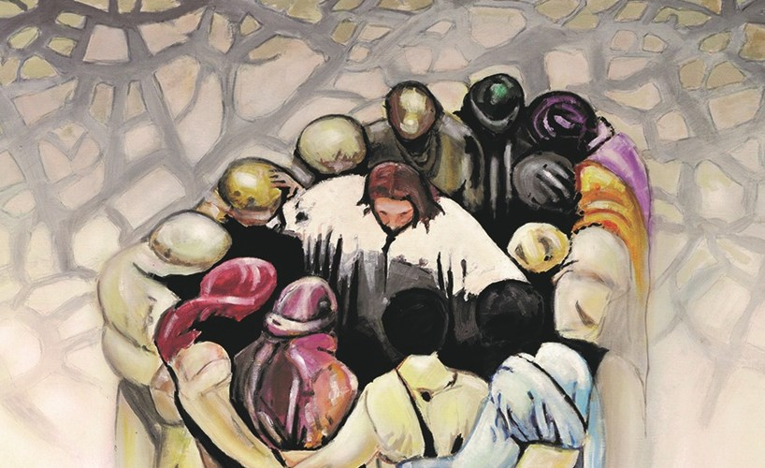
WAY OF DISCIPLESHIP:
BEING WITH GOD
Last call:
“Go and make disciples.”
Notes:
And right at the end of His work, Jesus told his disciples to, “Go and make disciples.”

Slide 10
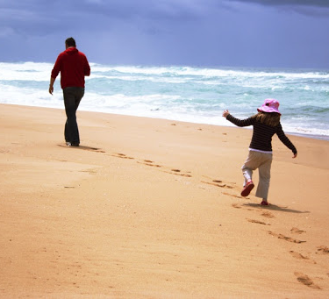
WAY OF DISCIPLESHIP:
BEING WITH GOD
A Disciple is someone who learns…as they follow.
Notes:
The call was not to, “Believe in Him,” but to, “Follow Him.” To be a disciple of someone is about being someone who “learns as they follow.” It is about having a close relationship with someone in which we are increasingly being with them, becoming like them, and doing the things they do. To be a disciple is to follow, and the nature of that discipleship is defined by the One we follow.

Slide 11
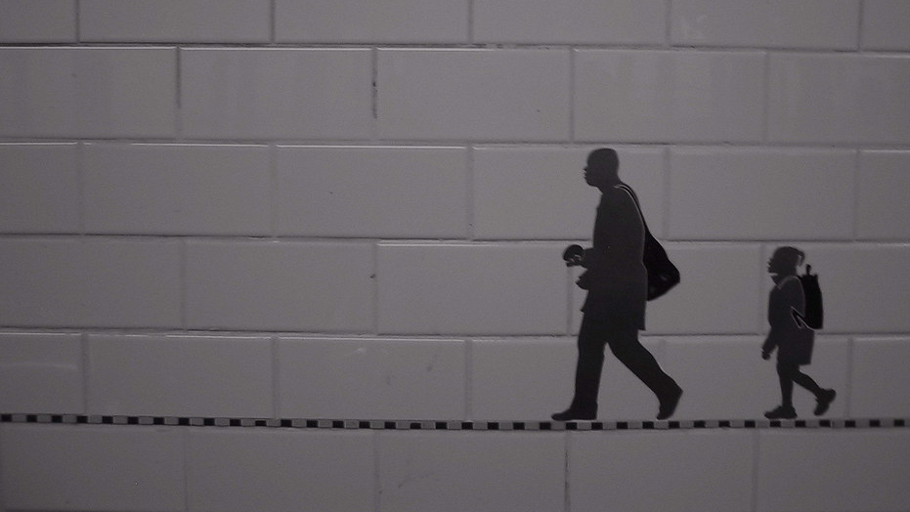
WAY OF DISCIPLESHIP:
BEING WITH GOD
“Being a disciple or apprentice of Jesus is a definite and obvious kind of thing. To make a mystery of it is to misunderstand it. There is no good reason why people should ever be in doubt as to whether they themselves are his students or not.”.
Notes:
One writer says that, “Being a disciple or apprentice of Jesus is a definite and obvious kind of thing. To make a mystery of it is to misunderstand it. There is no good reason why people should ever be in doubt as to whether they themselves are his students or not.”

Slide 12
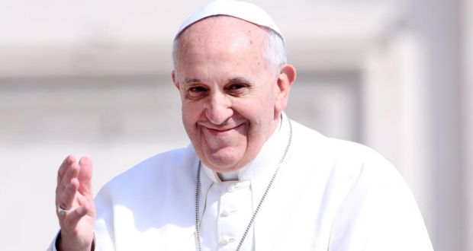
WAY OF DISCIPLESHIP:
BEING WITH GOD
“community of missionary disciples.”
Notes:
Many churches, especially today, emphasise discipleship. Pope Francis says that the church should be a, “community of missionary disciples.” You can read Everything Jesus said about discipleship, and a paper from the Church of England about discipleship.

Slide 13
WAY OF DISCIPLESHIP:
BEING WITH GOD
Why is being a disciple a good way of life?

Slide 14
WAY OF DISCIPLESHIP:
BEING WITH GOD
We all follow someone.
“…if we don’t disciple, then the culture sure will, and it’s doing a good job of it. Consumerism is the alternative religion of our day.”
“Who or what is shaping me?”
Notes:
There are five good reasons to be living as a disciple: We all follow someone. The examples of superfans might be unusual, but the truth is we are all centering our lives on something or someone. 24 hours a day. As one writer puts it, “…if we don’t disciple, then the culture sure will, and it’s doing a good job of it. Consumerism is the alternative religion of our day.” Alan Hirsch. The question isn’t, “Am I a disciple?” The question is, “Who or what is shaping me?”

Slide 15
WAY OF DISCIPLESHIP:
BEING WITH GOD
Becoming fully human.
“theosis”.
Eventually the (human) mirror is no longer seen, but only the reflected glory of God.
Notes:
Becoming fully human. Someone once said that Jesus did not come to make us more religious but came to make us fully human. Orthodox Christians have a beautiful understanding of being a disciple called “theosis”. It’s not that we can “become God”, but that as we draw close to God and reflect His love and life more fully, we become alive, more human as humanity was intended to be, because we have allowed God’s life to fill and eventually overwhelm us. Discipleship takes us along this road until eventually the (human) mirror is no longer seen, but only the reflected glory of God.

Slide 16
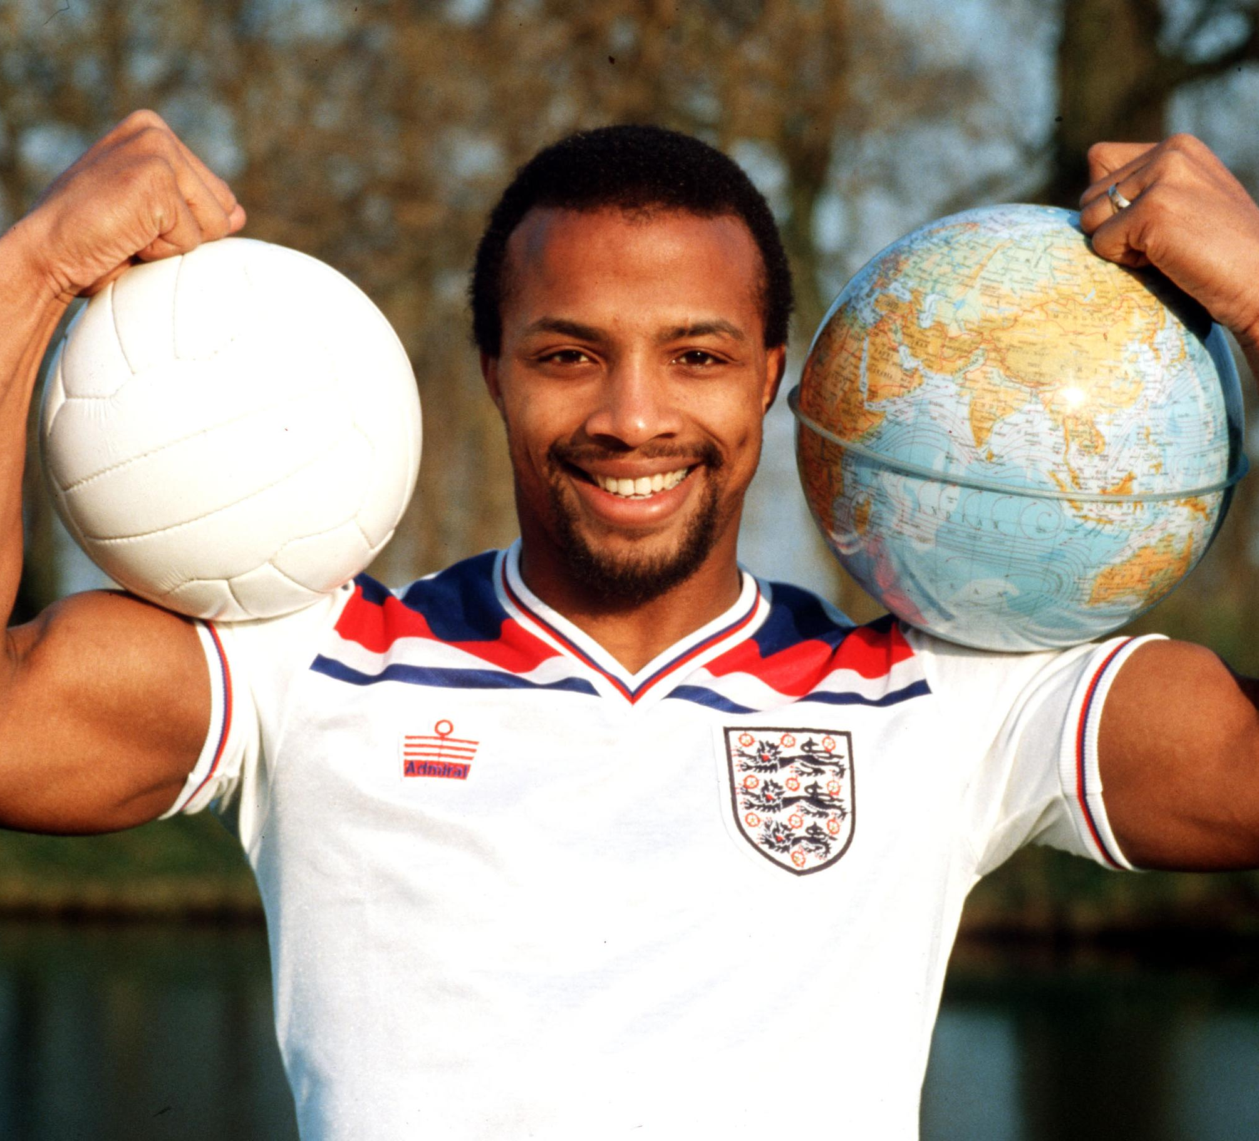
WAY OF DISCIPLESHIP:
BEING WITH GOD
It’s the best life you can find
“… the penny drops. It really sinks in that Christ loves me. He died for me and He rose again from the dead and this awesome sense of peace comes over me.”
Notes:
It’s the best life you can find! Cyrille Regis was the third black player to be capped by England, and a pioneer in the fight against racism in football. He played 614 matches and scored 158 goals in a 19-year professional career with Coventry, West Brom, Aston Villa and Wolves, which also saw him make five appearances for England. He became a Christian when he discovered that, “… the penny drops. It really sinks in that Christ loves me. He died for me and He rose again from the dead and this awesome sense of peace comes over me.”

Slide 17
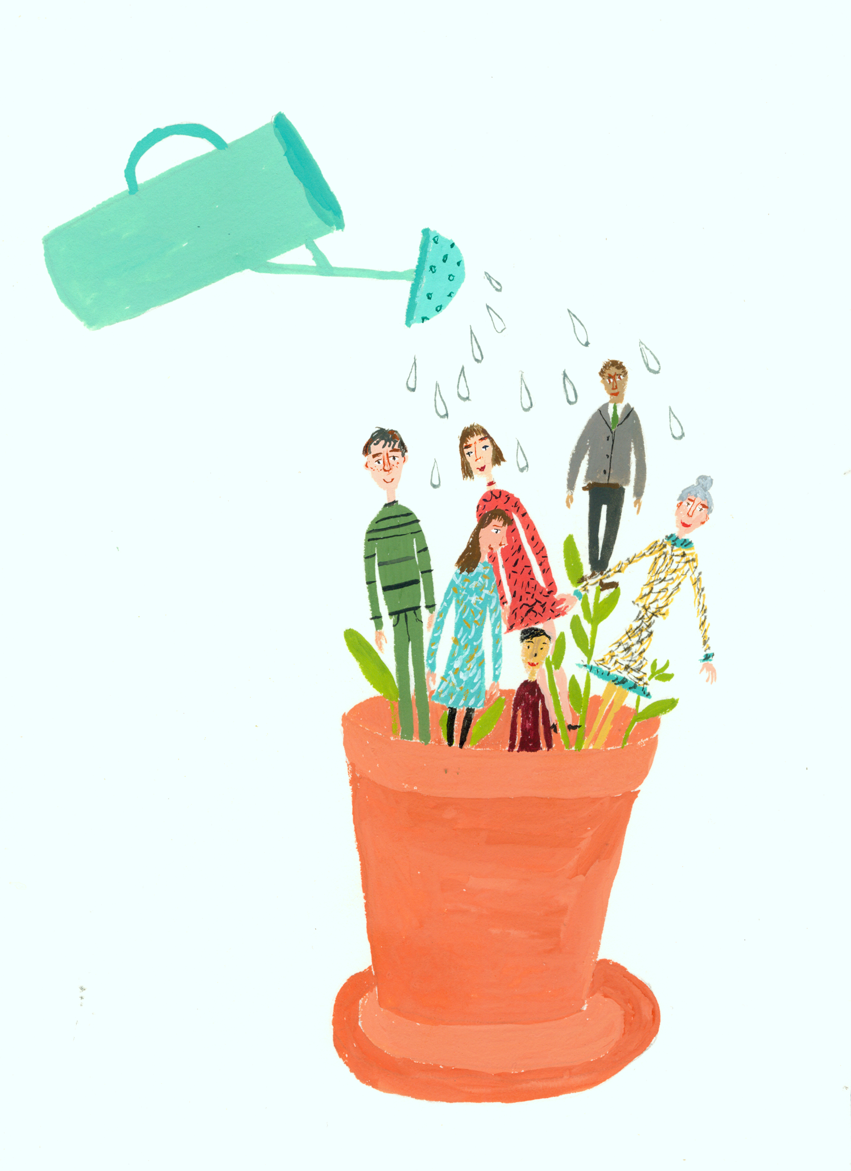
WAY OF DISCIPLESHIP:
BEING WITH GOD
Being and making disciples is the Church’s central task.
“The best way to grow the church is to grow people.”
If we focus on being and making disciples first, the rest will follow.
Notes:
Being and making disciples is the Church’s central task. The writer Robert Warren states, “The best way to grow the church is to grow people.” In the Roman Catholic Church, writer Sherry Weddell says, “…we have seen it happen over and over. The presence of a significant number of disciples changes everything: a parish’s spiritual tone, energy level, attendance, bottom line, and what parishioners ask of the leaders.” So the truth is if we focus on being and making disciples first, the rest will follow. Can we agree with this? “The best decision anyone can ever make, at any point in life, in any circumstances, whoever they are, wherever they are, is to become a disciple of Jesus Christ.” Archbishop Justin Welby

Slide 18
WAY OF DISCIPLESHIP:
BEING WITH GOD
What was the life of a disciple in Christ’s day?
What’s the aim of discipleship?

Slide 19
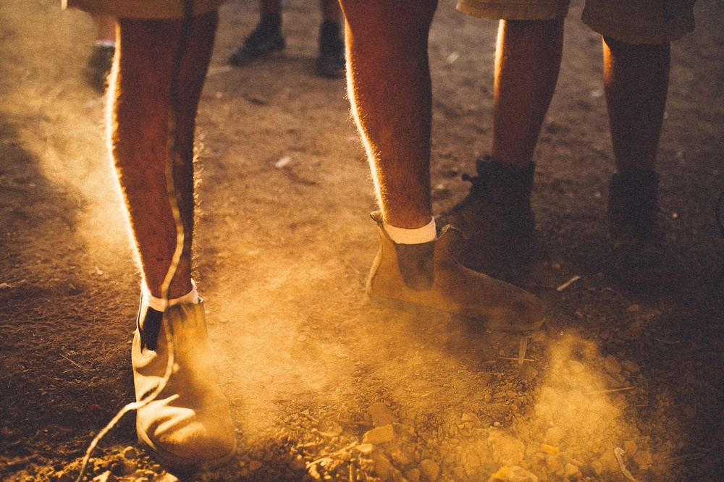
WAY OF DISCIPLESHIP:
BEING WITH GOD
“May you be covered with the dust of your Rabbi…”
Notes:
In Christ’s day, and in the early church, disciples would live with and follow their Rabbi so closely it was difficult to know where the life of the Rabbi ended and the disciple’s life started. Jewish people said, “May you be covered with the dust of your Rabbi…” May you be walking so closely with them, listening from them, watching them that at the end of each day you would be covered with the dust they kick up from the road in front of you. Discipleship-following would lead to change – a total transformation of who we are, how we think, how we act. The best way of describing what this feels like, is to think of being an apprentice to someone. This would involve three things:

Slide 20
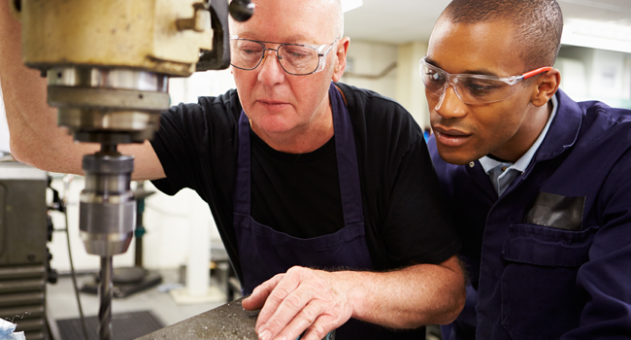
WAY OF DISCIPLESHIP:
BEING WITH GOD
Apprenticeship:
Being with.
Notes:
Being with: Obviously if you want to learn from a “teacher” the first thing will be that you spend as much time with them as possible.

Slide 21
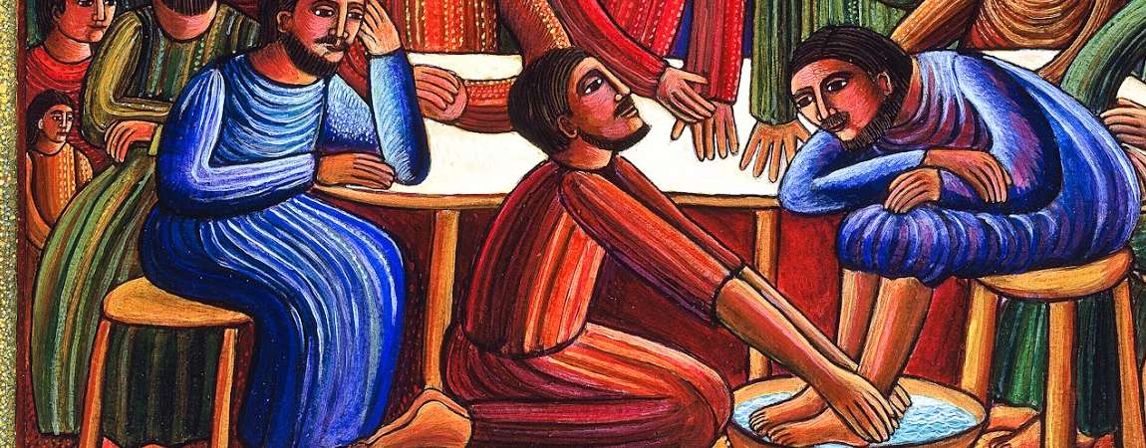
WAY OF DISCIPLESHIP:
BEING WITH GOD
Apprenticeship:
Becoming like
the righteous character produced
in your life by Jesus Christ
Notes:
Becoming like: Over time you will start to become like them – their character will shape yours, their responses and thoughts become part of the way you tick. Character change is a key part of being a disciple, and in fact, of being more fully human. This is precisely the hope that Paul expresses to the early Christians. “May you always be filled with the fruit of your salvation – the righteous character produced in your life by Jesus Christ – for this will bring much glory and praise to God.” Philippians 1:9-11, NLT

Slide 22
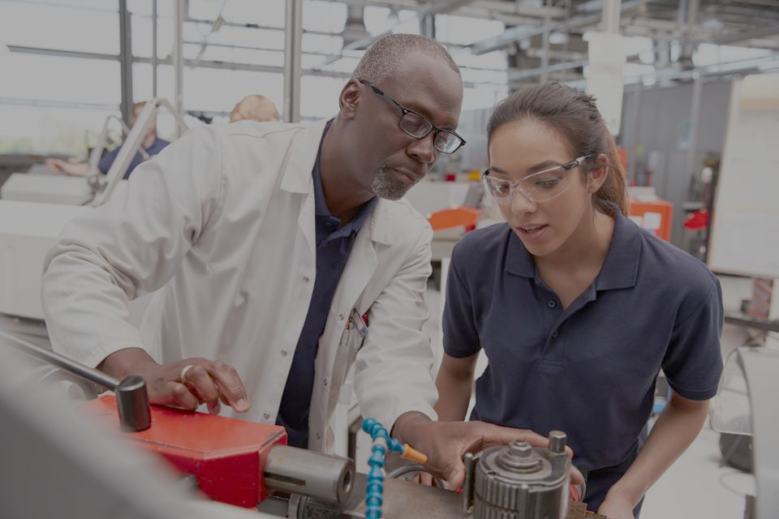
WAY OF DISCIPLESHIP:
BEING WITH GOD
Apprenticeship:
Joining in with
I am learning from Jesus to live my life as he would live life if he were I. I am not necessarily learning to do everything he did, but I am learning how to do everything I do in the manner in which he did all that he did.” Dallas Willard.
Notes:
Joining in with: The apprentice will gradually take on the work of the teacher, and do things the way the teacher does them. An “important way of putting this is to say that I am learning from Jesus to live my life as he would live life if he were I. I am not necessarily learning to do everything he did, but I am learning how to do everything I do in the manner in which he did all that he did.” Dallas Willard.

Slide 23
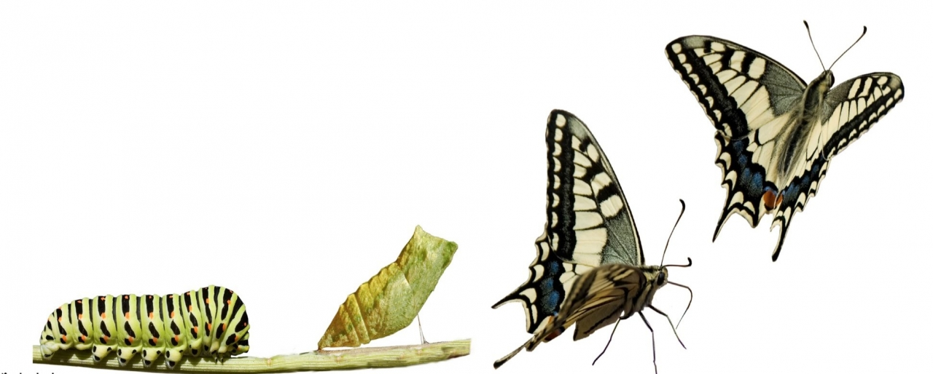
WAY OF DISCIPLESHIP:
BEING WITH GOD
‘So if anyone is in Christ, there is a new creation: everything old has passed away; see, everything has become new!’ (2 Cor 5.17).
Notes:
The aim of discipleship is always about change. In the New Testament, the apostle Paul exclaimed, ‘So if anyone is in Christ, there is a new creation: everything old has passed away; see, everything has become new!’ (2 Cor 5.17).

Slide 24
WAY OF DISCIPLESHIP:
BEING WITH GOD
How are these aims reflected in the Way of Discipleship?

Slide 25
WAY OF DISCIPLESHIP:
BEING WITH GOD
Four modules:
Being with
Becoming like
Joining in with
Bible confidence
Notes:
The Way of Discipleship is helping people to become apprentices, who are being with God, becoming like Christ, and Joining in with the Spirit. There is information, but this is much more about changing as we live, and learning as we follow. The four modules are focussed on these three aspects of being an apprentice, and having “Bible confidence” by understanding how the Bible works, how to listen to God through it, and how the story of your life is shaped by God’s story.

Slide 26
WAY OF DISCIPLESHIP:
BEING WITH GOD
I understand becoming like Christ, and joining in doing the things God does, but how do I grow in being “with God”?

Slide 27
WAY OF DISCIPLESHIP:
BEING WITH GOD
The first and most basic thing we can and must do is to keep God before our minds.
This is the fundamental secret of caring for our souls.
Notes:
Our part everyday in being “with God” is to be aware of Spirit. Making time to “abide” in Jesus (John 15). Dallas Willard puts it this way: ‘The first and most basic thing we can and must do is to keep God before our minds. This is the fundamental secret of caring for our souls… as we take intentional steps toward keeping God before us. Soon our minds will return to God as the needle of a compass constantly returns to the north. If God is the great longing of our souls, He will become the pole star of our inward beings.'

Slide 28
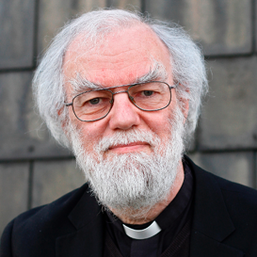
WAY OF DISCIPLESHIP:
BEING WITH GOD
Listening to God and responding to Him IS the heart of being a disciple.
Someone who keeps watching, listening and learning.
Notes:
If God is always with us, the first thing an apprentice does is to pay attention. Listening to God and responding to Him IS the heart of being a disciple. Our first module is all about this, and as we journey together, we will always be seeking to help each other pay attention. That’s why Archbishop Rowan Williams believes, being a disciple means to be someone who keeps watching, listening and learning. There’s no magic, or celebrity, or certificates to it. Just watching, listening and learning as an ongoing process.

Slide 29
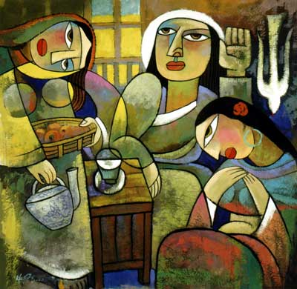
WAY OF DISCIPLESHIP:
BEING WITH GOD
Notes:
How does this Chinese painting of the disciple Mary being with Jesus speak to you about “being with” God?

Slide 30
WAY OF DISCIPLESHIP:
BEING WITH GOD
How do the modules “work”? How do disciples grow?

Slide 31
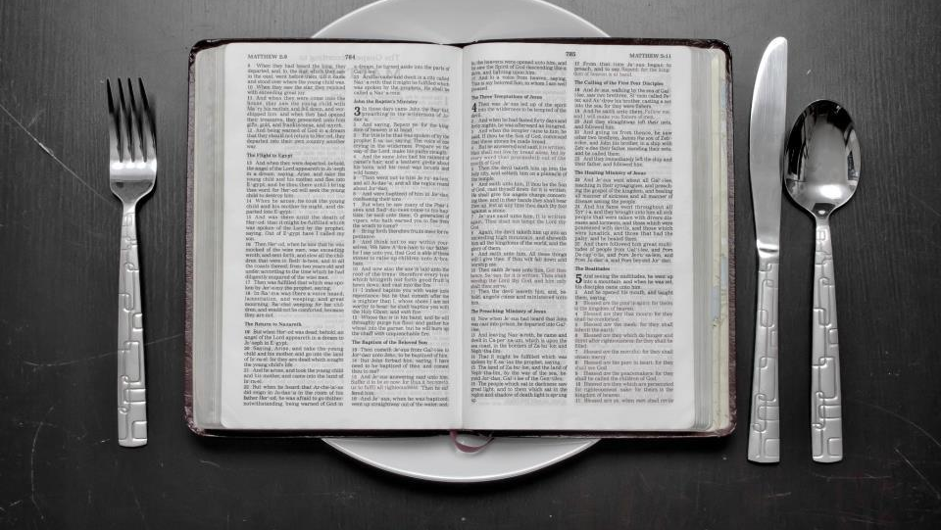
WAY OF DISCIPLESHIP:
BEING WITH GOD
Our task is not simply to study the Word of God; it’s to get it off the page and into our lives…it is meant to change us and change the people around us.
Notes:
‘From my desk at college,’ writes Shane Claiborne, ‘it looked like some time back we had stopped living Christianity and just started studying it. If we are to make disciples, we must do more than help people acquire biblical and theological information. Our task is not simply to study the Word of God; it’s to get it off the page and into our lives…it is meant to change us and change the people around us.’

Slide 32
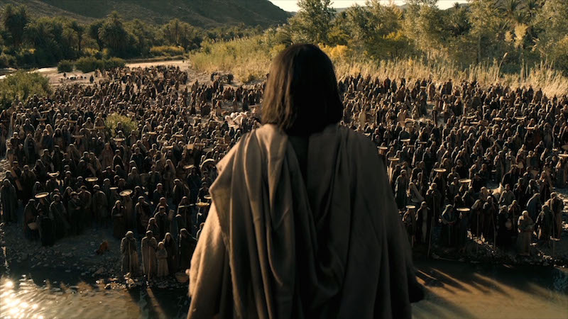
WAY OF DISCIPLESHIP:
BEING WITH GOD
We need the information and to be taught.
Notes:
To grow in this way there are (at least) four important elements. We need the information and to be taught. Jesus’ method has parallels in the way people learn a new language. Firstly, it obviously involves knowing some vocabulary and grammar. There is a body of information to be absorbed. Similarly, Jesus taught His apprentices in that He gave them information. The Sermon on the Mount, Lord’s Prayer, parables, the greatest commandment. They needed their minds shaped to understand what relationship God wanted with them, and the mission they were invited into. By and large, we are very good at this in church circles and in society. But what is more helpful in actually being able to use a language is being able to listen to people speaking it, and to imitate them, sometimes with unintended results. Information alone won’t make you a speaker.

Slide 33
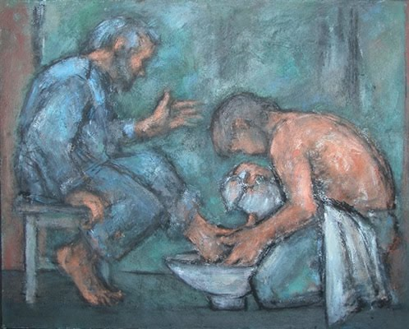
WAY OF DISCIPLESHIP:
BEING WITH GOD
Modelling and imitation is at the heart of apprentice style learning.
“So if I, your Lord and Teacher, have washed your feet, you also ought to wash one another’s feet. For I have set you an example, that you also should do as I have done to you.”
Notes:
Modelling and imitation is at the heart of apprentice style learning. Jesus inviting his disciples to live life as He lived it. He demonstrated everything He taught – how to pray, to heal, to teach, to love enemies. They learnt by observing Him. Most famously He did this at the last supper, when having washed their feet He said, “ 14 So if I, your Lord and Teacher, have washed your feet, you also ought to wash one another’s feet. 15 For I have set you an example, that you also should do as I have done to you.” I would say that the people who have had most influence on me are the ones whose lives I have sought to imitate. Discipleship is more caught than taught.

Slide 34
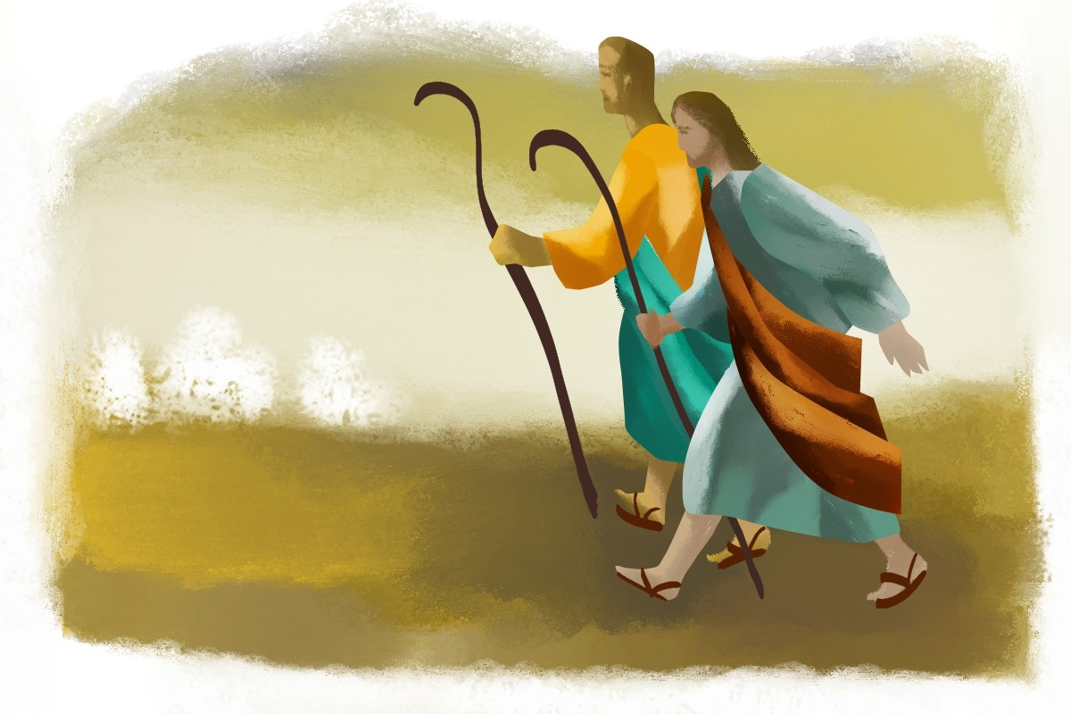
WAY OF DISCIPLESHIP:
BEING WITH GOD
“Tell me, I’ll forget. Show me, I’ll remember.
Involve me, I’ll understand.”
Notes:
But I’ll tell you how language really improves. By living in the country! When you have to actually use your knowledge, improvise, immerse yourself in the culture, down the market, in the college, the words you have read on the page, and repeated after other people, actually start to become a living language. Jesus taught his apprentices, he demonstrated, but then He sent them out on His mission. They learnt on the way. It’s common educational wisdom in action: as the Chinese proverb says, “Tell me, I’ll forget. Show me, I’ll remember. Involve me, I’ll understand.”

Slide 35
WAY OF DISCIPLESHIP:
BEING WITH GOD
Can I really be a disciple?

Slide 36
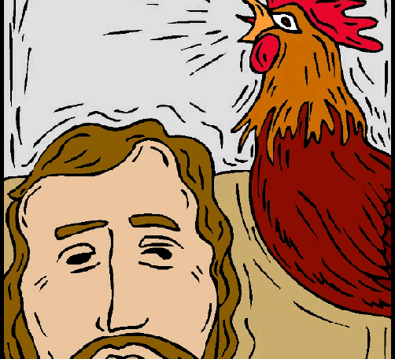
WAY OF DISCIPLESHIP:
BEING WITH GOD
Notes:
If we are not asking this question sometimes, then we are probably not paying attention…But the answer is, of course! … Like Peter, most of the disciples have their successes and failures.

Slide 37
WAY OF DISCIPLESHIP:
BEING WITH GOD
The disciples Jesus chose came from the bottom of the social ladder.
Notes:
The disciples Jesus chose came from the bottom of the social ladder.

Slide 38
WAY OF DISCIPLESHIP:
BEING WITH GOD
God always starts where you are at – you never need to wait until you are “ready”.
They were called disciples from day one – learners as they followed.
Notes:
God always starts where you are at – you never need to wait until you are “ready”. They were called disciples from day one – learners as they followed.

Slide 39
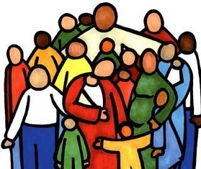
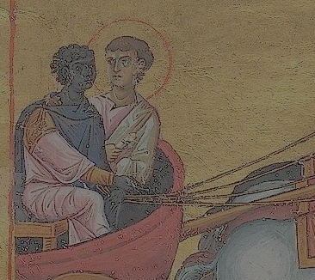
WAY OF DISCIPLESHIP:
BEING WITH GOD
We come to God, and we grow, in different ways.
We go through different stages in life, and on our faith journey.
Notes:
We come to God, and we grow, in different ways. There are four stories in the book of Acts which illustrate some of these different journeys Some come because of the influence of a particular person – see Philip and the Ethiopian – Acts 8: 26-39. Some grow up as disciples, inheriting faith from their family – see the Philippian jailer story in Acts 16: 22-34. Some are gradually drawn into church and start the Way of discipleship step by step – see the life of the early church in Acts 2: 42-47. Some hear a message and the penny drops in a moment - see Paul preaching in to people who have never heard before in Acts 17: 22-34. We go through different stages in life, and on our faith journey. There is a two page document on this if you want to study further.

Slide 40
WAY OF DISCIPLESHIP:
BEING WITH GOD
We change through training, not trying
Notes:
Finally we change through training, not trying. The Way of Discipleship is about training us in ways of life that help us transform over time.

Slide 41
WAY OF DISCIPLESHIP:
BEING WITH GOD
Can we really disciple each other?

Slide 42
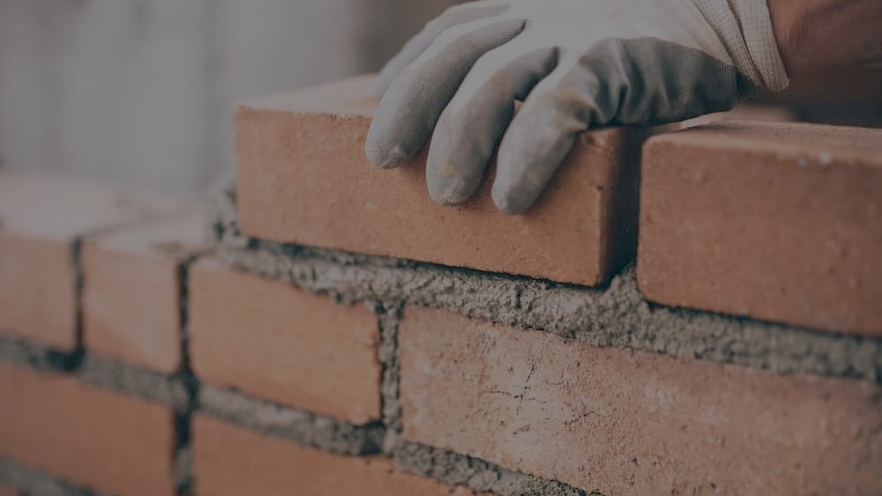
WAY OF DISCIPLESHIP:
BEING WITH GOD
Conversion and true faith are works of the Holy Spirit. But it is also true that we can, by our responses, help or hinder another’s journey.”
Notes:
But we may worry that we don’t have the right to apprentice others, as we either don’t feel worthy, or we don’t want to judge others. There is a balance here. We certainly can’t judge anyone, both because of our own state, and because we can never truly know what is happening in someone’s heart. But just because we can’t see what’s happening inside, as Sherry Wedell writes, “…let me stress that we cannot bring anyone to faith through pressure, guilt, argument or cleverness. Conversion and true faith are works of the Holy Spirit. But it is also true that we can, by our responses, help or hinder another’s journey.”

Slide 43
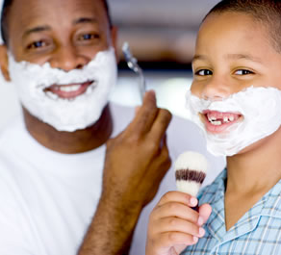
WAY OF DISCIPLESHIP:
BEING WITH GOD
We are modelling something!
“Be imitators of me, as I am of Christ.”
1 Corinthians 11:1
People don’t need a perfect example of Jesus - they just need a living example.
Notes:
We can help others, or we can hinder them. Paul knew that he was a model for others, so when writing to his disciples in Corinth he said its simply: “Be imitators of me, as I am of Christ.” 1 Corinthians 11:1 Bob Ronglien writes, “The call to make disciples is a call to point people towards Jesus by the fallible example of our lives. If people are only imitating us, they will get a degraded version of Jesus. People don’t need a perfect example of Jesus - they just need a living example. Paul would not let Timothy use his age as an excuse for not inviting people to imitate him.”

