Slide 1


WAY OF DISCIPLESHIP:
BECOMING LIKE CHRIST
OPENING WORSHIP
I bind unto myself today
The strong Name of the Trinity,
By invocation of the same,
The Three in One and One in Three.
I bind this day to me for ever.
By power of faith, Christ's incarnation;
His baptism in the Jordan river;
His death on Cross for my salvation;
His bursting from the spicèd tomb;
His riding up the heavenly way;

Slide 2
WAY OF DISCIPLESHIP:
BECOMING LIKE CHRIST
OPENING WORSHIP
His coming at the day of doom;
I bind unto myself today.
I bind unto myself today
The power of God to hold and lead,
His eye to watch, His might to stay,
His ear to hearken to my need.
The wisdom of my God to teach,
His hand to guide, His shield to ward,

Slide 3
WAY OF DISCIPLESHIP:
BECOMING LIKE CHRIST
OPENING WORSHIP
The word of God to give me speech,
His heavenly host to be my guard.
Against all Satan's spells and wiles,
Against false words of heresy,
Against the knowledge that defiles,
Against the heart's idolatry,
Against the wizard's evil craft,
Against the death wound and the burning,
The choking wave and the poisoned shaft,
Protect me, Christ, till Thy returning.

Slide 4
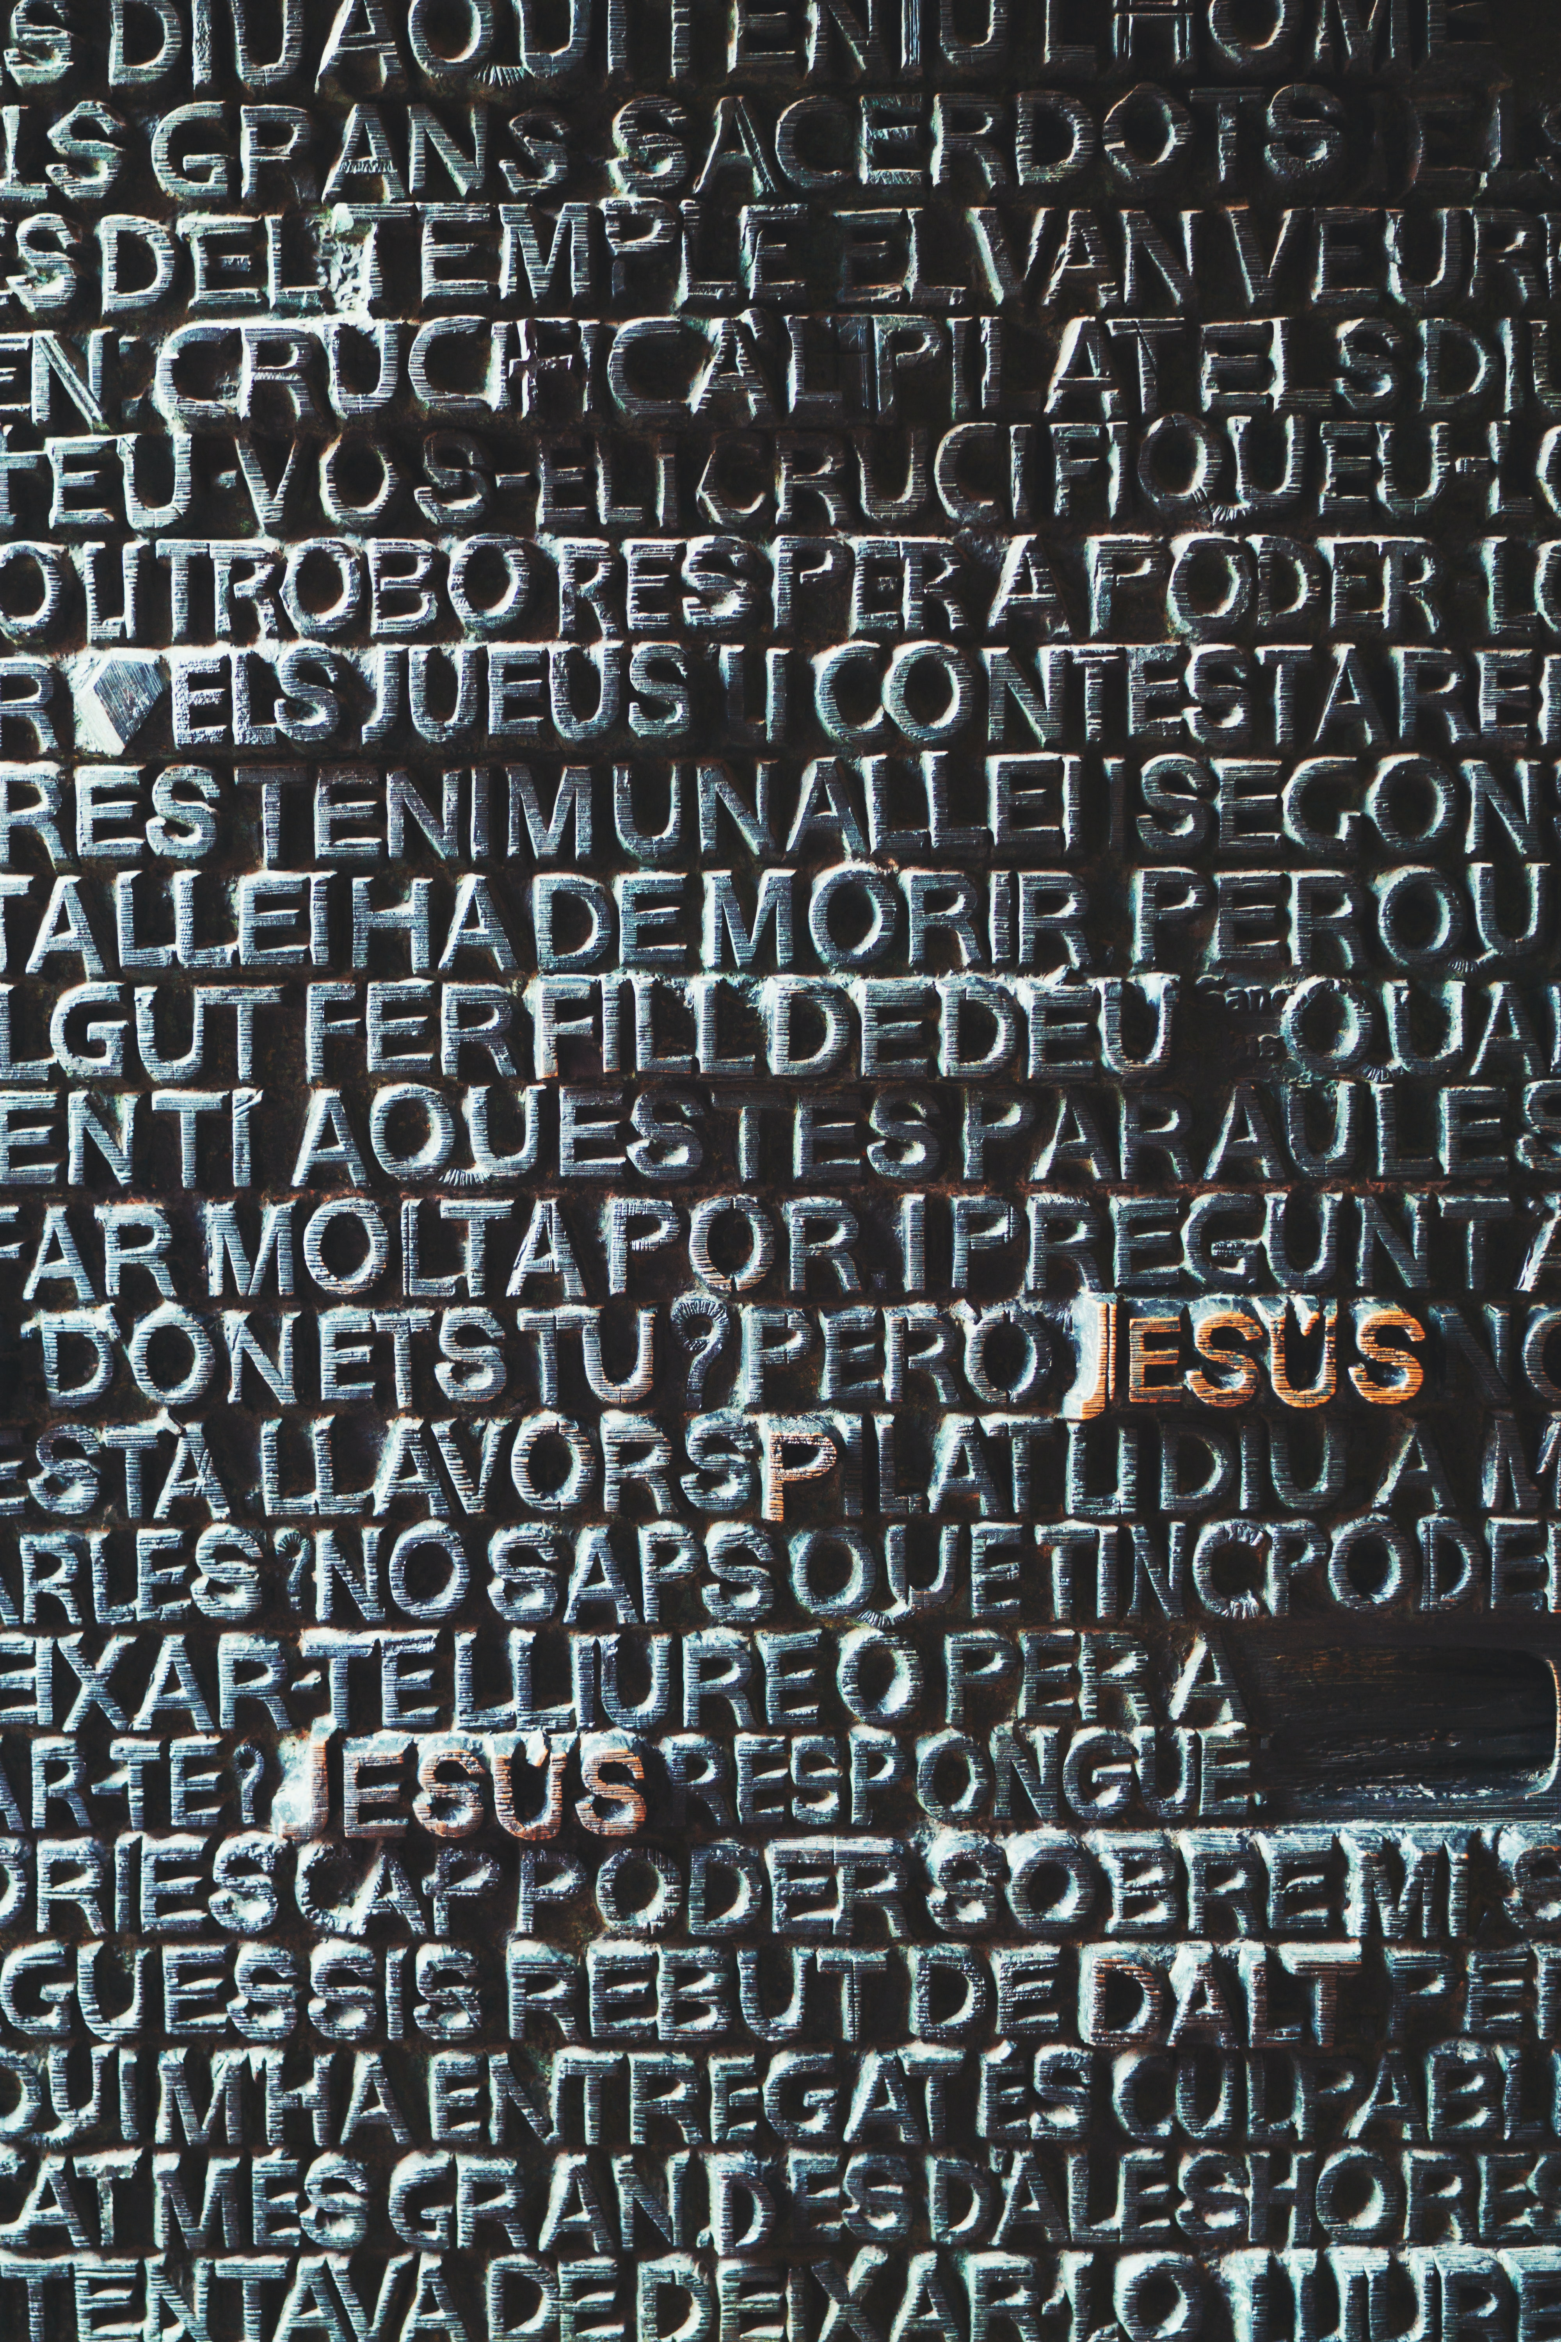
WAY OF DISCIPLESHIP:
BECOMING LIKE CHRIST
AIMS OF THIS SESSION (3)
To understand the atonement as the defeat of evil and death.
To understand how Jesus’ death and resurrection establishes Him as Lord, and how discipleship involves obedience
To recognise the reality of other idols, particularly money, as a challenge to Jesus’ Lordship in my life.
To reflect on the practice of generosity and financial giving in my lived experience.

Slide 5
WAY OF DISCIPLESHIP:
BECOMING LIKE CHRIST
DISCOVERY BIBLE STUDY PASSAGE
Matthew 6
19 “Do not store up for yourselves treasures on earth, where moths and vermin destroy, and where thieves break in and steal. 20 But store up for yourselves treasures in heaven, where moths and vermin do not destroy, and where thieves do not break in and steal. 21 For where your treasure is, there your heart will be also. 22 The eye is the lamp of the body. If your eyes are healthy, your whole body will be full of light. 23 But if your eyes are unhealthy, your whole body will be full of darkness. If then the light within you is darkness, how great is that darkness!

Slide 6
WAY OF DISCIPLESHIP:
BECOMING LIKE CHRIST
DISCOVERY BIBLE STUDY PASSAGE
Matthew 6
24 “No one can serve two masters. Either you will hate the one and love the other, or you will be devoted to the one and despise the other. You cannot serve both God and money. 25 Therefore I tell you, do not worry about your life, what you will eat or drink; or about your body, what you will wear. Is not life more than food, and the body more than clothes? 26 Look at the birds of the air; they do not sow or reap or store away in barns, and yet your heavenly Father feeds them. Are you not much more valuable than they? 27 Can any one of you by worrying add a single hour to your life?

Slide 7
WAY OF DISCIPLESHIP:
BECOMING LIKE CHRIST
DISCOVERY BIBLE STUDY PASSAGE
Matthew 6
28 “And why do you worry about clothes? See how the flowers of the field grow. They do not labour or spin. 29 Yet I tell you that not even Solomon in all his splendour was dressed like one of these. 30 If that is how God clothes the grass of the field, which is here today and tomorrow is thrown into the fire, will he not much more clothe you—you of little faith? 31 So do not worry, saying, ‘What shall we eat?’ or ‘What shall we drink?’ or ‘What shall we wear?’ 32 For the pagans run after all these things, and your heavenly Father knows that you need them. 33 But seek first his kingdom and his righteousness, and all these things will be given to you as well. 34 Therefore do not worry about tomorrow, for tomorrow will worry about itself. Each day has enough trouble of its own.”

Slide 8

WAY OF DISCIPLESHIP:
BECOMING LIKE CHRIST
DISCOVERY BIBLE STUDY QUESTIONS
What do we learn about God?
What do we learn about humanity?
What does this passage say about obedience?
In the light of what we now know about this passage, what is God calling you to do? (I will……..)
Who might you share this story with this week?

Slide 9

WAY OF DISCIPLESHIP:
BECOMING LIKE CHRIST
CLOSING PRAYER
2 Timothy 1:9-10
"He has saved us and called us to a holy life—not because of anything we have done but because of his own purpose and grace. This grace was given us in Christ Jesus before the beginning of time, but it has now been revealed through the appearing of our Saviour, Christ Jesus, who has destroyed death and has brought life and immortality to light through the gospel."

Slide 10
WAY OF DISCIPLESHIP:
BECOMING LIKE CHRIST
CLOSING PRAYER
Christ be with me, Christ within me,
Christ behind me, Christ before me,
Christ beside me, Christ to win me,
Christ to comfort and restore me.
Christ beneath me, Christ above me,
Christ in quiet, Christ in danger,
Christ in hearts of all that love me,
Christ in mouth of friend and stranger.
.

Slide 11
WAY OF DISCIPLESHIP:
BECOMING LIKE CHRIST
CLOSING PRAYER
I bind unto myself the Name,
The strong Name of the Trinity;
By invocation of the same.
The Three in One, and One in Three,
Of Whom all nature hath creation,
Eternal Father, Spirit, Word:
Praise to the Lord of my salvation,
Salvation is of Christ the Lord.

