Slide 1
WAY OF DISCIPLESHIP:
BIBLE CONFIDENCE AND KNOWING THE STORY
OPENING WORSHIP
To God, the father of mercies,
Light and source of all good,
Lord of history and of the universe,
Goal of the entire human journey,
We lift our praise.
To you, Father, be praise in the church and in the world,
in earthly history and in heaven.

Slide 2
WAY OF DISCIPLESHIP:
BIBLE CONFIDENCE AND KNOWING THE STORY
OPENING WORSHIP
May Mary mother of Jesus praise you;
May the angels praise you;
May the thrones and dominions praise you;
may the Saints praise you;
May our deceased praise you;

Slide 3
WAY OF DISCIPLESHIP:
BIBLE CONFIDENCE AND KNOWING THE STORY
OPENING WORSHIP
May everyone we meet praise you,
that we may all be able to unite
in a hymn acknowledging the fullness of glory
which your Son communicates to us
in the grace of the Spirit who animates our hearts.
Amen.
Carlo Maria Martini SJ. From “Hearts on Fire – Praying with Jesuits”

Slide 4
WAY OF DISCIPLESHIP:
BIBLE CONFIDENCE AND KNOWING THE STORY
AIMS OF THIS SESSION (3)
To understand the difference that the key themes of covenant, worship and idolatry, temple and presence make in my lived experience.
To understand the meaning of the God-breathed nature of Scripture.

Slide 5
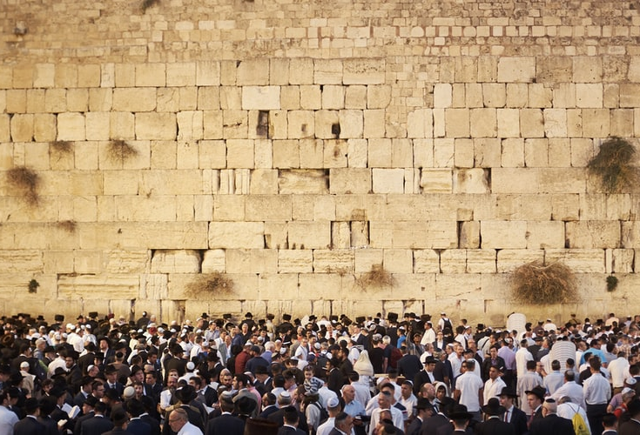
WAY OF DISCIPLESHIP:
BIBLE CONFIDENCE AND KNOWING THE STORY
CLOSING PRAYER
2 Chronicles 7
When Solomon finished praying, fire came down from heaven and consumed the burnt offering and the sacrifices, and the glory of the LORD filled the temple. 2 The priests could not enter the temple of the LORD because the glory of the LORD filled it. 3 When all the Israelites saw the fire coming down and the glory of the LORD above the temple, they knelt on the pavement with their faces to the ground, and they worshipped and gave thanks to the LORD, saying, “He is good; his love endures forever.”

