Slide 1
WAY OF DISCIPLESHIP:
BEING WITH GOD
WAY OF DISCIPLESHIP: BEING WITH GOD:
BEING WITH GOD IN A BALANCED LIFE

Slide 2
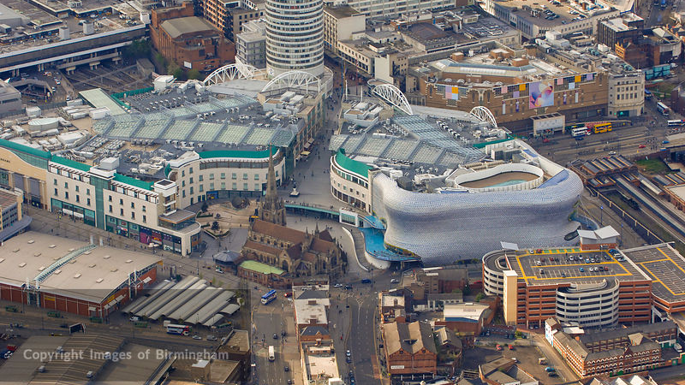
WAY OF DISCIPLESHIP:
BEING WITH GOD
What quality of life does God want for me?

Slide 3
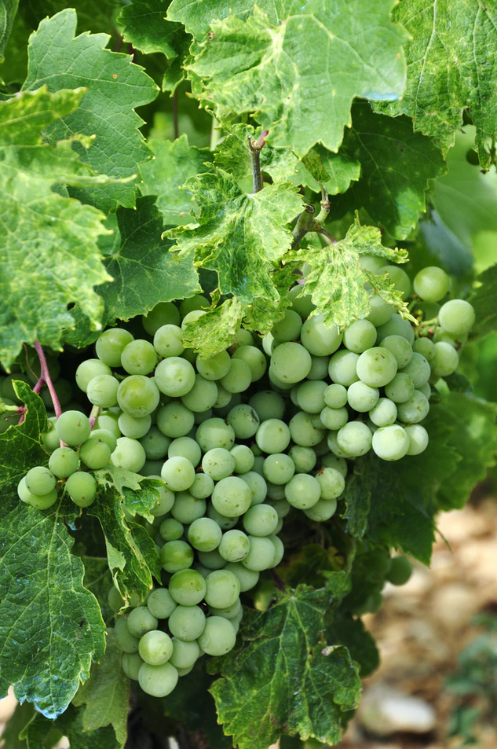
WAY OF DISCIPLESHIP:
BEING WITH GOD
“I have come that they may have life, and have it to the full.”
“The glory of God is the human person fully alive.”
“Be fruitful.…”
Notes:
One of the themes that consistently comes through in the Bible is that it is hard for us to imagine just how much God wants each human being to flourish and grow in love. Jesus revealed God’s hope for us when He said, “I have come that they may have life, and have it to the full.” St Irenaeus is famous for saying, “The glory of God is the human person fully alive.” While it’s a statement that is more than about just “being happy”, it celebrates the total goodness of God’s intentions towards us.
Being a disciple is living into this life in all its fullness, a life we can only begin to imagine. But both the story and teaching in the Bible show that life in all its fullness does not necessarily mean a trouble, pain-free existence. (In fact, as we shall see in module 3 sometimes discipleship can lead us into being more aware of suffering).
Instead, God has always invited His covenant-partners to be with Him so that we can be fruitful. We are made for fruitfulness – not just existence. God’s first command in the Bible to human beings is, “Be fruitful.…”
In the parable of the servants who are given talents to look after while their master goes away (Matthew 25:14-30) it is the servant who fails to grow his talents that is condemned – He is missing out on life in all its fulness. Human beings are designed for fruitfulness.

Slide 4
WAY OF DISCIPLESHIP:
BEING WITH GOD
Why is being with God at the heart of fruitfulness?

Slide 5
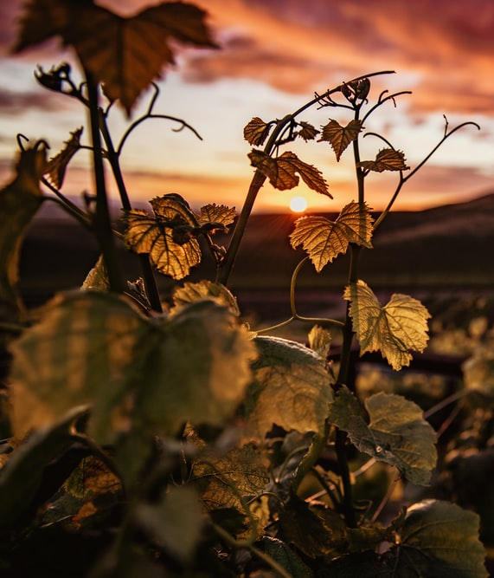
WAY OF DISCIPLESHIP:
BEING WITH GOD
The practices of worship, prayer, study and meditation are the “training exercises” which help us give space for God’s Spirit to change us from the inside out.
Paul had a deep sense that all true fruitfulness comes from God’s work: “I planted the seed, Apollos watered it, but God has been making it grow.” (1 Corinthians 3:6)
While human beings have a part to play, God is the one who grows fruit.
“No branch can bear fruit by itself; it must remain in the vine. Neither can you bear fruit unless you remain in me…apart from me you can do nothing.”
Notes:
The practices of worship, prayer, study and meditation we have looked at draw us into “being with God” and also become the “training exercises” which help us give space for God’s Spirit to change us from the inside out.
The kind of fruitful life God wants cannot come from us alone – instead it is a partnership with God in which in our daily lives God delights to work in and through us, if we invite Him to.
Speaking of growing disciples, Paul had a deep sense that all true fruitfulness comes from God’s work: “I planted the seed, Apollos watered it, but God has been making it grow.” (1 Corinthians 3:6) While human beings have a part to play, God is the one who grows fruit.
In His picture of the vine in John 15 Jesus reinforces this by reminding His disciples that their fruitfulness depends on being rooted in Him: “Remain in me, as I also remain in you. No branch can bear fruit by itself; it must remain in the vine. Neither can you bear fruit unless you remain in me. I am the vine; you are the branches. If you remain in me and I in you, you will bear much fruit; apart from me you can do nothing.”
In fact, the kinds of eternal fruitfulness that we have been looking at are so enormous, that to attempt to grow them ourselves, without being rooted in Him, will inevitably lead to frustration and failure: “If you do not remain in me, you are like a branch that is thrown away and withers; such branches are picked up, thrown into the fire and burned.”
As disciples, fruitfulness that doesn’t spring from being with God is impossible. We are not gifted, talented, or eternal enough to be fully fruitful in ourselves. We can see this in our own lives as disciples if we experience “religious burn out”.
Instead, God’s partnership with us as disciples is a life of balance – between being with God and doing; between listening and responding; between being active and stopping (for example, none of the fruits in our character like love, joy or peace can be achieved by rushing); between giving out from what we have first received.
This session is about living into simple rhythms in our daily lives and each week which enable this balanced life to be part of our lived experience. They are rhythms which God gave His people throughout Scripture and which we see in the life of Jesus. They are rhythms that not only give God’s Spirit space to make us eternally fruitful, but, in a stressed and anxious culture, help us to live peacefully and be a non-anxious presence in a hurting world.

Slide 6
WAY OF DISCIPLESHIP:
BEING WITH GOD
We are not gifted, talented, or eternal enough to be fully fruitful in ourselves.
God’s partnership with us as disciples is a life of balance –
between being with God and doing;
between listening and responding;
between being active and stopping;
between giving out from what we have first received.
This session is about living into simple rhythms in our daily lives and each week which enable this balanced life to be part of our lived experience.
Notes:
As disciples, fruitfulness that doesn’t spring from being with God is impossible. We are not gifted, talented, or eternal enough to be fully fruitful in ourselves. We can see this in our own lives as disciples if we experience “religious burn out”.
Instead, God’s partnership with us as disciples is a life of balance – between being with God and doing; between listening and responding; between being active and stopping (for example, none of the fruits in our character like love, joy or peace can be achieved by rushing); between giving out from what we have first received.
This session is about living into simple rhythms in our daily lives and each week which enable this balanced life to be part of our lived experience. They are rhythms which God gave His people throughout Scripture and which we see in the life of Jesus. They are rhythms that not only give God’s Spirit space to make us eternally fruitful, but, in a stressed and anxious culture, help us to live peacefully and be a non-anxious presence in a hurting world.

Slide 7
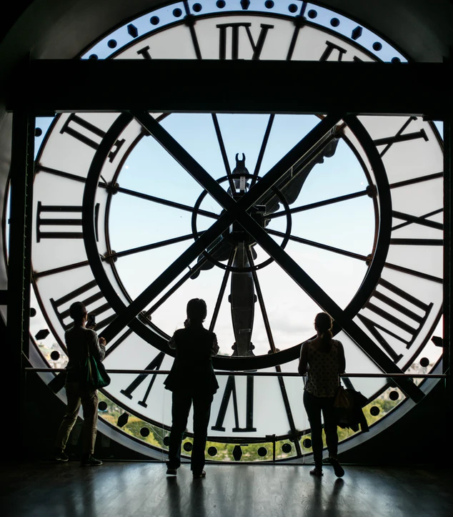
WAY OF DISCIPLESHIP:
BEING WITH GOD
“The spirit of Joy and the spirit of Hurry cannot live in the same house.”
“Hurry sickness” is a recognised phenomenon.
We cannot get more time than we have. But we can make choices to shape time differently around the things that matter for ever.
Living fruitful lives of being with God will inevitably come up against cultural barriers and call us to make choices about how our time is used.
Notes:
The writer Evelyn Underhill once said, “The spirit of Joy and the spirit of Hurry cannot live in the same house.” But if it is true that God’s work in us is incompatible with hurry, then it is not surprising if the culture we live in makes the idea of taking time to be with God or to remain in Jesus seem like a mountain to climb.
The world we live in is mentally and spiritually crowded in a way that can work against us being attentive to God, being able to put Him at the forefront of our minds. The screens we watch (4 hours of TV a day if we are over 16), the advertising messages we receive (six hundred a day), the bits of information from disconnected sources we absorb daily (more than at any time in history) and the years of our lives we spend on social media (6 years and 8 months on average) can have a profound effect: unsatisfied desires, FOMO, anxiety and hurry, workaholism, restlessness and overbusyness.
While monks originally invented the clock to regulate prayer throughout the day, our experience of time can be shaped less by rhythm and more by deadline and speed, making it hard to have good priorities and look after our health. “Hurry sickness” is a recognised phenomenon.
This makes the necessity of a balanced life all the more necessary. But it also makes it all the more difficult. The practices we will explore in this session are about intentionally making space for being with God in our daily lives. We cannot get more time than we have. But we can make choices to shape time differently around the things that matter for ever.
None of us want to experience discipleship as superficial, or to settle for less than God’s offer of life in all its fulness. But it is worth acknowledging that it can be easy for us to be distracted or overbusy, and that living fruitful lives of being with God will inevitably come up against cultural barriers and call us to make choices about how our time is used.

Slide 8
WAY OF DISCIPLESHIP:
BEING WITH GOD
Why is Sabbath so important for being with God?

Slide 9
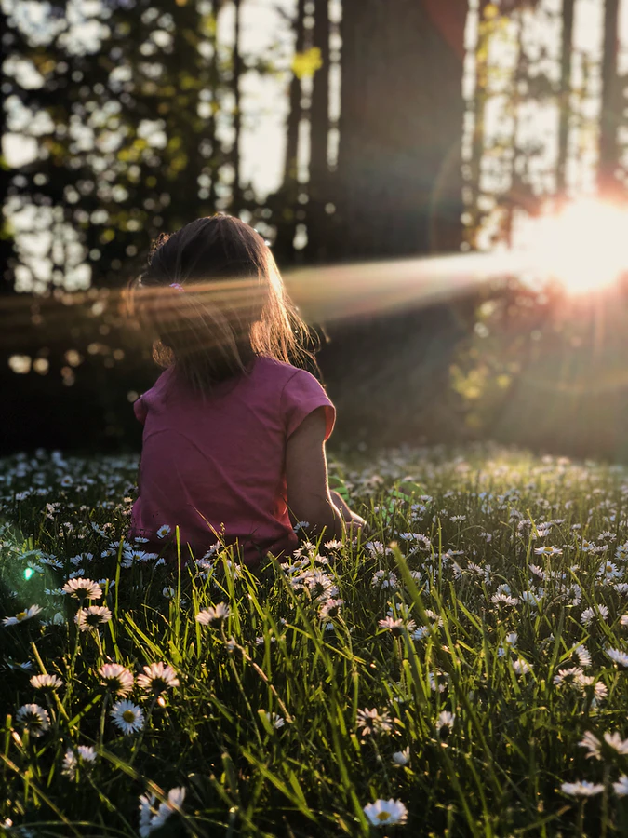
WAY OF DISCIPLESHIP:
BEING WITH GOD
The Sabbath (meaning rest) is a complete day of rest in Scripture.
Even God rests from His work.
Being able to rest on Sabbath is about freedom from slavery.
It says there are limits on how much is expected of us.
The word Sabbath can also be translated as to worship or delight.
The Sabbath is also a taste of what is to come in our experience of eternal life, when we see God face to face.
Notes:
The Sabbath (meaning rest) is a complete day of rest in Scripture. Today, even Christian disciples might struggle to have a rhythm of a day of rest every week, but the balance we need for fruitfulness is established at the beginning of the Bible where in Genesis, even God rests from His work. Right from the start there is a regular weekly practice in the way the world is that sets out both work and rest.
The Sabbath is first named as an explicit commandment by God – the fourth of ten - after He rescues His covenant-partner people of Israel from slavery in Egypt. It is a holy day – to be set apart as vital and important – on which the people specifically remember that they are free – they are not slaves any more. (Deuteronomy 5: 12-15).
Being able to rest on Sabbath is about freedom from slavery – from overwork, from being defined only by being productive, from other people’s expectations or control. It is a gift, as well as a commandment, because it says there are limits on how much is expected of us. (In a consumer society this can be a way of saying, “I am, or I have enough.”)
The word Sabbath can also be translated as to worship or delight. God establishes a regular time when, together, we offer praise to Him.
The Sabbath is also a taste of what is to come in our experience of eternal life, when we see God face to face. God gives it as a way of remembering the freedom He has already given us, but also looking forward to our ultimate freedom.

Slide 10
WAY OF DISCIPLESHIP:
BEING WITH GOD
What are the benefits of Sabbath?

Slide 11
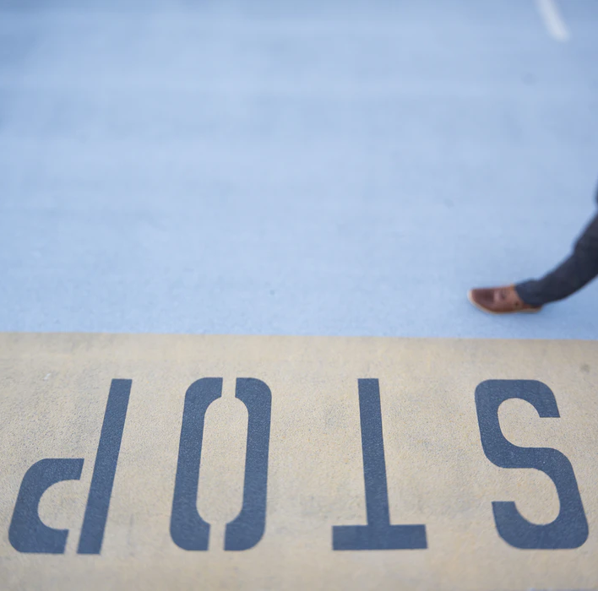
WAY OF DISCIPLESHIP:
BEING WITH GOD
Rest to refresh the whole week
A day which opens us to a different way of living which can spread into the other six days.
Sabbath rest, worship, and being with God is being taken into the week that is to come.
Working from rest, as opposed to resting from work. We cannot be fruitful without rest.
This was our first full day, a day of rest. Then the work began.
Regular Sabbath rest can train us to be more restful every day of the week.
Notes:
Rest to refresh the whole week
God wants us to “be with Him” more than one day a week, but the Sabbath creates a day which opens us to a different way of living which can spread into the other six days.
To symbolise this at the end of the Sabbath Jewish people will practise 'Havdalah", in which they light a multi-wick candle (at least 3 strands) and also pass around a small container of sweet spices, which reminds us of the sweetness of Shabbat, to take us through the week. It's accompanied by prayers for a fruitful and blessed week to come. Sabbath rest, worship, and being with God is being taken into the coming days.
Whereas for some a day off may be a time to escape, or recover after a busy period, for disciples Sabbath as God intended can offer the possibility of working from rest, as opposed to resting from work. We cannot be fruitful without rest.
This reflects the first experience of Adam and Eve in the book of Genesis. As Mike Breen writes, “God created man and woman on the sixth day, setting them in a garden full of wild, wonderful creatures and delicious foods. He gave them instruction on caring for the animals and plants in the garden. He told them to be fruitful.
But on the first full day of existence for Adam and Eve, God rested. All of creation took a well-deserved break in activity. This was our first full day, a day of rest. Then the work began. From this we see an important principle of life: we are to work from our rest, not rest from our work.” Breen, Mike. Building a Discipling Culture. 3DM. Kindle Edition.
Regular Sabbath rest can train us to be more restful every day of the week.

Slide 12
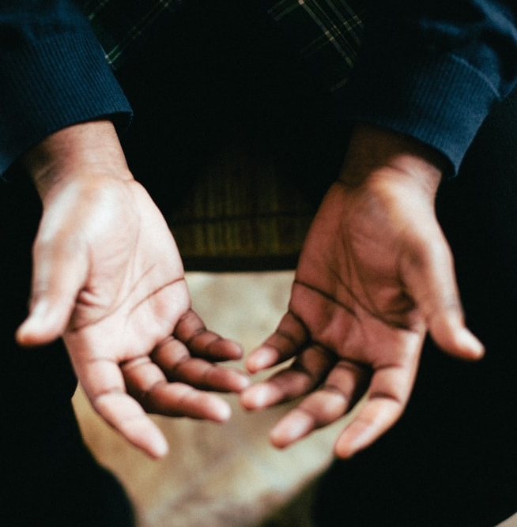
WAY OF DISCIPLESHIP:
BEING WITH GOD
Not having to be in control, and knowing our limits
“We learn to let God take care of us…giving up our feeble attempts to be God in our own lives.”
It reinforces the truth that only God can truly satisfy our desires in a way that our career, possessions or reputation cannot.
It reminds us as well that many of the things we may strive to attain are only loaned to us.
Notes:
Not having to be in control and knowing our limits
The writer Marva Dawn says, “A great benefit of Sabbath keeping is that we learn to let God take care of us – not by becoming passive and lazy, but in the freedom of giving up our feeble attempts to be God in our own lives.” Sabbath is taking a day a week to remind ourselves that we did not make the world and that it will continue to exist without our efforts.
Stopping in order to be with God reinforces the truth that only God can truly satisfy our desires in a way that our career, possessions or reputation cannot. It is a way of living into the belief that our reputation is God’s business, when we remember that we are loved just because we exist.
It reminds us as well that many of the things we may strive to attain are only loaned to us. When the businessman John D. Rockefeller died his accountant was asked by a curious person, "I know that Mr. Rockefeller was an immensely wealthy man, just how much did he leave behind?" The accountant quickly replied, "Everything.” Through Sabbath we can find out how much of our efforts can be about earning something we already have.

Slide 13
WAY OF DISCIPLESHIP:
BEING WITH GOD
Being re-created
Sabbath can create space so that we can “taste and see that the Lord is good.”
Slowing down to a speed in which we can notice and enjoy His goodness
List the things that you could do for a day that would bring you joy and make you want to praise God.
It aims to help us to appreciate and savour the present moment.
God “...makes me lie down in green pastures, he leads me beside quiet waters, he restores my soul.”
Notes:
Being re-created
Sabbath can create space so that we can “taste and see that the Lord is good.” One of the translations of the word is to delight. Part of being with God is being able to slow down to a speed in which we can notice and enjoy His goodness, and do things we enjoy with gratitude. A good way to approach Sabbath might be to list the things that you could do for a day that would bring you joy and make you want to praise God.
Sabbath re-creates us because it aims to help us to appreciate and savour the present moment. According to many spiritual writers, and particularly to Jesus, this is the main secret of living without anxiety. In Matthew 6 Jesus asks His disciples, “Can any one of you by worrying add a single hour to your life?” In order to illustrate His point, He points to the birds and the flowers who are here today and gone tomorrow – they have no guarantee of an easy life – and yet are content before God because they live in the present moment. This is the re-creation King David wrote about in Psalm 23 in which, even in the midst of difficulties, God “...makes me lie down in green pastures, he leads me beside quiet waters, he restores my soul.”

Slide 14
WAY OF DISCIPLESHIP:
BEING WITH GOD
How do I practise a fruitful Sabbath?

Slide 15
WAY OF DISCIPLESHIP:
BEING WITH GOD
Stop. Even if in the midst of busyness Sabbath means stopping from working.
Rest. Physical, Mental and emotional. Spiritual –if we are not used to it, resting like this can lead us to feeling low, as our mind, body and spirits settle into a different way of being with God.
Delight. Doing unplanned things as they come into your mind or heart. Or doing things that create joy, happiness and gratitude.
Worship. Offering our life and the coming week to His glory.
Preparation. This may be something we have to work towards, rather than arrive at in one go. Schedule our rest before we schedule work. A full day to stop and be fully present to God and others required effort and choices.
Notes:
There are four translations of the Hebrew word Sabbath which give a framework for a fruitful Sabbath: stop, rest, delight and worship. It is not necessary to include all these elements in a structured way, but none of them should be completely missing from your lived experience.
Stop. Even if in the midst of busyness Sabbath means stopping from working, and, as much as possible, from all the thinking and worrying that work can mean. This means making choices not to attend to messages and communications that can distract us, perhaps by turning devices off.
Rest. This can be physical – simply enjoying sleep. It can be mental and emotional – giving ourselves time to process things that are happening. It can be spiritual – deliberately resting in a sense of God’s love and closeness. It is worth being aware that at first, if we are not used to it, resting like this can lead us to feeling low, as our mind, body and spirits settle into a different way of being with God.
Delight. Doing unplanned things as they come into your mind or heart. Or doing things that create joy, happiness and gratitude – meals, music, games, fun, friends, nature. Doing something creative that isn’t your job but that needs no justification. Appreciating the beauty God has made. Delight in people by having time for relationships.
Worship. While we can worship God in all the above, Sabbath gives us the opportunity to share in praise and adoration of God, offering our life and the coming week to His glory.
Preparation
The key thing is to seek a 24 hour period every week to practise Sabbath – it doesn’t need to be a particular day of the week. As we have noted, the idea of a full day’s rest to be with God may seem hard, and may be something we have to work towards, rather than arrive at in one go.
We may need to acknowledge that there is never a moment when all our work feels done. Sabbath is a day for stopping in the midst of the busyness of our lives, not for when we are no longer busy. We will have to make choices, perhaps finding it helpful to schedule our rest before we schedule work.
If we go on holiday or a trip there is always a lot to do beforehand in getting ready. No one just walks out of their house without packing at least one bag. Similarly, the Jewish people had to have a day of Preparation for the Sabbath. It’s interesting that even in a culture where it was so established, there was a recognition that a full day to stop and be fully present to God and others required effort and choices.

Slide 16
WAY OF DISCIPLESHIP:
BEING WITH GOD
How did Jesus (and others in the Bible) experience “being with God” in solitude and silence?

Slide 17
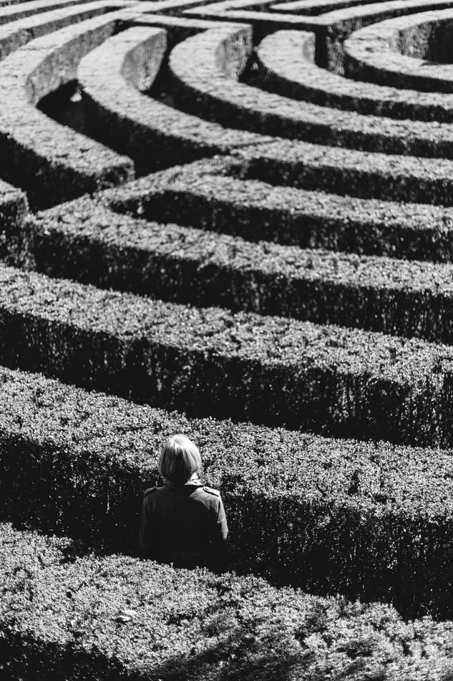
WAY OF DISCIPLESHIP:
BEING WITH GOD
Jesus frequently withdrew from people to be with God on His own at other times, and sometimes for extended periods.
Disciples down the centuries have practised solitude and silence.
Solitude is being apart from others and from “external noise” with the purpose of being with God..
Silence is needed for solitude. It is not just “not talking”, but waiting for my internal chatter and thoughts to stop so I can be in a better place to receive what God might want to communicate. Both go together.
Notes:
While Jesus practised Sabbath, he would also frequently withdraw from people to be with God on His own at other times, and sometimes for extended periods. This was intentional time to be alone with God, and to listen to His Father. Disciples down the centuries have imitated these two practices of solitude and silence, particularly at times of change or challenge, in order to grow in being with God.
Solitude is being apart from others and from “external noise” with the purpose of being with God. It is not seeking “emptiness” which can lead to loneliness. Instead it is time on our own intentionally focussing on God with the aim of leading to being fulfilled by His presence.
Silence is needed for solitude. It is not just “not talking”, but waiting for my internal chatter and thoughts to stop so I can be in a better place to receive what God might want to communicate. Both go together.

Slide 18
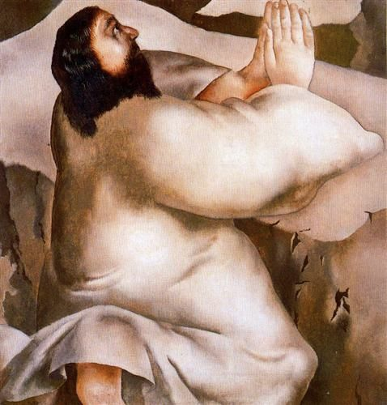
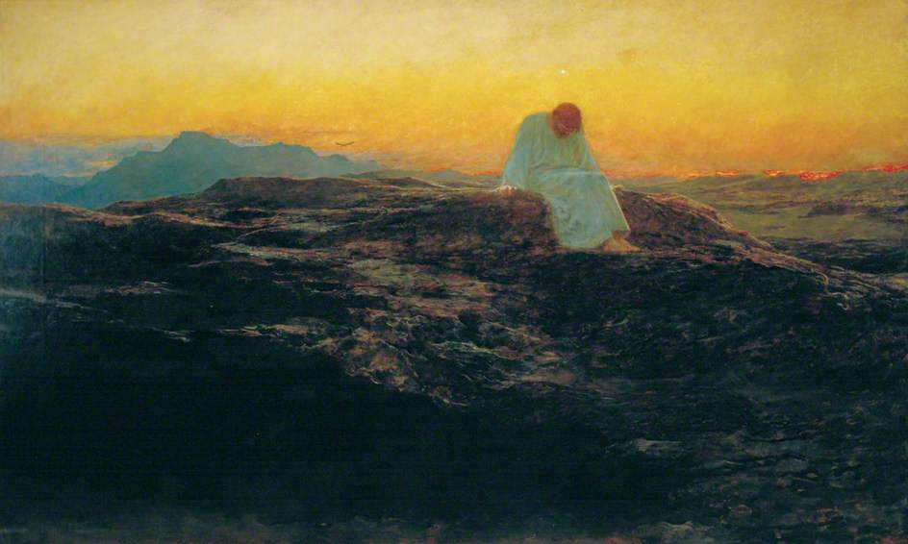
WAY OF DISCIPLESHIP:
BEING WITH GOD
Notes:
Look at these two paintings of Jesus in the desert, in silence and solitude. What do you think He is thinking? What do you think He is feeling?

Slide 19
WAY OF DISCIPLESHIP:
BEING WITH GOD
It is striking how often He would go to a quiet place to be with His Father
Forty days with His Father in the desert (Matthew 4:1-11). Before choosing his disciples He spent the night alone (Luke 6:12).
God meeting people in the “wilderness”
The Greek word for such a place is “eremos” and occurs 48 times in the New Testament!
Notes:
As we read the accounts of Jesus it is striking how often He would go to a quiet place to be with His Father – at the beginning of His ministry He spent forty days with His Father in the desert (Matthew 4:1-11). Before choosing his disciples He spent the night alone (Luke 6:12). There is a regular pattern of seeing Jesus withdraw, sometimes with His disciples, when things got busy. Even when huge needs were presenting themselves, perhaps especially then, Jesus would find the place of heart solitude with God.
This echoes a strong pattern throughout the Bible of God meeting people in the “wilderness” – a place where they encounter Him in more intense ways. The Greek word for such a place is “eremos” and occurs 48 times in the New Testament! The people of Israel wander in the wilderness, recognising their need for food and water. Moses meets God there in a burning bush and receives God’s name alone on a mountain. The prophet Elijah hears God’s “still, small voice”.

Slide 20
WAY OF DISCIPLESHIP:
BEING WITH GOD
What are the benefits of solitude and silence?

Slide 21
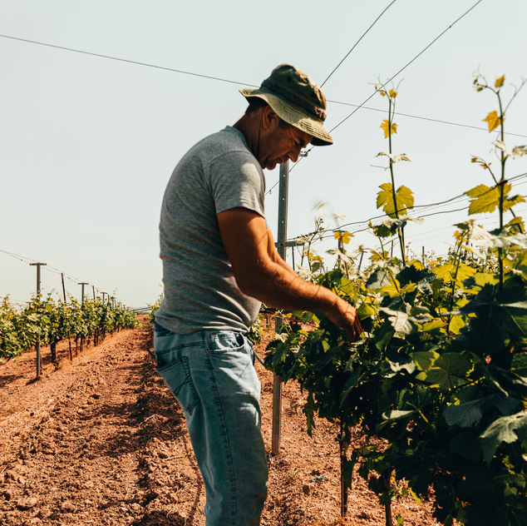
WAY OF DISCIPLESHIP:
BEING WITH GOD
In solitude we can be strengthened by experiencing the truth that only God matters.
In solitude the ways in which we are being pruned can become fruitful.
Notes:
As we have seen, in John 15 Jesus tells His disciples that the fruitfulness God wants can only come as we work alongside a rhythm of remaining in Him. He also talks about how times of “pruning”, being cut back in our activity, or shaped in our character, are part of God’s work in making us fruitful.
Times of solitude and silence are a way in which we “remain in Him”, and in which we can experience being renewed by God, allowing the pain of any pruning experiences we are having to enable new growth in our discipleship.
In solitude we can be strengthened by experiencing the truth that only God matters.
The wilderness is not a place of weakness, it is a place of strength. In being alone, we can gain a fresh sense of our own limitations once what we do, who we know and what we own is taken away. We are alone with God and ourselves. We are faced with the question of who we are when things that give us significance are not there – and can realize it is only God who is enough. We are faced with the question of who will control things when we are not present – and can realize it is only God who is in control.
The purpose of solitude is to be able to see and hear what God wants more clearly. We give God space to communicate with us through His Spirit (paying attention to Him is the essence of being a disciple) in the different ways we have explored. This realization can only help us to surrender to what God wants more. We become people who are more likely to give out of what we have first received.
Being strengthened like this helps us to be fruitful in that our work and service can spring more fully from God’s leading. The story is told of two woodsmen. One woodsman challenged the other woodsman to an all-day wood-chopping contest. The challenger worked hard all day long, pausing only for a brief lunch. On the other hand, the challengee took several breaks during the course of the day and also took a leisurely lunch. Well, the end came to the all-day wood chopping contest and the challenger was surprised (and annoyed) to find out that the challengee had cut more wood than he! So, the challenger said, "You cut more wood than I did, even though I worked longer." To which the challengee responded, "What you did not realize is that I was sharpening my axe, every time I sat down to rest."
In solitude the ways in which we are being pruned can become fruitful.
In a way, being alone with God can bring us face to face with new challenges. Jacob wrestled with an angel in the desert. It was in the desert that Jesus had a fierce struggle with the temptations He needed to overcome at the start of His ministry.
Whether our problems are caused by things that happen to us in the sufferings of life, or by our own inner struggles, solitude offers a place where these things can no longer be ignored, but can be brought to God. It is also vital for our emotional well-being that we have windows in our lives in which to process difficulties. Peter the disciple knew a lot about being pruned. In silence we can follow His advice by taking the unhurried opportunity to “Cast all your anxiety on him because he cares for you.” (1 Peter 5:7).
We all experience hardship of one kind or another. For Jesus, the key question is can we allow these difficulties to become opportunities for pruning for fruitfulness?

Slide 22
WAY OF DISCIPLESHIP:
BEING WITH GOD
In silence we can express and deepen our trust in God.
Through silence our words and actions can count for more.
“'All of humanity's problems stem from a human being’s inability to sit quietly in a room alone.”
In solitude we can value and love others more.
“Solitude and silence teach me to love them for what they are, not for what they say.”
Notes:
In silence we can express and deepen our trust in God.
The writer John Main puts it like this, “To be silent with another person is a deep expression of trust and confidence and it is only when we are unconfident that we feel compelled to talk. To be silent with another person is truly to be with that other person.” True communication with God, or with others, can often feel deeper without words, as we rest in trust.
A 19th century French priest once noticed a peasant come in to the church and stay for hours, kneeling in front of a cross with a representation of Jesus on it. The priest asked this man, “What do you say during all that time before Jesus? The peasant replied, "Nothing. I look at Him and He looks at me."
One way into this silent trust before God can simply be to ask yourself the question, “What do you see when you look at God, looking at you?”
Through silence our words and actions can count for more.
On a summer scout camp a young man fell out of a tree injuring himself. His friend ran to get the scout leader from the other side of the camp. As the scout leader left his tent, walking slowly towards the site of the accident, the friend began to panic, thinking he hadn’t communicated the urgency of the action. When the scout leader came to the young man he immediately gave mouth to mouth resuscitation, put him in the recovery position and sent for an ambulance.
After the young man had been taken away, his friend angrily blurted out, “You took so long to walk over to him! Didn’t you realize how serious it was?” The scout leader replied, "I know you are angry because I didn't rush. But I needed to buy myself a bit of time to remember what I needed to remember. And I knew my first decision had to be the right one. And I can't give mouth to mouth resuscitation if I’m out of breath."
The French philosopher Blaise Pascal is famous for saying, “'All of humanity's problems stem from a human being’s inability to sit quietly in a room alone.” In silence we can ensure that we have listened before we act, giving ourselves space to slow down and pay attention to God so that our first decisions can be wise.
Similarly, if our words are a thermometer of our hearts, they will have more value after silence with God, and may be more wisely chosen.
In solitude we can value and love others more.
Thomas Merton said that one of the fruits of solitude can be to increase our sensitivity to and compassion for others because “It is in deep solitude that I find the gentleness with which I can truly love my brothers and sisters…Solitude and silence teach me to love them for what they are, not for what they say.”

Slide 23
WAY OF DISCIPLESHIP:
BEING WITH GOD
How do I practise solitude and silence?

Slide 24
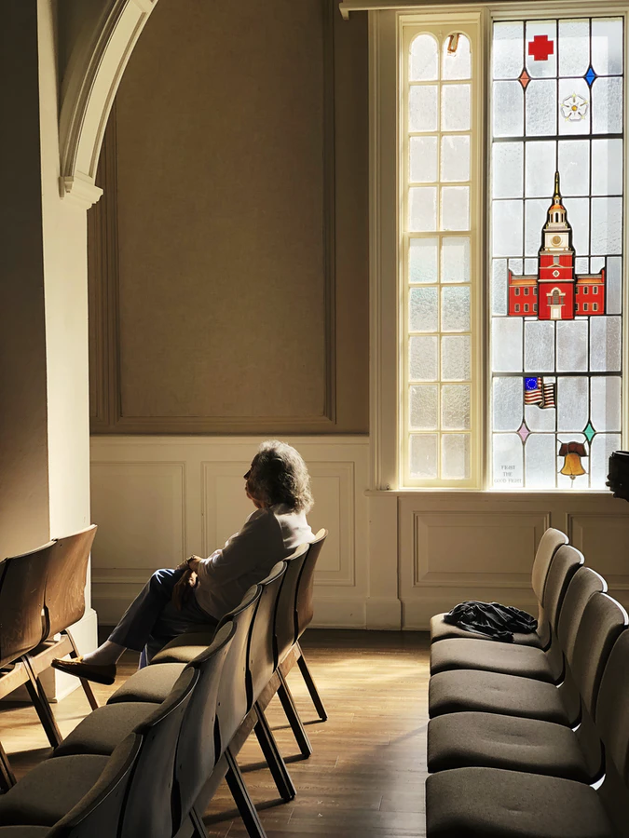
WAY OF DISCIPLESHIP:
BEING WITH GOD
Jesus commended it to His disciples as a normal way of praying…
Knowing God wants to draw near to us
Working towards regular times of being silent before God…
...but also being aware of the season we are in.
Using the opportunities we already have.
Notes:
As well as modelling withdrawing from others to be alone with God, Jesus commended it to His disciples as a normal way of praying: “...when you pray, go into your room, close the door and pray to your Father, who is unseen. Then your Father, who sees what is done in secret, will reward you.”
As we have seen, learning to do this goes against the grain of much of our cultural experience, and the ways in which most of us live. It also goes without saying that your circumstances and personality will affect the length of time and the way in which you are able to grow in practising this.
Nevertheless, if being with God is the foundation of discipleship, these first thoughts may help:
Knowing God wants to draw near to us. Our desire to withdraw to “be with God” is increased when we connect with how much God wants and promises to be with us. “Draw near to God, and he will draw near to you.” (James 4:8)
Working towards regular times of being silent before God…it is unlikely that we will develop times of solitude with God unless we have an intentional rhythm
...but also being aware of the season we are in. In John 15 there is a balance between times of being fruitful and times of remaining in God. In our lives it may be hard to regulate what is necessary in a strict way. It may be more a case of becoming aware of the season we are in. Growth cannot occur without remaining in the vine, or pruning. So, for example, if we are aware that we are not seeing much fruitfulness in our lives, it may be a prompt to us that we need to have a season of withdrawing to be with God.
Using the opportunities we already have.
While having a special place and time can be helpful, it is possible to find moments of solitude and silence in the normal run of a day. It is better to start as we are than wait until we change circumstances. Driving more slowly, pausing before meals, taking a brief walk, getting up a few minutes earlier, turning off our devices can all offer opportunities within the structure of our existing lives for a moment of silence in which we pay attention to the present moment, knowing that this kind of daily being with God is, as Christian doctor Paul Tournier said, “mostly about waiting for God’s presence.”

Slide 25
WAY OF DISCIPLESHIP:
BEING WITH GOD
How can the practices which train me to “be with God” and pay attention to Him move from idea to reality?

Slide 26
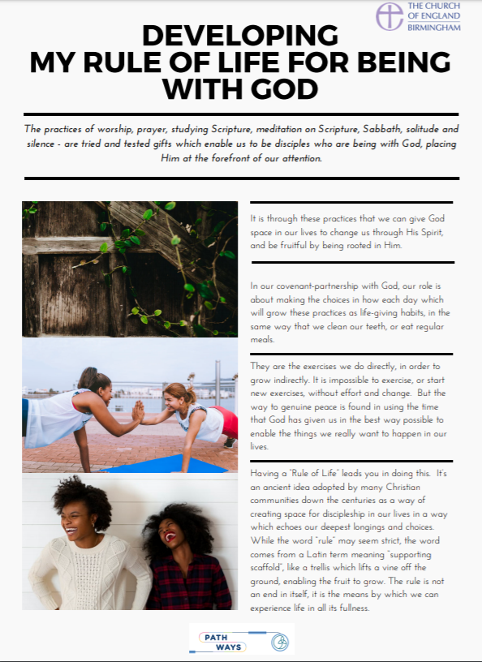
WAY OF DISCIPLESHIP:
BEING WITH GOD
Our role is about making the choices in how each day which will grow these practices as life-giving habits. They are the exercises we do directly, in order to grow indirectly.
Mary had chosen the one thing necessary. Practices move from idea to reality when we make choices about how to do them in our daily lives.
“Rule of Life” is an ancient idea adopted by many Christian communities down the centuries as a way of creating space for discipleship in our lives in a way which echoes our deepest longings and choices.
A “supporting scaffold”, like a trellis which lifts a vine off the ground, enabling the fruit to grow. The rule is not an end in itself, it is the means by which we can experience life in all its fullness.
Notes:
All the practices we have looked at in this module – worship, prayer, studying Scripture, meditation on Scripture, Sabbath, solitude and silence - are tried and tested gifts which enable us to be disciples who are being with God, placing Him at the forefront of our attention. It is through these practices that we can give God space in our lives to change us through His Spirit, and be fruitful by being rooted in Him.
In our covenant-partnership with God, our role is about making the choices in how each day which will grow these practices as life-giving habits, in the same way that we clean our teeth, or eat regular meals. They are the exercises we do directly, in order to grow indirectly.
It is impossible to exercise, or start new exercises, without effort and change. But the way to genuine peace is found in using the time that God has given us in the best way possible to enable the things we really want to happen in our lives.
In Luke’s gospel Martha complains that, rather than helping her in the kitchen, her sister Mary is sitting at Jesus’ feet, listening to Him. But the Lord answered her, “Martha, Martha, you are anxious and troubled about many things, but one thing is necessary. Mary has chosen the good portion, which will not be taken away from her.”
Mary had chosen the one thing necessary. Practices move from idea to reality when we make choices about how to do them in our daily lives.
As a closing exercise to this module, you are invited to think about how you experience these practices, and what the next steps might be that God is calling you to do in living them out. To support one another, you are invited to meet up with someone else and share your intentions with them.
The handout “Rule of Life” leads you in doing this. It’s an ancient idea adopted by many Christian communities down the centuries as a way of creating space for discipleship in our lives in a way which echoes our deepest longings and choices. While the word “rule” may seem strict, the word comes from a Latin term meaning “supporting scaffold”, like a trellis which lifts a vine off the ground, enabling the fruit to grow. The rule is not an end in itself, it is the means by which we can experience life in all its fullness.

