Slide 1
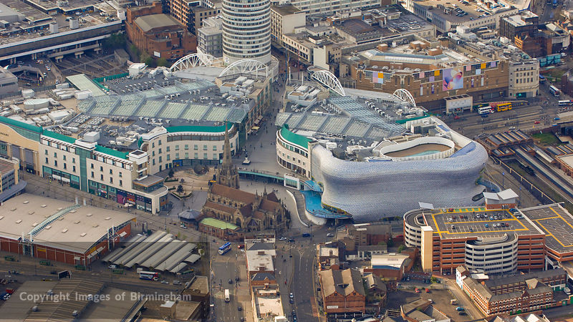
WAY OF DISCIPLESHIP:
BEING WITH GOD
WAY OF DISCIPLESHIP: BEING WITH GOD:
WHAT DOES DAILY DISCIPLESHIP
LOOK LIKE?

Slide 2
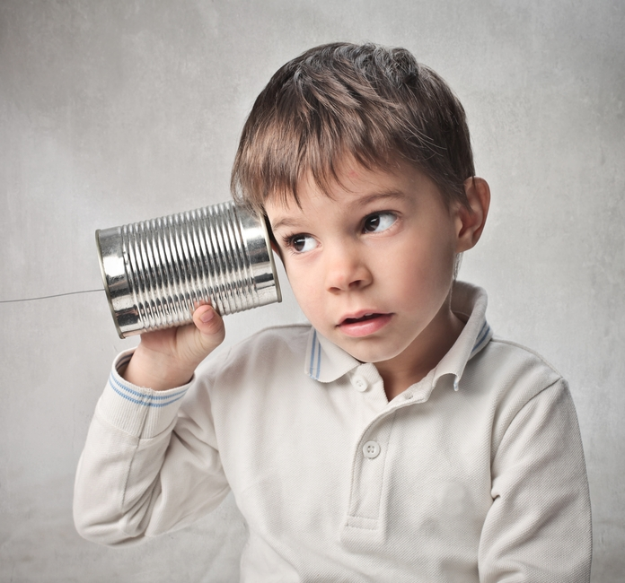
WAY OF DISCIPLESHIP:
BEING WITH GOD
We are all growing into being certain kinds of people, shaped by:
the things we give most attention to
the choices we make
the influence of the relationships we have.
To be a disciple is to welcome God to be the centre of all of these
Notes:
Whether or not we call ourselves Christians, we are all growing into being certain kinds of people. The ways we are being formed are shaped by
the things we give most attention to
the choices we make
the influence of the relationships we have.
To be a disciple is to welcome God to be the centre of all of these, growing into the people that He desires us to be – being with Him, becoming like Him, and joining in with Him.

Slide 3
WAY OF DISCIPLESHIP:
BEING WITH GOD
What does this mean
day by day?

Slide 4
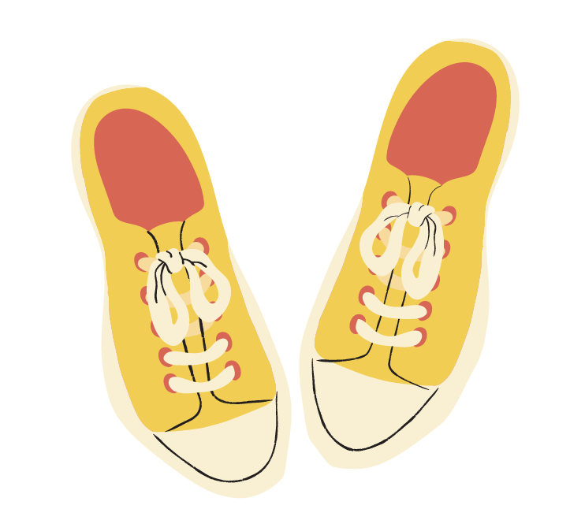
WAY OF DISCIPLESHIP:
BEING WITH GOD
What we give attention to: Being open to God’s presence and paying attention to what He is saying….
The choices we make in what we do: Responding to what He is saying in loving obedience….
The character we are becoming: Enabling God to change me from the inside out to become more like Christ
Notes:
On a daily basis how we put God at the centre is shaped by three things:
What we give attention to: Being open to God’s presence and paying attention to what He is saying, which leads to
The choices we make in what we do: Responding to what He is saying in loving obedience, which leads to
The character we are becoming: Enabling God to change me from the inside out to become more like Christ by putting into practice regular ways of living which open me up to the work of His Spirit. (This is the focus of module 2 – Becoming like Christ) This session focusses particularly on the first two: How do we pay attention to God day by day? And what are the best reasons to respond in obedience to what He is saying?

Slide 5
WAY OF DISCIPLESHIP:
BEING WITH GOD
What we pay attention to: Why is paying attention to God at the heart of being a disciple?

Slide 6
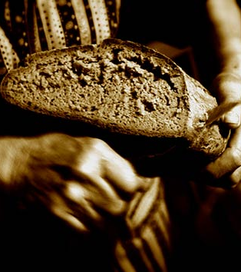
WAY OF DISCIPLESHIP:
BEING WITH GOD
“Humans do not live by bread alone, but by every word that comes from the mouth of God.” (Matthew 4:4)
“I tell you the truth, the Son can do nothing by himself; he can do only what he sees his Father doing, because whatever the Father does the Son also does.”
(John 5:19)
“We are what we hear from God.”
(Emil Brunner.)
Notes:
We are constantly paying attention and responding to different voices in life. As we have seen, being a disciple at its most basic is growing in responding to God above all else. Jesus said God’s word is more important than food: “Humans do not live by bread alone, but by every word that comes from the mouth of God.” (Matthew 4:4) He had a deep sense that His life was shaped by God’s leading: “"I tell you the truth, the Son can do nothing by himself; he can do only what he sees his Father doing, because whatever the Father does the Son also does. (John 5:19). One writer put it like this, “We are what we hear from God.” (Emil Brunner.)

Slide 7
WAY OF DISCIPLESHIP:
BEING WITH GOD
How does Jesus’ first “sermon” describe this?

Slide 8
WAY OF DISCIPLESHIP:
BEING WITH GOD
“The kingdom of God has come near. Repent and believe the good news!”
Notes:
In Mark 1: 14 we read, “Jesus went into Galilee, proclaiming the good news of God. “The time has come,” he said. “The kingdom of God has come near. Repent and believe the good news!” When Jesus started His ministry, He began by telling people two important things:

Slide 9
WAY OF DISCIPLESHIP:
BEING WITH GOD
This was a particular moment to pay attention. This was not just “ordinary”, minute by minute time (chronos)
The word for time (Kairos) is a specific time of opportunity. He told them that this moment was a time when, “The kingdom of God has come near.”
Notes:
That this was a particular moment to pay attention. This was not just “ordinary”, minute by minute time (chronos), this was a time when God was acting in a new way. When He said, “The time has come” the word for time (Kairos) is a specific time of opportunity. He told them that this moment was a time when, “The kingdom of God has come near.”

Slide 10
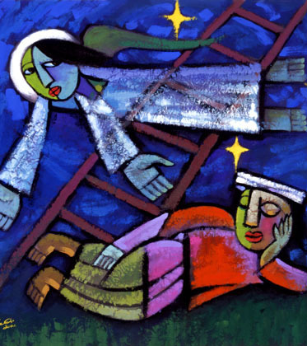
WAY OF DISCIPLESHIP:
BEING WITH GOD
All that God wants in the world is now close – His love, His presence, His healing
Notes:
All that God wants in the world is now close – His love, His presence, His healing. God is not far from people – and the whole of the gospels are full of people responding to God (as we saw in the story of Jacob from Genesis 28.)

Slide 11
WAY OF DISCIPLESHIP:
BEING WITH GOD
Certain events – positive or negative - become the doorway to us recognising it, and asking, “God, how do you want me to respond?”
The disciple will be growing in paying attention in all these things.
Notes:
From the beginning, Jesus is showing how at the heart of being a disciple is wanting to be open to His presence by recognising the moments where God is close, and how He is working. In our daily lives, the kingdom of God in God’s world is near. It may be that certain events – positive or negative become the doorway to us recognising it, and asking, “God, how do you want me to respond?” God may speak through our successes or failures, through things we see, hear or read; large or small happenings, things we do or are done to us. The disciple will be growing in paying attention in all these things.

Slide 12
WAY OF DISCIPLESHIP:
BEING WITH GOD
This was the time to “Repent” and “Believe” – to respond to what God is doing by
Changing their way of thinking.
Starting to live differently – believing is starting to let our choices and relationships be shaped by how God is acting and calling us.
Notes:
That this was the time to “Repent” and “Believe” – to respond to what God is doing by Changing their way of thinking – repenting means to “turn our minds” from seeing things our way to seeing things God’s way. Starting to live differently – believing here is deeper than what goes on in our minds. It is starting to let our choices and relationships be shaped by how God is acting and calling us, demonstrating in our lived experience what we are really trusting in. From the beginning Jesus is describing the heart of being a daily disciple as paying attention to God in moments of opportunity and responding by living in new ways.

Slide 13
WAY OF DISCIPLESHIP:
BEING WITH GOD
What does this mean in my lived experience?

Slide 14
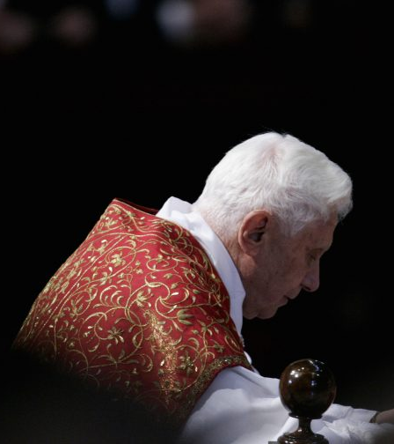
WAY OF DISCIPLESHIP:
BEING WITH GOD
“Faith is above all a personal, intimate encounter with Jesus, and to experience his closeness, his friendship, his love; only in this way does one learn to know him even more, and to love and follow him ever more. May this happen to each one of us.”
Notes:
It means daily discipleship is a close relationship: In the words of Pope Benedict 16th, “Faith is above all a personal, intimate encounter with Jesus, and to experience his closeness, his friendship, his love; only in this way does one learn to know him even more, and to love and follow him ever more. May this happen to each one of us.”

Slide 15
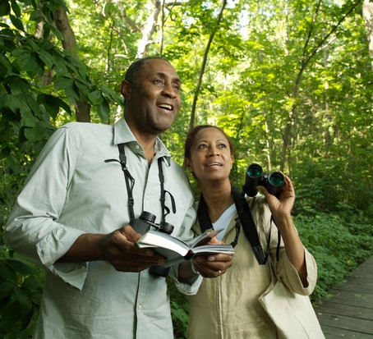
WAY OF DISCIPLESHIP:
BEING WITH GOD
“The true disciple is an expectant person, always taking it for granted that there is something about to break through from the master, something about to burst through the ordinary and uncover a new light on the landscape.”
Notes:
It reinforces the point that daily discipleship is growing in seeing where God is present in your life: Archbishop Rowan Williams says, “The true disciple is an expectant person, always taking it for granted that there is something about to break through from the master, something about to burst through the ordinary and uncover a new light on the landscape.”

Slide 16
WAY OF DISCIPLESHIP:
BEING WITH GOD
The choices we make in what we do: Why is knowing God’s teaching and putting it into practice at the heart of being a disciple?
Notes:
It’s possible to pay attention to God’s presence, and to get to know His teaching, yet for that to make little difference in our lived experience. In a sense that’s like “repenting” (changing the way we think), without believing (changing the way we live.)

Slide 17
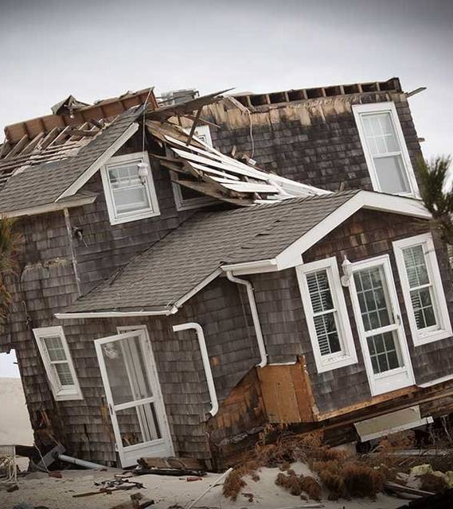
WAY OF DISCIPLESHIP:
BEING WITH GOD
Both builders have heard God’s words and received His teaching.
The wise person in the parable, whose house remains standing, is the one “who hears these words of mine
and puts them into practice.”
Notes:
In the Sermon on the Mount Jesus gives us a large amount of teaching on what the life of discipleship looks like. But, crucially, immediately after this there comes the parable of the wise and foolish builders. One builds on rock, and when, “The rain came down, the streams rose, and the winds blew and beat against that house…yet it did not fall, because it had its foundation on the rock.” But the other builds on sand. When the storm comes, it “fell with a great crash.” Both builders have heard God’s words and received His teaching. But that is not what makes the difference. The wise person in the parable, whose house remains standing, is the one “who hears these words of mine and puts them into practice.”

Slide 18
WAY OF DISCIPLESHIP:
BEING WITH GOD
How does this relate to the difference between faith and belief?

Slide 19
WAY OF DISCIPLESHIP:
BEING WITH GOD
Pisteuo, means putting faith into action.
Standing on the seashore, pointing at a ship, and saying that you think it will take you to the other side of the sea is a statement of belief.
Getting on the ship and trusting it to take you to the other side of the sea is an act of faith.
Notes:
The Greek word for faith, pisteuo, means putting faith into action. Faith is not having a mental list of beliefs but trusting someone enough to give them control of our lives. Martin Luther distinguished between belief and faith using the image of a ship. Standing on the seashore, pointing at a ship, and saying that you think it will take you to the other side of the sea is a statement of belief. Your life does not depend upon the ship. Getting on the ship and trusting it to take you to the other side of the sea is an act of faith. This faith is justified when the ship is reliable and takes you safely on your journey. When Jesus called people to believe, it was with this sense of faith - He was calling them to entrust their whole lives to God in this way.

Slide 20
WAY OF DISCIPLESHIP:
BEING WITH GOD
What are the best motives for paying attention to God and responding to Him in the way we live?

Slide 21
WAY OF DISCIPLESHIP:
BEING WITH GOD
As a response to God’s love and grace.
Notes:
As a response to God’s love and grace. We have seen how God is a God of love who calls us into covenant relationship. That we obey God because He is God. But as we go further, it’s crucial that our daily obedience is only about responding to God’s grace. Imagine if you gave someone you love a gift for their birthday and they asked you, “Why did you do this?” Now imagine you reply, “Because I had to.” Or, “Because I was afraid you would be angry if I didn’t.” Wouldn’t we have missed the whole point?

Slide 22
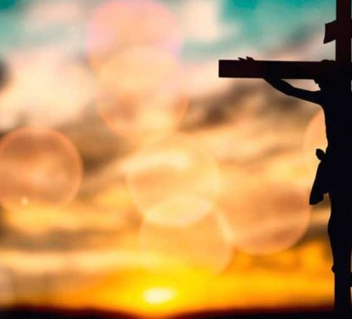
WAY OF DISCIPLESHIP:
BEING WITH GOD
“The greatest honour we can give to God is to live gladly because of the knowledge of His love.”
Notes:
The only good reason for giving a gift is love. Similarly, obedience and response to God which doesn’t come from love is not only destructive for our lives but undermines our sense of God’s great love for us. The first and greatest commandment is to “Love God.” Julian of Norwich put it like this, “The greatest honour we can give to God is to live gladly because of the knowledge of His love.”

Slide 23
WAY OF DISCIPLESHIP:
BEING WITH GOD
Why is living in God’s grace so essential?
Notes:
It is easy for our “putting God’s teaching into practice” to slip into duty or legalism. This can crush our spirits, make us bitter and judging of others, and as we shall see, fail to transform the heart. The motive for being a disciple can only because we are loved, forgiven and accepted by God, even before we think about obeying Him. “We love, because He first loved us.”

Slide 24
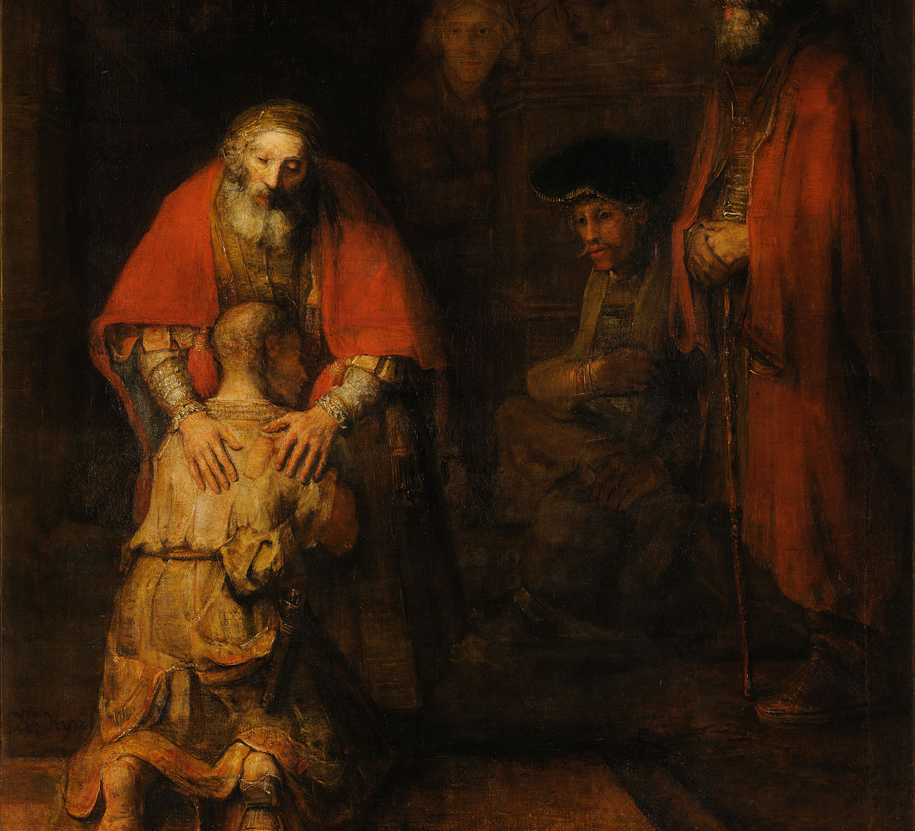
WAY OF DISCIPLESHIP:
BEING WITH GOD
The more we grow in receiving His grace, the more we will want to pay attention and obey.
Responding to God in obedience is therefore effort, but it is never earning.
We are already loved, whether we obey or not.
Notes:
Scripture calls this undeserved, unconditional love grace. We have explored how God is love. His grace is the quality of love God has for us, and that Jesus’ life and death demonstrated, that gives complete and utter worth to anyone, regardless of who they are or how they live. The starting place for obeying God can only be this: the more we grow in receiving His grace, the more we will want to pay attention and obey. Responding to God in obedience is therefore effort, but it is never earning. We are already loved, whether we obey or not. As Paul writes, “For it is by grace you have been saved, through faith—and this is not from yourselves, it is the gift of God— ⁹ not by works, so that no one can boast.”

Slide 25
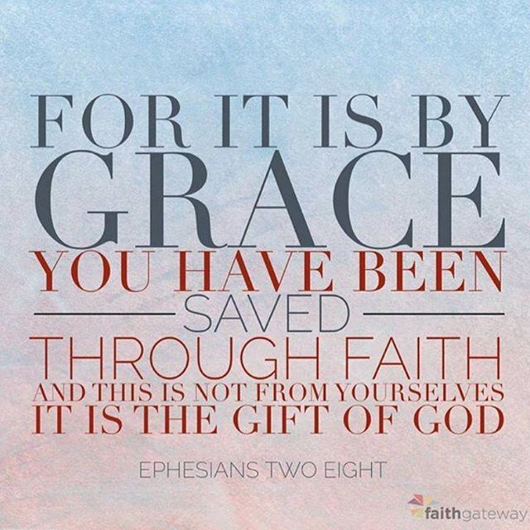
WAY OF DISCIPLESHIP:
BEING WITH GOD
“Christians affirm a foundation of identity that is absolutely unique in the marketplace of spiritualties. Whether we realize it or not, our being is grounded in God’s love. …..And identity grounded in God would mean that when we think of who we are, the first thing that would come to mind is our status as someone who is deeply loved by God.”
Notes:
This is the jewel of Christian discipleship. As one writer puts it, “Christians affirm a foundation of identity that is absolutely unique in the marketplace of spiritualties. Whether we realize it or not, our being is grounded in God’s love. …..And identity grounded in God would mean that when we think of who we are, the first thing that would come to mind is our status as someone who is deeply loved by God.”

Slide 26
WAY OF DISCIPLESHIP:
BEING WITH GOD
“not legal obedience driven by commandment but trusting response to known love.”
Notes:
Jesus was fully obedient to God His Father, even to death. Scots theologian Thomas Smail says that the motive for this was “not legal obedience driven by commandment but trusting response to known love.”

Slide 27
WAY OF DISCIPLESHIP:
BEING WITH GOD
Why is this so hard, but so important?

Slide 28
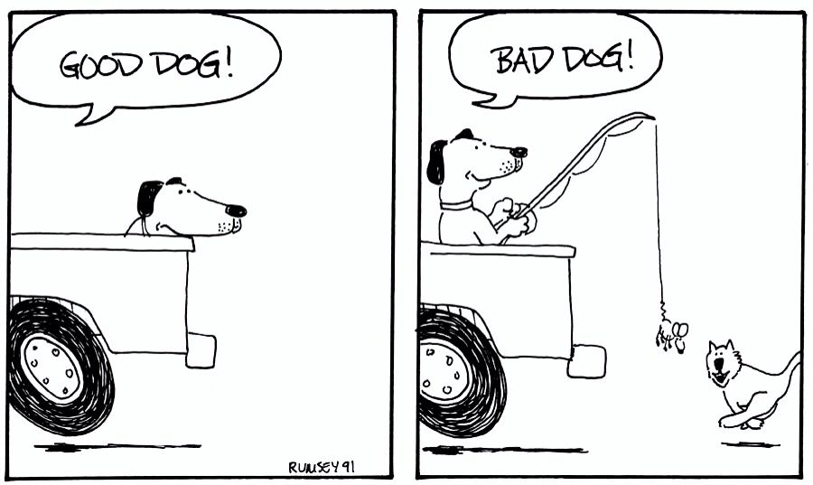
WAY OF DISCIPLESHIP:
BEING WITH GOD
“It is not the healthy who need a doctor, but the sick. But go and learn what this means: ‘I desire mercy, not sacrifice.’ For I have not come to call the righteous, but sinners.”
Notes:
We live in a world of conditionality and are trained from childhood that good behaviour leads to reward, while bad behaviour leads to punishment. We can therefore easily slip into experiencing discipleship as religiously trying to build a bridge to God (which is perhaps a little arrogant!). The reality of grace however is that God has, through Christ, built a bridge to us. Christ was clear that it is only those who know they need to receive God’s grace that will truly turn to Him: “It is not the healthy who need a doctor, but the sick. ¹³ But go and learn what this means: ‘I desire mercy, not sacrifice.’ For I have not come to call the righteous, but sinners.” It is only God’s grace that can give us the assurance that we are loved, and the motivation to serve Him.

Slide 29
WAY OF DISCIPLESHIP:
BEING WITH GOD
What are the best motives for paying attention to God and responding to Him in the way we live?

Slide 30
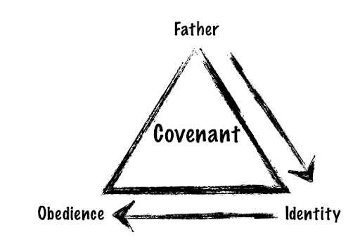
WAY OF DISCIPLESHIP:
BEING WITH GOD
As a way of living into our true identity.
Not to gain an identity but because He has already given us an identity.
It is only God who can truly tell us who we are.
The more we realize how God sees us, the more we will want to obey Him and to become our true selves.
“We are never free until we submit our hearts and minds in obedience to Christ, and we are never so much our true selves as when becoming more like him.”
Notes:
As a way of living into our true identity. It’s worth repeating that in daily discipleship, one of the best reasons for responding to God is not to gain an identity but because He has already given us an identity. In fact, while the world of consumerism might try and seduce into building our own identity through what we own, Christians believe that it is only God who can truly tell us who we are. It’s only by receiving this identity that we will truly change - the more we realize how God sees us, the more we will want to obey Him and to become our true selves. One writer puts it like this, “We are never free until we submit our hearts and minds in obedience to Christ, and we are never so much our true selves as when becoming more like him.”

Slide 31
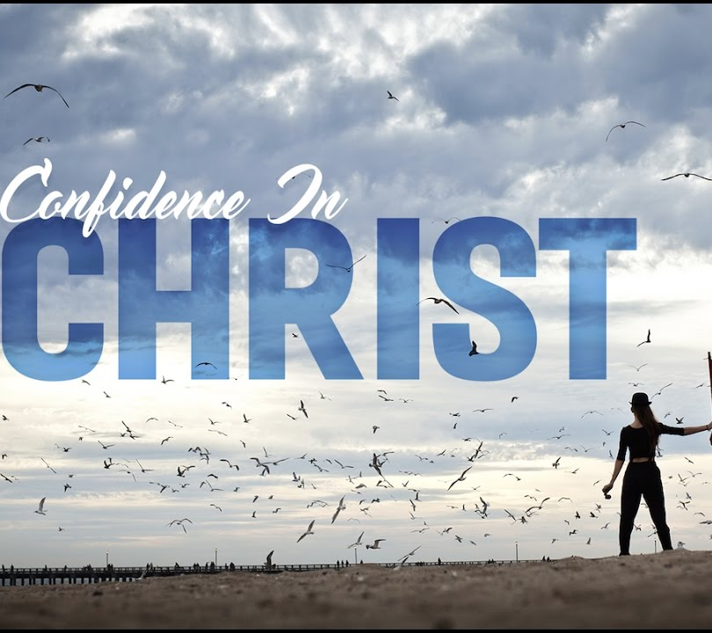
WAY OF DISCIPLESHIP:
BEING WITH GOD
Restored confidence in obeying:
Although I am not divine like Jesus, because I share in the same restored identity revealed in Jesus I do things “in His name” – authorised as a covenant-partner to act on His behalf.
“I am seated with Christ, looking down from the same vantage point He has.”
Notes:
Restored confidence in obeying: One of the reasons I respond to God is because although I am not divine like Jesus, because I share in the same restored identity revealed in Jesus I do things “in His name” – authorised as a covenant-partner to act on His behalf. This gives me an incredible dignity and motivation. Pete Greig puts it like this: “I am no longer sitting in a world of troubles looking up to God for help; rather, I am seated with Christ, looking down from the same vantage point He has.”

Slide 32
WAY OF DISCIPLESHIP:
BEING WITH GOD
Restored desire to obey:
Serving God, not out of a sense of duty, but out of love.
“You did not receive the spirit of slavery to fall back into fear, but you have received the spirit of adoption as sons by whom we cry Abba father.”
Notes:
Restored desire to obey: As you live into the identity God gives you as a disciple, there is a freedom in serving God, not out of a sense of duty, but out of love. Paul described this by contrasting a fear-based slave mentality that comes from trying to please God in our own strength, with growing in our desire to God’s will as we realize our identity as His “adopted children”. “You did not receive the spirit of slavery to fall back into fear, but you have received the spirit of adoption as sons by whom we cry Abba father.”

Slide 33
WAY OF DISCIPLESHIP:
BEING WITH GOD
To summarize:

Slide 34
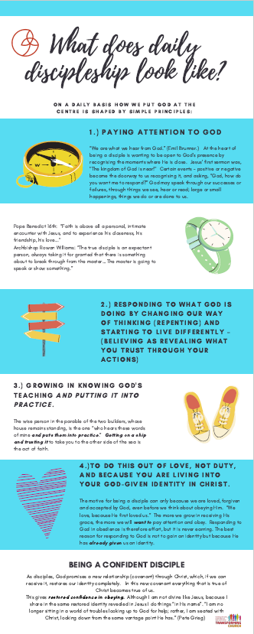
WAY OF DISCIPLESHIP:
BEING WITH GOD
Notes:
The outline of this content is available as a bookmark, as well as in the session book.

